Slide 1
eduGAIN –
The GÉANT Project Aspects
Ann Harding, SWITCH/GÉANT
eduGAIN Town Hall December 2014
Notes:
Check if anyone not staying for refeds meeting.

Slide 2
The GÉANT Projects Timeline
Active - GN3plus
  2 years
  End 30/4/2015
Strategy - GN4 P2
  3 Years
  End 30/4/2019
Defined - GN4 P1
  1 Year
  End 30/4/2016
Notes:
Budget and DoW to be voted in Zagreb, December.
P2 – some preliminary green lighting of obvious stuff

Slide 3
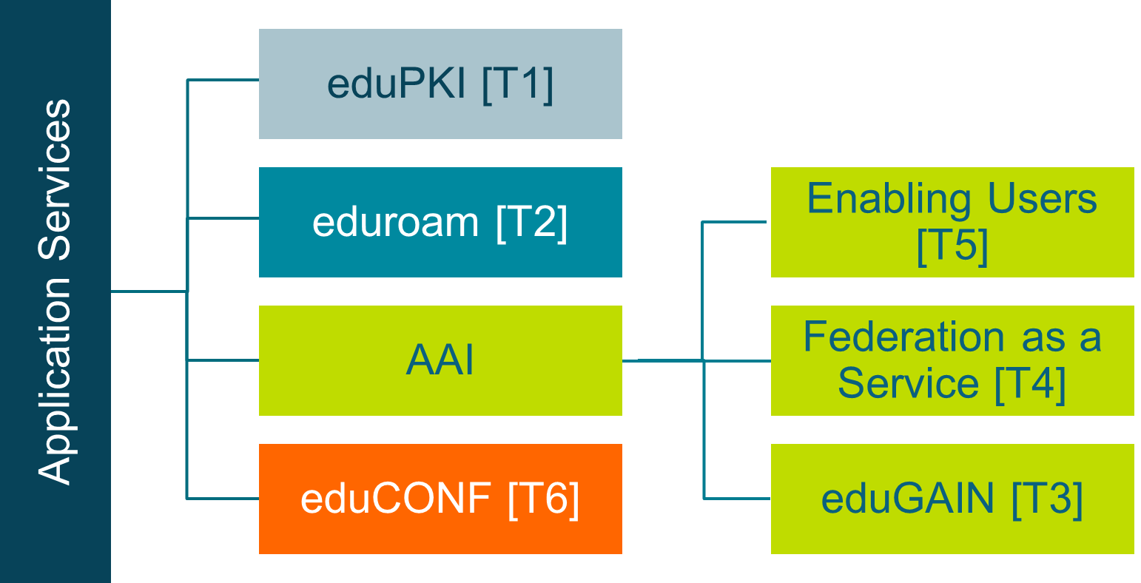

eduGAIN in GN3plus

Slide 4

GN3plus Ambitions
Collaborate with the wider GÉANT project and with international user communities to increase
usage of AAI infrastructure
Act as an expert partner for large, pan-European projects with AAI requirements (2-3 pilots)
Develop needed policy and technical infrastructure for offering a “Federation
as a Service” pilot
Develop a pilot for the unified SSO case (Moonshot), investigating options for non-web support

Slide 5
eduGAIN in GN3plus – how did we do?
eduGAIN
  New eduGAIN policy adopted
  10 (12) new federations
    Starting to think about the implications of the very new federations joining
  Targeted 100% annual growth (150-300)
    Now over 1,000 each IdPs and SPs
    The slow rise of opt-out begins?
Moonshot
  Pilot case studies
    SSH at Finland’s 2nd largest supercomputer
    iRODs demo
    SSH at PaNData sites in UK and CH
    Samba in CZ
  Basic infrastructure pilots
    ES, FR, HU, FI
Federation as a Service
  Pilot developed and launched
  Training delivered
  VM includes
    RR
    MDA
    HSM
    DS
Enabling Users
  3 collaborative pilots planned and launched
    ELIXIR, DARIAH, Umbrella/PaNData
  2 more underway
    CERN, ESA
  Test IdP/IsFederated tools
  Consultancy/Support
Notes:
From 20 (18) to 30 federations
Y1 target 143 entities, achieved 310.
Currently at 1087 IdPs, 1133 SPs

Slide 6




Quick look at Research Community Hot Topics
Requirements for
Levels of Assurance
Mapping to Federation Policies
ELIXIR Services in HAKA Production Federation
Bridging Umbrella- Persistent Identities
Non-web-browser Based Access
Architectures for
using eduGAIN
Consult on DASISH AAI strategy
Support safe attribute release via GÉANT CoCo

Slide 7



eduGAIN in GN4
R&D, Service Development and Operations
JRA3
Trust & Identity Research
SA5
Trust and Identity Service Development
SA4 Application Services Operations

Slide 8
The eduGAIN family in GN4
Service Development
eduGAIN
Federation as a Service
Enabling Users
Federation as a Service
VO Platform as a Service
Pilots
Consultancy
SP registration simplification
eduGAIN technical development, inc. portal
Federation development
InAcademia
Harmonisation
Entity Categories
CoCo
Federation Practices
Assurance Business Case
Interoperability
Non web
Moonshot
ECP
New Task
New Subtask/work area
Notes:
Note, new to be funded in GÉANT, not new per se
In Academia to be presented later by Niels
VOPaaS, to be presented in REFEDS
Asking for slightly less than 1.5M EUR (inc eduroam) (GN3plus was 3.9M over 2 years, inc. eduCONF, eduroam)

Slide 9
Who’s who in GN4?
Harmonisation
eduGAIN
Federation as a Service
Non Web
Enabling Users
GÉANT AAI
eduroam
VOPaaS & InAcademia
Nicole Harris, GÉANT Assoc.
John Chapman, JISC
Brook Schofield, GÉANT Assoc.
Marina Vermezovic, AMRES
Niels van Dijk, Surfnet
Lukas Hämmerle, SWITCH
Mandeep Saini, GÉANT Assoc.
Miroslav Milinovic, CARnet/SRCE

Slide 10
What’s coming that’s important for the eduGAIN SG?
eduGAIN SG provides technical steering for eduGAIN service
To keep governance simple, we also need your input on
Moonshot policy
Harmonisation pilots (Learn more at the REFEDS BoF)
Entity Categories
Federation Operational Policies
Building the case for assurance
Services layered on top of eduGAIN
InAcademia policy/AUP
VO Platform as a Service
Simplified SP registration for pan-European projects

Slide 11



Topic snapshot – eduGAIN technical portal
Develop and consolidate http://www.edugain.org/technical/ into a single toolkit/portal for federations and large users
IsFederated tool https://wiki.edugain.org/isFederatedCheck/
Wiki/KB
Test IdP
Metadata validation
Make it easier to find things
Participants
Documentation
Support
Operational notifications/advisories
Improve reporting and visualisation
From perl scripts scraping entities towards a service catalog
Help us talk to our managements

Slide 12
Topic snapshot – “Single Registration Point for pan European SPs”
Problem Statement
  SPs which want to provide services primarily at the pan-European or global level, have to join a Federation in order to have their metadata published by eduGAIN
  Particular types of SPs do not necessarily have an obvious federation to go to e.g e.g. Cloud, EFSRI cluster projects
  Procedures and requirements for joining a Federation vary from Federation to Federation
Desired benefits
  Mitigate the burden for federations of supporting new SPs with no real national relationship only in order to publish their metadata in eduGAIN
  For large international research projects and global service providers, disambiguate the process of publishing metadata to eduGAIN
Solution
  <work goes here>
  Initial thoughts?

Slide 13

GN4 Open Calls
An opportunity for open development
Open Calls 1 in GN3plus focussed on innovation
Wider scope being considered for OC2
Total budget TBD
60% service, 30% R&D, 10% Innovation ?
Accelerate development, validation, testing of state of the art user-focused services and technologies
Open beyond NREN/Campus
Bring new users to the infrastructures
Guidelines
Impact
Sustainability
Select topics/themes in early 2015
Launch call in September 2015

Slide 14

Coffee @11…discuss now.

