Slide 1
Work Package 9 / SA5
Application Services
Ann Harding, SWITCH

Slide 2
SA5: Application Services
Organisation & Structure
  Role of Application Services
  Organisation
  Resources
Task-by-Task
  Objectives
  Challenges
  Achievements
Conclusions
  Activity Summary
  Looking Ahead

Slide 3




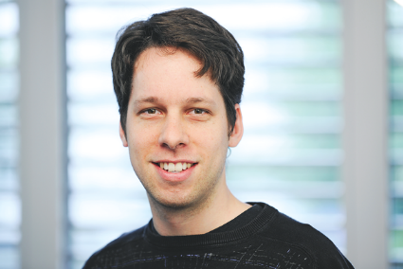


Organisation
Meet the team
T1: eduPKI
T2: eduroam
T3: eduGAIN
T4: Federation as a Service
T5: Enabling Users
T6: eduCONF
Reimer Karlsen-Masur
DFN
Miroslav Milinović
SRCE
Brook Schofield
GÉANT Association
Valter Nordh
SUNET
Lukas Hämmerle
SWITCH
Tim Boundy
JISC
Activity Leadership
Ann Harding
SWITCH
Valter Nordh
SUNET
(Deputy)
Notes:
I want to somehow represent that T3, 4 and 5 work very closely together.
Last year I colour coded related tasks – I’ve tried to do that here with various shades of blue.

Slide 4



















Organisation
Meet the partners

Slide 5
Resources (1 April 2014 to 30 April 2015)
Manpower and partners
T1
T2
T3
T4
T5
T6
eduPKI
(4.1 MM)
eduroam
(42.9 MM)
eduGAIN
(101 MM)
Federation as a Service
(13.7 MM)
Enabling Users
(24.4 MM)
eduCONF
(21.6 MM)
Year 2 budget (used / forecast) | €1.96 M / €1.39 M (141%)
Total Year 2 manpower | 216 MM / 195 MM (111%)
Participants | 122 persons, 18 (19) partners
6 Tasks and Task 0: All Tasks completed successfully in Final Year GN3plus, including 2/2 Deliverables and 3/3 Milestones
✓

Slide 6
eduPKI
Task 1 Objectives & KPIs
✓
✓
Help users obtain the right certificates
for the right purpose
KPIs
Infrastructure availability
Certificates Issued
✓
Competence centre within
GÉANT for PKI issues
Year 2
Results
Website: 99.99%
Infrastructure 99.99-100%
22 issued
206 active
✓
Solving problems commercial operators, such as TCS,
won't solve
✓
✓
Notes:
Green arrows need resizing
Final figures will be provided end May

Slide 7

eduPKI
Task 1 Achievements
Service improvement by eduPKI:
  eduPKI Trust Profile for Generic Server- and Client-Machine-Certificates (June 2014)
  All end-entity certificates issued with the signature algorithm sha256WithRSAEncryption
Innovation supported by eduPKI:
  Certificate Transparency Log
  Enables detection of rogue CAs
  Review of JRA3 results and beta

Slide 8

eduroam
Task 2 Objectives
✓
To maintain and operate the eduroam infrastructure
✓
To deploy, maintain and improve tools that will
increase the quality of the service
✓
To increase uptake of eduroam
Open your laptop and be online
Notes:
We also had an objective to give support to SA7 mobile and other areas, but they did not require it and MEAL already had the relevant experts.

Slide 9

eduroam
Task 2 Challenges
Heartbleed SSL Bug April 2014
  Review of potential vulnerable points
  Creation of a custom eduroam heartbleed check
    Official check was not adequate
  Coordination of vulnerability testing with NROs
  Coordination of response
  Delay to service report deliverable
Change in licensing and legal contact from SecureW2
    Helper component for Windows XP, Vista and Windows 7
  Temporarily removed from CAT
  Re-implementation of CAT helper component
Notes:
21,7% vulnerability rate
Animate securew2

Slide 10

eduroam
Task 2 Achievements – KPIs
KPIs
ETLRS Availability
National Authentications
per month
International Authentications
per month
Year 2
Results
Target: 99%
Achieved: 100%
Target:130,000,000
Achieved: 147,726,234
Target: 24,000,000
Achieved: 31,832,243
✓
✓
✓
Notes:
Click for International KPI animation!
National KPI exceeded by 13%
International KPI exceeded by 32%
Max national in March 163,251,373
Max international in October 35,880,095

Slide 11

eduroam
Task 2 Achievements
Supporting services suite:
  Four different environments consolidated in one portal
CAT (Configuration Assistant Tool):
    1.2 million user downloads
  Android app support (see demo!) from SENSE Open Call
Monitoring on campus:
  Basic – trial based on RIPE Atlas probes
  Expert – developing custom tool based on Raspberry PI
Active Community:
  eduroam in Zagreb and Rijeka
    Supporting the European University Games
    EUG2016 want to help promote eduroam and they add
    it into their "info package" for all guests
Notes:
5000 people at the games
eduroam at Geneva joins Stockholm and others – growth of eduroam in public places.

Slide 12
eduroam
Task 2 Achievements
Notes:
5000 people at the games
eduroam at Geneva joins Stockholm and others – growth of eduroam in public places.

Slide 13

eduroam
From Open Call to production – Android Demo for CAT
Notes:
Break now for Stefan’s demo.

Slide 14


eduGAIN
Task 3 Objectives
✓
To continue the operation and growth of the eduGAIN service
✓
To develop a pilot for the unified SSO case (Moonshot), investigating options for non-web support
✓
To promote uptake of the GÉANT Code of Conduct, further develop the non-EU/EEA Code of Conduct
✓
To open a dialog with STORK on R&E and Government interoperability

Slide 15
eduGAIN
Task 3: KPIs
KPIs
Increase in member federations from GÉANT
Increase in member federations beyond Europe
Increase in entities available via eduGAIN
Year 2
Results
Target: 24
Baseline: 21
Achieved: 25
Target:4
Baseline:3
Achieved: 7
Target: 602
Baseline: 301
Achieved:2,150
✓
✓
✓
15
Notes:
Click for entities animation
Y0 -> Y1 -> [target] -> Y2
45 -> 103 -> [206] -> 941 (SPs only) 913% growth
98 -> 198 -> [396] -> 1211 (IdPs only) 616% growth
143 -> 301 -> [602] -> 2150 (IdP/SP/AAs) 714% growth

Slide 16























eduGAIN members: GÉANT
Austria – ACOnet
Identity Federation
Belgium – Belnet Federation
Croatia – AAI@EduHr
Czech Republic –
eduID.cz
Denmark – WAYF
Estonia – TAAT
Finland – HAKA
France – Fédération
Éducation-Recherche!
Germany – DFN
Greece – GRNET
Hungary – eduId.hu
Ireland – Edugate
Israel – IUCC Identity
Federation
Italy – IDEM
Latvia – LAIFE
Lithuania – LITNET FEDI
The Netherlands – SURFconext
Norway – FEIDE
Poland – PIONIER.Id
Slovenia – ArnesAAI Slovenska izobraževalno
raziskovalna federacija
Spain – SIR
Sweden – SWAMID
Switzerland – SWITCHaai
Ukraine – PEANO
United Kingdom – UK federation
PEANO
Notes:
New full members were IUCC (Israel), LITNET FEDI (Lithuania), MINGA (Ecuador), InCommon (US), TAAT (Estonia), MATE (Argentina)

Slide 17
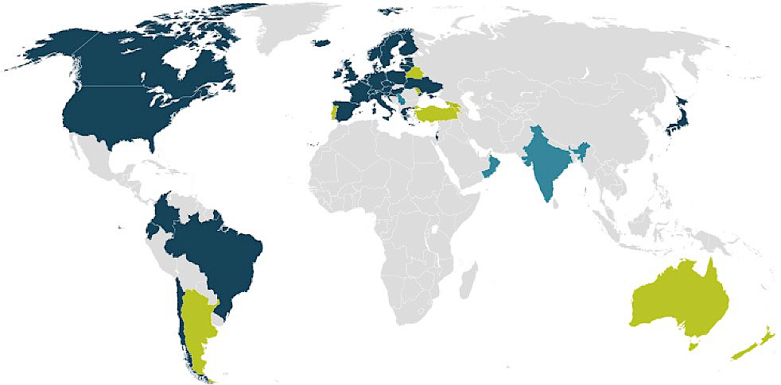









eduGAIN members: Rest of world
Brazil – CaFe
Canada – Canadian
Access Federation
Chile – COFRe
Colombia – COLFIRE
Ecuador – MINGA
Japan – GakuNin
U.S. – InCommon
eduAIN
Joining
Candidate
17
17
17

Slide 18

eduGAIN
Task 3 Challenges
Managing expectations in the early phases of the Moonshot pilot:
  Advanced workshop on Trust Router included elements of testing/trialling
  Some participants were expecting a fully ready deployment training
  The workshop was critical to reaching this state so participants for similar will be better briefed in future
Progress in STORK/eduGAIN interoperability deployment was delayed by STORK2.0 project internal priorities
  Technical solution was prepared but the use case demonstration had to be delayed
Non-EU Code of Conduct contractual options are difficult to scale to get equivalent protection to EU
  Consensus still pending
Notes:
Animations.

Slide 19

eduGAIN
Task 3 Achievements – eduGAIN core Service
Infrastructure
  New Metadata Aggregation Service deployed
  New backend database developed
Growth
  Four new federations
  Over 600% growth in IdPs, over 900% growth in SPs
  UK, SE, FR, IT opt-out pilots
Code of Conduct
  Submission to WP29
  Deployment support
  Code of Conduct monitor
  Non-EU Code of Conduct development
Notes:
Add federation names to notes, not on slide.

Slide 20

eduGAIN
Task 3 Achievements – Moonshot
Five sites have deployed their own Trust Routers: CSC, RedIRIS, SWITCH, NIIFI and Janet
Five sites connected to Janet Trust Router
PSI, CESNET, RedIRIS, CSC, Janet have all demonstrated successful Moonshot AuthN to applications/services
Trust router peering policy developed with a view to being an eduGAIN technical profile
Business and service aspects of development
Documentation of pilot for transition to operations

Slide 21

eduGAIN
Task 3 Achievements – STORK2.0 Interoperability
Goals
Investigate interoperation scenarios between eduGAIN and STORK
Implementation of a limited pilot
  GRNET (GN3Plus), University of Murcia (GN3Plus, STORK), Hellenic Ministry of Administrative Reform and e-Governance (STORK)
Development
Bridging element (eduPEPS)
  SAML2Int to SAML-STORK and vice versa
  Attribute mapping
Two scenarios:
  STORK user visiting an eduGAIN SP
  An “eduGAIN” user visiting a STORK service
Notes:
Not able to proceed to deployment due to stork delays
Would like the boxes transparent like on slide 2 and 31 but something didn’t go quite right

Slide 22
Federation as a Service
Task 4 Objectives
✓
To lower the technology barrier for deployment of Identity federation for NRENs and other groups
✓
To provide the tools to efficiently manage Identity federation and connect to eduGAIN
✓
To operate the FaaS pilot
✓
Support eduroam, webSSO/SAML, inc. eduGAIN, and, if possible, unified SSO
✓
Investigate the conditions that would allow providing services to support Collaborative or Virtual Organisations
Notes:
eduroam – CAT delivering excellently at campus level GN4 Y1 workplan
Unified SSO – when Moonshot pilot transitions -> GN4
Focus on WebSSO federation and VO services as priority
KPI1 : number of GN3plus partners participating in the service - (goal 3)
KPI2 : number of GN3plus partners participating in the service and exposed to eduGAIN - (goal 2)
KPI3 : uptime of infrastructure operated measured by 3 months period (goal 95%)
KPI4 : percentage of requests for support being resolved within five working days (goal 90%)
KPI5 : number of NRENs participating in the service for the local federation management, who report that the service meets or exceeds their requirements – IMO still not relevant, only FaaS task participants are using FaaS at the moment (goal 2)
KPI6 : number of NRENs participating in the service for inter-federation management, who report that the service meets or exceeds their requirements

Slide 23
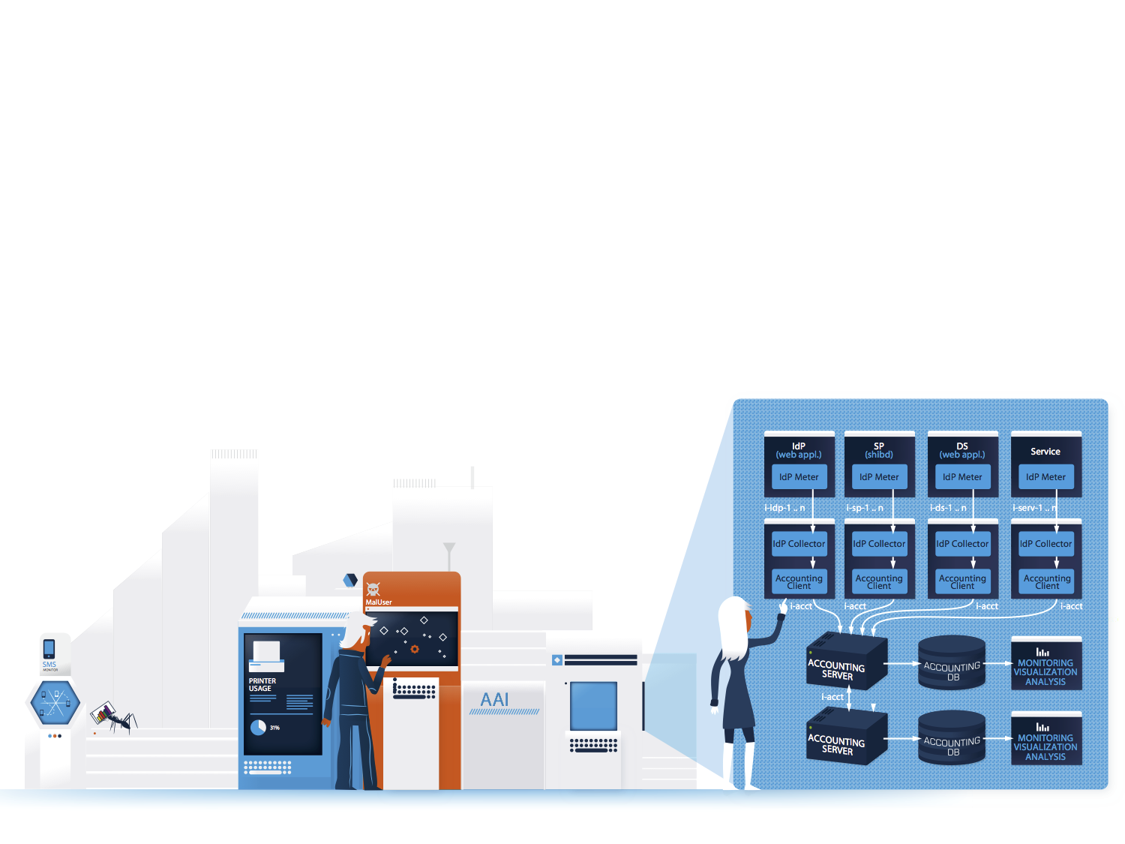
Federation as a Service
Task 4 Federation as a Service for NRENs Achievements
FaaS entered Pilot in May 2014, 12 pilot users over reporting period
2 NRENs already committed to move from pilot to production
  New and existing federations
Each FaaS customer gets its own FaaS instance with hosted tools:
  Resource Registry – web application for registering IdPs and SPs and their metadata
  Metadata Aggregation
  Metadata signing using HSM (Hardware Security Module)
  Central Backup Discovery service
2 training sessions delivered, 12 NRENs
Interest from outside Europe in adopting
  CAREN + WACREN
Notes:
Mention we maintain demo sessions
Litnet and Montenegro are production commitments
Highlight we would already be in production but wish to follow best of breed PLM – GN4 structure.

Slide 24
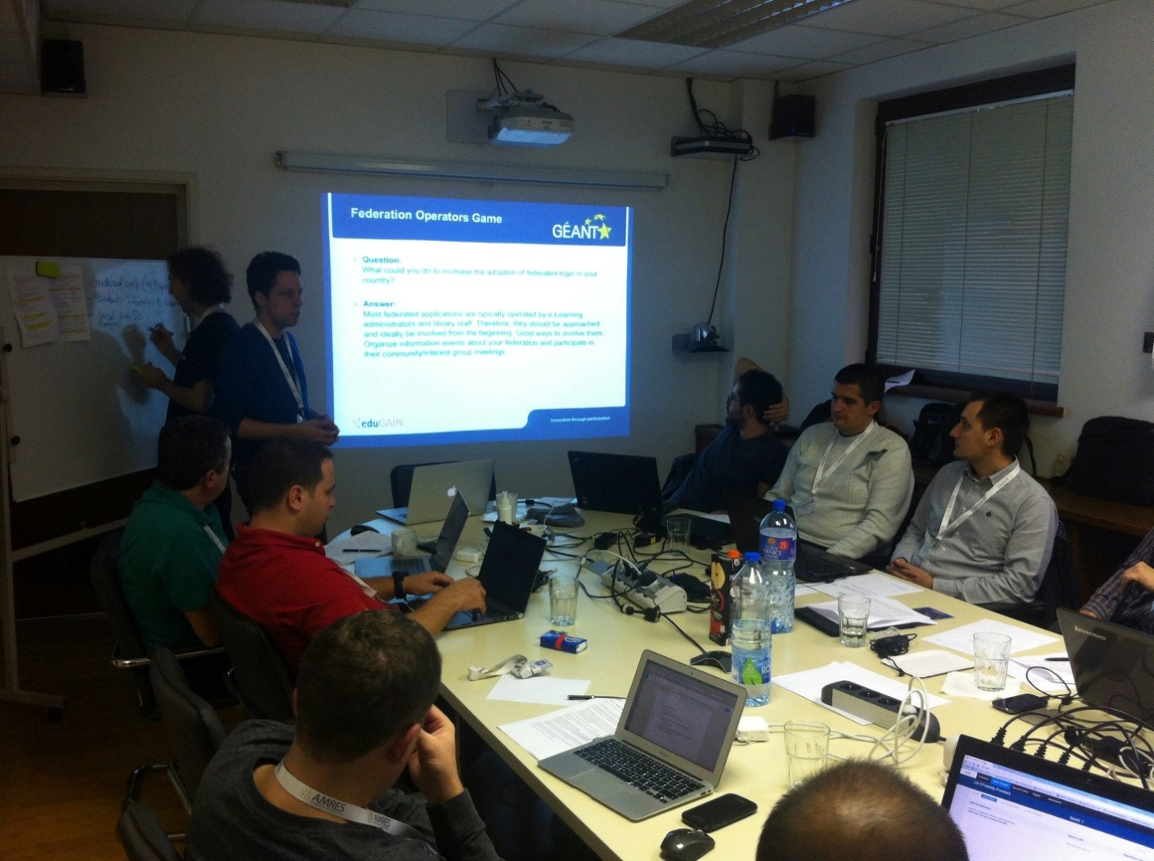
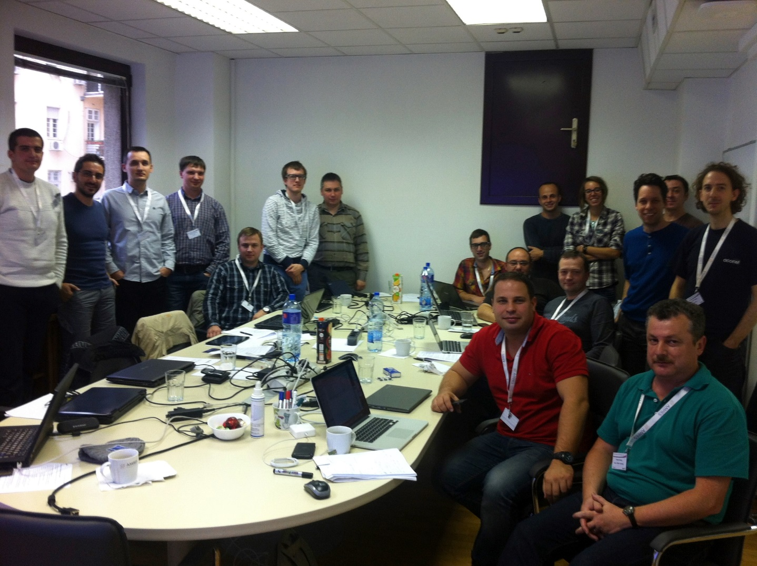
Federation as a Service
Task 4 Federation as a Service for NRENs Achievements

Slide 25

Federation as a Service
Task 4 Federation as a Service for Virtual Organisations
Market analysis commenced
  User requirements
    Gather requirements and priorities with/from communities
    Look at existing tools and technologies vs. requirements
  Operations and market
    Look into potential delivery models
    Gather data for cost benefit analysis & sustainability
Work closely with Enabling Users (T5) Team

Slide 26
Enabling Users
Task 5 Objectives
✓
To collaborate with the wider GÉANT project and with international user communities to increase usage of AAI infrastructure
✓
To act as an expert partner for large, pan-European projects with AAI requirements
✓
To coordinate two or three five projects between GÉANT and user communities, addressing their federated-identity concerns
✓
To provide support such that four GN3plus project tools/services are AAI-enabled
Notes:
Animat on point 3

Slide 27

Enabling Users
Task 5 Challenges
Accurate user requirements
  Listen carefully to the user requirements
  Ask the users to describe what they want to achieve, not what they want to get from you
The research communities need to be properly resourced to run the community-specific parts
  Need to understand their own identity management workflows before a solution
  e.g. change in funding for one group disrupted moving from pilot to production in their site
Sometimes the best solution for the research group is too specific for the general service:
  Need to be sure how far we can disrupt the cost/benefit equation for everyone
Notes:
I still wonder if challenges come best before achievements – always finish on a high….if so, the template order at the bottom needs adjusting

Slide 28

Enabling Users
Task 5 Achievements – user-driven service development
Expert federation operators and development teams supporting e-Infrastructures and research collaborations on their trust and identity needs
Pilots with CERN, DARIAH, ELIXIR, ESA, PaNData
  Consultancy for CLARIN, OpenAIRE, EIDA
  Vidyo use case
GÉANT Service developments strongly driven by pilots
  Improvements to eduGAIN and eduGAIN features
    Access check tool https://access-check.edugain.org/
    Metadata consumption check
  New service developments e.g. VO platform, Moonshot
Notes:
Fill in final consultancy list end April
SCI – security for collaboration in eInfrastructures
Emphasise tight links between dev etc. as the fastest way to drive change
N4U consultancy in Y1 -> new tools in Y2. Also cloud SA7.

Slide 29

Enabling Users pilots and use cases
CERN
Use Case:
Add the CERN IdP and a selection
of service to eduGAIN e.g. Indico
GÉANT partner – SWITCH
Service Development:
SIRTFI – A Security Incident Response Trust Framework for Federated Identity
Based on the Security for collaboration in e-Infrastructures policy
CERN, the European Organization for Nuclear Research. Over 10,000 physicists from more than 60 countries collaborate to process LHC data
Notes:
note SIRTFI now spun off to independent existence

Slide 30

Enabling Users pilots and use cases
DARIAH
Use Case:
Enabling federated access to all DARIAH services
Enhancing attribute release by supporting the adoption of the GÉANT Data Protection Code of Conduct for Service Providers in EU/EEA
GÉANT Partner – DFN
Digital Research Infrastructure for the Arts and Humanities. over 2000 users registered with the user management of DARIAH. Users highly distributed with little privileged access to IT
Service Development:
White Paper – Options for Joining eduGAIN
Enhanced Code of Conduct Deployment
Open Letter to CIOs
  https://wiki.edugain.org/CoCoEndorsement

Slide 31

Enabling Users pilots and use cases
Elixir
Use Case:
EGA portal REMS services available via eduGAIN
Minimise the number of homeless users
Identify ELIXIR’s requirements for Assurance vs. current federation capabilities
GÉANT Partner – CSC (Finland)
European infrastructure for biological information, supporting life science research and its translation to med-icine, agriculture, bio industries and society. Many of the datasets in life sciences cannot be freely distributed due to ethical, legal, societal or intellectual property reasons
Service Development:
Tool to check if a user is federated and can access services in eduGAIN
  https://wiki.edugain.org/isFederatedCheck/
Assurance requirements as based for GN4
Notes:
EGA has around (estimated at around 4000 users)

Slide 32

Enabling Users pilots and use cases
ESA
Use Case:
Deployment of a test environment reproducing the Landsat data dissemination server as Service Provider in eduGAIN
Deployment of a test environment reproducing the ESA EO Identity Provider in the Italian test federation
GÉANT Partner – GARR
The European Space Agency is Europe’s gateway to space. One of ESA’s branches is Earth Observation (EO). EO data is distributed via the use of ESA EO
web application services to a worldwide user community that includes around 20,000 scientists
Service Development:
Improved documentation for a commercial outsourced provider to manage the pilot

Slide 33


Enabling Users pilots and use cases
Umbrella
Use Case:
Bridging of eduGAIN-Umbrella
  Linking user’s university identity to an Umbrella identity
Non-browser access to facility servers
GÉANT Partner – SWITCH
Umbrella is the pan-European authentication and authorisation platform for the photon and neutron research community. A total of
more than 30,000 users visit these facilities annually, with 40%-60% of these visiting multiple facilities
Service Development:
Moonshot pilot for non-web SSO
Account translation mechanism in Umbrella

Slide 34


Task 5 Enabling Users Achievements
Impacts
connect • communicate • collaborate
CERN
…our community will be able to connect in an easier way to our services and resources thanks to the use of a single set of access credentials.”
Frédéric Hemmer, head of CERN IT
ELIXIR
The eduGAIN and GÉANT enabling user actions have been instrumental in getting forward together to work on life sciences data infrastructure challenges.
Tommi Nyronen (CSC Finland) ELIXIR
DARIAH
We see eduGAIN as the best approach to achieve a much-needed Europe-wide Authentication and Authorisation Infrastructure within DARIAH.
Peter Gietz (DAASI) DARIAH
PaNData – Integration of Umbrella IdP, Moonshot
…with the GÉANT enabling user actions the Umbrella Federation of the Photon and Neutron community was connected to the eduGAIN federation, allowing our users to sign in with their home institution accounts.
Mirjam van Daalen
(UmbrellaID, PSI)
ESA
We had the possibility to transfer to Siemens the eduGAIN vision of identity federations … including all the eduGAIN specifications and recommendations...We had a very good experience with the technical staff of Siemens.
Maria Laura Mantovani, IDEM
Notes:
Mention role of NA2 in collecting and disseminating this experience.
Features on eduGAIN website. Less focussed on mechanics, more on the users.

Slide 35

Enabling Users
Task 5 Achievements – GÉANT Services
OTRS trouble ticketing system
Product Lifecycle Management Portal
Authorisation management for GÉANT as a VO
  Rapid development
    Prototype to deployment within months
    Federated delegation of authorisation rights implemented for over 400 users
  Collaboration with JRA3 and FaaS VO platform
    Recommendations and results from JRA3
    Input to VO platform market analysis
Notes:
Update after end April with final results

Slide 36


eduCONF
Task 6 Objectives
✓
To further develop and relaunch the eduCONF service, taking into account the KPI performance of the previous pilot
✓
To assist in the roll-out and uptake of the service within participant NRENS
✓
To operate the eduCONF service
✓
To investigate and follow market trends in the VC sphere, make recommendations for enhanced, GÉANT-wide VC services
36

Slide 37

eduCONF
Task 6 Challenges
Everyone thinks they know what eduCONF is/should be:
  End-user VC
  High end, high quality
  Unnecessary market duplication
  Procurement vehicle
eduCONF fills a specific niche:
  Integration and interoperability
  Enable the requirements to be met, not meet them directly
  Revised service is popular with its target users who face these issues daily
    Institutional take-up is visible
Notes:
The image is supposed to symbolise what happens when you try to please everyone all of the time☺
Everyone = users, NRENs, Product Management, EC, everyone!

Slide 38
eduCONF
Task 6: KPIs
KPIs
World Gatekeeper Availability
NRENs Certified
Endpoints Certified
Year 2
Results
Target: 99%
Delivered
Target: 10
Achieved: 18
Target: 20
Achieved: 93
✓
✓
✓
38
Notes:
Update at end April
Compare Y1 where 4 NRENs and 8 endpoints were registered.

Slide 39

eduCONF
Task 6 Achievements
Outreach, training and promotion effort in September/October 2014
  A short promotional video has been produced to describe the benefits of using the eduCONF services, of Testing, Monitoring, Directory
60 institutions in 22 NRENs over 30 countries carrying out over 1,000 test calls
SIP testing introduced and in production, alongside IP and e.164 tests
Video graphic test added to enable use assessment of video connection
The Gatekeeper Monitoring service has been simplified and functionally separated from the Directory to enable easier registration of Gatekeepers
Global Video Alliance – An assessment of similar global directories has informed a Standard for Directory Data sharing. This has been produced and circulated. A pilot group is in early discussion
Notes:
Mention NA2 for training and promotion effort & website.

Slide 40

Conclusions
Activity Summary
Excellent operations for eduPKI, eduroam, eduGAIN
Continued eduroam growth and service improvement
Continued eduGAIN growth and service improvement
Five Moonshot pilot sites
Federation as a Service business case and pilot launched, market analysis for VO Platform commenced
Enabling Users supported pilots with five research communities
Group Management System for GÉANT project – prototype delivered
The eduCONF directory service, with integrated test suite was successfully relaunched

Slide 41

Conclusions
Looking Ahead
Dedicated Trust and Identity Development Activity to address the growing and complex demands
Pilot and production of InAcademia validation service
Prototype and pilot services for Virtual Organisations
Harmonisation – using the Enabling Users experience to develop eduGAIN’s baseline further
Continue to support user communities to use eduGAIN
Collaborate with AARC (E-INFRA-7)
Non-web and Federation as a service – from pilot to production
eduroam as a Service – supporting deployment at small sites
Improved eduGAIN facilities for federations and service provider registration
Notes:
Highlight that the AAI space is immense and plenty of room for more players.

