Slide 1


Federation as a Service SA5/Т4
Marina Vermezović, AMRES
STF, Summer 2015
14-15 July 2015, Ljubljana

Slide 2
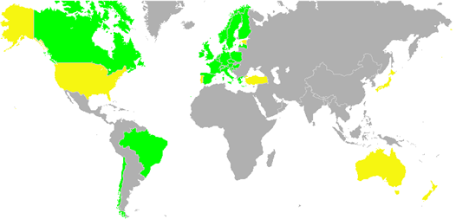
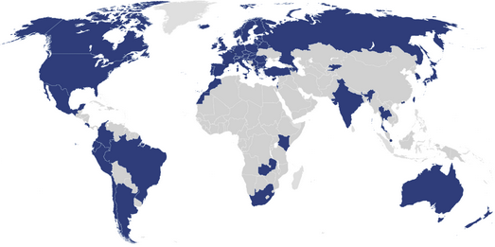


Federation as a Service
Lower the technology barrier for NRENs and other interested groups in order to build their Identity federation and use eduGAIN.
Number facts, when we started:
  43 partners in GN3plus
  almost all GN3plus partners in eduroam, 18 federations in eduGAIN
21 GN3plus partners didn’t have WebSSO Identity federation
source: www.edugain.org
source: www.eduroam.org

Slide 3
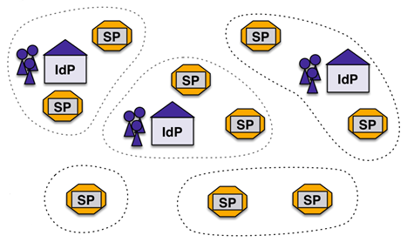
What is an Identity federation?
Stone age: Applications maintain users credentials and information locally
Modern age: user credentials and information is stored centrally (IdP) and application (SP) maintains only app-specific user data
Identity federation is group of organizations running IdPs and SPs that agree on a common set of rules and standards

Slide 4
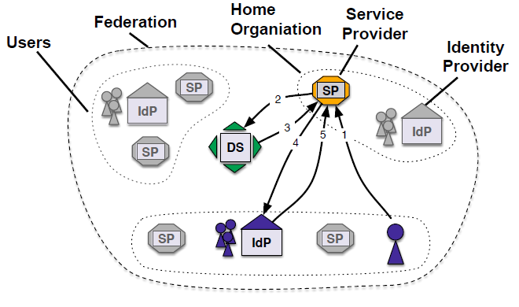
Login flow in Identity federations

Slide 5
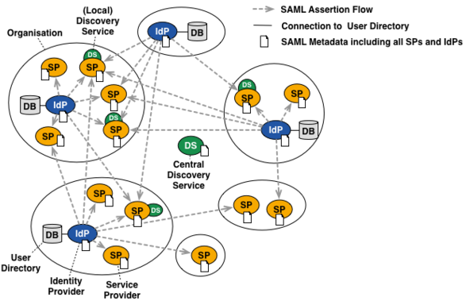
Full mesh federation architecture

Slide 6
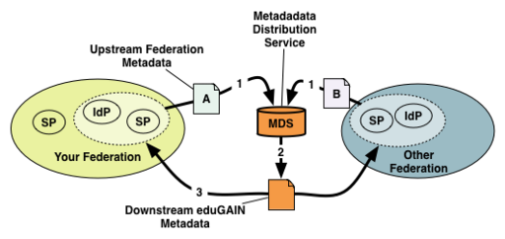
Interfedetation - eduGAIN
eduGAIN is a service that interconnects the participating identity federations.
They agree on a set of common standards and policies which ensure interoperability.

Slide 7
Identity federation operator
A federation operator is an organisation that operates an identity federation.
Technicaly, operation includes enabling trust relations between IdPs and SPs within federation and interfederation wise.
Federation operator registers local federation entites metadata and republishes eduGAIN metadata, so that typically there are:
  Downstream federation metadata
  Upstream fedederation metadata

Slide 8
FaaS offer - Market Analysis
First, we needed to understand what are the issues hindering development of Identity federations in NRENs
April - September 2013 FaaS was conducting Market Analysis talking to NRENs
6 NRENs responded and were interviewed

Slide 9
FaaS Survey – Identifying Issues
priority
funding
server infrastructure
knowledge
manpower
policy
no SPs
NREN
Institution Authentication Infrastructure
Institution Identity Management
interest
manpower
knowledge
server infrastructure
interest
manpower
knowledge
server infrastructure
management of user accounts

Slide 10
FaaS in GN3plus
Goal: Lower the technology barrier for deployment of Identity federation for NRENs and other groups
Provide the tools to efficently manage Identity federation and connect to eduGAIN
Each FaaS customer gets its own FaaS instance with hosted tools:
  Resource Registry – web application for registering IdPs and SPs and their metadata
  Metadata Aggregation
  Metadata signing using HSM (Hardware Security Module)
  Central Backup Discovery service

Slide 11
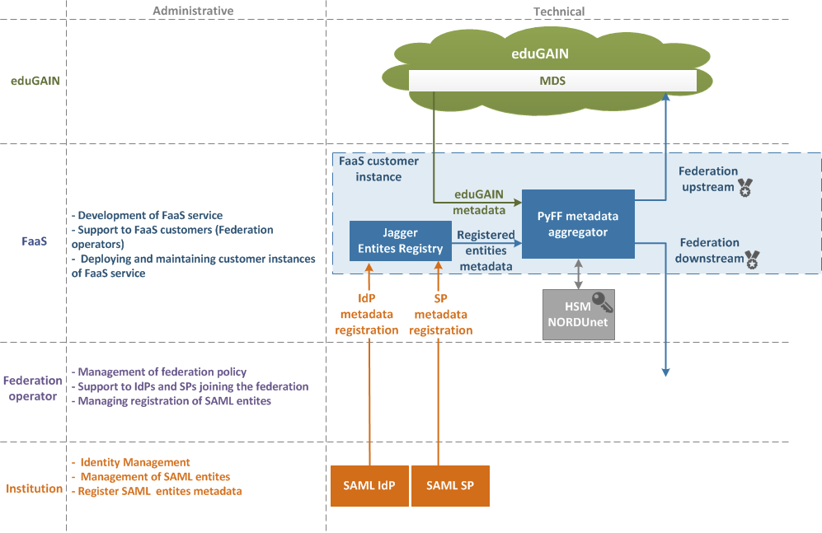

Slide 12
FaaS timeline
FaaS entered Pilot in May 2014
We had FaaS training in October 2014 and in April 2015, in total 12 NRENs participated
Currently we have 4 NRENs who are using the service
Planning for transitioning the service to the production in 6M of GN4

Slide 13
FaaS current work
Deep in preparations to go „production“
Production team is in SA4 and FaaS will undergo:
  Testing and validation of the service
  Transition to production to meet all the „production“ standards
  Enter the Continual service improvement

Slide 14


