Slide 1
Trust and Identity in the GÉANT project
Thinking globally, acting locally
Ann Harding
GÉANT Activity Leader, Trust and Identity Development
SWITCH Project Manager
Networkshop 44, Manchester
24.3.2016

Slide 2


Trust and Identity today
Classic Identity Federations interoperating via eduGAIN
  Identity Provider (IdP) asserts authentication and information about users.
  Service Providers (SP) check and consume this information for authorization and make it available to an application
A group of organizations running IdPs and SPs that agree on a common set of rules and standards that build trust
Notes:
Typical use cases – journals, e-learning, contracts happen out of band. Simple 1:many models.

Slide 3


































From local to global
3

Slide 4

A changing research environment
More Machines
e-infrastructure
Technology
Crowd Intelligence
Digital Research
Open Innovation
Collaborative Design
HPC
Big Compute
Big Data
e-Science
Faster Networks
Conventional
Computing
Flexible Communication
More People
(Scholars, citizens)
More complex trust
4
Adapted from: Professor David De Roure, Professor of e-Research at University of Oxford
4
Notes:
If we work together, we must trust.
Many to many.
Virtual and distributed.

Slide 5

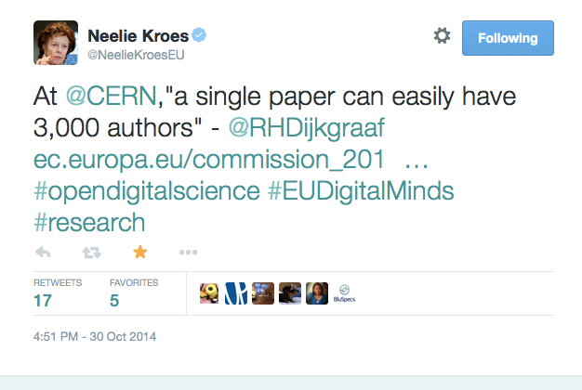
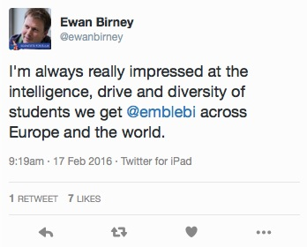
No researcher works in isolation
Source: LIGO/Caltech
Notes:
Borderless research
LIGO: Total members: 1006 Total institutions: 83 Countries represented.
Horizon 2020 “excellent Science” programme
United Kingdom (1161) (Germany next biggest c700).

Slide 6





e-Research Trust and Identity Infrastructures
Campus
Federation
eduGAIN
General and Specific e-Research Infrastructures
Individual Experiments
Hundreds of thousands of users
Tens of thousands of services
Thousands of services
Hundreds of services
Tens to hundreds of individuals *
SPECIFIC
GENERIC
Notes:
39 federations providing statistics to REFEDS Feb 29 2016
3493 IdP 7893 SPs
– inc. centralised IdPs
Numbers for eduGAIN Feb 2016–
Federations 38
IdPs: 1999
SPs: 1119
21 ESFRI Projects with a high degree of maturity - including 6 new Projects - and 29 ESFRI Landmarks

Slide 7

Selected Roadmap
Developments until 2016
Next Generation Architectures and Protocols
Assurance
Campus IdP Services
e-Research Support
AARC Collaboration
Entity Categories for Attribute Release
InAcademia Simple Validation Service
Virtual Organisation Platform
Moonshot Production

Slide 8

In Focus - VO Platform
Enable flexible collaboration
In Identity Federations this information is often conveyed using attributes
Often attributes from the Home Organisation alone are not enough: VO related Services need attribute information in the context of the VO
VOs therefore need to be able to manage and provide attribute and group information towards Services, independently from the Home Organisation
To be able to grant access, a Service needs information beyond Authentication

Slide 9
In Focus – VO Platform functional requirements
Persistent Identifier - Allow the VO to identify the user even if (s)he changes IdP
VO Membership Registry - To become members of the VO a certain workflow must be followed
‘External’ Identities – Not all VO users will be in eduGAIN
Group Management - groups may also be used to define roles and rights
(de)Provisioning – Identity, attributes and groups need to be provided to Services
Service Proxy and Attribute Aggregation
Attributes beyond the IdP are needed for VO roles and rights, or to provide extra context (e.g. ORCID, Grant number)

Slide 10

VO Platform Basic Service Requirements
Pilot in preparation
VO Membership service
  registry for VO persistent Identifier
  VO specific Workflows for onboarding
  Limited set of attributes
External Identity Provider (extIDp)
  One persistent (SAML) IdP for many ‘Guest’ Identity Providers, including:
    Social (Google, Twitter, Linkedin, Facebook)
    NREN operated & Commercial Guest IdPs (OpenIDP, UnitedID.org, eduID.se)
    eGOV (STORK)
  Provides LOA: eIDAS by default once available, others upon request from SP
  Available and accessible through eduGAIN

Slide 11

Unlocking Attributes
I am not a lawyer…
Most of eduGAIN is under EU Data protection directive or equivalent
The objective of the directive is to protect a person’s fundamental rights while guaranteeing the free flow of personal data between member states
Member States shall provide that the controller must implement appropriate technical and organizational measures to protect personal data against accidental or unlawful destruction or accidental loss, alteration, unauthorized disclosure or access, in particular where the processing involves the transmission of data over a network, and against all other unlawful forms of processing.
Notes:
The standard approach to achieving minimum risk under the EU Data protection directive would expect contracts between a Home Organisation and the entities responsible for every Service Provider accessed by every member of its community.
very few Home Organisations would be able to assess every potential Service Provider.

Slide 12

Balancing Risk
https://wiki.refeds.org/display/ENT/Guidance+on+justification+for+attribute+release
Notes:
Note balance between user freedom from and freedom to.
Note balance between regulatory risk and ‘commercial business purpose’ risk for campus.
Note R&E tends to do more for privacy than industry for whom legislation is normally designed.
Reminder of project engagement in pan Euro research has worth.
Processing is necessary for the purposes of the legitimate interests pursued by the controller or by the third party or parties to whom the data are disclosed.

Slide 13
In Focus - Attribute Release
Tools to automate risk-analysis-based support of e-Research
Entity Categories group federation entities that share common criteria.
Facilitate IdP decisions to release a defined set of attributes to SPs without the need for detailed local review for each SP
Research and Scholarship Entity Category relies on the legitimate interest approach
Safeguards of data minimisation, privacy enhancing tech
Limits the types of services that are allowed to claim this category and focusing on low-risk, high benefit services that have a clearly identifiable need for personal information
Each SP is considered on a case-by-case basis by the federation in question and reviewed annually.
GÉANT Code of Conduct approach aims to minimise the risk that arises from depending on each other.
Legitimate interest is also fundamental
Signals that the Home Organisation and Service Provider are aware of the legal requirements
Based on Directive 95/46/EC 1995
Check with JISC for advice on which best suits your needs

Slide 14

What we can do
Now can LIGO have some attributes please?
We have many more years of gravitational-wave astronomy
discoveries to come and realizing the full science potential
will require close collaboration with astronomers and
astrophysicists from around the world. eduGAIN and your
national federations can help make that happen.
- Scott Koranda, lead architect for the Laser Interferometer Gravitational-Wave Observatory Identity and Access Management
Read more about releasing attributes for Science https://refeds.org/a/1154

Slide 15
@hardingar

