Slide 1
Federated Identity Fundamentals
Ann Harding, SWITCH
Cambridge
July 2014

Slide 2
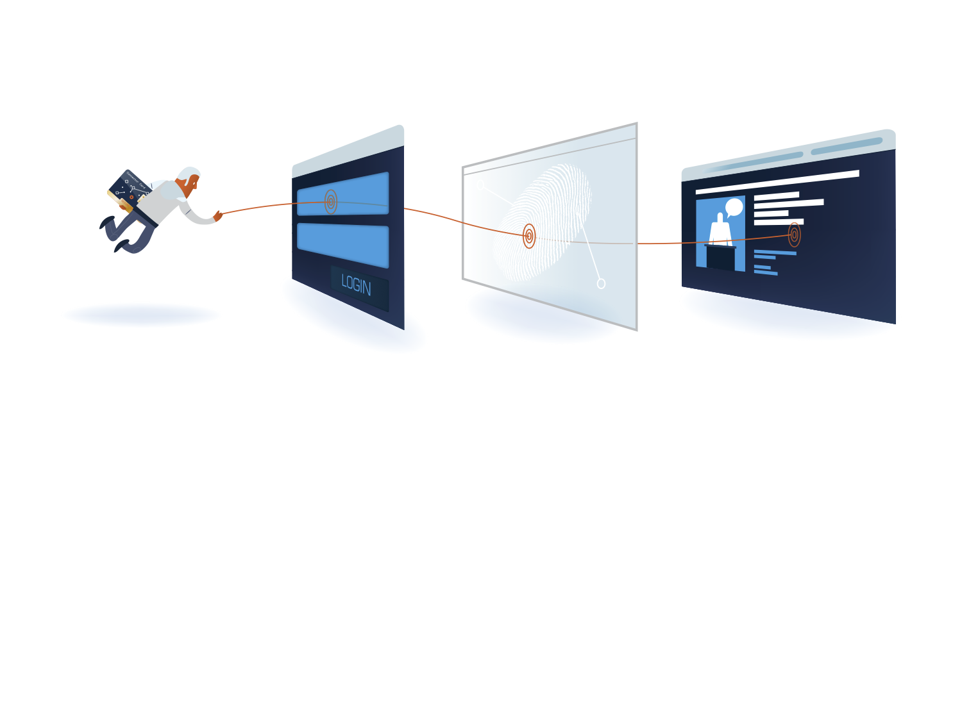
Learning Objectives
What is Federated Identity Management?
What is a Federation?
  Full mesh example (SWITCHaai)
  Hub and spoke federation example
  eduroam example
What is Interfederation?
  eduGAIN example
  Positioning Federation as a Service
Notes:
Fix image
Learn the principles behind eduGAIN, FaaS, Enabling Users,
Highlight differences with eduroam and moonshot

Slide 3
Evolution of Identity Management
Primordial Soup
Nothing yet!
Diamond Age
Federated Identity
Stone Age
Application holds all info
Bronze Age
Centralised credential e.g. LDAP
Iron Age
Central credentials and Identity
Identity in app
App only has specific user data
Share information outside one domain

Slide 4


Federated Identity
  Identity Provider (IdP) asserts authentication and identity information about users.
  Home organisation (HO) a related term
  Service Providers (SP) check and consume this information for authorization and make it available to an application
  Relying Part (RP) a related term
  Identity Providers and Service Providers are collectively called entities

Slide 5



Federated Identity
✗
The first principle within federated identity management is the active protection of user information
Protect the user’s credentials - only the IdP ever handles the credential
Protect the user’s identity information, including identifier - customized set of information released to each SP

Slide 6
Benefits/Compelling Reason to Act
Reduces work
Authentication-related calls to Penn State University’s helpdesk dropped by 85% after they installed Shibboleth
Provides current data
Studies of applications that maintain user data show that the majority of data is out of date. Are you “protecting” your app with stale data?
Insulation from service compromises
In FIM data is pushed to services as needed. If those services are compromised the attacker can’t get everyone’s data.
Minimize attack surface area
Only the IdP needs to be able to contact user data stores. All effort can be focused on securing this one connection instead of one or more connections per service.

Slide 7
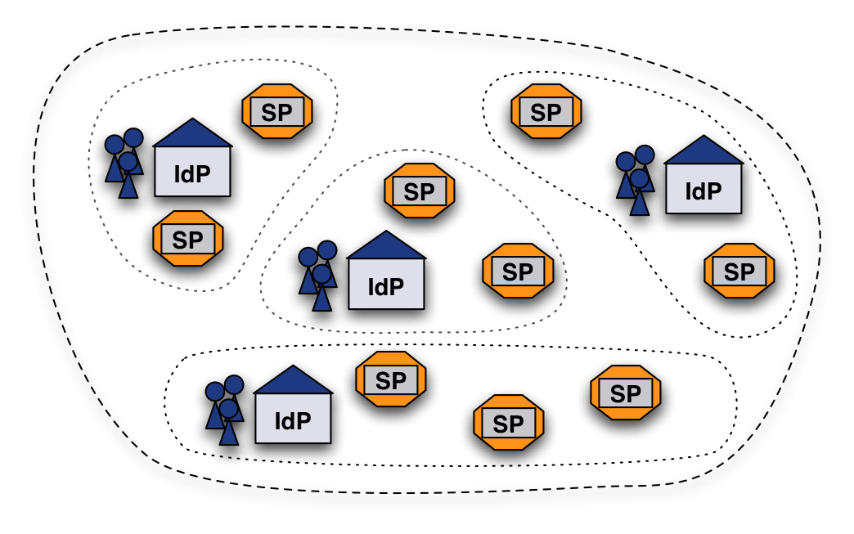
What is a Federation?
A group of organizations running IdPs and SPs that agree on a common set of rules and standards
The grouping can be on a regional level (e.g. SWITCHaai) or on a smaller scale (e.g. large campus)
IdPs and SPs "know" nothing about federations
They read metadata!
An organization may belong to more than one federation at a time
Notes:
A federation is not equivalent to a network AS

Slide 8
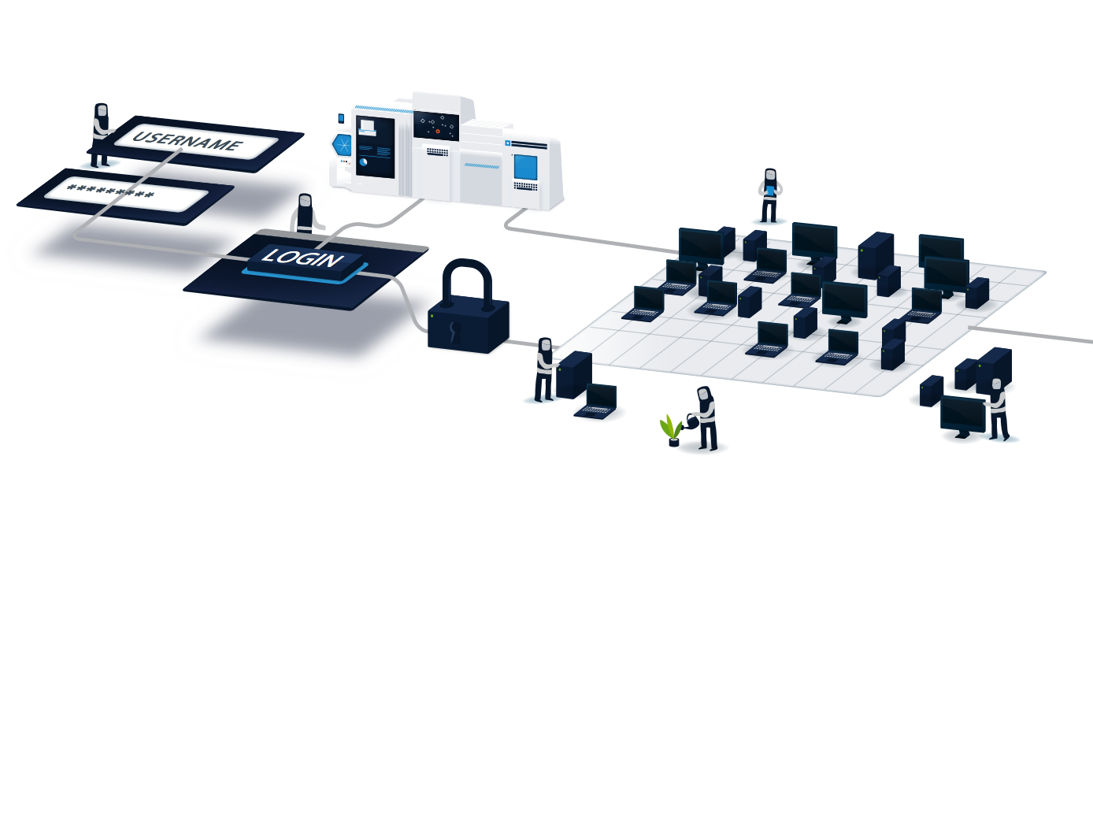
What do Federations do?
At a minimum a federation maintains the list
of which IdPs and SPs are in the federation
Most federations also
  Define agreements, rules, and policies
  Provide some user support (documentation, email list, etc.)
  Operate a central discovery service and test infrastructure
Some federations
  Provide self-service tools for managing IdP and SP data (Resource Registry)
  Provide application integration support
  Host or help with outsourced IdPs (IdP in the Cloud, hosted IdP
  Provide tools for managing "guest" users
  Develop custom tools for the community

Slide 9



Federation Rules?
Technical Interoperability
Supported protocols
User authentication mechanisms
User attribute specifications
Accepted X.509 server certificates
Legal Interoperability
Membership agreement or contract
Federation operation policies
Requirements on identity management practices
Others
Common/best operational practices e.g. http://switch.ch/aai/bcp

Slide 10
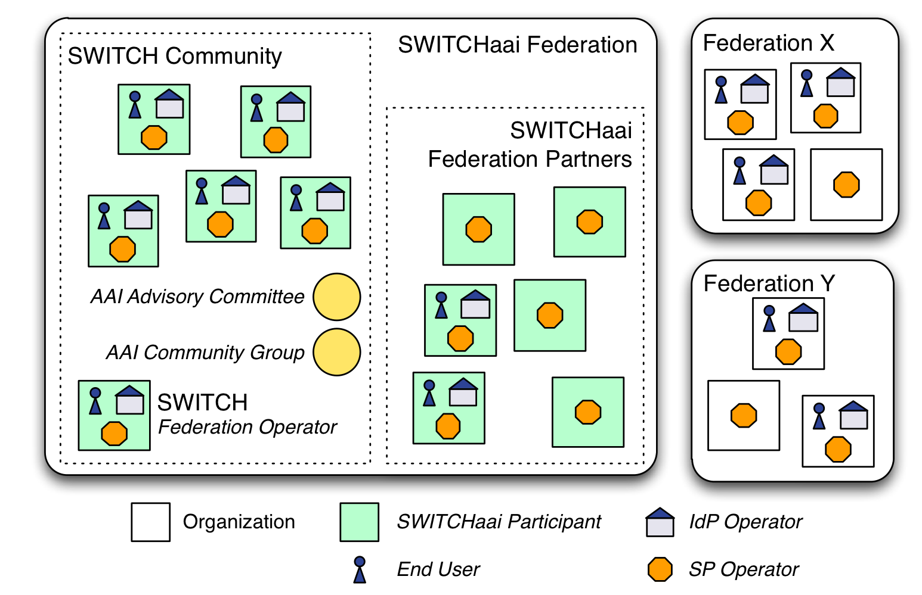
SWITCHaai Example
SWITCH operates the SWITCHaai Federation
AAI is a Basic Service for the SWITCH Community
Two classes of SWITCHaai Participants:
SWITCH Community
  Organization fits the definition from the SWITCH Service Regulations
  May incur costs
Federation Partner
  Organization sponsored by a SWITCHaai Participant from the SWITCH Community
  Includes commercials
  Typically incurs costs

Slide 11
SWITCHaai Example
Federal Law, Cantonal Law
(e.g. data protection)
SWITCHaai Service Description
(includes Policy)
SWITCH
Service Regulations
Federation Partner Agreement & GTC
SWITCH Community
Federation Partners
Org 1
Org 2
Org ...
Org n
User Regulations
User Regulations
User Regulations

Slide 12
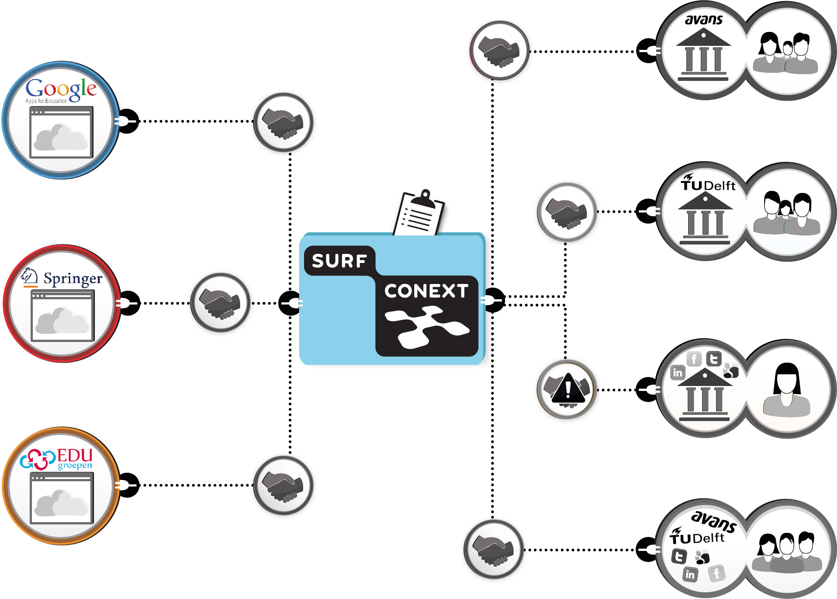
SURFconext example
SURFconext manages the mutual authentication and authorization between them.
SURFconext is the central point where the connection between a service and it's users is made.
Commercial SPs have contractual arrangements via SURFmarket
Community AND free SPs have contracts via SURFnet

Slide 13
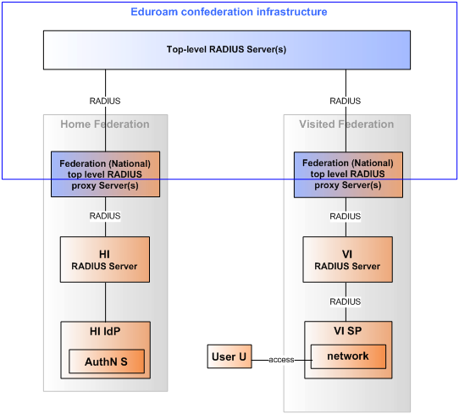
Other technology example - eduroam
HI = Home Institution
VI = Visited Institution
IdP = Identity Provider
SP = Service Provider
Notes:
Quiz – what do people think the service an SP provides is

Slide 14


Interfederation
Interconnecting national federations
eduGAIN → Interfederation, eduroam → Confederation
No longer a single legal or policy framework
Each federation has its own eduGAIN has one as well
No single 'interfederation helpdesk' in case of problems
Debugging involves probably more parties
Involved parties will generally know less about each other
Different sets of attributes used internationally
Notes:
Different sets of attributes used internationally

Slide 15
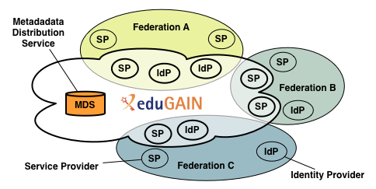
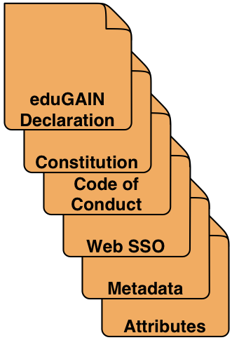
eduGAIN Example
eduGAIN provides policy framework and standards
to build trust
SPs and IdPs of participating federations opt-in for eduGAIN
Various local processes for what this means
MDS fetches, aggregates and republishes metadata
Opt out being piloted by some

Slide 16
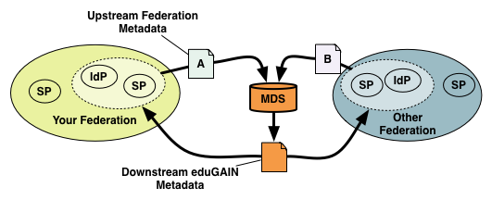
Metadata Exchange for eduGAIN
Each Federation publishes a Metadata file with the entities that want to interfederate.
The eduGAIN Metadata Data Service fetches them
eduGAIN MDS aggregates all metadata and republishes it
Federations fetch it and filter-out their own entities
Entities consume the filtered eduGAIN metadata file
in addition to the one from the federation

Slide 17

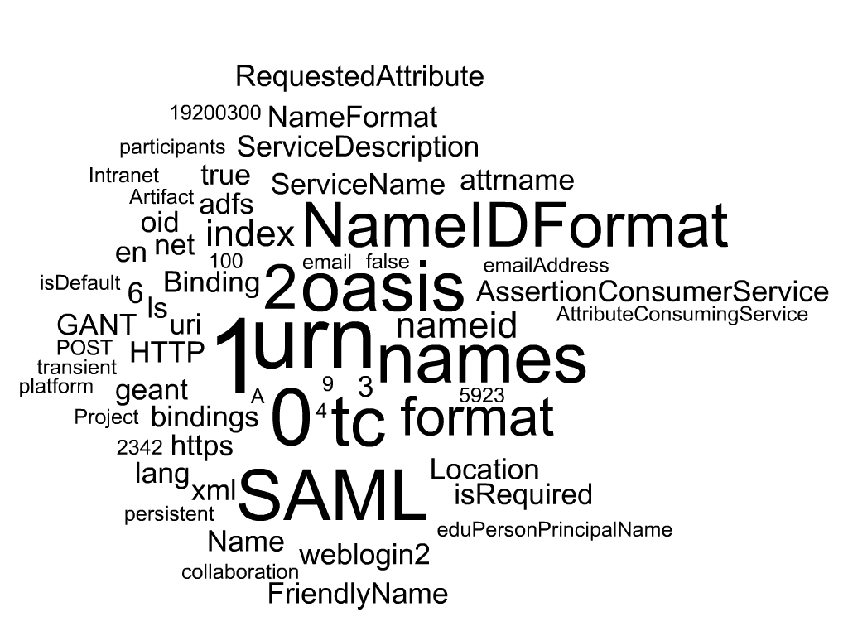
eduGAIN technical infrastructure in a nutshell

Slide 18


eduGAIN Constitution and Policy
http://www.geant.net/service/eduGAIN/resources/Pages/home.aspx
Governance and Governing Bodies
Participant Federations MUST:
No express right of communication
  eduGAIN Executive Committee (eEC)
  eduGAIN Steering Group (eSG)
  Operational Team (OT)
  Primarily serve the interests of the education and research sector.
  Provide a point of contact for their Members for dealing with technical issues.
  Provide processes for handling complaints and incidents involving their Members.
  Have a published Metadata registration practice statement.
  Follow the eduGAIN SAML 2.0 Metadata Profile
  For an Entity registered in an eduGAIN Participant Federation it does not imply any right of communication with any other Entity exchanged through eduGAIN.

Slide 19
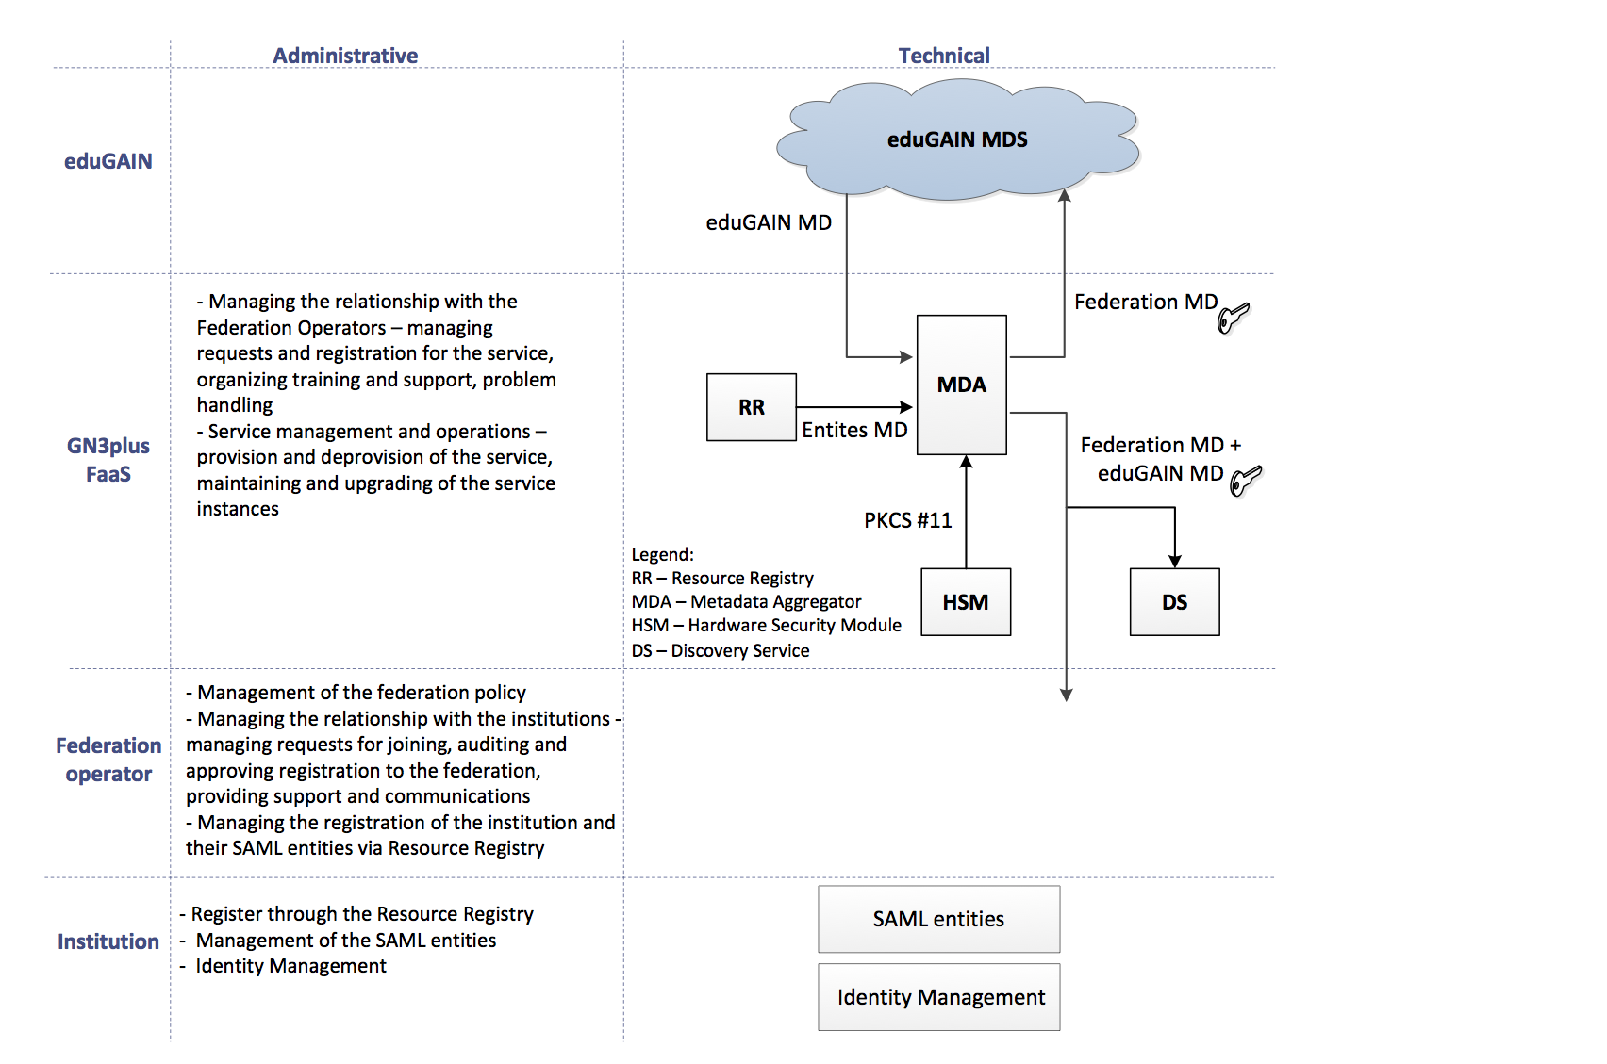
Where Federation as a Service fits

Slide 20

Key Interfederation Challenges
Coverage
  Number of federations
  Depth of adoption
Policy and requirements
  Cannot mandate much for entities
Reputation of the overall service depends on that of the members
Branding
Visibility vs. trust

Slide 21

Quiz Time

Slide 22
Quiz Time
Which of the following is NOT an entity?
  IdP
  RR
  SP
  MDS
Which of the following statements are true in Federated Identity Management?
  Only the IdP holds the user credentials
  Federations route credentials to SPs
  Per service credentials are held in applications
  The SP needs all information about a user to be released
Name an advantage of Federated Identity Management

Slide 23
Quiz Time
Which of the following are offered by most federations?
  Discovery Service
  List of entities
  Policies and Guidelines
  Managed IdP
Full mesh or hub and spoke?
  Operated by most federations
  Connections between entities managed by the federation
  Every entity has a copy of the trusted federation metadata listing all federation members
True or False? Participating eduGAIN members must
    Primarily serve the interests of the education and research sector.
    Provide a minimum standard attribute release between entities
    Get approval of the eduGAIN SG for commercial entities in eduGAIN
    Provide processes for handling complaints and incidents involving their Members.

Slide 24

Back at 11:30

Slide 25
Thank you!

