Slide 1
Research Community Requirements
Ann Harding, SWITCH
Cambridge
July 2014

Slide 2
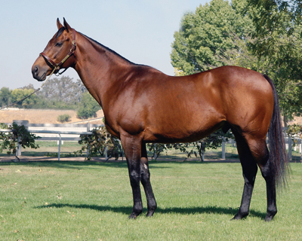
What eduGAIN is.

Slide 3

What people think eduGAIN is.
Notes:
What was marketed
What was built
What we want to avoid building

Slide 4

What we risk creating if we don’t close the gap wisely.

Slide 5


eduGAIN Gap Analysis –
Research Community Requirements
TERENA AAA Study 2012
8 Use cases,
CERN to Life sciences and beyond
5 flavours of AAI
25 Recommendations
FIM4R Paper 2012-2013
HEP, Life sciences, Humanities, Climate science
12 common requirements
4 recommendations to providers
Group continues at RDA
Notes:
http://www.terena.org/publications/files/2012-AAA-Study-report-final.pdf
https://cdsweb.cern.ch/record/1442597

Slide 6
Summary of High & Medium Requirements
User friendliness and Ease of use
Authorisation under community control
Flexible and scalable attribute release
Bridging communities
Browser federated access
Non-browser federated access
Well defined and harmonised attributes
Privacy and data protection
Open standards and sustainable licenses
Attributes that cross national borders/Data Protection
Attribute aggregation for authorisation
Technology translators
Levels of Assurance
Security Incident Response in Federations
Notes:
Also Authorisation under community control, open standards, well defined, harmonised attributes

Slide 7
Requirements vs. GÉANT engagement
User friendliness and Ease of use
Authorisation under community control
Flexible and scalable attribute release
Bridging communities
Browser federated access
Non-browser federated access
Well defined and harmonised attributes
Privacy and data protection
Open standards and sustainable licenses
Attributes that cross national borders/Data Protection
Attribute aggregation for authorisation
Technology translators
Levels of Assurance
Security Incident Response in Federations
Active
Partially Active
Not Active
Notes:
Also Authorisation under community control, open standards, well defined, harmonised attributes

Slide 8
Requirements vs. maturity of solution
User friendliness and Ease of use
Authorisation under community control
Flexible and scalable attribute release
Bridging communities
Browser federated access
Non-browser federated access
Well defined and harmonised attributes
Privacy and data protection
Open standards and sustainable licenses
Attributes that cross national borders/Data Protection
Attribute aggregation for authorisation
Technology translators
Levels of Assurance
Security Incident Response in Federations
Service/Tool/BCP*
Research/Service Development
Requirements only
* Deployment not universally guaranteed
Notes:
Also Authorisation under community control, open standards, well defined, harmonised attributes

Slide 9
Requirements vs. supply chain critical path
(Warning – dangerously simplified)
User friendliness and Ease of use
Authorisation under community control
Flexible and scalable attribute release
Bridging communities
Browser federated access
Non-browser federated access
Well defined and harmonised attributes
Privacy and data protection
Open standards and sustainable licenses
Attributes that cross national borders/Data Protection
Attribute aggregation for authorisation
Technology translators
Levels of Assurance
Security Incident Response in Federations
IdP/Campus
eduGAIN
Federation
Other/very complicated
SP/Research Community
Notes:
Modelling in more detail in interactive session
LoA
Attribute Release
Attribute Aggregation

Slide 10




Collaborative pilots between user communities and GÉANT
  “A connected network of people, information, tools, and methodologies for investigating, exploring and supporting work across the broad spectrum of the digital humanities.”
  “Basic life science information constitutes a testament of human and natural evolution and advancement. As such, this wealth of knowledge should be freely available for all to access, study and process”
“Umbrella is the Federated Identity Solution of the Photon and Neutron Community, enabling user initiated trans-facility access.”
Notes:
Goal – use these pilots to address issues from FIM4R for the benefit both of the individual communities and the wider community. Both geant and the communities invest significant time and effort.
Pilots were a recommendation for technology providers in the FIM4R paper

Slide 11

DARIAH Goals
Support digital humanities researchers
Find and use a wide range of research data
Work across domains and disciplines
Experiment and innovate in collaboration with other scholars
  Make DARIAH services available via eduGAIN
  Encourage attribute release based on GÉANT Code of Conduct
  Group and attribute management integration with DARIAH-DE
Textgrid Lab tools for scholarly digital editions

Slide 12

DARIAH Experience
eduGAIN is the best approach to pan European AAI for DARIAH but some time is needed to fulfil all needs
DARIAH would like to see more entities available in eduGAIN and reasonable attributes available
DARIAH has been able to meet many requirements
  Distributed user and privilege administration
  Policies that allow for integration into DFN-AAI and eduGAIN
Combination of eduGAIN and community specific
  DARIAH homeless-IdP and attribute authority

Slide 13
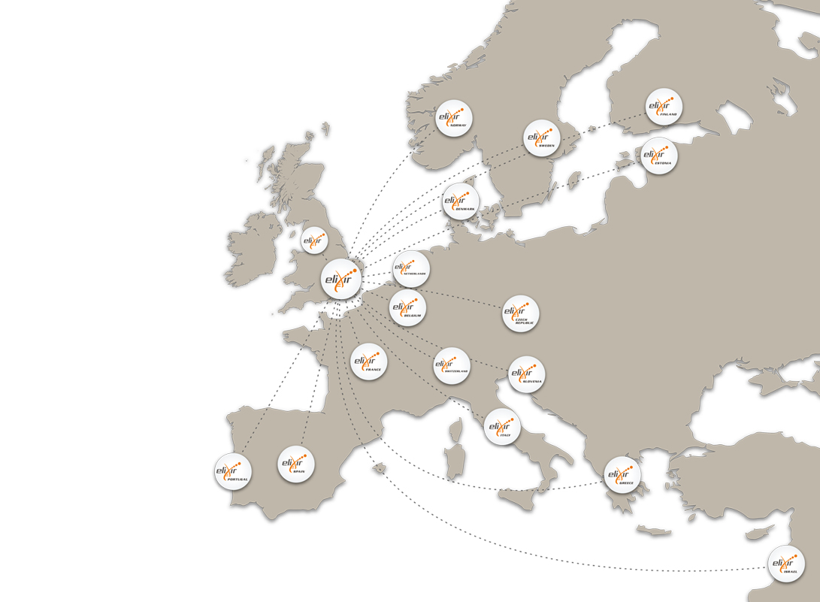
ELIXIR Goals
Research requiring AAI – Matching the treatment to the cancer
One in 10 women in the EU-27 will develop breast cancer before the age of 80.
If they can identify patterns of genes that are active in different tumours, we can diagnose and treat cancers earlier
Requirements for Levels of Assurance
Make EGA and REMS available on a pan-European basis via eduGAIN
Part of a wider portfolio of ELIXIR AAI work
ELIXIR distributed infrastructure

Slide 14
ELIXIR Experience
Next phase of AAI in ELIXIR – blueprint for discussion
External IdPs via eduGAIN
ELIXIR specific services for authorisation (REMS), non web, homeless users and community management
Federated identity cross sector collaboration:
REMS to be used by FI-CLARIN & FI-CESSDA
A pan-European approach to LoA would be appreciated/necessary in the future
Minimise ELIXIR-specific customisation

Slide 15
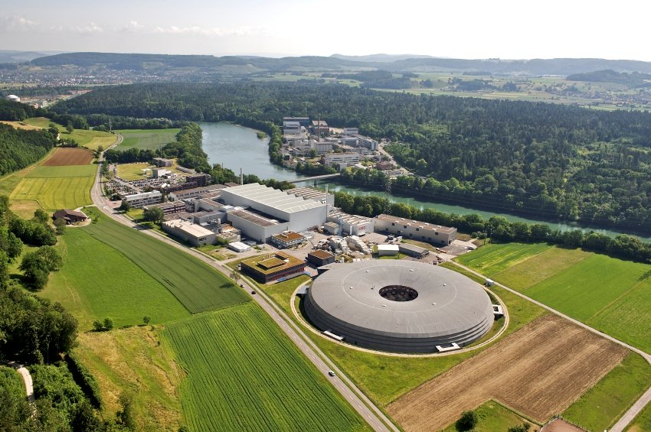
Umbrella Goals
Umbrella platform - a collaborative effort by leading European Photon and Neutron facilities as part of several EU projects
Unique and persistent user identification for interdisciplinary user community from biology, physics to earth sciences
Optimisation of the process from experimental data acquisition to data publication
Swiss Light Source at Paul Scherrer Institute in Villigen Switzerland
Six such facilities use Umbrella and serve over 30’000 users - 40% of these researchers use multiple facilities.
Bridging Home Institution Accounts with Umbrella persistent identities
  Enable Home Org identities to be used in Umbrella & Umbrella identities to use eduGAIN
Non-web-browser based access

Slide 16
Umbrella Experience
More opportunities for NREN/Research Infrastructure Collaboration
  Security analysis discussion at FIM4R
Piloting with a wider community has benefits
  JANET/Diamond Light in UK Moonshot Pilot
Confidentiality aspects critical for Umbrella - high competition, especially structural biology
  Authorisation is delegated to the systems participating in Umbrella

Slide 17

GÉANT Experience
Better Understanding = Better Services
Learning the profile of the user communities:
Where are their users?
Where are their services?
Community expertise even more valuable than eduGAIN
Get people thinking beyond technology – focus on workflows not eduGAIN
Misunderstanding == unhappy users
Unhappy users will just go away and make all the same mistakes we did 10 years ago
Custom support for finding the best option
Help reach the right federation contacts
White paper “Options for Joining eduGAIN”
Improved public documentation & knowledgebase

Slide 18
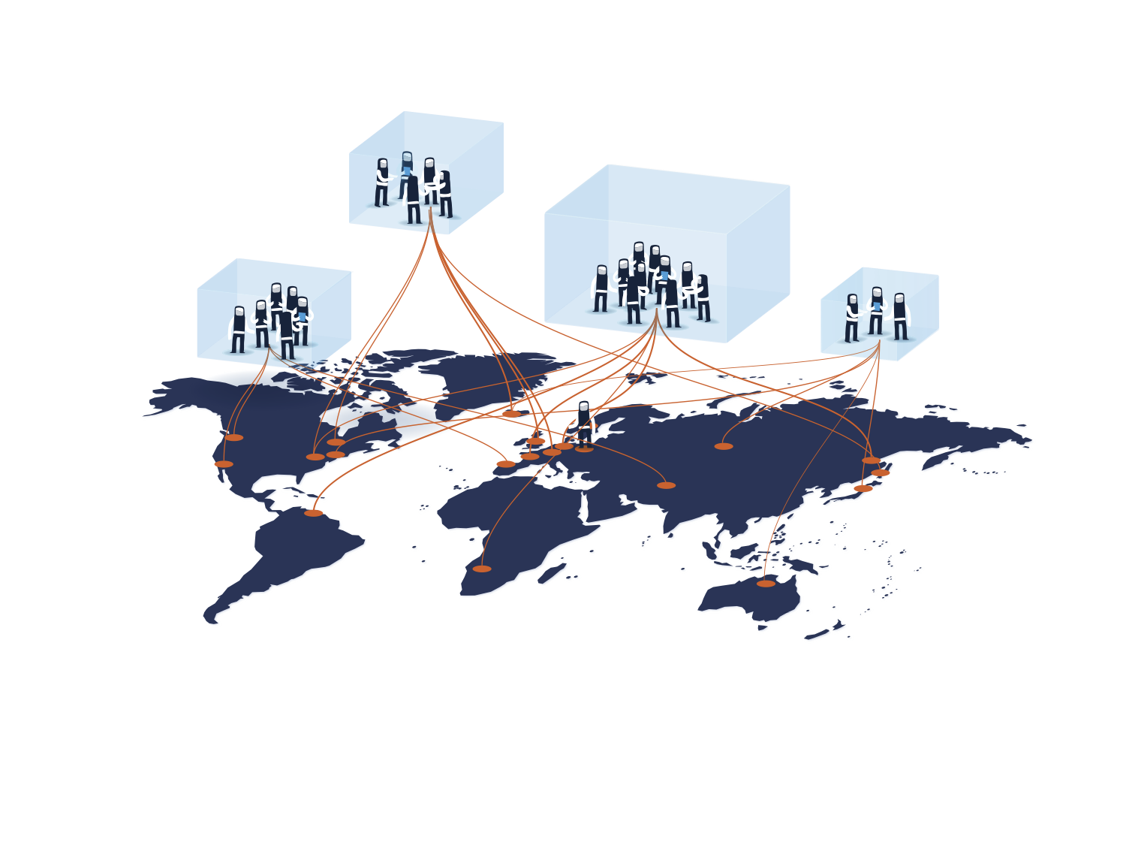
GÉANT Experience –
Where do we see progress?
Sharing knowledge of federation capabilities
Survey of Levels of Assurance
Federations looking to do more
Support of GÉANT Code of Conduct
Emerging ‘opt-out’ pilots for eduGAIN
REFEDs Federation Operator Best Practice
Research communities services appearing in national federations and eduGAIN
Knowledge gained with these pilots helps support other communities & plan service
  Ask us for help:
  edugain-integration@geant.net

Slide 19


The right way to deliver the wings and the rainbows
Preserve the core value of eduGAIN to NRENs, federations and their campus users
Be very aware of the supply chain
Listen carefully to the consistent demands of the user communities
Open up new approaches to the requirements
  GÉANT, serving more than eduGAIN?

Slide 20

Quiz Time

Slide 21
Quiz Time
How is GÉANT working on non-browser federated access?
Which of these requirements can eduGAIN most address:
  Security incident response
  Attributes that cross national borders
  User friendliness and ease of use
  Authorisation under community control
What communities are involved in FIM4R?
What are the two most important questions when talking to a new user group?

Slide 22
Quiz Time
Name a community interested in technology translation
Name a challenge hindering well defined and harmonised attributes
Name a mechanism for encouraging attribute release developed by GÉANT/REFEDS
Name a requirement NOT explicitly listed by FIM4R

Slide 23

Back at 16:00

Slide 24
Thank you!

