Slide 1
The 2014 GÉANT Timeline
Active - GN3plus
  2 years
  End 30/4/2015
Strategy - GN4 P2
  3 Years
  End 30/4/2019
Defined - GN4 P1
  1 Year
  End 30/4/2016
  Separate Dev & Ops
Notes:
Budget and DoW to be voted in Zagreb, December.

Slide 2
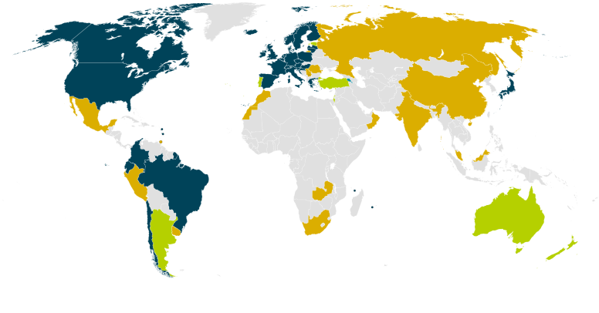

The eduGAIN context
Growth & Maturity
eduGAIN Members
Joining eduGAIN
Other federations
Notes:
Ref growth in entities, growth in federations
C30 federations, over 2000 entities (since november)

Slide 3
The eduGAIN family in GN4
Service Development (SA5)
eduGAIN
Federation as a Service
Enabling Users
Federation as a Service
VO Platform as a Service
Pilots
Consultancy
SP registration simplification
eduGAIN technical development, inc. portal
Federation development
InAcademia
Harmonisation
Entity Categories
CoCo
Federation Practices
Assurance Business Case
Interoperability
Non web
Moonshot
ECP
New Task
New Subtask/work area
Notes:
Note, new to be funded in GÉANT, not new per se

Slide 4
Who’s who?
Harmonisation
eduGAIN
Federation as a Service
Non Web
Enabling Users
GÉANT AAI
eduroam
VOPaaS & InAcademia
Nicole Harris, GÉANT Assoc.
Rhys Smith, JISC
Brook Schofield, GÉANT Assoc.
Marina Vermezovic, AMRES
Niels van Dijk, Surfnet
Lukas Hämmerle, SWITCH
Mandeep Saini, GÉANT Assoc.
Miroslav Milinovic, CARnet/SRCE

Slide 5
In depth – Assurance
REFEDS/GÉANT/AARC working together
AARC & Enabling Users
REFEDS
Harmonisation
eduGAIN
Requirements
Pre-existing design work
Profiles
Experiences
Pilot (P2)
Incorporate (P2, P3)
Develop business case (P1)
Specific
Anchored in real use cases
Costing
Supply chain
Training
Don’t reinvent wheels – do try to really use them
Notes:
Talk about this also as a general principle.
It makes sense to talk about some things in REFEDS.
eduGAIN internal stuff is less about being secret, and more about being specific (aka tedious).

