Slide 1
Building and Orchestrating your Service Continuum
Marco Iorio, Alessandro Olivero, Fulvio Risso, Politecnico di Torino (Italy)
Notes:
Per essere piu’ sul pezzo, potremmo dire Building and Orchestrating your Multi-Cluster Infrastructure
Building your Service Continuum with Liqo

Slide 2
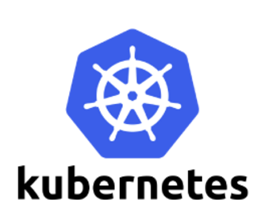
The emerging common denominator
De facto Standard
Kubernetes is becoming predominant in IT infrastructures
(86% interviewed report it)
Heterogeneous Infrastructure
64% clusters on premises
31% on multiple cloud vendors
10% on Edge (rapidly expanding)
Kube Sprawl
40% have more than 5 clusters,
10% more than 50 clusters
Sources: VMware State of Kubernetes Survey 2020, StackRox State of Container and Kubernetes Report 2020, CNCF Survey Report 2019

Slide 3
The cluster sprawl problem
Multiple departments spawn clusters within the same organization
01
Organizational structure
Many organizations rely on multiple infrastructure providers (e.g., Public Clouds)
Multiple Providers
02
Law regulations and/or performance issues may require cluster in diverse geographical locations
03
Geographical
Constraints
Kubernetes clusters cannot grow endlessly; scalability limitations arise around a few thousand nodes
Scalability
04
Complex cluster interconnection mechanims when a company offers services that have to be consumed by another company
05
Separation of concerns
Notes:
Separation of concerns (multiple admin entities)

Slide 4

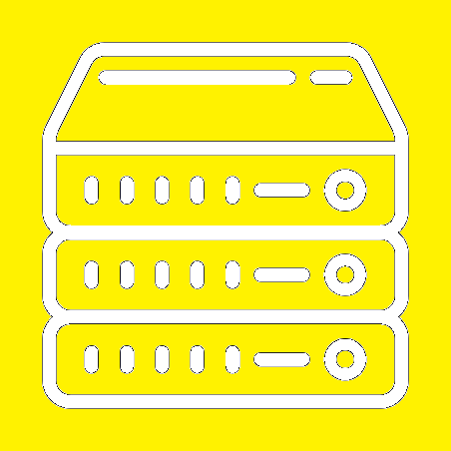
Cloud/Edge computing
Rigid siloes
Liqo
Borderless…
Liqo
…orchestration
A
A
B
A
A
A
A
B
C
D
E
C
C
D
E
D
B
C
A
B
A
B
C
A
B
A
B
C
B
C
D
B
C
D
E
C
D
B
C
D
E
Keep data in UK
One instance per country
Run D,E close to customers
liqo-super-cluster
Italy-north-dc
europe-uk-dc
Italy-north-dc
europe-uk-dc
italy-north-dc
europe-uk-dc
italy-milan-edge
italy-turin-edge
italy-milan-edge
italy-turin-edge
italy-milan-edge
italy-turin-edge

Slide 5

From Clusters to Virtual Clusters
8x
separate clusters
Virtual cluster #1
Virtual cluster #2
Virtual cluster #3
A cluster can join multiple Virtual Clusters

Slide 6
Possible use cases
Cluster A
(broker)
Cloud bursting
Cluster A
Cluster B
Advertise
Cloud/cluster migration
Virtual cluster
Service catalog
Aggregate and advertise
Private data spaces
Cluster C
Cluster B
Advertise
Multi-cluster orchestration (e.g., for cost optimization)
Cluster A
Virtual cluster
Cluster D
Cluster aggregation (e.g., at the edge)
Virtual cluster
Cluster B
Cluster C
Resource/service brokering

Slide 7
Why Liqo?
We offer
  Multicloud
  European
  No lock-in (hyperscalers)
  Open-source
  Open governance (CNCF incubation planned)
We ask
  Pilots
  Feedback
  Feature requests
  Directions
Need to provide a common ground for the upcoming
European Cloud Infrastructure

Slide 8

Borderless… but who owns what?
Controlled sharing is different from federation
Cluster 1 (master)
Cluster 2 (slave)
Cluster 1 (owner 1)
Cluster 2 (owner 2)
Federated cluster
Liqo virtual cluster
Notes:
https://pjimgallagher.files.wordpress.com/2015/12/img_2715.jpg?w=334&h=194

Slide 9

Basic workflow
Discover (cluster)
Advertise (resources&services)
Peer (and accept conditions)
Synchronize
Use (seamlessly)
De-peer

Slide 10


Liqo in a nutshell
Clusters
Controlled either by the same organization or by different entities
Either on-prem or on public cloud
Supported: Vanilla Kubernetes, K3s, OpenShift, Amazon, Google, Azure
Cluster #1
Cluster #2
Master controller
Resource reflection
Master controller
Clusters automatically sync relevant data (e.g., whether a service is running or is stopped) in order to provide a complete (virtual) view of the service state, while hiding the cluster state.
B
D
Service fabric
A
C
Each cluster has a complete view of the service, such as all components were running locally.
A
B
D
Network and storage fabric
C
Liqo provides automatic, seamless network connectivity and access to data storage, independently from the actual characteristics of the clusters (e.g., network addresses, location of the storage, etc.).

Slide 11
Liqo keywords
Dynamicity
Peer and unpeer in a matter of seconds
[Cluster] Virtualization
Create a unique virtual space across multiple clusters, as it were a single cluster, and do whatever you like in this virtual space
Ownership
Everyone keeps ownership of its resources

Slide 12
Pillar #1: Big Clusters with Big Nodes
“A “Big node” virtualizes the remote cluster, hence making the local cluster a “Big cluster”
“Big nodes” are equivalent to physical nodes w.r.t. the Kubernetes Control plane
  Can be controlled by the vanilla Kubernetes scheduler and controller-manager
Compatible with the Kubernetes deployment logic
Support for K8s and K3s
“Home” cluster
Node 1
(server)
(Big)
Node 2
(virtual)
(Big)
Node 3
(virtual)
peering
peering
“Foreign” cluster A
“Foreign” cluster B
Node 1
Node 2
Node 1
Node 2

Slide 13




Pillar #1: Big Clusters with Big Nodes
“A “Big node” virtualizes the remote cluster, hence making the local cluster a “Big cluster”
“Big nodes” are equivalent to physical nodes w.r.t. the Kubernetes Control plane
  Can be controlled by the vanilla Kubernetes scheduler and controller-manager
Compatible with the Kubernetes deployment logic
Support for K8s and K3s
“Home” cluster
Node 1
(server)
(Big)
Node 2
(virtual)
(Big)
Node 3
(virtual)
“Foreign” cluster A
“Foreign” cluster B
Node 1
Node 2
Node 1
Node 2

Slide 14
“Elastic Cluster” model
“Super Cluster” model
“Home” cluster
“Home” cluster
Node 1
Node 2
(Big)
Node 3
(Big)
Node 1
(Big)
Node 2
“Foreign” cluster A
“Foreign” cluster A
“Foreign” cluster B
Node 1
Node 2
Node 1
Node 2
Node 1
Node 2
Elastic K8s/K3s (with multi-cluster)
Resource sharing/offering
Multi-ownership
Kubernetes@scale
Aggregation of multiple (geographically dispersed) clusters

Slide 15

Multi-level scheduling
A two-level scheduler decreases the placement complexity
Can handle bigger “clusters” (or make more accurate scheduling decisions)
Possible extension to an N-level scheduler
“Home” cluster
Curios about scalability? Check out our talk at Cisco Scale X: https://youtu.be/W4b5B7CQ5mw
Node 1
Node 2
(Big)
Node 3
(Big)
Node 4
“Foreign” cluster B
“Foreign” cluster A
Node 1
Node 2
Node 3
Node 1
Node 2

Slide 16
Pillar #2: Operations Transparency
Kubernetes federation
Liqo
Single cluster
K1
deploy
inspect
K1
deploy
inspect
deploy-fed
inspect-fed
Kubefed
K1
deploy
inspect
K1
Liqo “big nodes” provide a “virtual twin” of remote clusters
Multi-cluster
BN2
BN3
K2
K3
K2
K3
API and commands change when moving from single to multi-cluster setup
API and commands are the same in either single and multi-cluster setup

Slide 17

Pillar #3: Resource Reflection (control plane)
Any resource exists in the “native” and “shadow” form (on the other cluster)
  Liqo transparently re-aligns their state
  Resources can be handled (created, inspected, modified, etc.) by interacting with the “home” cluster
A transparent data plane exist to enable seamless communication among cluster
Control plane reflection
Data plane communication
“Home” cluster
“Foreign” cluster

Slide 18
Pillar #4: Network Fabric (data plane)
Cross-cluster network fabric, with uniform network connectivity
  Pod-to-pod, pod-to-service, etc., independently from the location of src and dst
Liqo provides
  Special-purpose network overlay to a Liqo Gateway (possibly replicated) in each cluster
  Gateways directly (and securely) connected
Network params (e.g., local/remote IP addresses for pods and services) are dynamically negotiated
  Transparent (double) NAT is established if needed
Does not depend on the underlying CNI
Liqo GW+NAT
From P1* to P2*
Liqo GW+NAT
Node
Node
From P1* to P2*
From P1 to P2
Big
node
K8s CNI network
Router LoadB
Internet
Router LoadB
K8s CNI network
Node
Node
Node
From P1 to S1

Slide 19
Pillar #5: Decentralized peering model
Peering: policy-driven, voluntary and direct relationship of administratively separate clusters for the purpose of exchanging resources and services
Decentralized governance: no “master” cluster
“Offering” clusters keep the control over the resources they share
Support for different business models (e.g., brokering, reselling resources, etc.)
Direct peering
K2
BN2
K1
BN3
K3
Brokering
K6
K4
BN5
K5
K7
Big node virtualing resources on K6/K7
Brokering service

Slide 20
Pillar #6: Automatic cluster discovery
Which are the available clusters?
  Liqo can dynamically add new clusters to the “Big Cluster” abstraction
Two methods available
  Automatic cluster discovery on local area networks (mDNS)
  Manual configuration
    E.g., for testing or not-yet-configured domains
Is there a cluster available?_
Internet
DNS
Yes, here there is
K4
K5
K1
K2
K3
K2 is here!
Notes:
Fulvio: può essere tranquillamente omesso; o messo in fondo. Non mi sembra venga percepito come importante.
Metterei come primo pillar il concetto di “big node”.

Slide 21


Slide 22
Technical roadmap and vision
Simplify
Virtualize
Applications
Cloud computing requires huge skills.
Automate, simplify, through network, storage and service fabric.
Do not care about infrastructure details, e.g., how many clusters you have, where they are, who operates them, who is the owner of the applications in it.
Just offer a unique, virtual service continuum.
Connecting infrastructures is needed, but the value is limited.
We aim at connecting people and services, simplifying the life to who delivers, operates, and consumes applications.

Slide 23
Possible business models
PRIVATE/PUBLIC/HYBRID/EDGE
MULTI-CLUSTER ENABLER
SERVICE COMPOSITION
ENABLER
SMALL-MEDIUM CLOUD PROVIDERS AGGREGATOR
Medium to large companies can use Liqo to manage their multi-cluster container strategy.
Cloud services buyers can use Liqo to compose a multi-vendor service taking resources from different providers (small to large).
On the way to a European Cloud, opposing to foreign “giants” monopolies, Liqo can aggregate multiple small-medium vendors to offer an aggregated service.

Slide 24
Liqo status
Community
  733 stars on GitHub
  200 users on the Slack channel
Core team
  Alessandro Olivero: senior computer engineer
  Marco Iorio: senior (PhD) computer engineer
  Francesco Cheinasso: junior computer engineer
  Fulvio Risso: professor, part-time
Extended team
  Francesco D’Anzi, Filippo Projetto, Alessandro Colli Vignarelli, Francesco Torta: MSc students @POLITO
  Alessandro Cannarella, Luca Rocco: TOPIX
  Alessandro Lucani: ENGINEERING
Contribution rules
  “You made it, you own it”
  New features require automatic integrated testing
  Uniform code style through automatic linting
  Independent code review

Slide 25
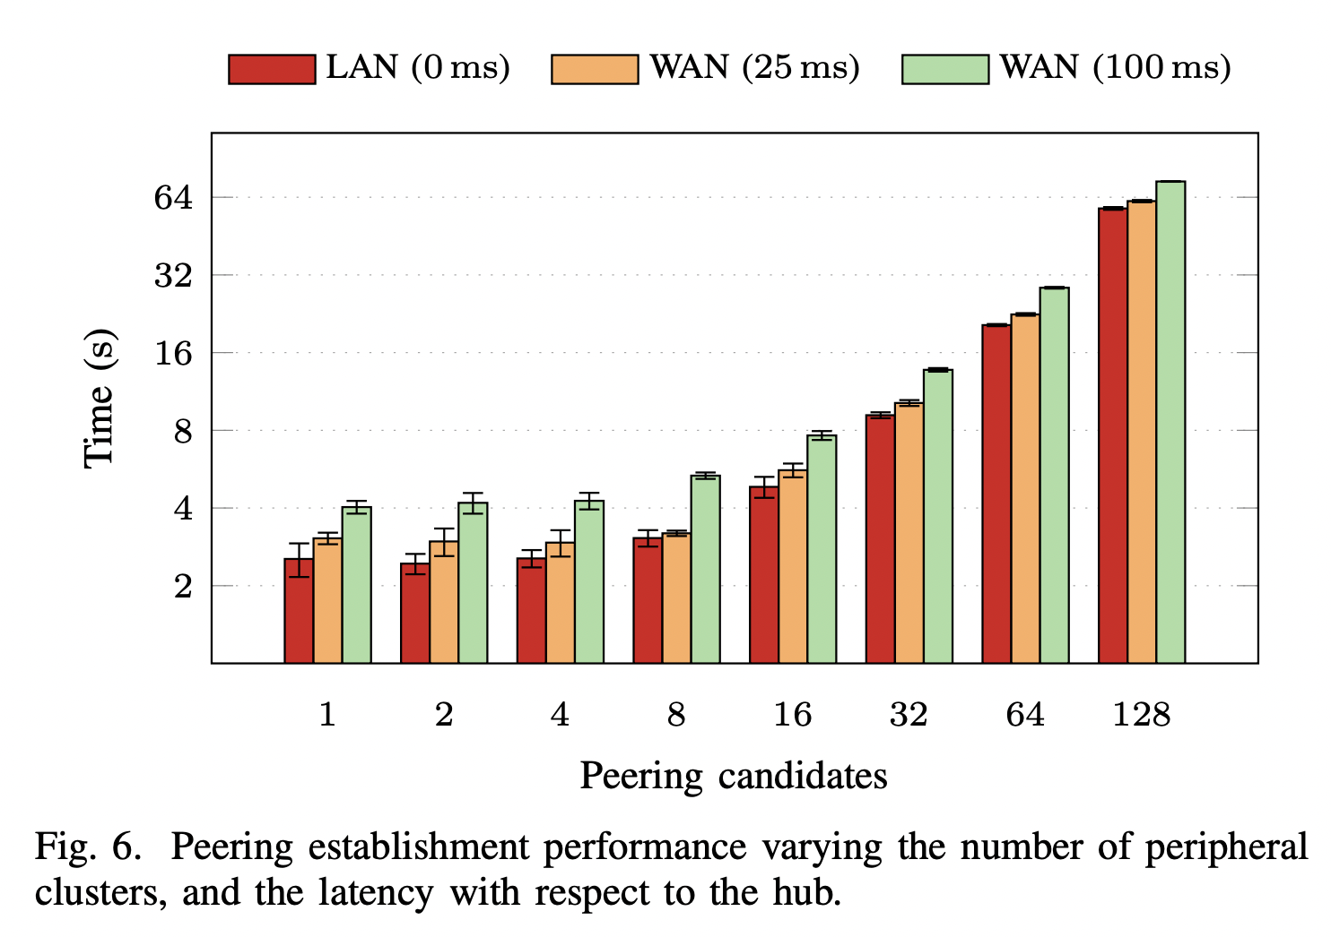
Experimental validation – 1

Slide 26
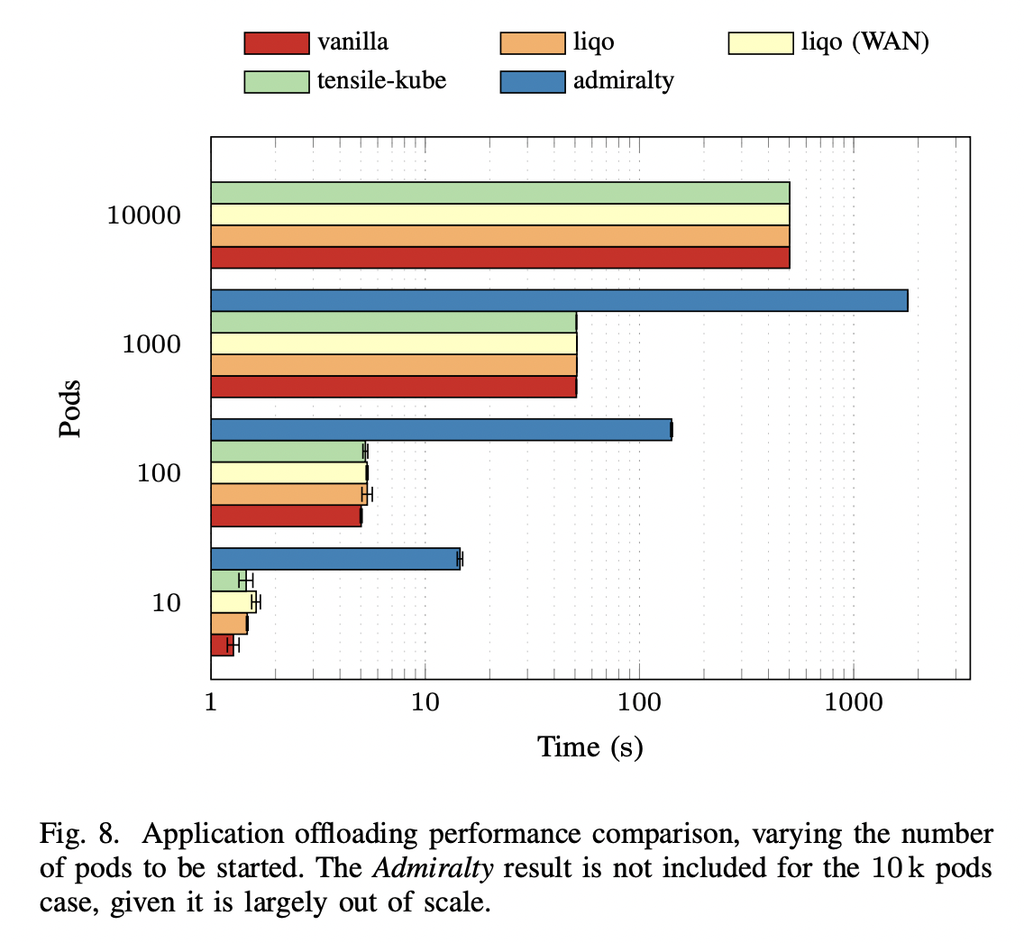
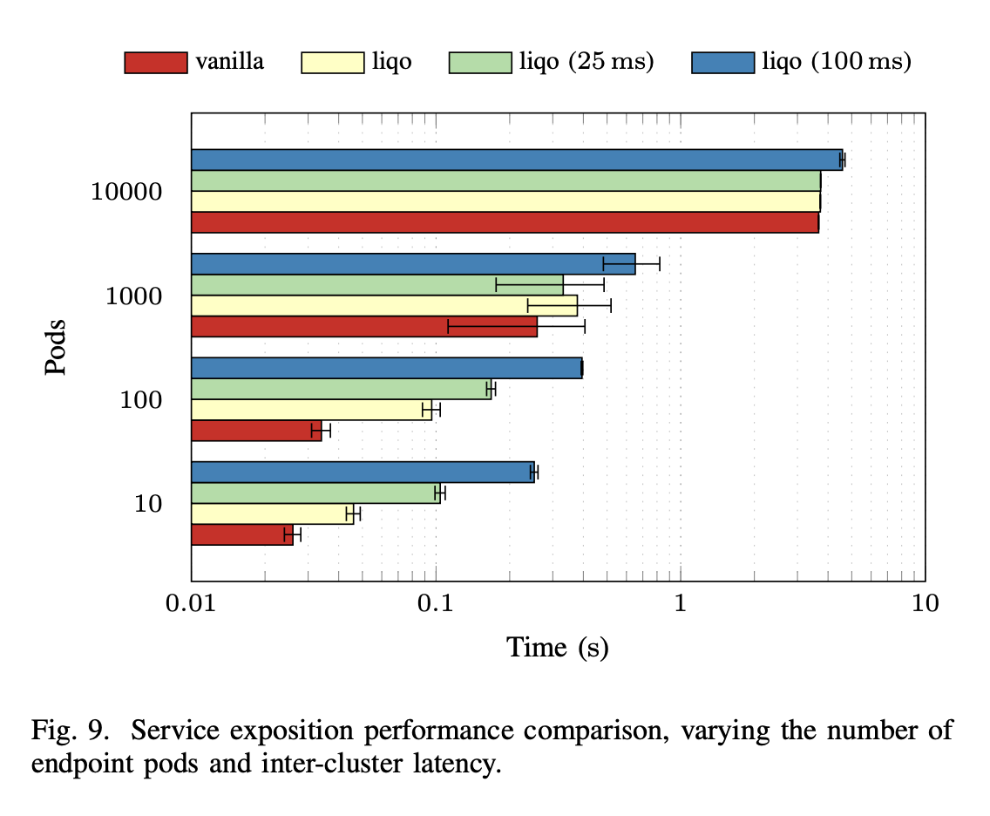
Experimental validation - 2

Slide 27
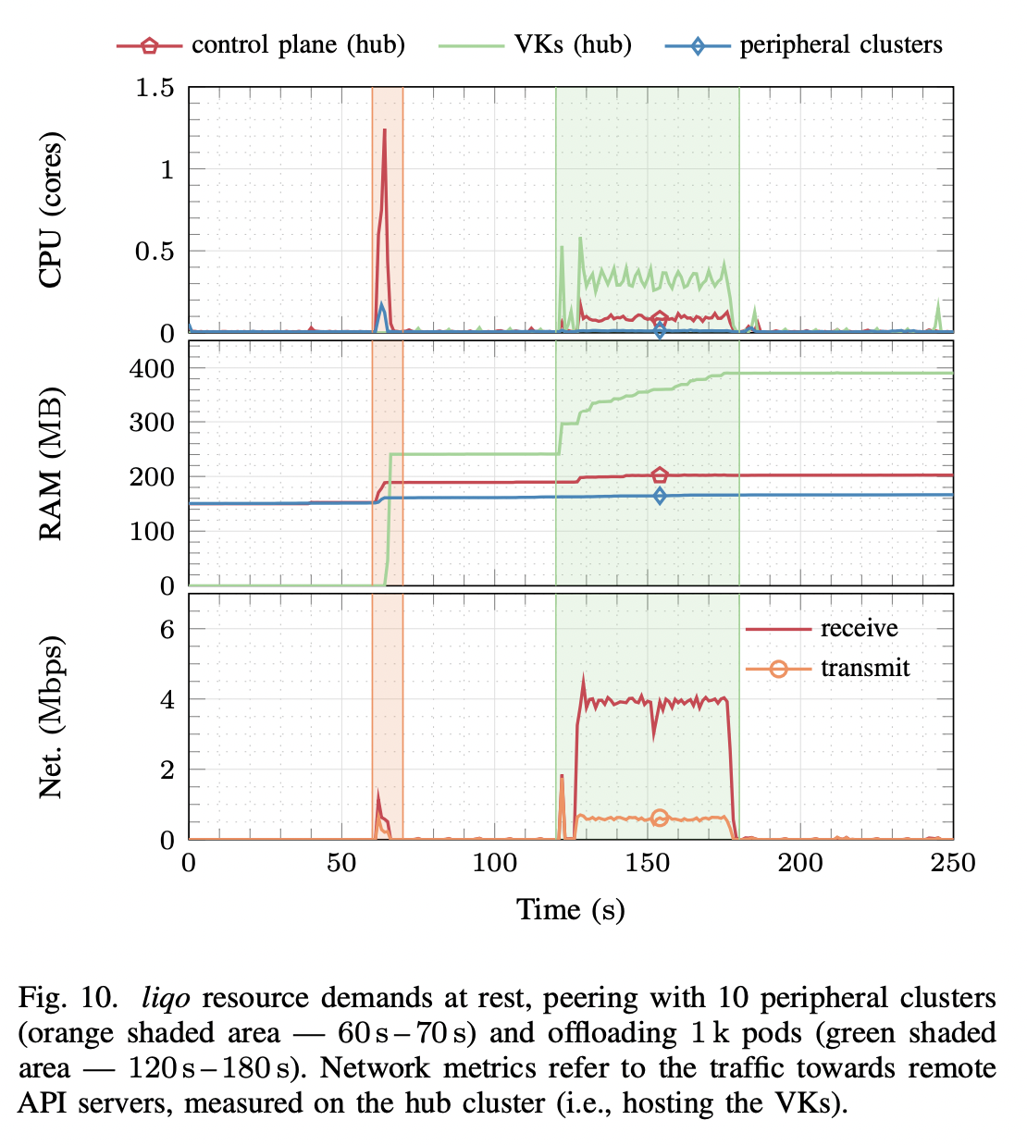
Experimental validation - 3

Slide 28
Features
Available
  Dynamic discovery and peering between clusters (including authentication, dynamic parameter negotiation, e.g., IP address spaces)
  Transparent and resilient (e.g., tolerate connectivity losses) pod offloading among clusters
  Secure network overlay (inter-cluster)
  Support for different types of clusters: On-premise (vanilla K8s and K3s), OpenShift, Google GKE, Azure AKS, Amazon EKS
  Deployment policies (taints and toleration)
  Support for deployments spanning over an arbitrary number of clusters
Missing
  Remote automatic cluster authentication on LAN (e.g., through shared secret)
  Direct network connectivity between any cluster (currently only hub-and-spoke support)
  Intra-cluster secure network overlay
  Support for virtual cluster-wide network policies
  No support for deep edge technologies (e.g., KubeEdge, …)
  Multi-Level deployment policies
  Scheduling algorithm
  Multi-Level Liqo peering (resource aggregation)
  Granular resource advertisement and negotiation
  Support for brokering scenarios
  …

Slide 29
Next steps (v0.6 and beyond)
v0.6 (current release)
  Extend the support to offload applications that need to contact the local API Server (e.g. operators and some DB applications)
  Improve the observability and the robustness of the network fabric
  Provide the possibility to better schedule and orchestrate workloads using policies.
Future
  Direct Connectivity between Clusters (“brokering” scenario)
  Reflection of Custom Resources
  Support for sharing applications in addition to resources
  Custom scheduling algorithm
  Different types of inter-cluster connectivity
  CNCF sandbox project

Slide 30
Additional resources
Website: https://liqo.io
Documentation: https://docs.liqo.io
GitHub: https://github.com/liqotech/liqo
Draft paper: https://arxiv.org/pdf/2204.05710.pdf
Slack: https://join.slack.com/t/liqo-io/shared_invite/zt-h20212gg-g24YvN6MKiD9bacFeqZttQ
Public Dashboard: https://liqo-dashboard.crownlabs.polito.it/

Slide 31
Thanks!

