Slide 1
Cloud = change = choice
SIG-CISS, michel.wets@surf.nl

Slide 2
Agenda
Introduction
Clouds within SURF
To CMP or not to CMP
Orchestration challenges
Governance

Slide 3
Sourcing strategies
Have datasets and applications on premise
Look at SURF for community clouds
Use the elasticity and wide set of functions within Public Clouds

Slide 4
SURF Cloud approach
  Lower barriers for consumption
    Tender
    Transparency on privacy and security
    Dedicated cloud teams supporting R&E
    Broad range of 5 US and 8 European suppliers
  Recognize that requirements vary
    Central IT -> Wholesale -> SURFcumulus
    Researchers -> VRE / SaaS -> SURF Research Cloud

Slide 5
SURFcumulus

Slide 6
SURFcumulus

Slide 7
SURFcumulus

Slide 8
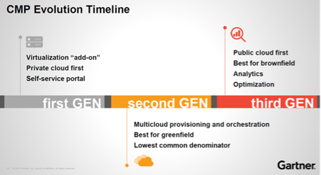
Cloud Management Platforms
Notes:
The sweet spot for the CMP is delivering a single pane of glass and self-service across multiple clouds; organizations with a multi-cloud strategy can therefore derive the most value from it. In practice, we see that there are actually no groups at institutions that really use multiple cloud platforms. Of course there are faculties, research and product groups that use other clouds, but individually those groups appear to work with a single platform. We also see that the platform's own portals (for example that of Microsoft Azure) are becoming increasingly mature and are developing functionalities (cost control, approval processes) that erode the added value of the CMP.

Slide 9
Orchestration challenges
Provisioning CMPs offer Limited feature set
Which lags behind the release of new features
Native Hyperscaler portals improve rapidly

Slide 10
Why Multi-Cloud management
Governance
  Which cloud fits which requirements best
  Roles (who can do what)
  Cost control / forecasts / spend analyses
  Security
Training & Certification
Notes:
Understand that true multi cloud is expensive
Requires additional staff, training, certification

Slide 11

Cost control options
Notes:
Suppliers like CloudHealth and Cloudcheckr
Excel in reporting, tagging, show back/charge back costs per research group or faculty
You’d want these over all clouds used, but is it essential and are you willing to pay for it?
Often charge a percentage of your total cloud spend
Native supplier portals lag but are catching up

Slide 12
SURF approach
CMP only for research SaaS
Native supplier portals for general use
Keep eye on future needs

Slide 13
Cloud = Change: evolve!
Azure Sentinel SOC/SIEM PoC
HPC scale out PoC
Saving Plans comparison Azure/AWS/GCP
Encryption capabilities comparison Azure/AWS/GCP

Slide 14

Questions?

