Slide 1
CERN’s journey towards HPC
Melissa Gaillard and Maria Girone (Presented by Tim Smith)
21st February 2023

Slide 2
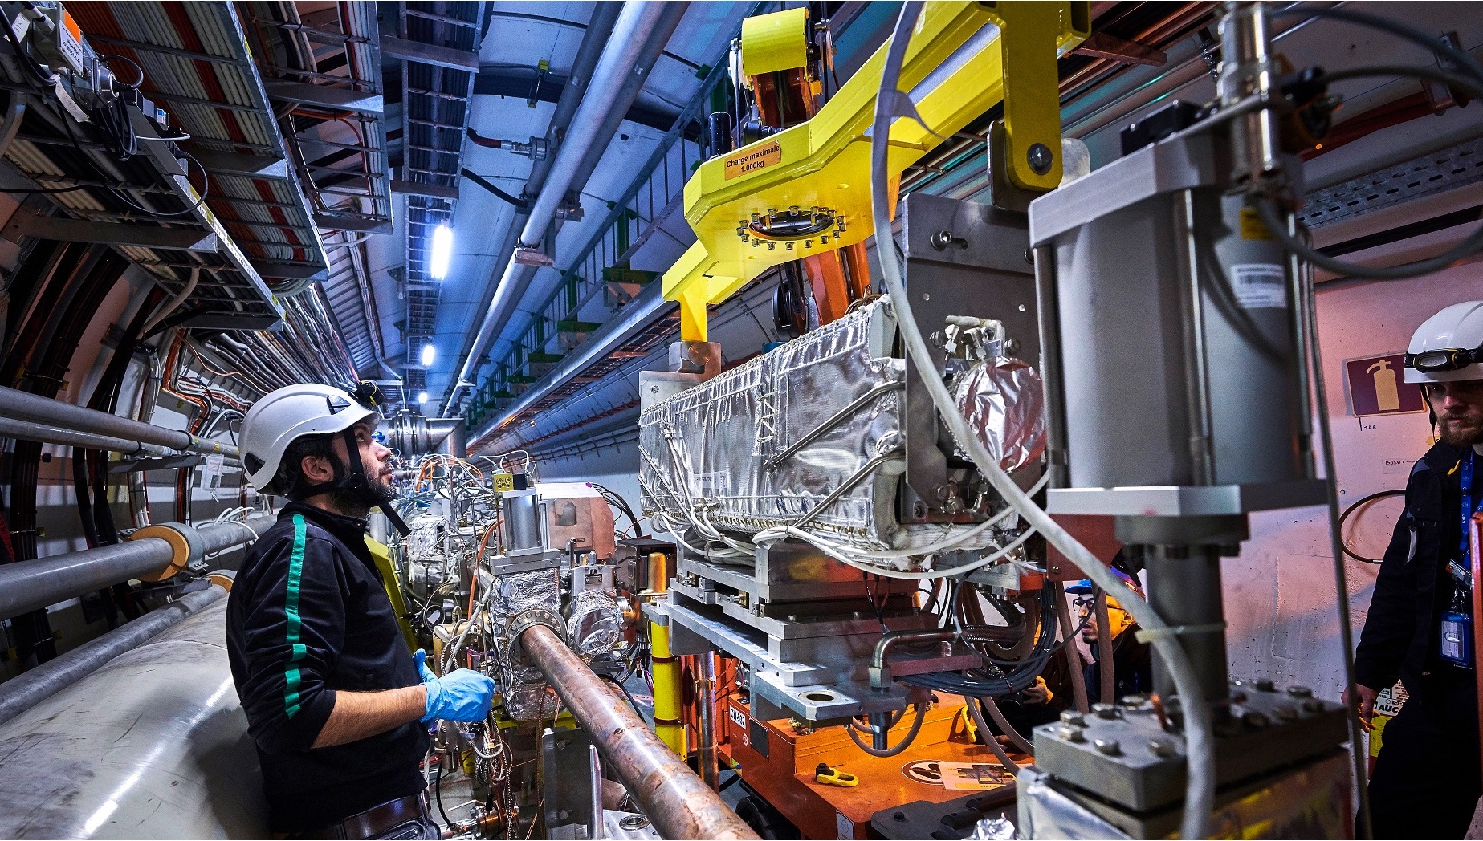
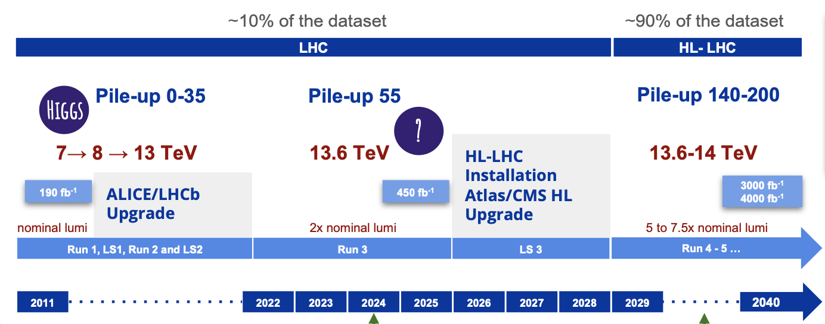

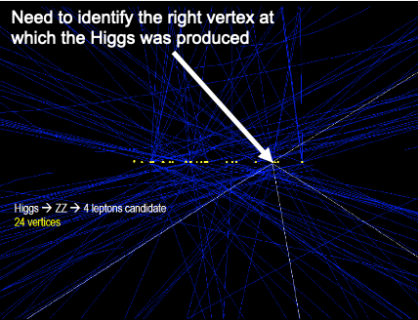
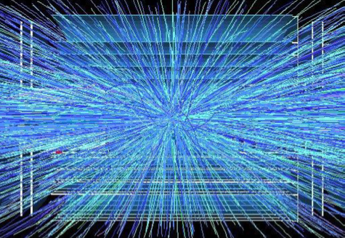

The HL-LHC will use new technologies to provide
10 times more collisions than the LHC
It will provide greater precision and discovery potential
It will start operating in 2029 and run until 2040
Run2 – Average 40 collisions per crossing
High-Luminosity LHC upgrade started
Run4 – Average 200 collisions per crossing
Notes:
As large scale as the current LHC program is, it has been designed to allow the luminosity to be upgraded.
By 2029, the high-luminosity LHC will deliver about 10 times more collisions at increased complexity, with a pile-up that will go from 40 superimposing events of Run2 to 200. The difference between the two scenarios is visible here and the complexity of the events to disentangle will be unprecedented.
The increase in luminosity is so large that the entire program up to 2029 will only be 10% of the total data collected.

Slide 3
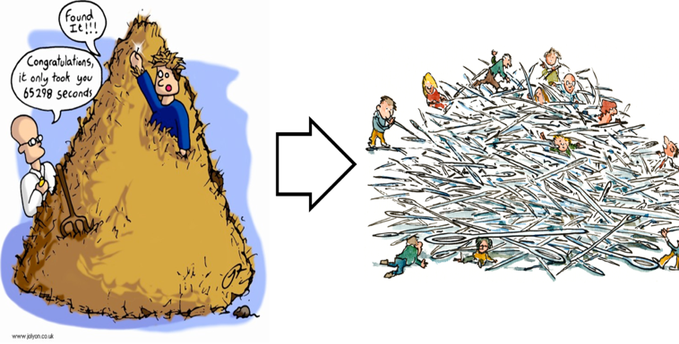
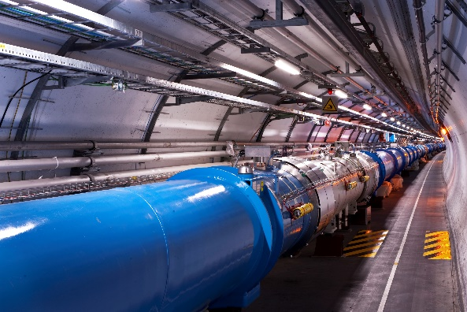

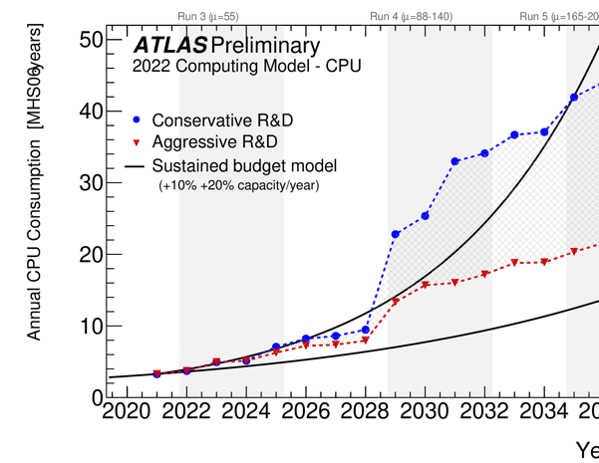
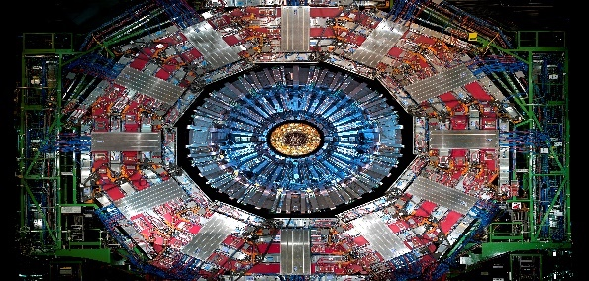
Upgraded Accelerator
Higher Luminosity
Changing Filtering
Paradigms
Higher Data Rates
Higher Sensitivity
R&D Investments
Code modernization, HPC and hardware accelerators
Reducing storage needs
New techniques, from AI to QC
Upgraded Detectors
Higher Granularity
Higher Occupancy
New Computing Challenges
HL-LHC upgraded program = new challenges
Notes:
The full exploitation of the HL-LHC entitles several challenges
For the accelerator with much higher luminosity;
For the upgraded detectors, with higher granularity for higher occupancy
The experiments will increase their acceptance rates by changing their filtering paradigms.
The planned upgrades will greatly increase the scientific reach and will help physicists to observe rare processes and study them with greater precision. In a way, it is like moving from looking for a needle in a haystack to producing haystack of needles. This will impose challenges in computing and storage and necessitates an investment in R&D to modernize the code, use new resources like HPC and hardware accelerators and use new techniques and disruptive techniques from AI to Quantum Technologies.

Slide 4

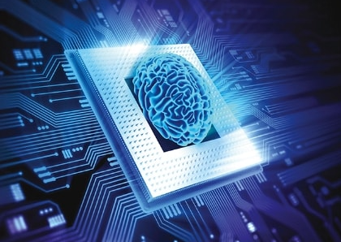
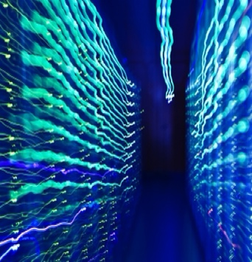
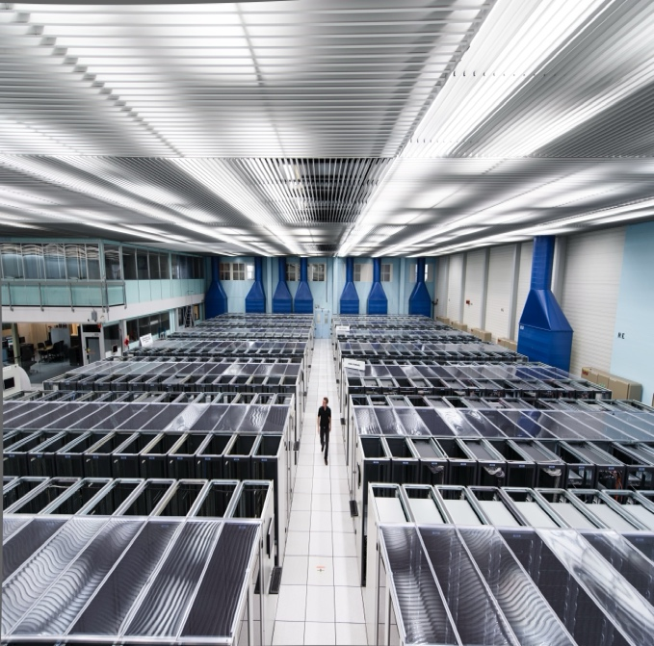
Adopting AI/ML techniques (already optimized for accelerated co-processors):
Engagement with HPC Community as a catalyst for progress
Evolving to heterogeneous architectures
(software performance, portability libraries,..):
Unified programming models facilitate HPC adoption
HPC
Expanding resources for data intensive sciences (faster technology improvements of alternative architectures):
HPC Supercomputers will grow by a factor of 10 on the time scale of the HL-LHC
HPC: intersection of several important R&D areas
Notes:
And discuss the ongoing R&Ds in AI/ML, using heterogeneous architectures and expanding resources. HPC is the catalyst that drives development in all of them.

Slide 5

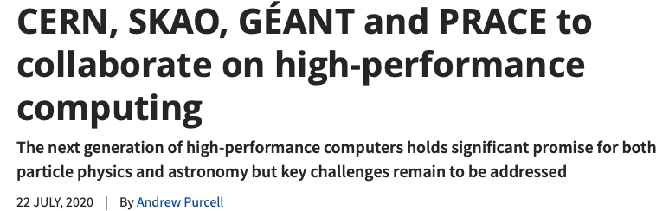
An HPC Collaboration agreement was signed by CERN, SKAO, GÉANT and PRACE, CERN and SKA on 22.07.2020
  Engages at the community level
    Bringing together data intensive sciences, high-performance computing infrastructures and networking
Collaboration built around 4 pillars
    Building a common centre with expertise to support heterogenous hardware
    Benchmarking Demonstrator
    Data Access Demonstrator
    Authentication and Authorization Demonstrator
Importance of communication for new collaboration
An Exascale project for an Exascale problem
https://home.cern/news/news/computing/cern-skao-geant-and-prace-collaborate-high-performance-computing
Working together: the HPC collaboration
Maria Girone
CERN openlab CTO

Slide 6
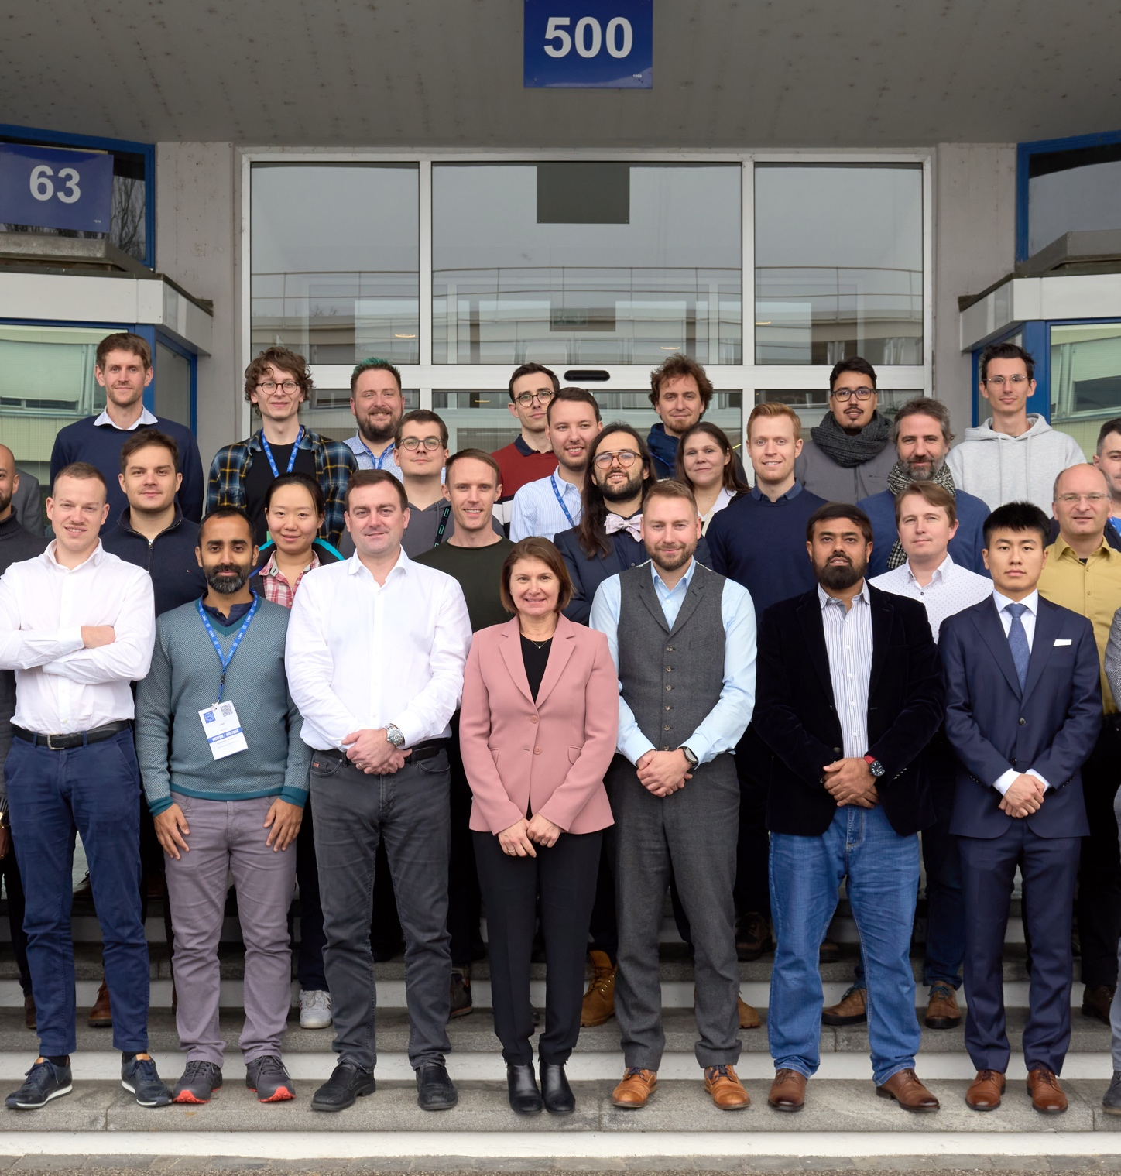
CoE RAISE All-Hands Meeting 2023 at CERN
    CoE RAISE
      EC-funded project under Horizon 2020.
      Developing AI approaches for exascale supercomputers.
        For use across both science and industry.
        Use cases include optimisation of wind-farm layouts, design of efficient aircraft, improved sound engineering, seismic imaging with remote sensing…
        CERN also provides a use case.
    Event held at CERN from 17 to 20 January.
      54 project members attended meeting.
    Communications about event published on multiple channels:
      RAISE website
      CERN openlab website
      Main CERN website
      CERN Bulletin (community newsletter)
      Multiple social media channels.
Notes:
High-level description of the CERN use case:
This work focuses on the improvement of methods for reconstructing particle-collision events at the upgraded High-Luminosity Large Hadron Collider (HL-LHC), which is set to come online in 2029. The HL-LHC will see more particle collisions than ever taking place, producing exabytes of data each year, resulting in unprecedented computing challenges. To reconstruct particle collision events today (with data sets in the order of terabytes or petabytes), hundreds of different algorithms run concurrently: some are traditional algorithms optimised for particular hardware configurations, while others already include AI-driven methods, such as deep neural networks (DNNs). The members of the project team at CERN are working to increase the modularity of systems and ensure that code is optimised to fully exploit heterogeneous architectures, as well as increasing the use of machine learning and other AI methods for reconstruction of collisions and classification of particles.

Slide 7

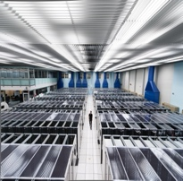
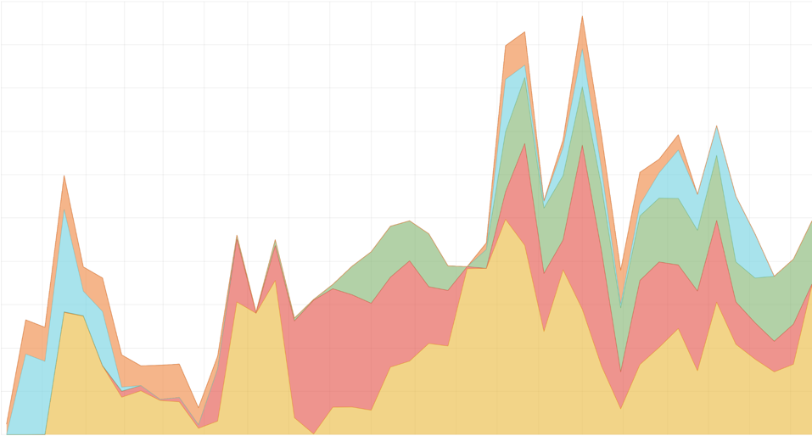
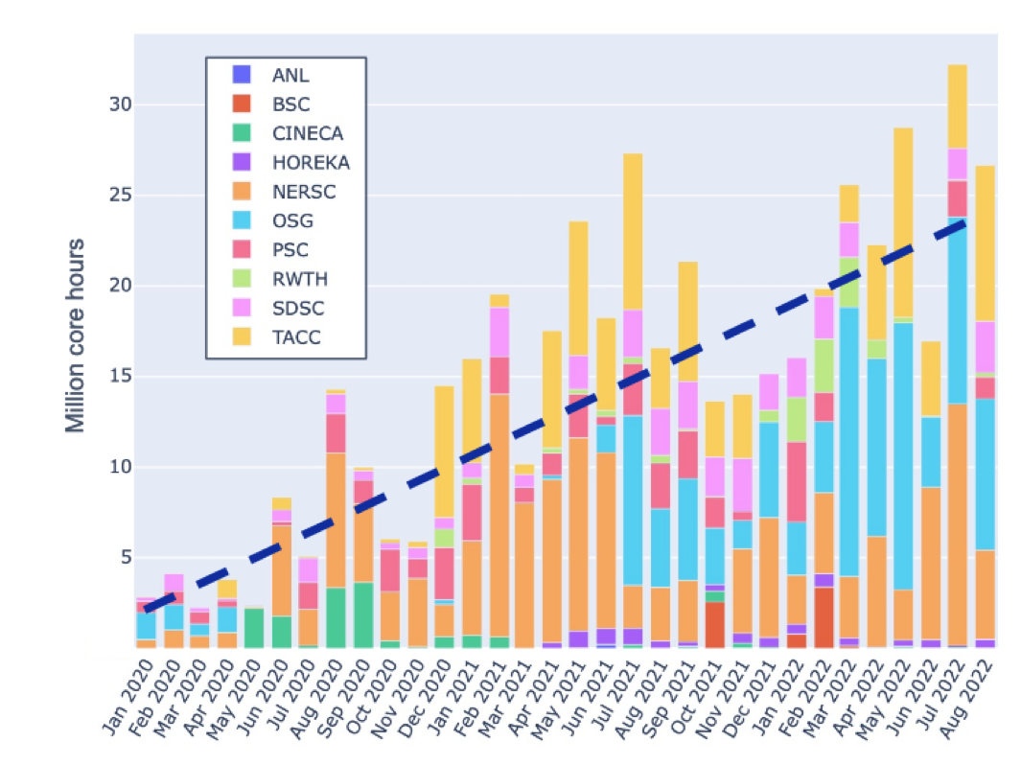

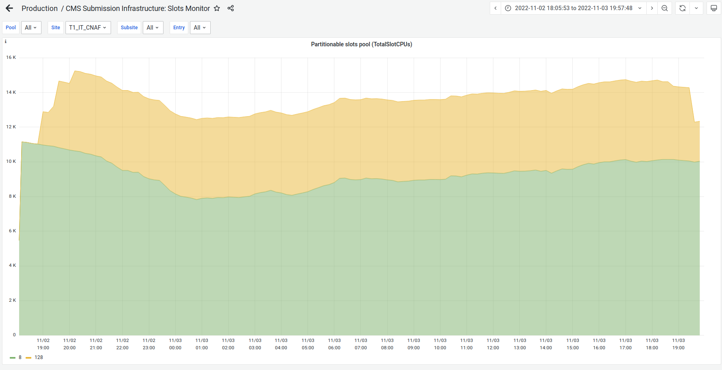
HPC sites are important for data intensive science
HPCs based on CPUs have been used by all LHC experiments (examples from CMS)
- Continuous work to commission HPC sites
Number of Cores used at US HPCs by CMS in 2022
40k
30k
20k
Anvil
10k
TACC
PSC
SDSC
NERSC
Jan
Apr
Jul
Oct
# Running Cores @ T1_IT_CNAF
[source Monit]
PowerPC @ M100
x86_64 @T1_IT_CNAF
Expanding Resources into HPCs
Courtesy O. Gutsche, D. Hufnagel, D. Spiga, C. Wissing
Notes:
This slide shows some examples of using CPU resources at HPC sites. The upper right is the number of cores used on US HPC sites in 2022, where you can see the peaks exceed 50k cores. The lower right is the number of millions of CPU core hours delivered per month and there is a nice increase over the 2.5 year period. The lower left shows the usage of PowerPC CPUs on the Marconi100 HPC by CMS. The production workflow has been validated for the Power architecture.

Slide 8
Challenges/Opportunities in HPC Integration
Computing
  Use of heterogeneous architectures is both a challenge and an opportunity
  Challenge: reengineer large/complicated codebases for high performance and evolving hardware
  Opportunity is to expand the pool of resources
    to benefit from the faster technology improvements of the alternative architectures
    to benefit from new techniques like AI and ML which are already optimized for accelerated co-processors
Data Management, Data-Aware Networking and Storage
  Convergence of HPC and HTC requires development in the scale of data management, data-aware networking and workflow management
  HEP community developed a set of effective tools for large data organization, management, access and networking
  Work is also needed in organised data movement, real-time data delivery, integration of the network in the software stack and scalable storage

