Slide 1
Mapping NRENs' contributions to UN SDGs:
An initiative by AfricaConnect3
Harold Bowa
SIG-Marcomms, 21 February 2023
Kajaani, Finland

Slide 2
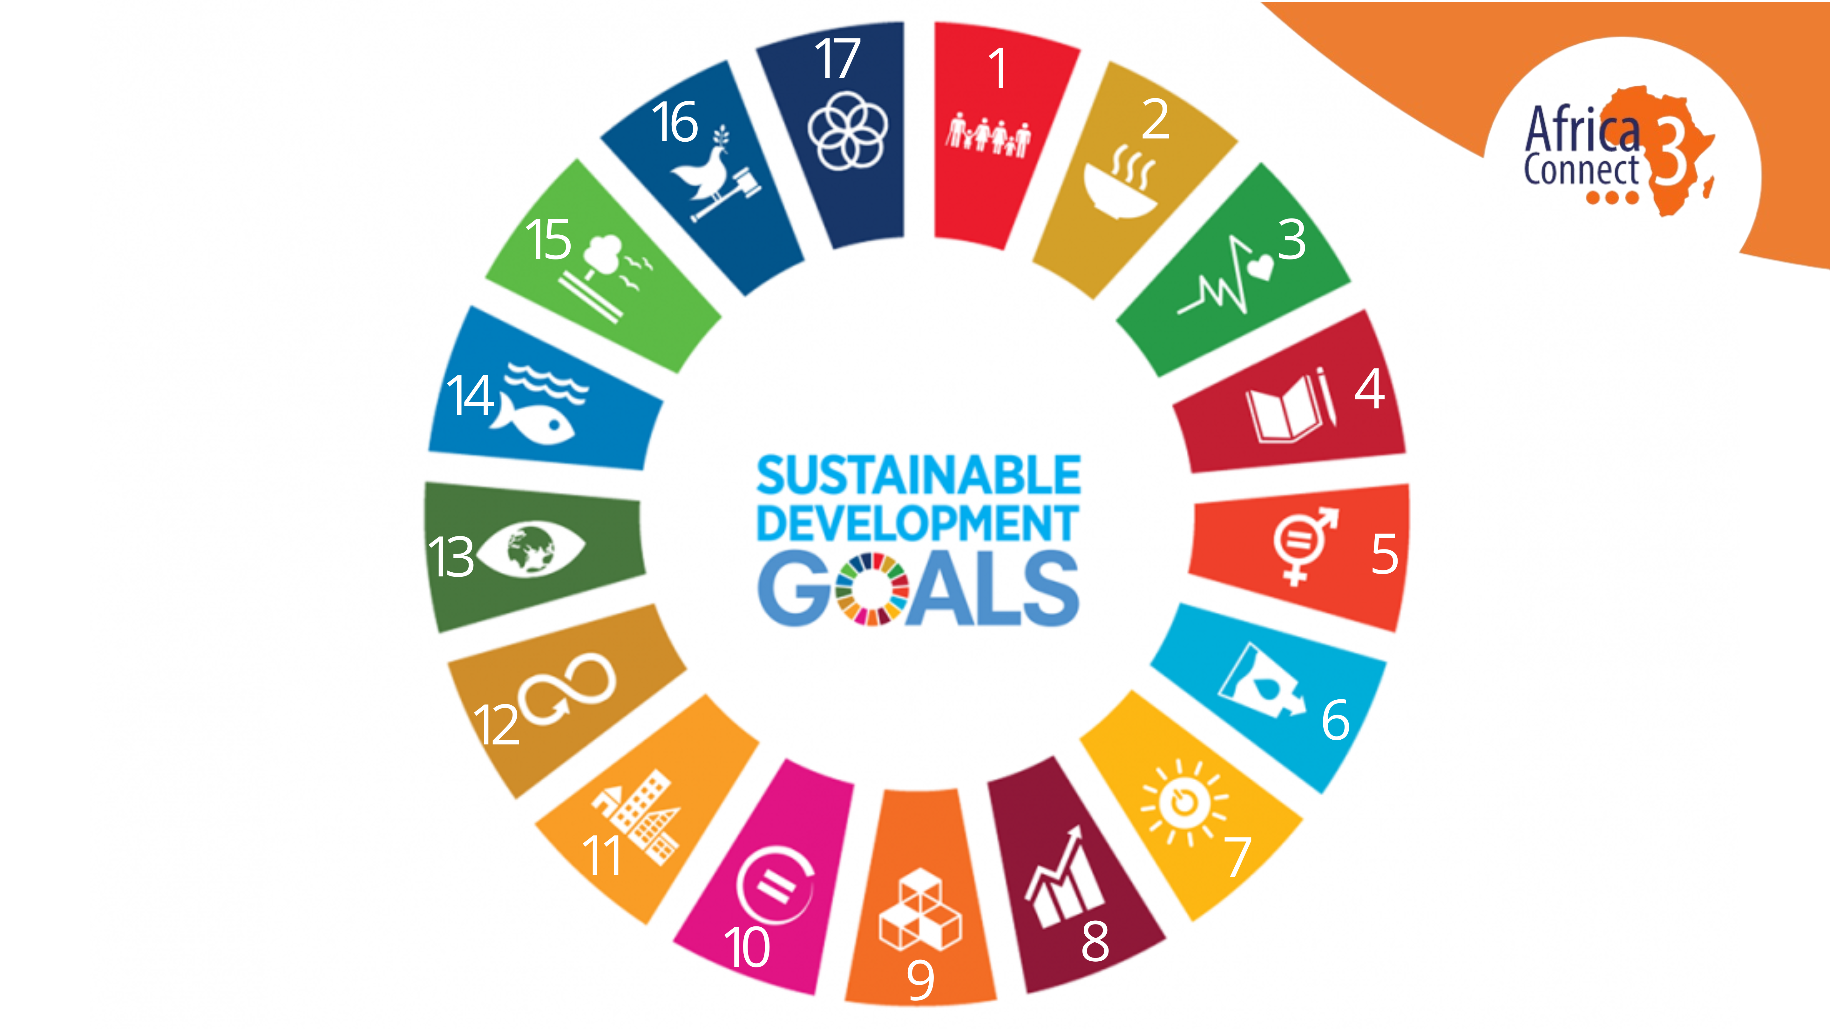
africaconnect3.org
africaconnect3.net

Slide 3
Why do SDGs matter?
africaconnect3.net

Slide 4



Attract policy and decision-makers
Attract funding from local and global organisations
Align projects and activities with stakeholders’ needs
Attract and nurture partnerships
africaconnect3.net

Slide 5
A direct service provision, i.e. affordable, reliable and high-speed internet connectivity and services to education institutions, which in turns increasing accessibility to education (SDG 4); resilient and sustainable infrastructure that foster technology development (SDG 9).
Direct contribution
Indirect contribution
What is enabled by the NREN’s infrastructure, i.e. support to vital research in the fields of food and environmental sustainability (SDG 2), and water management (SDG 6); shape public policies (SDG 8).
africaconnect3.org
africaconnect3.net

Slide 6
The AC3 initiative
ONLINE WEBINAR
F2F WORKSHOP
1
2
3
4
5
BRAINSTORMING
SURVEY
PUBLICATIONS

Slide 7
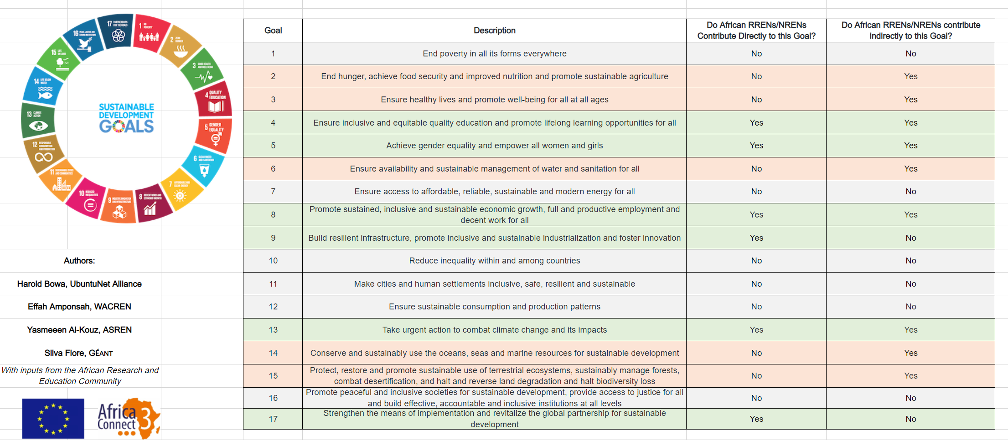
First output is out!

Slide 8
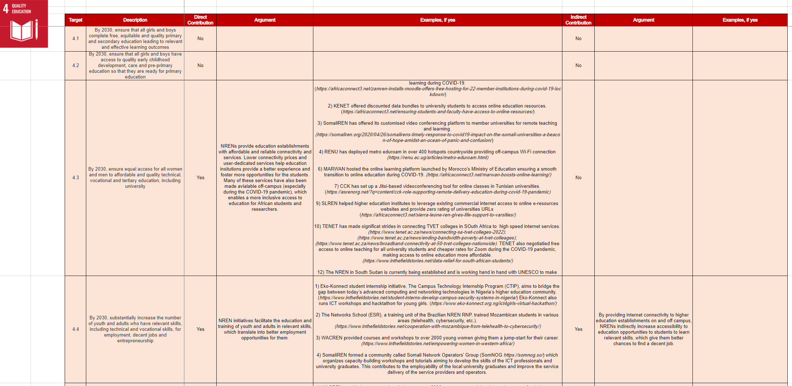

Slide 9

Share your story!
Promote your NREN’s activities through the lenses of the UN SDGs
africaconnect3.net
9

Slide 10



Thank you
Any questions?
@AC3_News
AfricaConnect3
africaconnect3.net

