Slide 1
GRNET MarComms on all HPC related projects
Artemis Psarianou, Head of Marketing and Communications – GRNET
Thomas Kakavas, Marketing and Communications Coordinator - GRNET

Slide 2

^{MISSION}
National Infrastructures for Research and Technology - GRNET’s mission is to offer an integrated environment of cutting-edge technologies, model digital solutions, infrastructures and specialized expertise which contributes to the modernization and digital advancement of the overall citizen experience in the fields of Public Administration, Education, Research, Health and Culture.

Slide 3
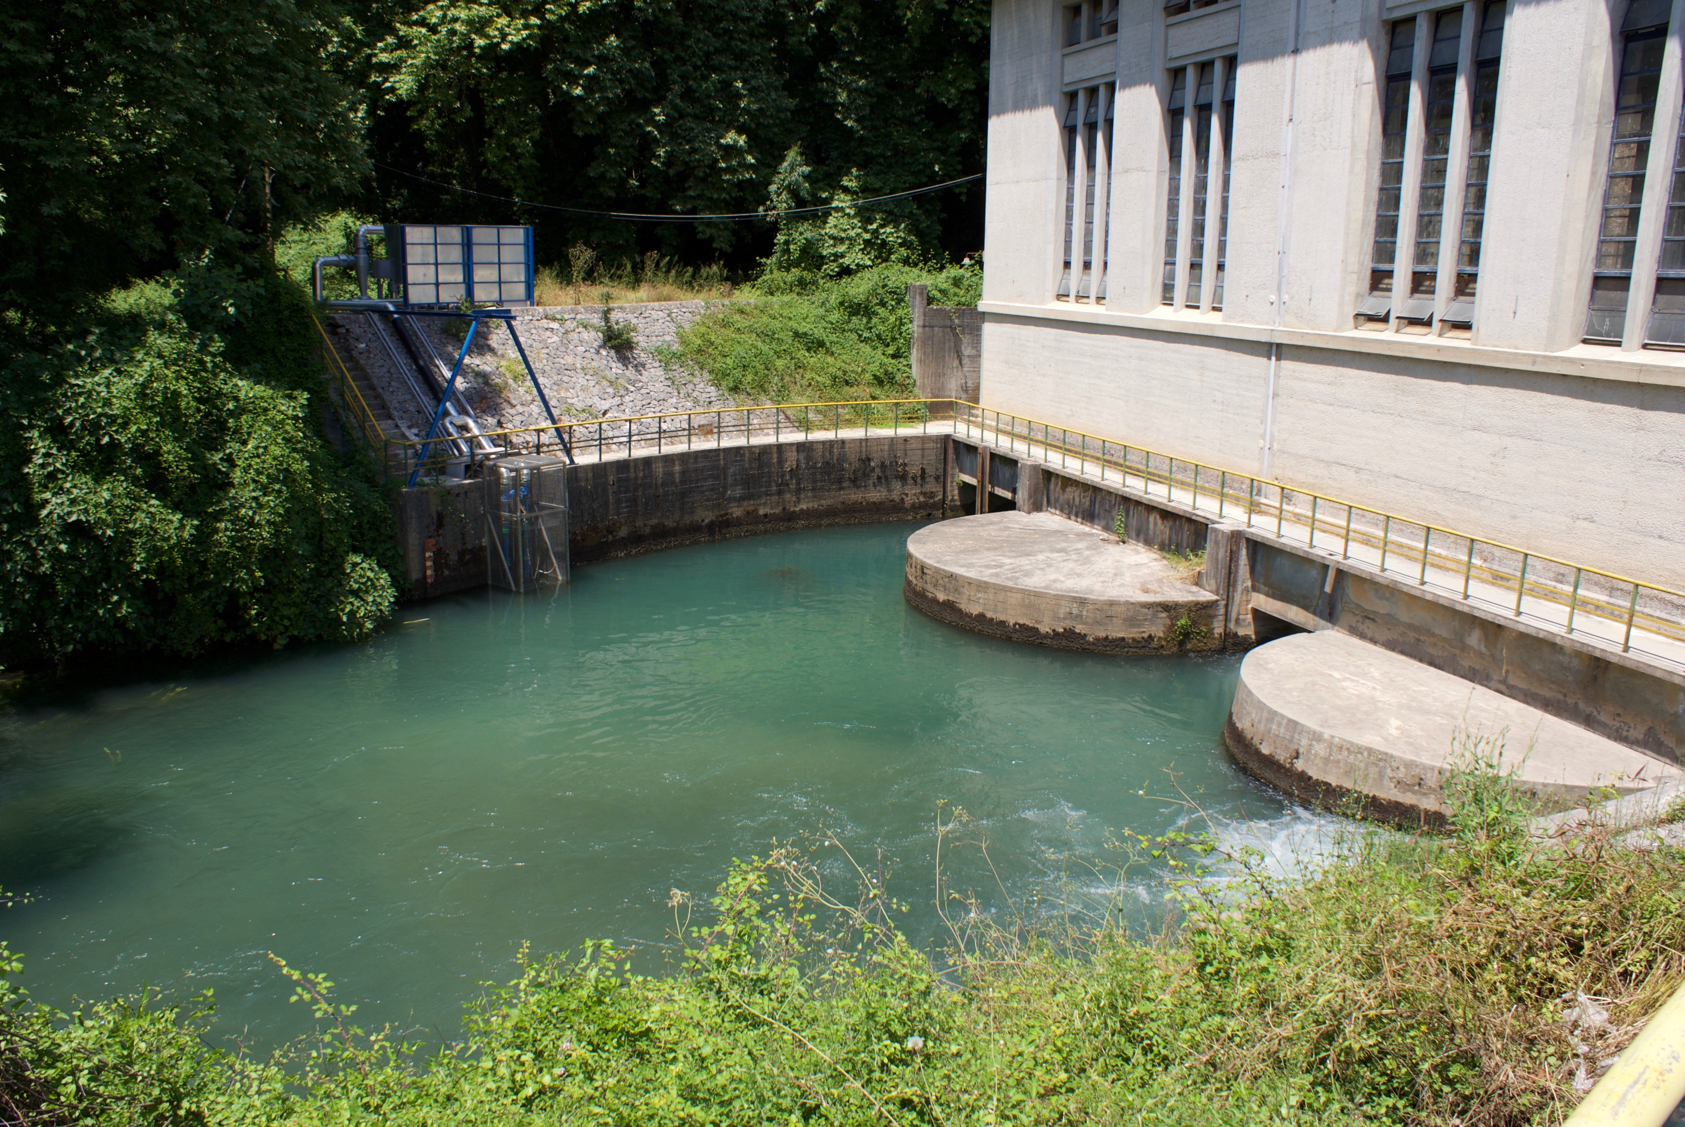
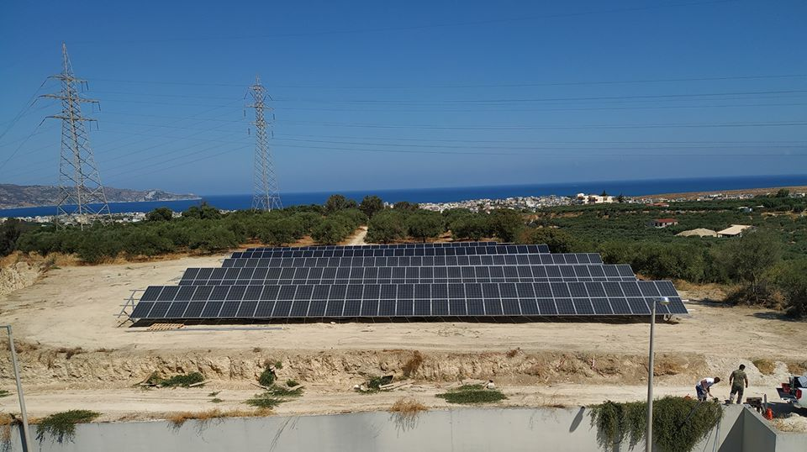
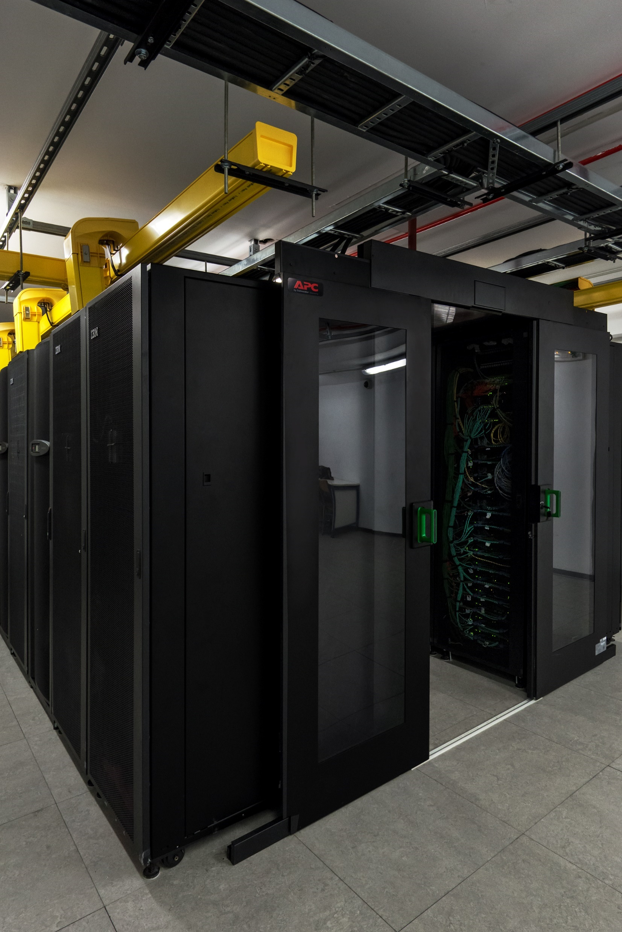
^{Computing Infrastructures}
Louros River, Arta
33.101 ~okeanos cloud users
6 data centers in 3 geographic locations
2.000 servers
11.500 active VMs
5.200 datacenter network ports in total
10.000 active cloud users
An optical network of a maximum capacity of 1 Tbps for the datacenters
Heraklion, Crete
Ministry of Education,Marousi

Slide 4

High Performance Computing (HPC)
^{Projects}

Slide 5



^{EuroCC}
^{www.eurocc-project.eu}
^{Funding: HORIZON 2020}
Duration: 01/09/2020 - 31/12/2025
^{National Competence Centers}
^{in the framework of EuroHPC}
A joint initiative between the EU, European countries and private partners to develop a World Class Supercomputing Ecosystem in Europe, which will be reinforced by a European Network of HPC Expertise.
^{HPC-EUROPA3}
^{www.hpc-europa.eu}
^{Funding: HORIZON 2020}
Duration: 01/05/2017 - 30/04/2022
Transnational Access Programme Pan-European Research Infrastructure on High Performance Computing
The main objective of the HPC-Europa3 project is to maintain the high quality of transnational access services to some of Europe's most advanced supercomputing infrastructures in the European community of computer science researchers.
^{PRACΕ-6IP}
^{www.prace-ri.eu}
^{Funding: HORIZON 2020}
Duration: 01/05/2019 - 31/12/2022
^{Partnership for Advanced}
^{Computing in Europe}
The mission of PRACE is to enable high-impact scientific discovery and engineering research and development across all disciplines to enhance European competitiveness for the benefit of society.

Slide 6


Development of a new national HPC system “DAEDALUS”
Upgrade of National HPC System “ARIS”
Funding: Operational Program “Attica 2014-2020” and the Priority Axis “Dissemination and Development of Innovative Products and Services of SMEs using ICT”
Duration: 01/01/2022 - 31/12/2023
GRNET’s existing HPC system will be upgraded with additional high performance computing equipment at the existing Data Center. ARIS HPC will continue to support the scientific applications which have special requirements regarding the speed of executing calculations, the storage space and memory capacity in various scientific fields of the Greek scientific community.
^{DAEDALUS}
^{www.grnet.gr/en/daedalus/}
Funding: Joint Undertaking/ EU / Recovery And Resilience Facility (RRF) Greece 2.0 – NextGenerationEU
Duration: 01/06/2022 - 31/12/2029
HPC DAEDALUS will serve a wide range of Greek and European users of the scientific and academic community, the industry and public sector. Anticipated to boost the development of new applications in a wide range of research fields such as Computational Chemistry, Physics, Biology, Biomedicine, Meteorology, Artificial Intelligence.
^{EUMaster4HPC}
https://grnet.gr/en/business-directory/eumaster4hpc-en/
Funding: Horizon 2020 Framework Programme
Duration: 01/01/2022 - 31/12/2025
The HPC European Consortium Leading Education Activities (EUMaster4HPC) aims to develop a new and innovative European Master programme focusing on high performance solutions to address these issues. The master programme aims at catalysing various aspects of the HPC ecosystem and its applications into different scientific and industrial domains.

Slide 7

Greece participating in Leonardo Consortium
Greece, represented by GRNET, participates in the European Leonardo consortium for the operation of a pre-exascale level supercomputer system, providing research and innovation communities’ significant resources to assist in the development of new outcomes.
Greece joined the Leonardo consortium (12/2020) alongside existing partners of Italy: Austria, Hungary, Slovakia and Slovenia.
GRNET’s teams of professional experts, engineers and HPC project managers, contributing to the High Level Support Team (HLST) of the Leonardo consortium.
Research teams will access both the existing and the developing infrastructures of the consortium, opening new horizons of scientific, technological and economic progress.
Partners’ collaboration and communication, will further contribute to technological progress, through the exchange of best practices and technology know-how in the field of High Performance Computing, research and innovation.
Social Media, Website and newsletter announcements about Leonardo to all relevant audiences
Notes:
It should be noted that GRNET is one of the largest contributors to technological progress and modernization of Greece’s infrastructures, through its participation in a number of pan-European HPC initiatives and mainly through the development and maintenance of the HPC – ARIS, which is the most powerful computer system for scientific purposes in Greece.
The benefits of Greece’s participation and GRNET’s contribution in this strategically important initiative are manifold, both at national and European level. Research teams in need of high performance computing resources in order to conduct scientific research will -in the future- be able to access both the existing and the developing infrastructures of the consortium, opening new horizons of scientific, technological and economic progress. Thus, they will further benefit from the use of supercomputer resources to conduct large-scale applications in a wide range of scientific fields. In addition, the consortium countries partners’ collaboration and communication, will further contribute to technological progress, through the exchange of best practices and technology know-how in the field of High Performance Computing, research and innovation.

Slide 8
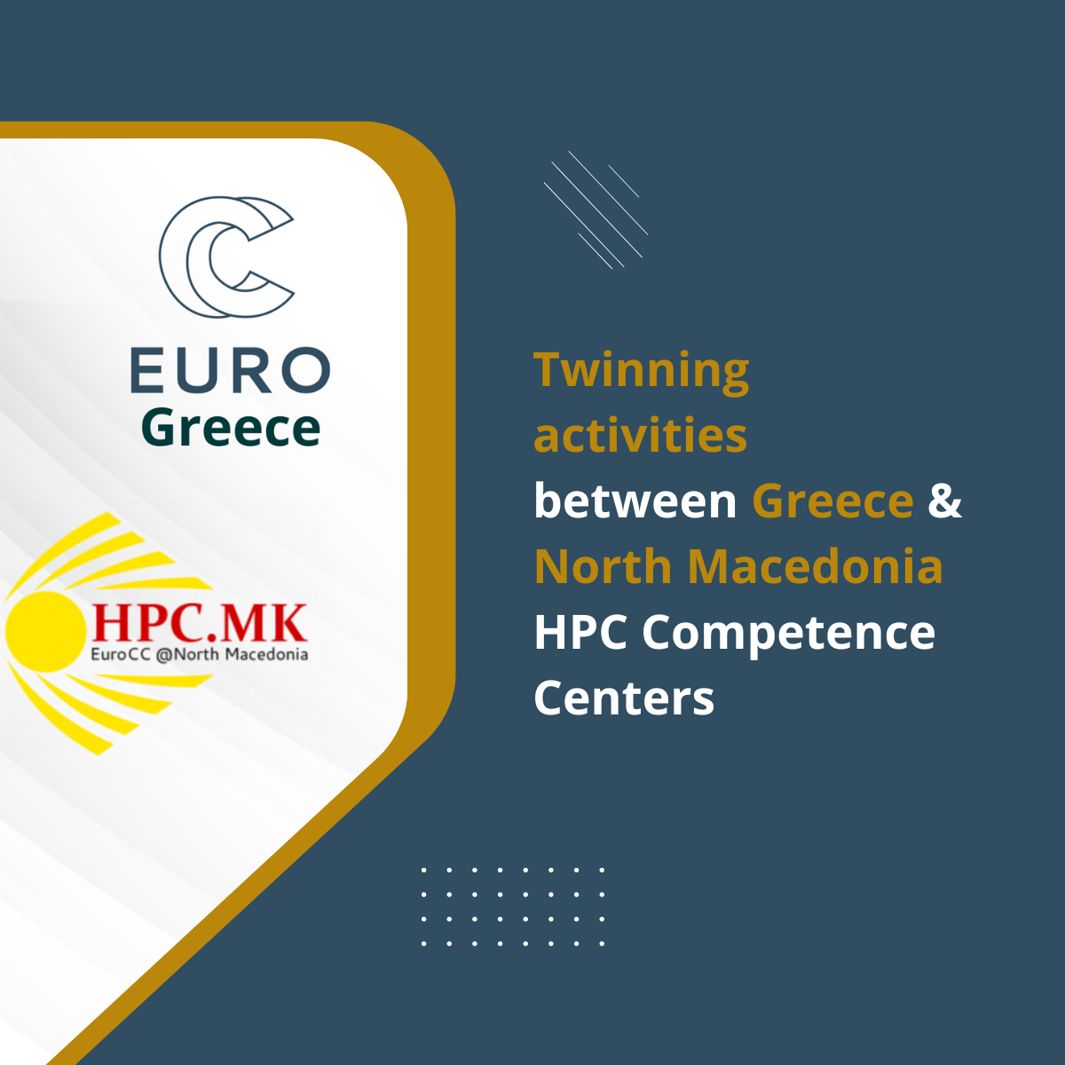

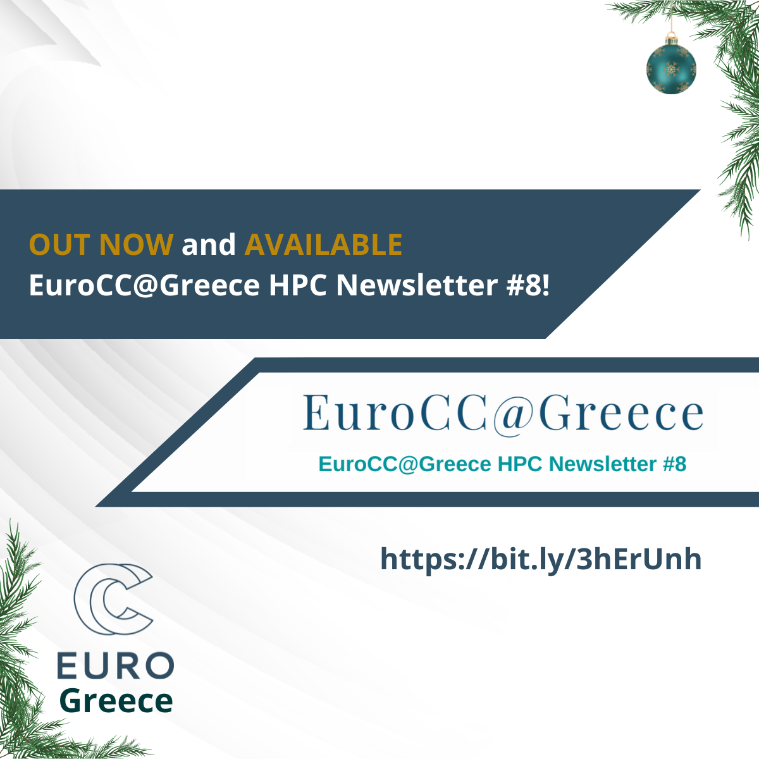
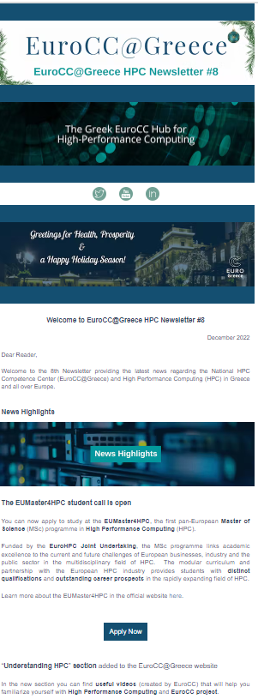
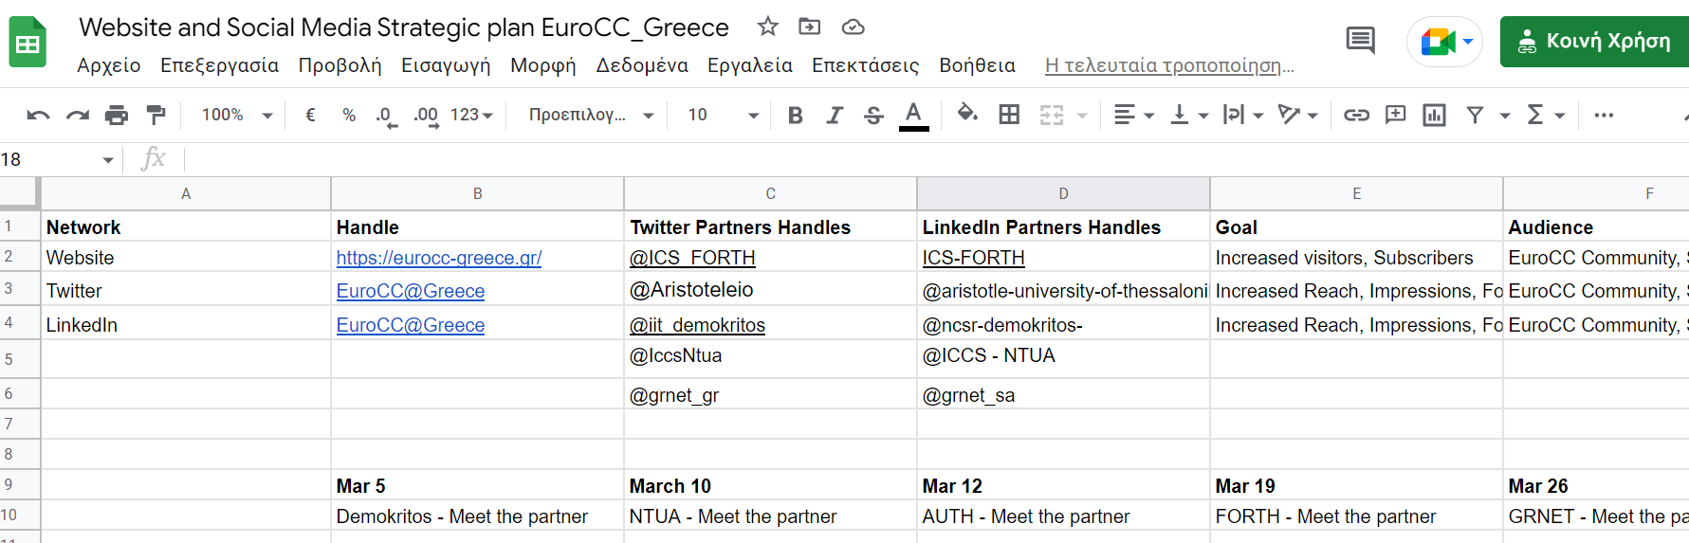
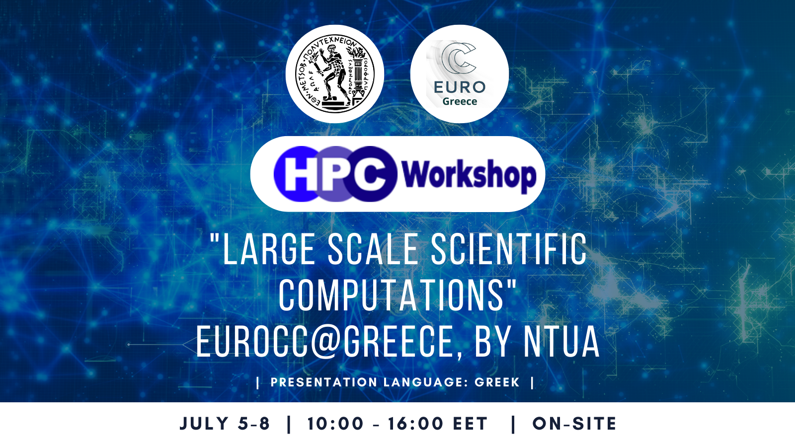
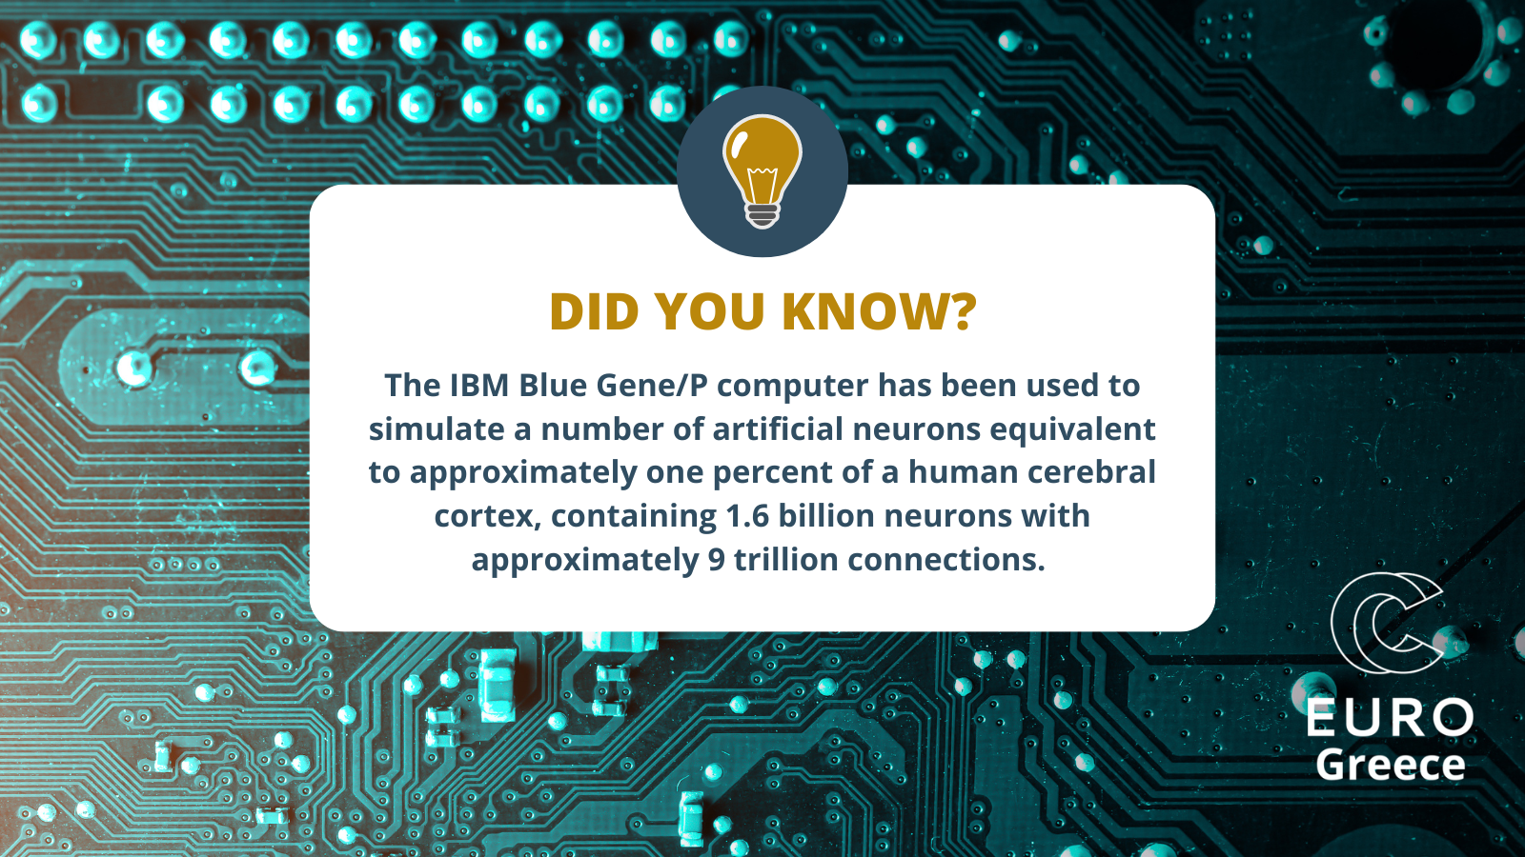
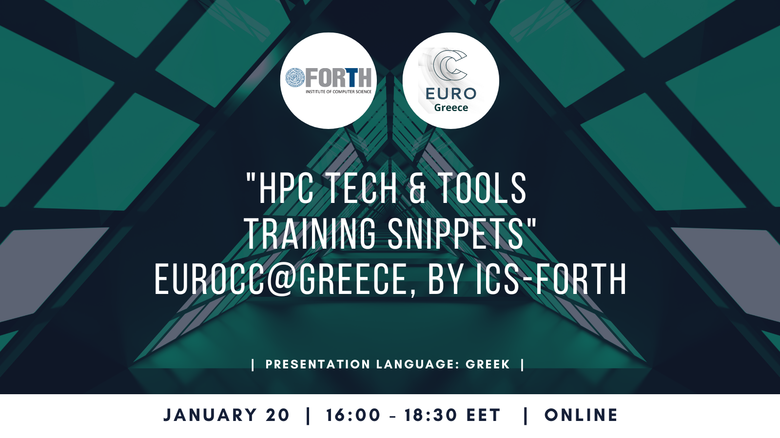
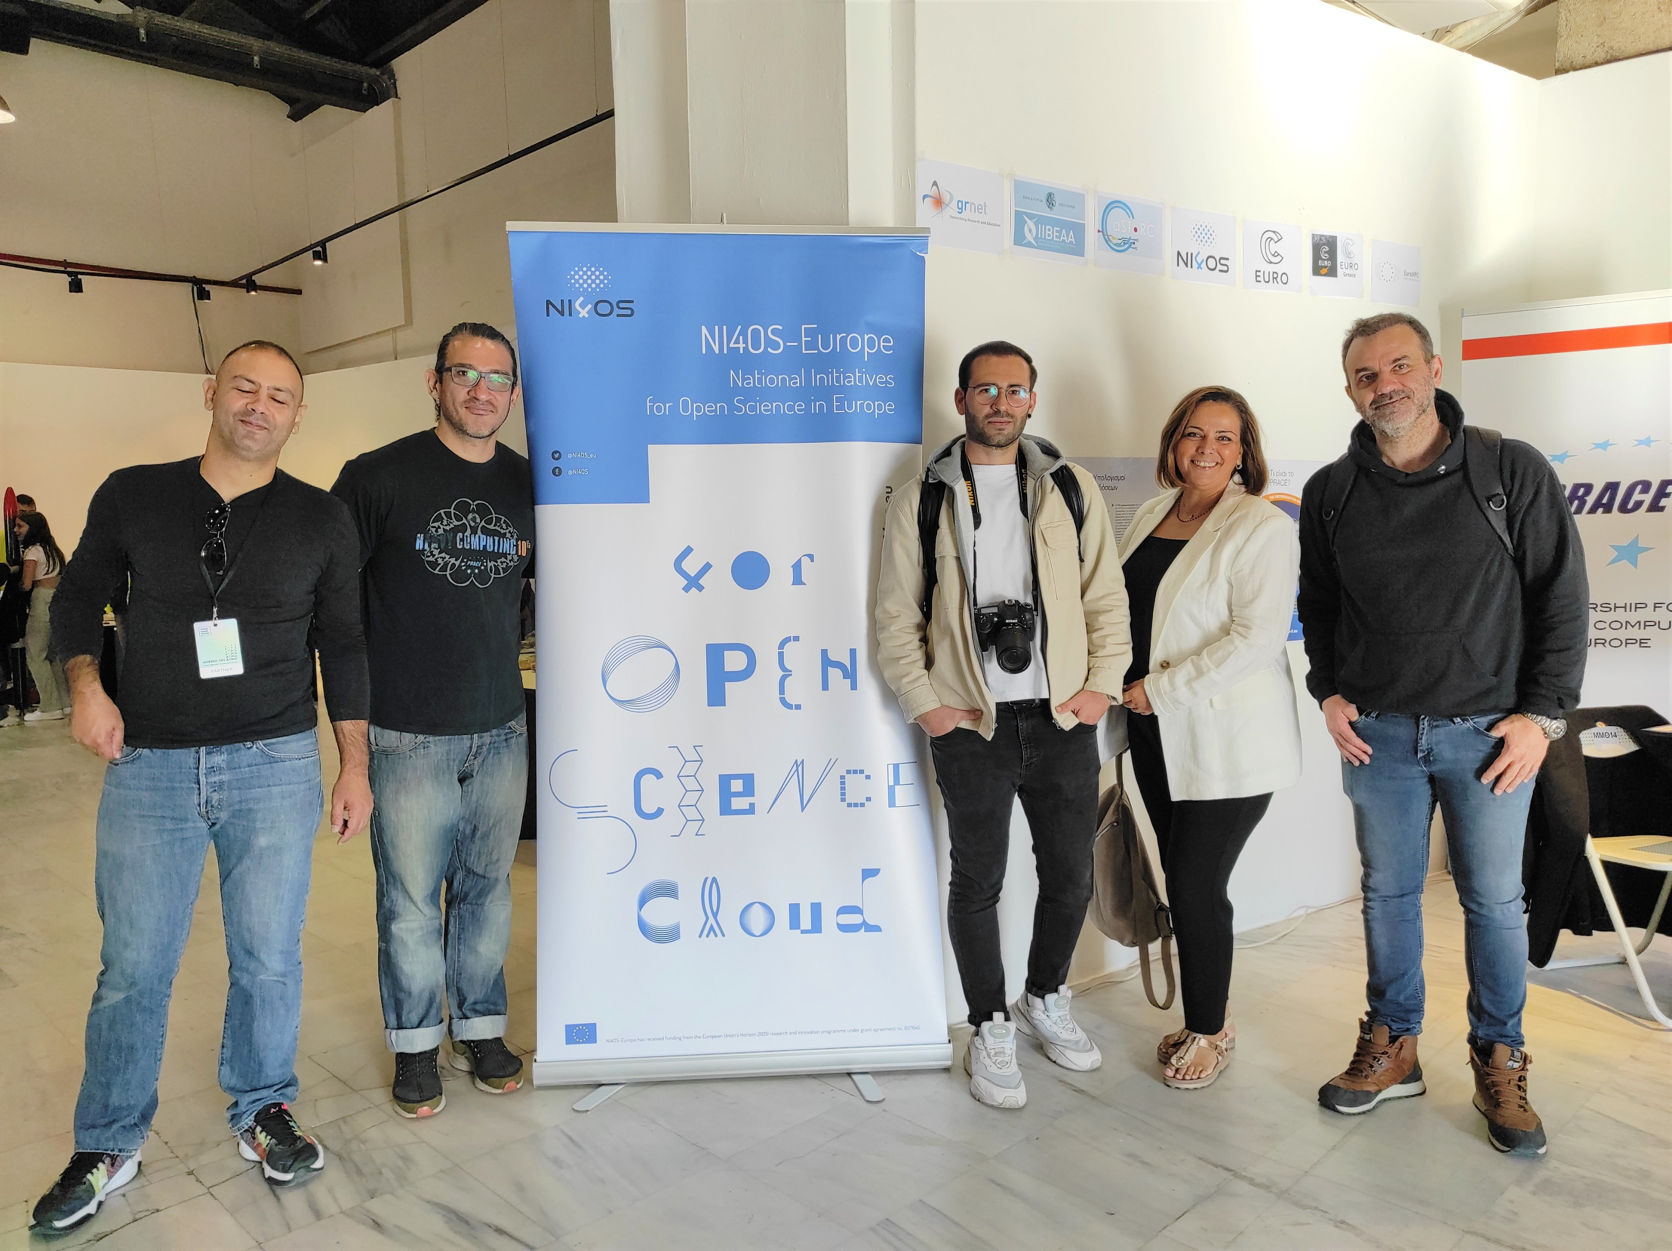
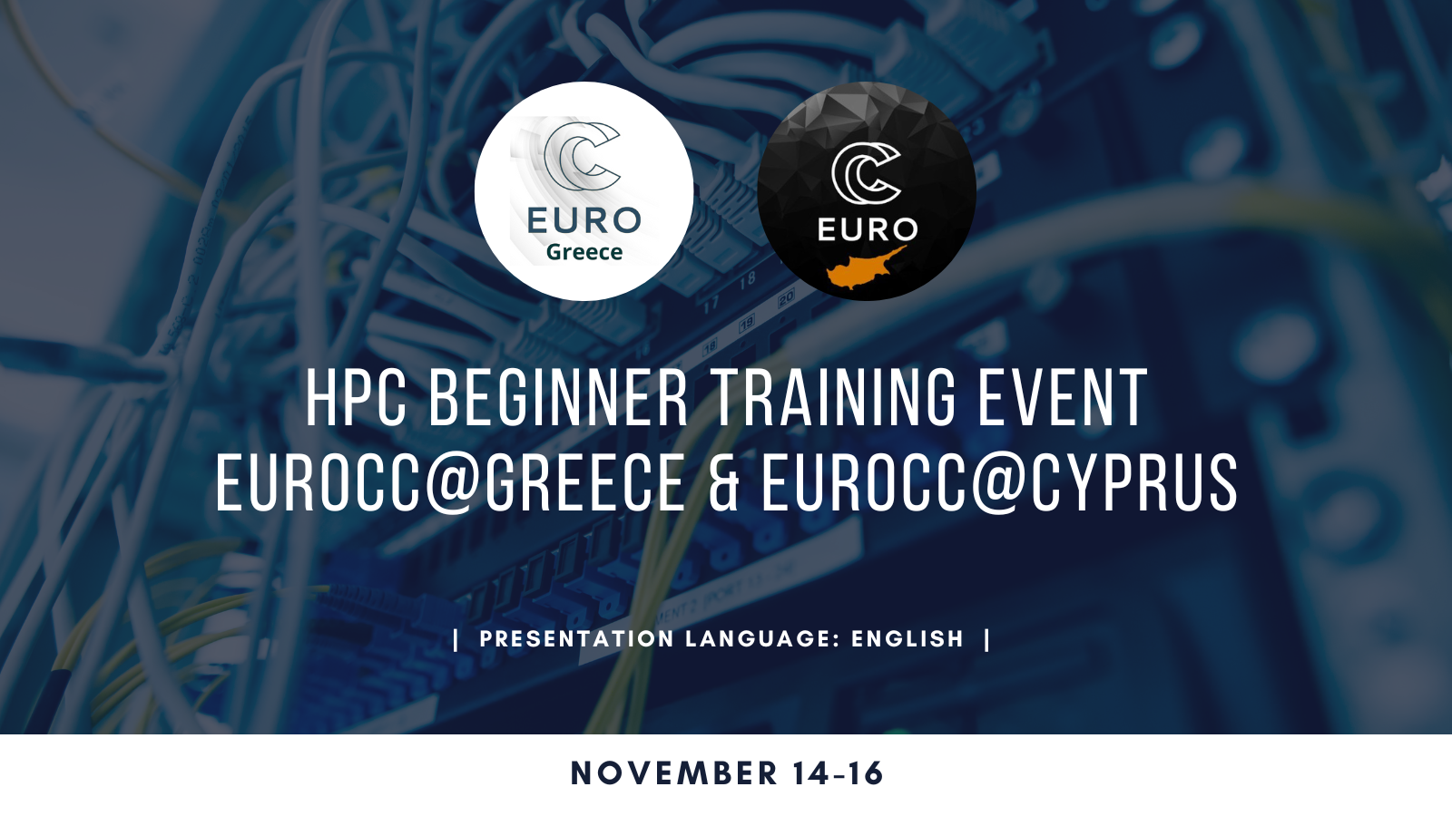
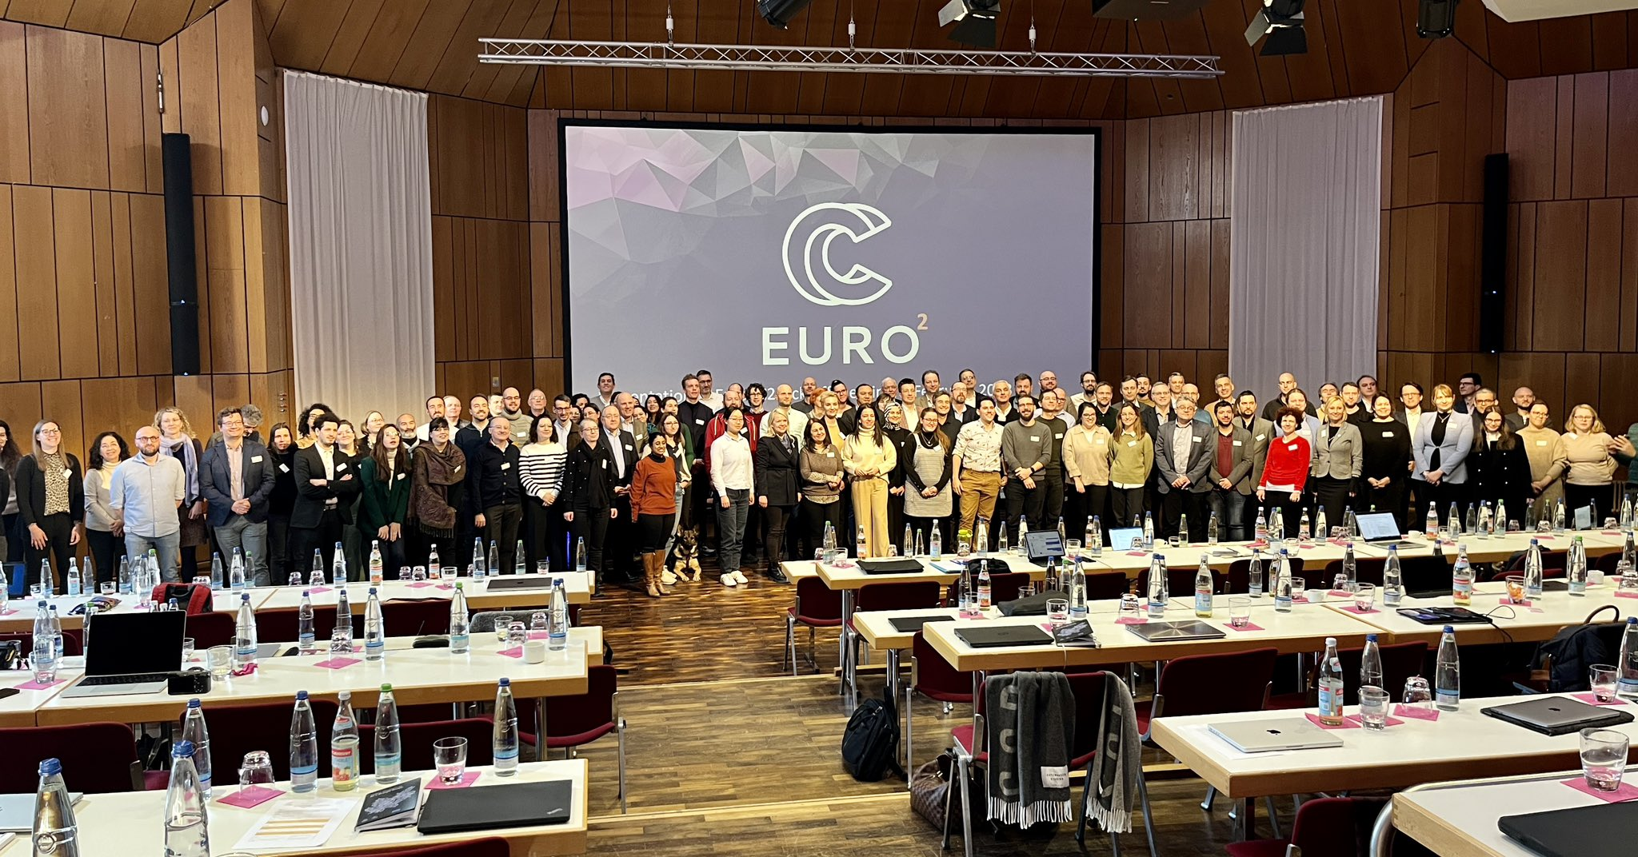
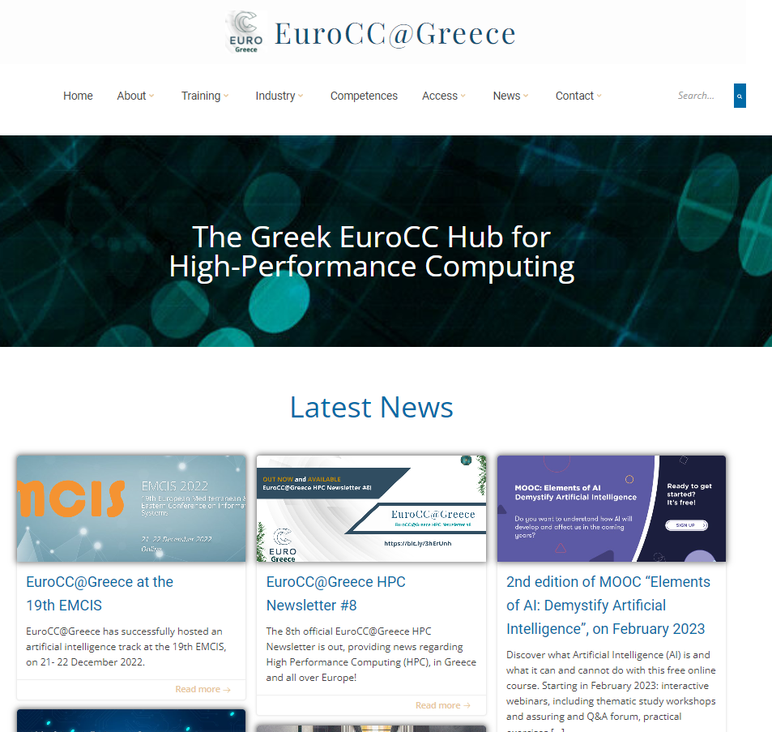
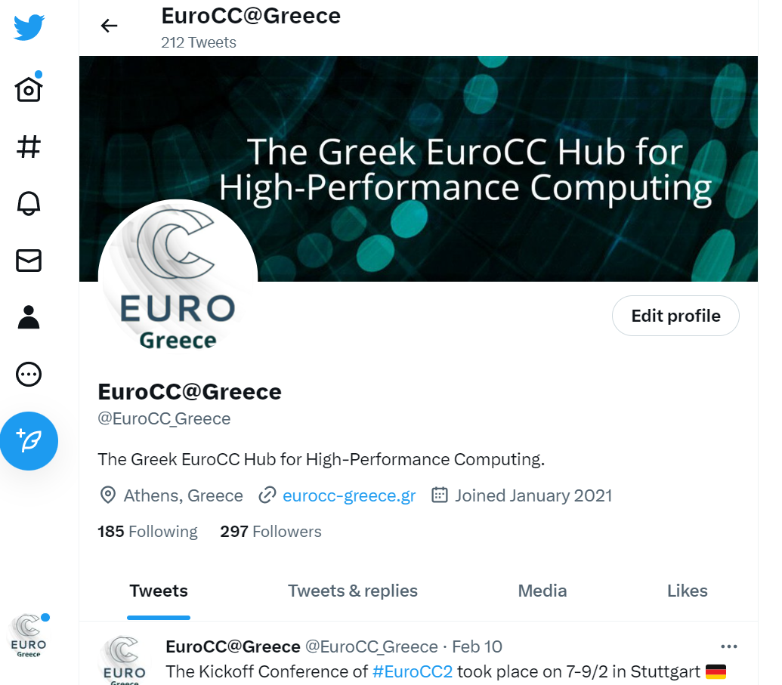
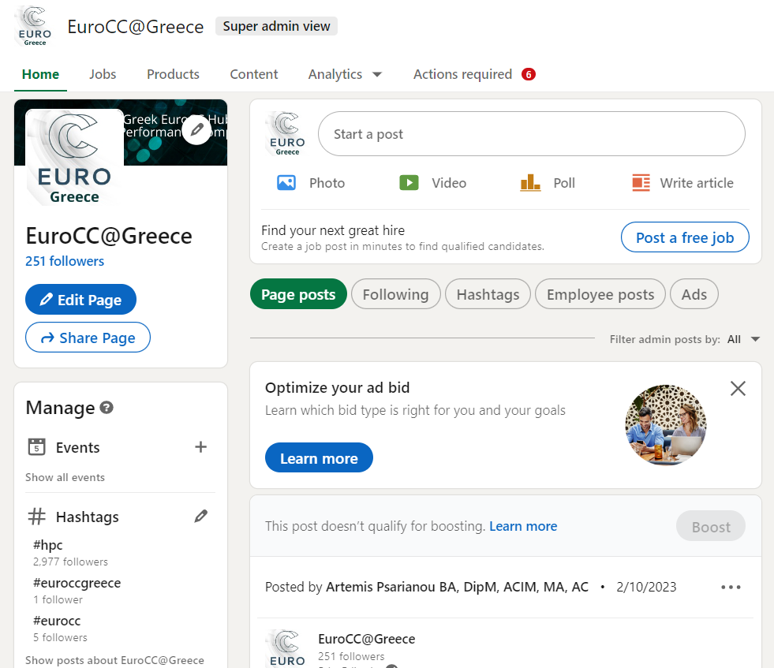
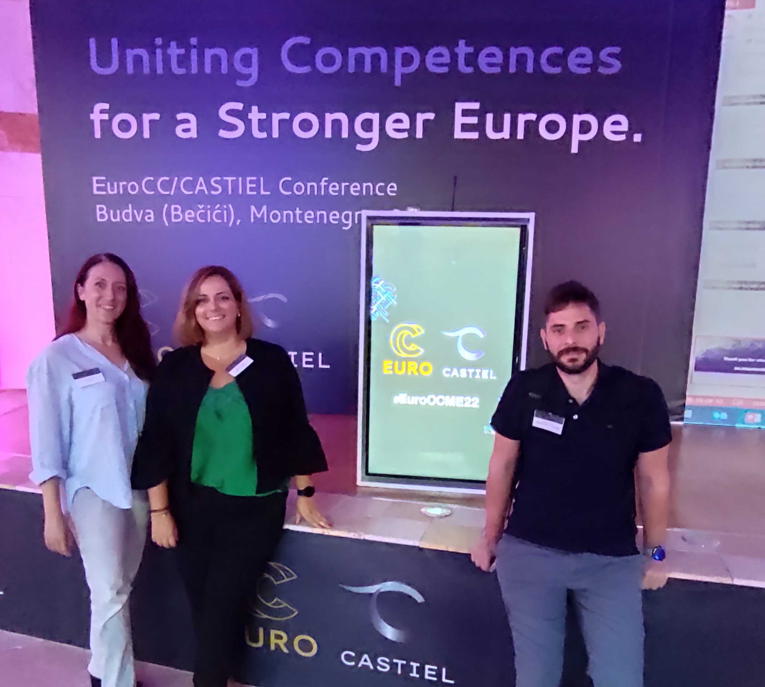
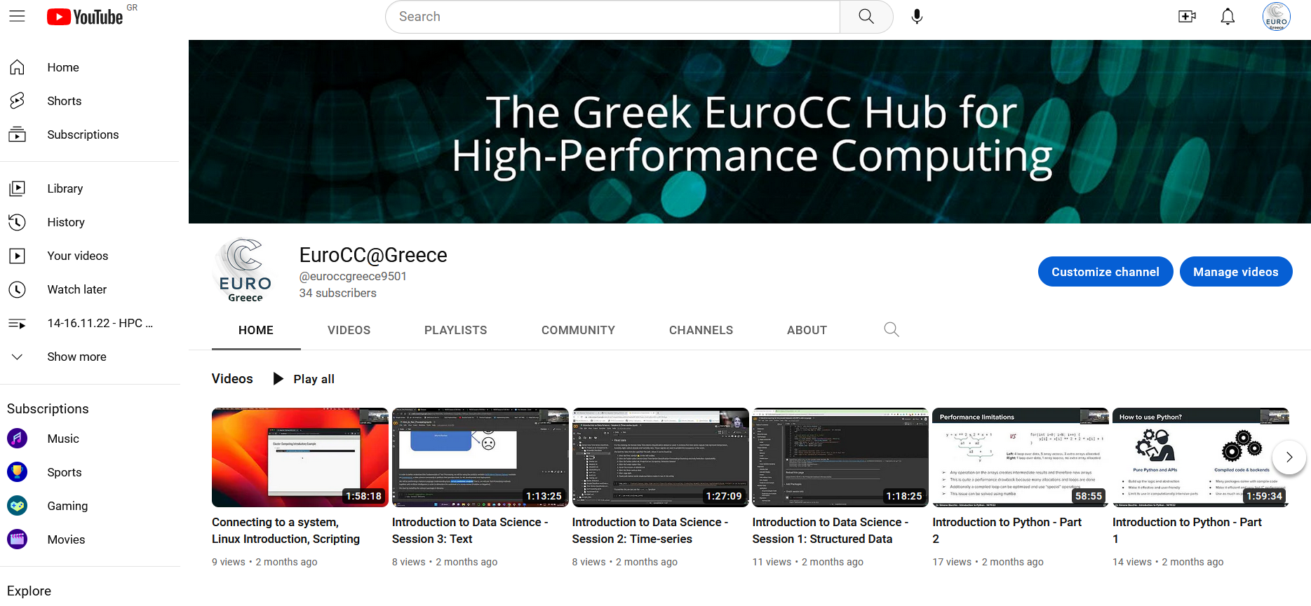
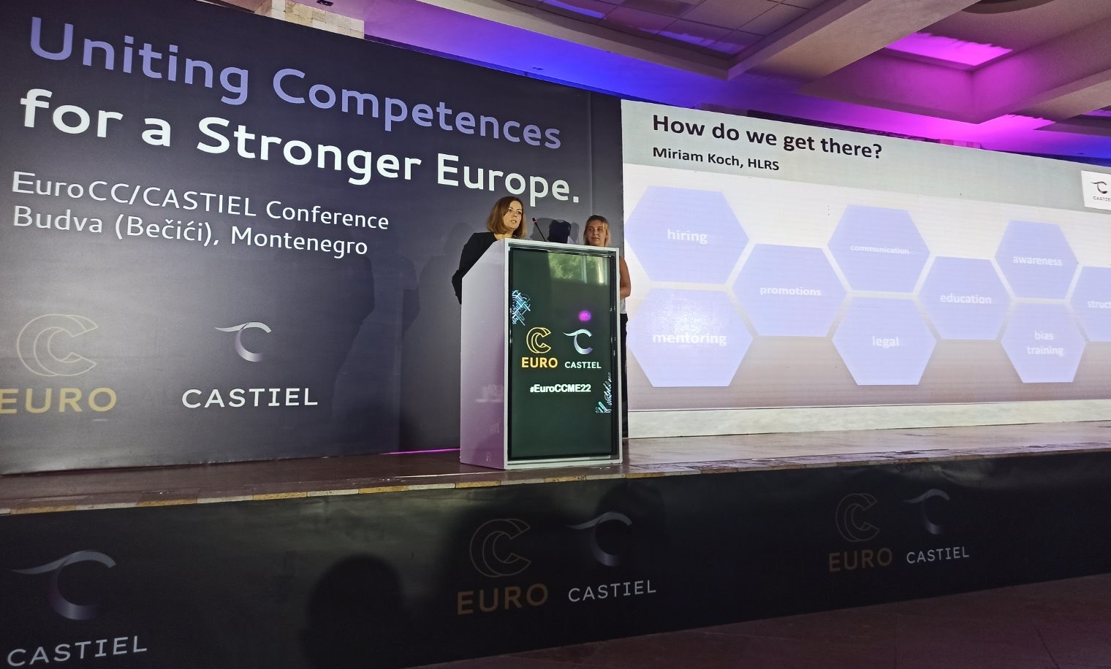

EuroCC@Greece MarComms Strategy and Execution
Project Dissemination Strategic Marketing and Communication Plan & Calendar
Design Collateral Materials
Events
Online media (Social Media, Website set up and all media monitoring)

Slide 9
EuroCC@Greece MarComms in numbers
EuroCC Media | 2022 | 2021 | % Change ‘22 vs ‘21
Website posts | 82 | 78 | 5
Twitter Followers | 288 | 176 | 64
Twitter Posts | 98 | 70 | 40
LinkedIn Followers | 241 | 63 | 283
LinkedIn Posts | 87 | 66 | 32
YouTube Subscribers | 34 | 13 | 162
YouTube uploads | 27 | 22 | 23
Banners designed | 112 | 83 | 35
Events organised | 5 | 4 | 25
Events disseminated | 38 | 23 | 65
Newsletters / campaigns | 6 | 9 | -33
Website Visitors | 2.580 | 1.876 | 38

Slide 10
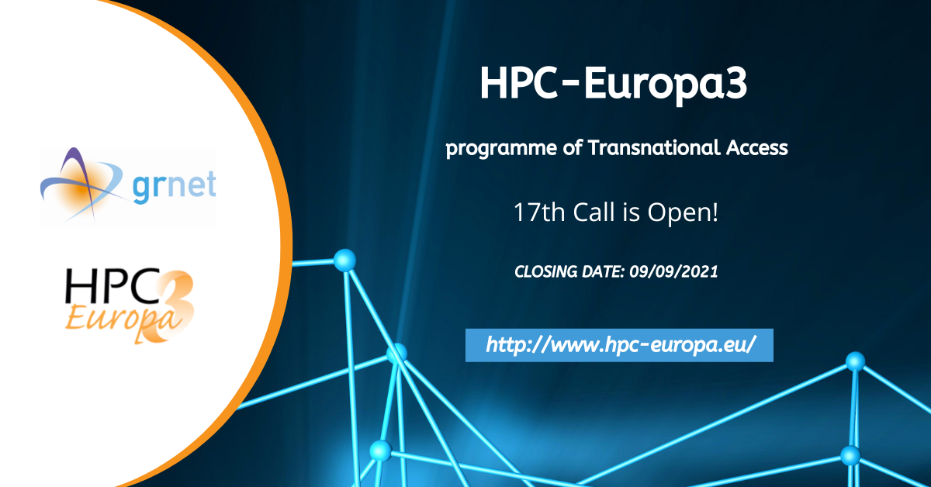

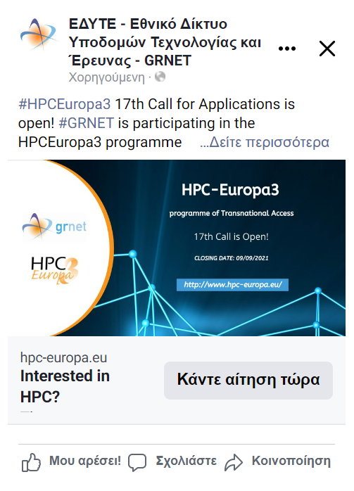
^{HPC-Europa3 Dissemination}
Paid Facebook Campaigns (17th & 18th Calls)
Campaign Results
Campaign Name | Country |  | Outreach | Views | Frequency | Currency | Cost (EUR)
All | All |  | 552288 | 2867743 | 5,19 | EUR | 1612,41
HPC Europa3 18th Call | All |  | 503876 | 2451829 | 4,87 | EUR | 1400,00
 | GE |  | 223760 | 1012036 | 4,52 | EUR | 552,63
 | AM |  | 130516 | 885519 | 6,78 | EUR | 540,39
 | AL |  | 41114 | 182207 | 4,43 | EUR | 91,94
 | BA |  | 37016 | 172506 | 4,66 | EUR | 88,97
 | MD |  | 16138 | 42494 | 2,63 | EUR | 27,89
 | ME |  | 8197 | 41300 | 5,04 | EUR | 27,06
 | RS |  | 16010 | 37356 | 2,33 | EUR | 26,46
 | MK |  | 16395 | 58141 | 3,55 | EUR | 25,21
 | BG |  | 3842 | 5889 | 1,53 | EUR | 8,51
 | RO |  | 3202 | 4248 | 1,33 | EUR | 6,07
 | IL |  | 6916 | 8985 | 1,30 | EUR | 3,46
 | HU |  | 384 | 604 | 1,57 | EUR | 0,69
 | HR |  | 384 | 521 | 1,36 | EUR | 0,68
 | XK |  |  | 22 |  | EUR | 0,02
 | unknown |  |  | 1 |  | EUR
HPC Europa3 17th Call | All |  | 144048 | 415914 | 2,89 | EUR | 212,41
 | GE |  | 65598 | 188100 | 2,87 | EUR | 98,80
 | AM |  | 38969 | 124699 | 3,20 | EUR | 62,36
 | AL |  | 11572 | 35443 | 3,06 | EUR | 15,84
 | BA |  | 10326 | 28389 | 2,75 | EUR | 14,51
 | ME |  | 4380 | 13062 | 2,98 | EUR | 5,23
 | MK |  | 4220 | 10696 | 2,53 | EUR | 5,09
 | MD |  | 3293 | 6129 | 1,86 | EUR | 3,94
 | RS |  | 3453 | 6624 | 1,92 | EUR | 3,61
 | BG |  | 895 | 1098 | 1,23 | EUR | 1,52
 | RO |  | 384 | 485 | 1,26 | EUR | 0,86
 | IL |  | 831 | 957 | 1,15 | EUR | 0,39
 | HU |  | 128 | 145 | 1,13 | EUR | 0,18
 | HR |  |  | 87 |  | EUR | 0,08
 |  |  | 552288 | 2867743 | 5,19247748 | EUR | 1612,41

Slide 11
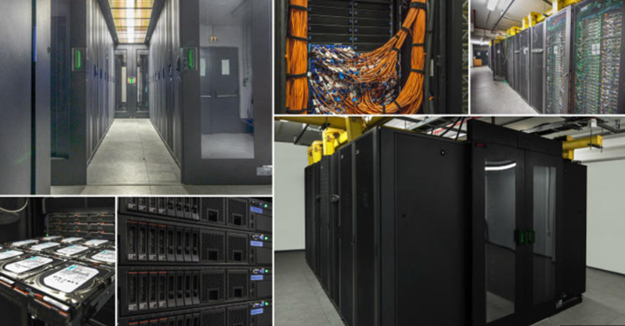
^{National HPC Infrastructure}
^{ARIS - HPC}
5 computational islands, 535 compute nodes
2 PB of storage space
535 TFlops HPC Tier - 1 centre
1.100 HPC projects
58.200 core Years (510 million core Hours) during the last 7 years
GRNET is a PRACE Training Center

Slide 12

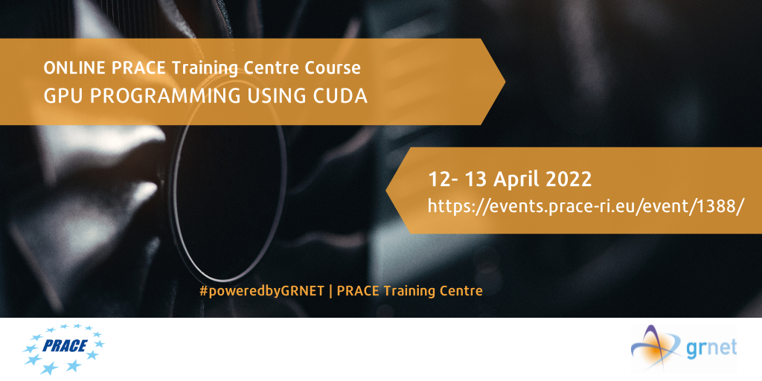
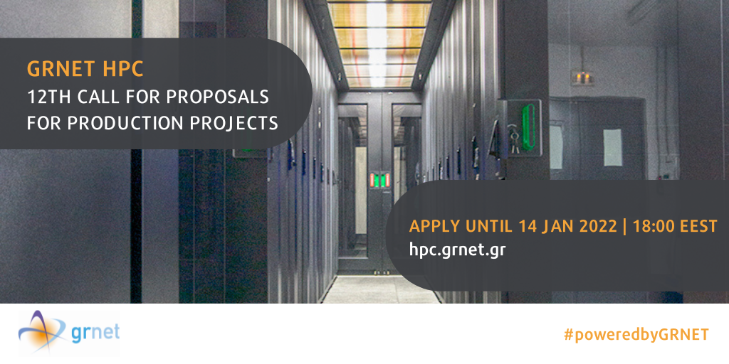
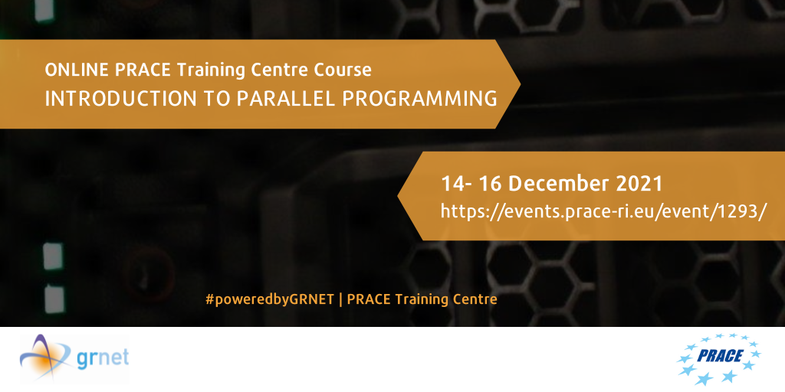
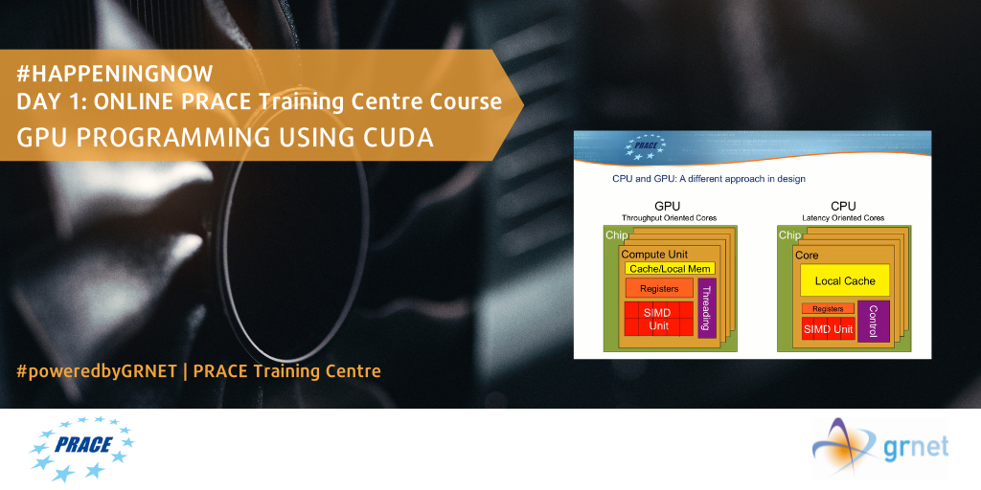
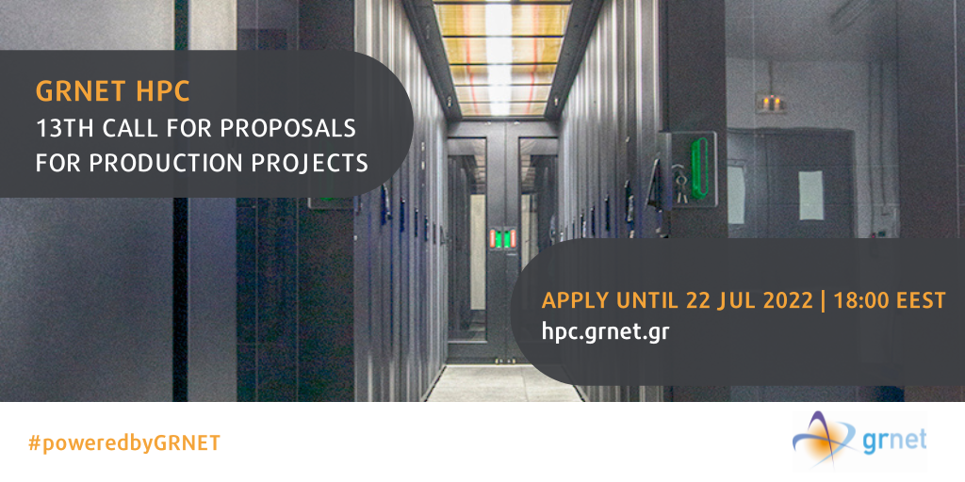
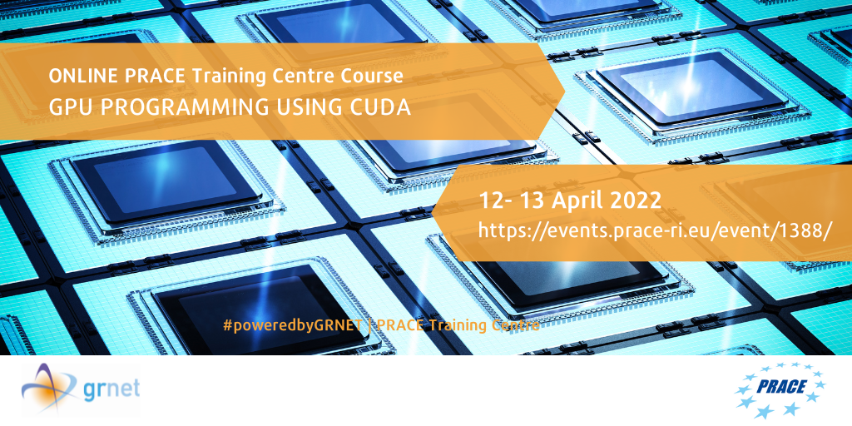
^{PRACE-6IP Dissemination}
^{HPC ARIS Dissemination}
HPC ARIS Trainings in the context of GRNET being a PRACE Training Centre
GRNET Calls for Proposals for access to HPC ARIS
In total, during 2021-22, there have been 6 PRACE Training Centre courses with 308 total participants
and 4 Calls for Proposals for access to HPC ARIS, disseminated through direct emails, website posts & SM.

Slide 13
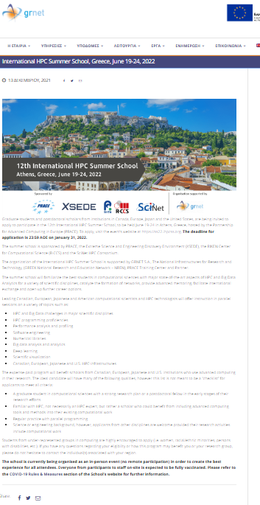

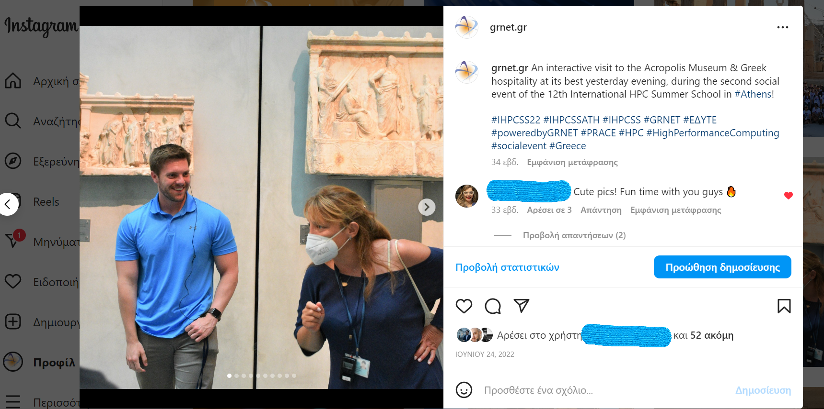
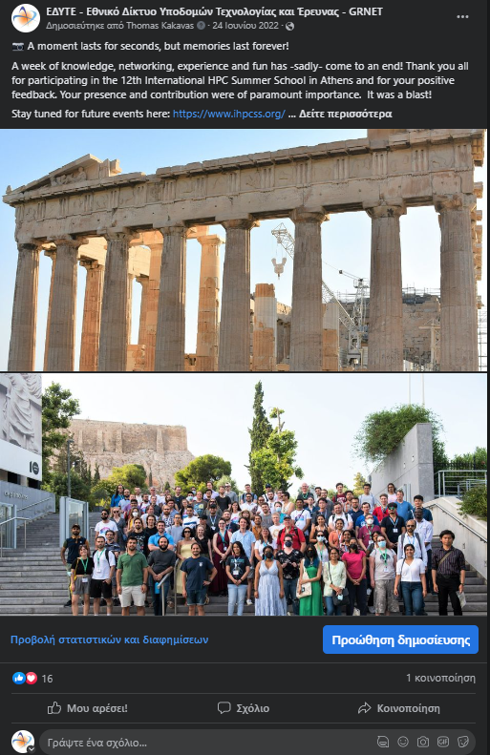
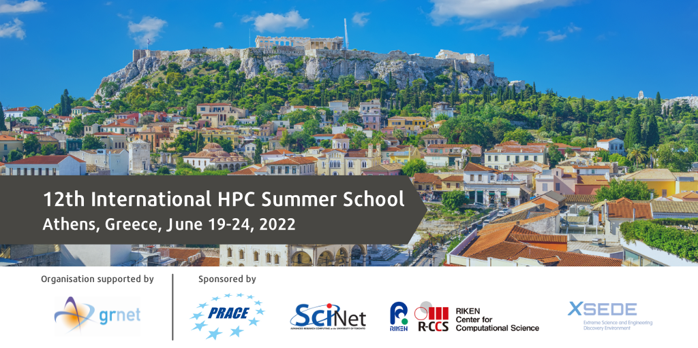
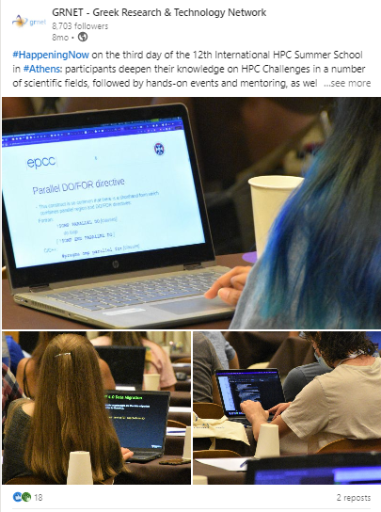
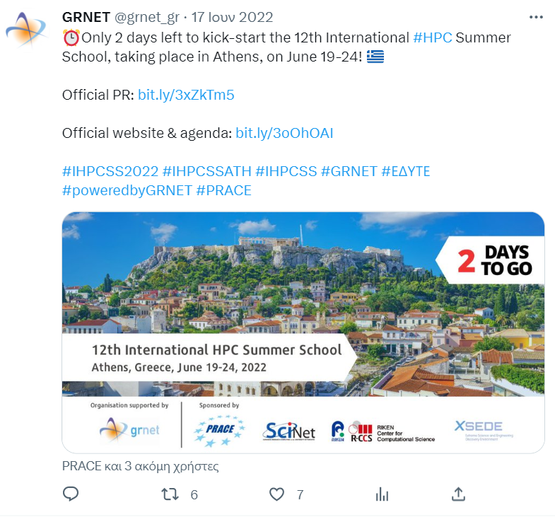
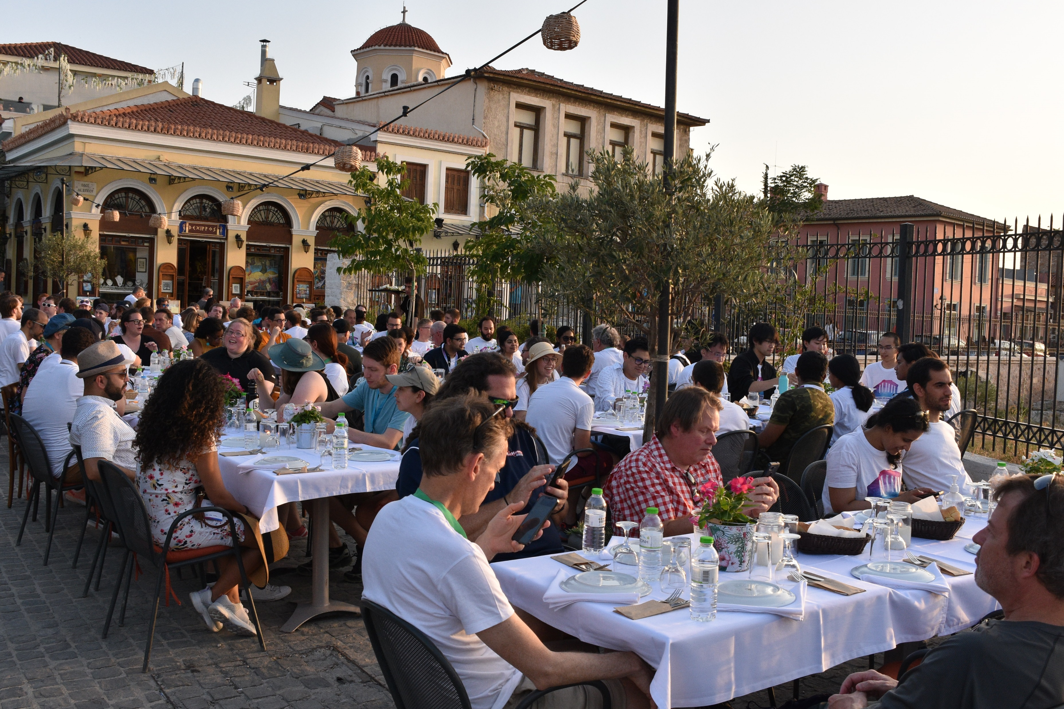
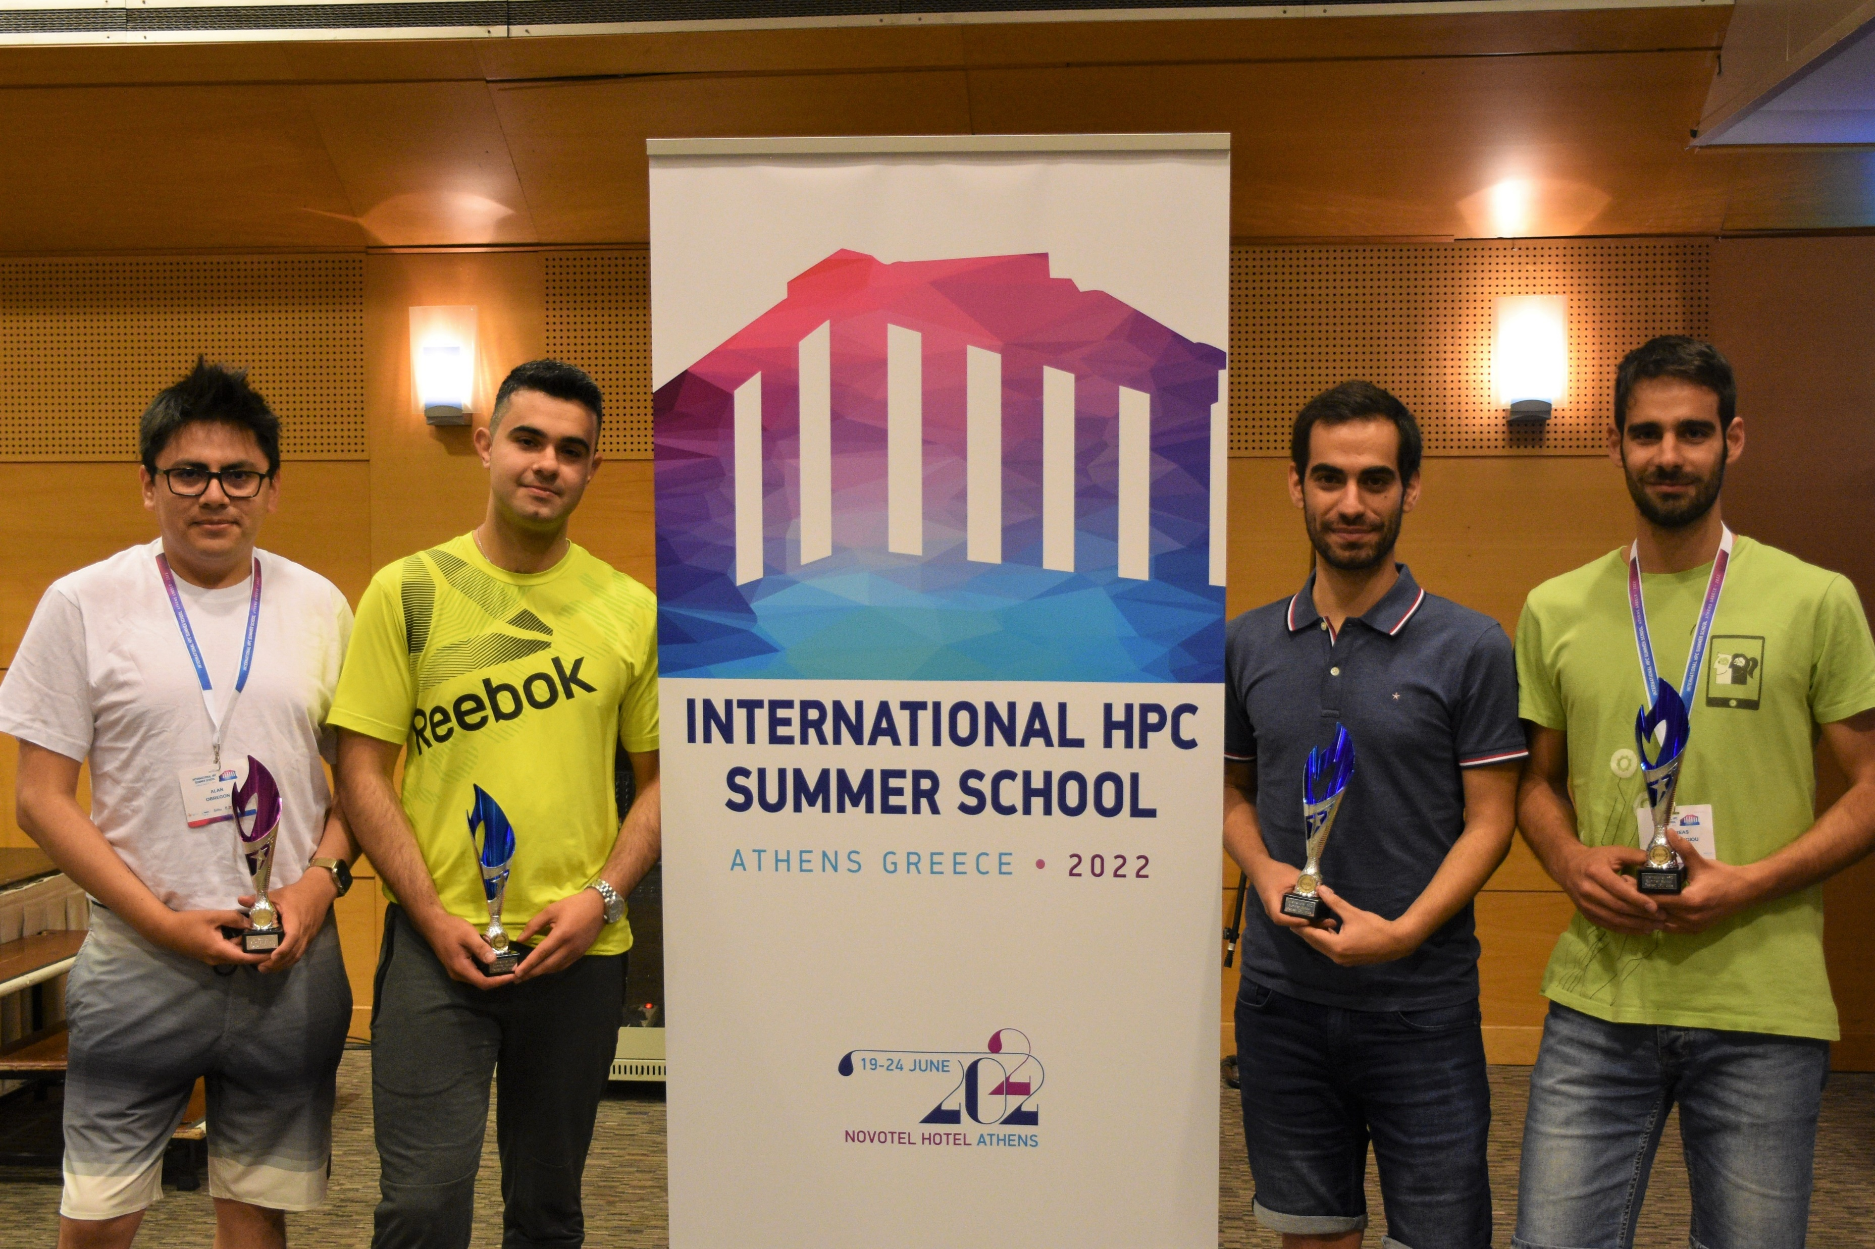
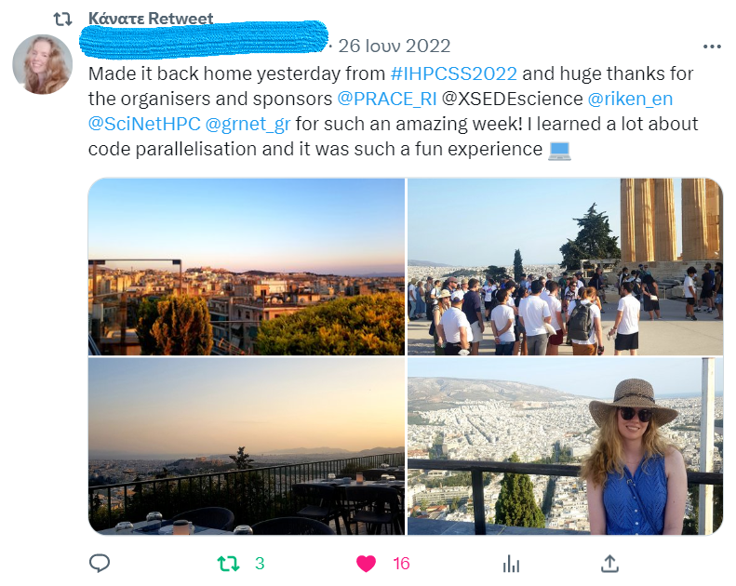
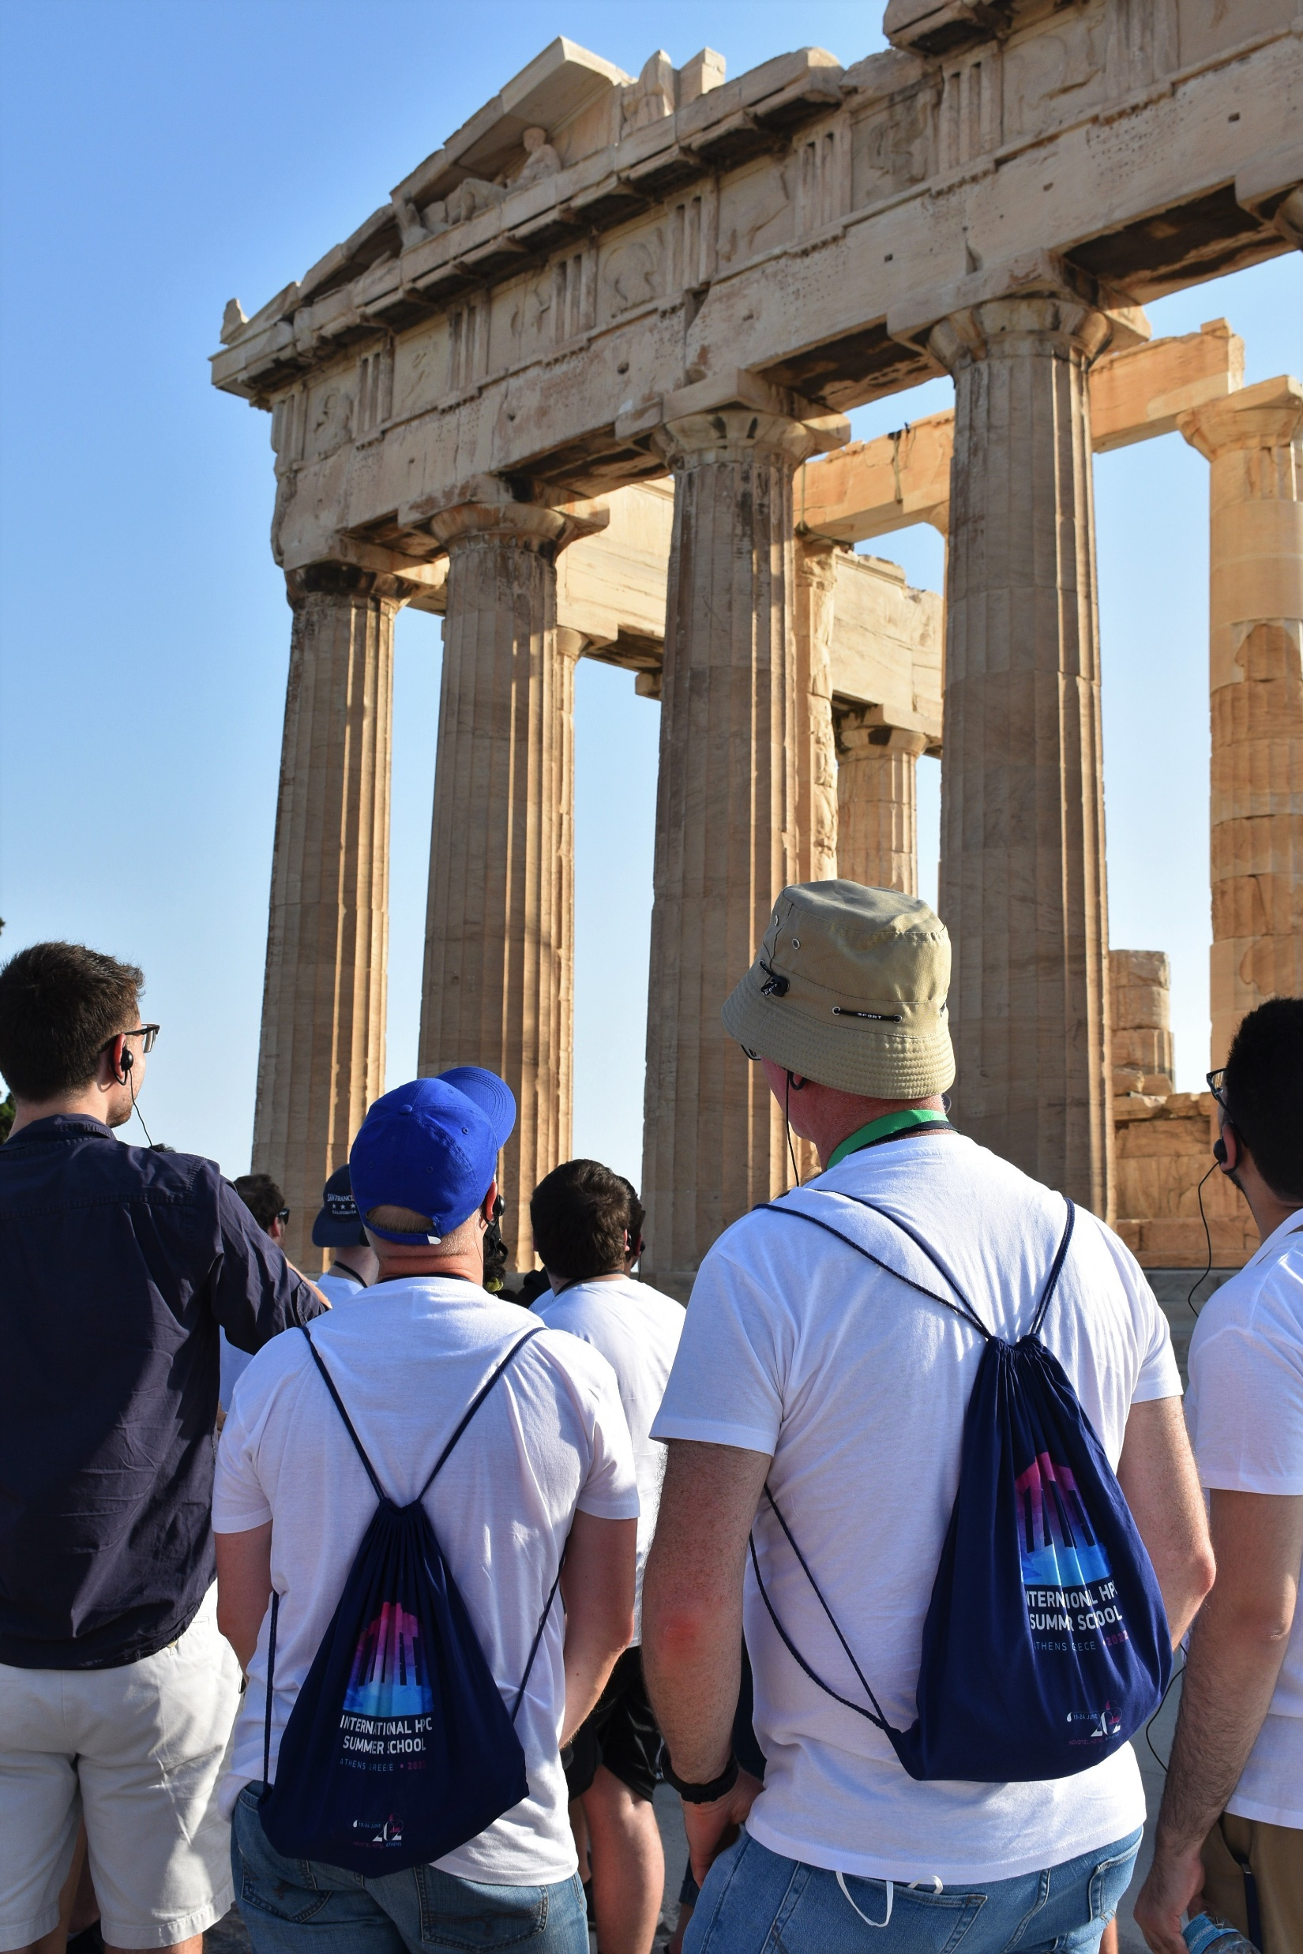
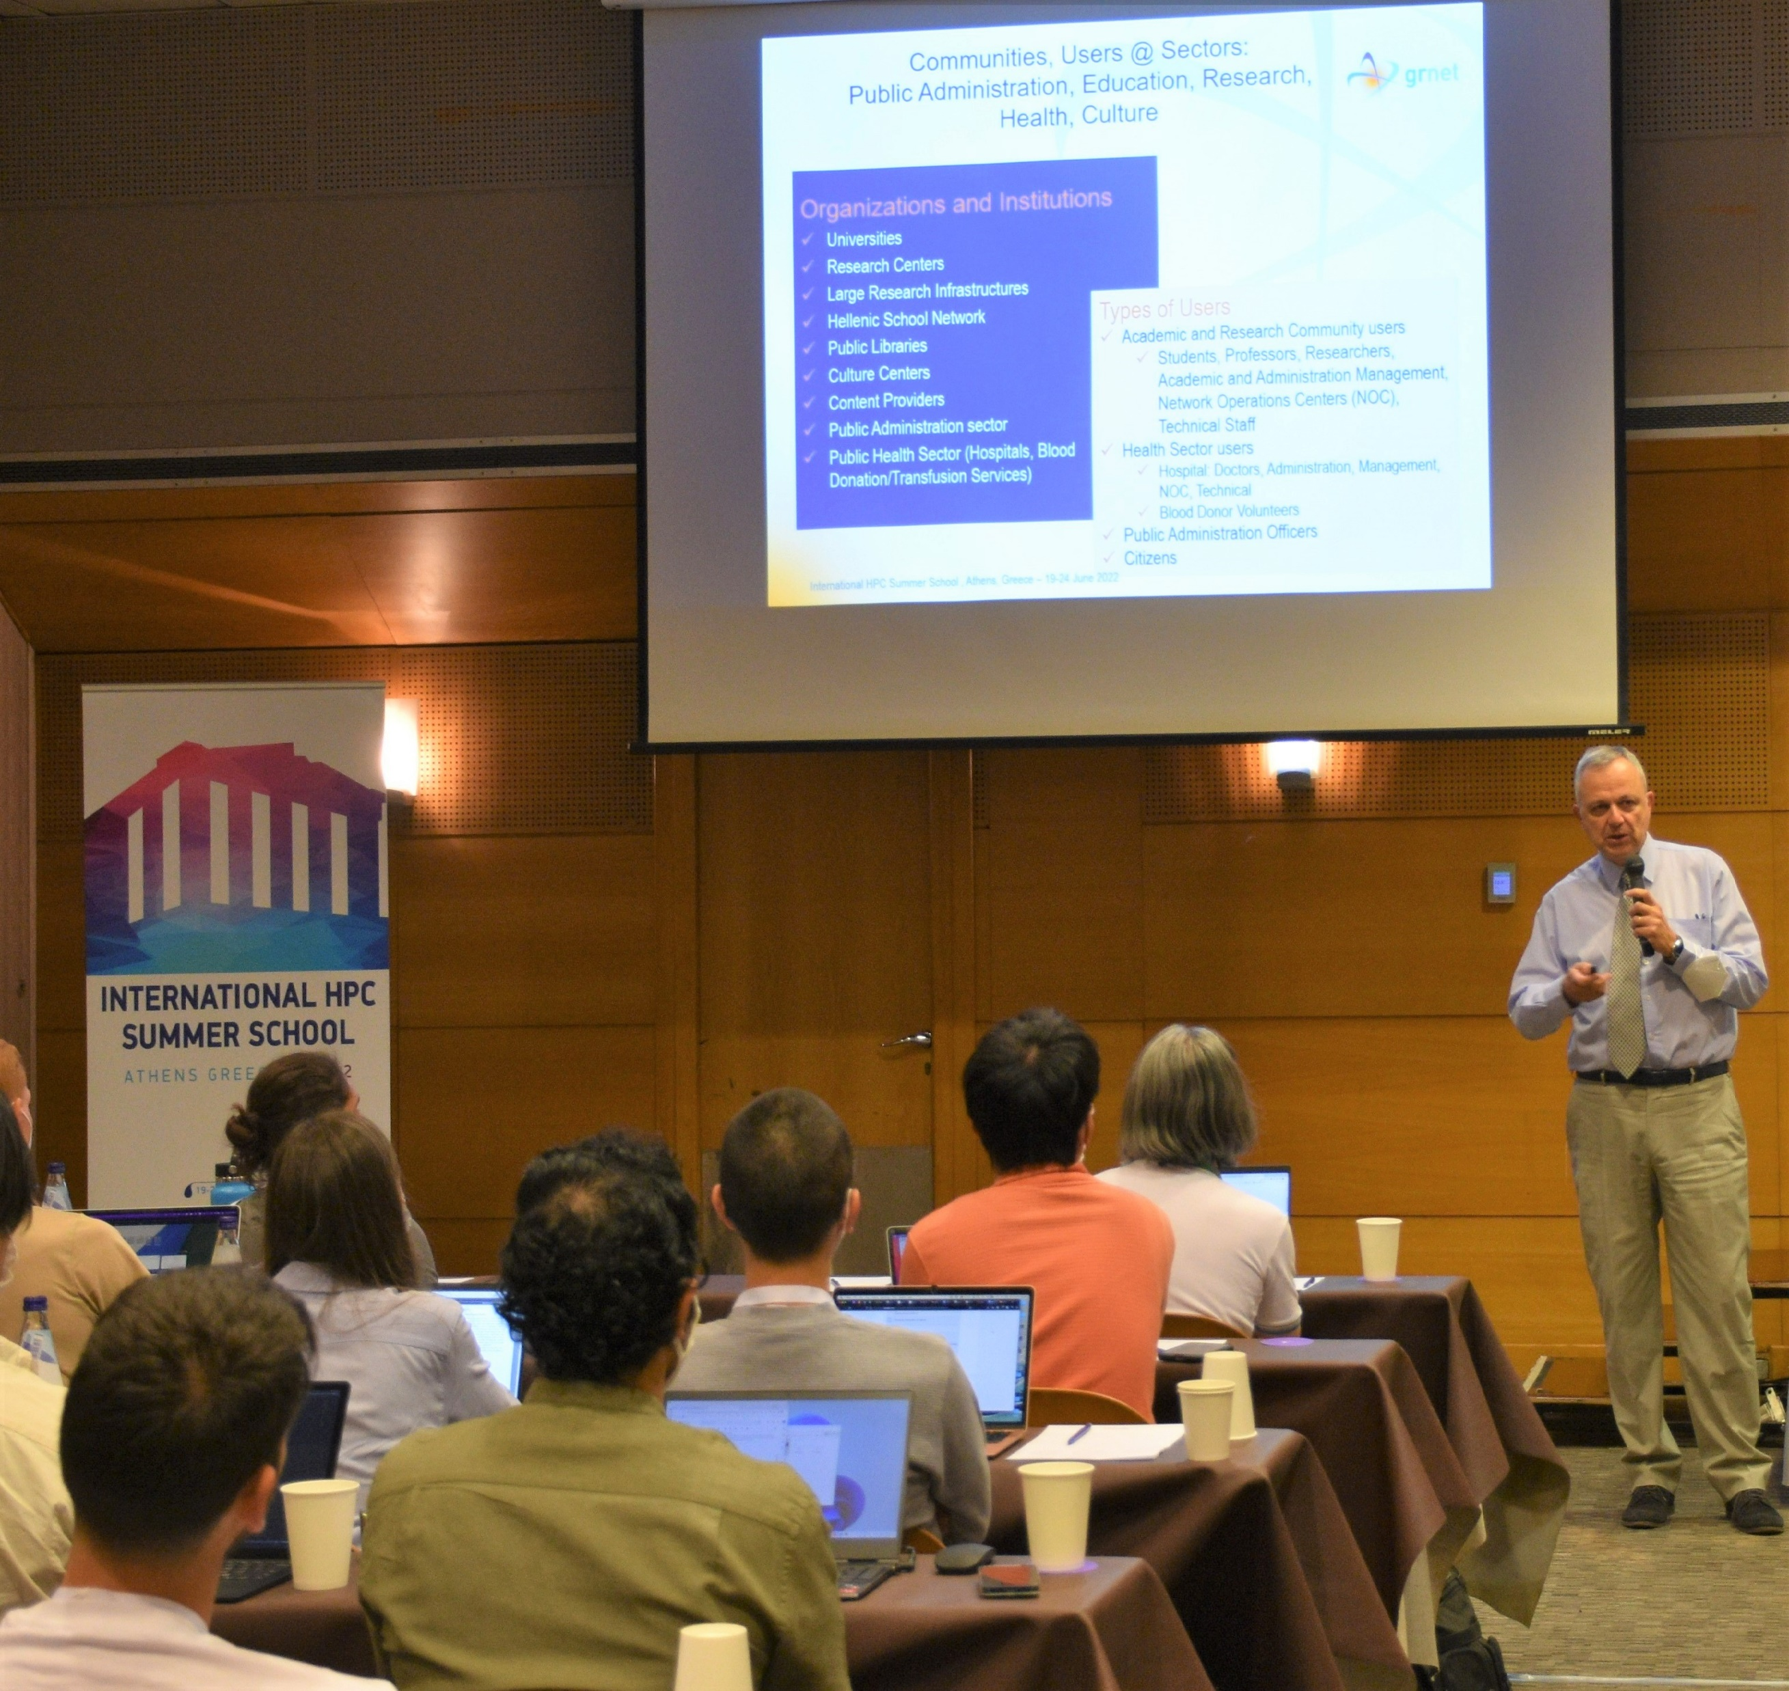
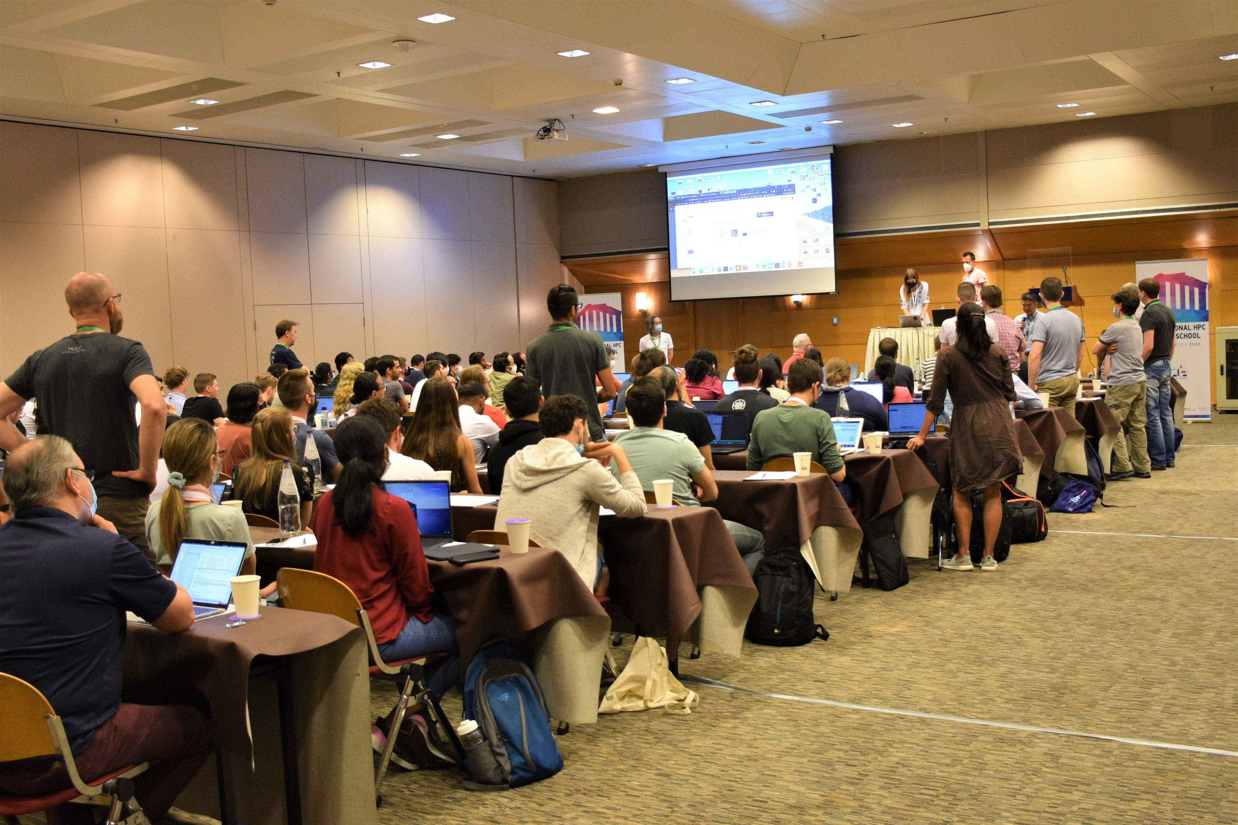
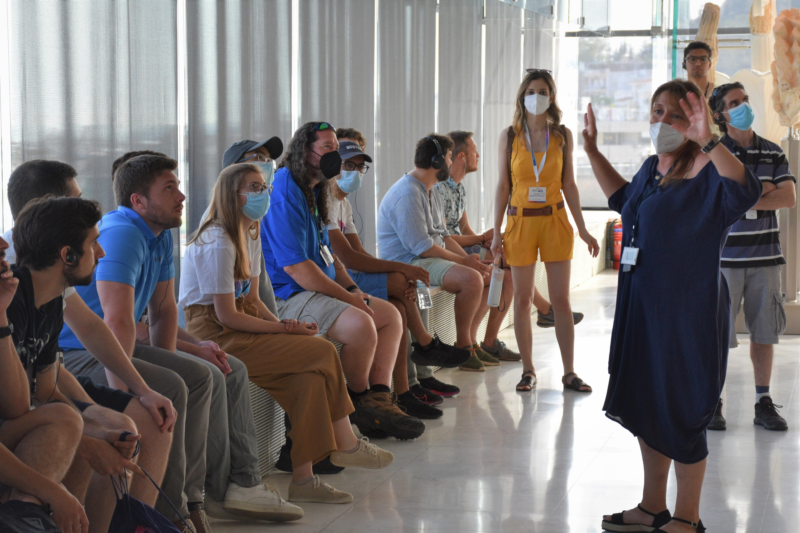
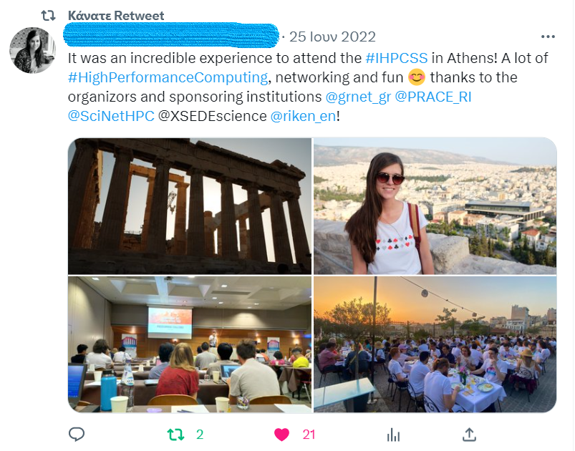
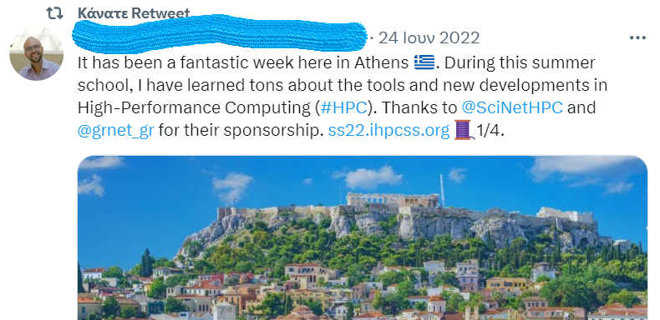
PRACE-6IP – Organising and Hosting 12th IHPCSS 2022 in Greece
Event organisation, execution and dissemination of the 12th International HPC Summer School 2022
1. Contacting with partners, 2. Finding a local Agency, 3. Choosing the Venue, 4. Brand Identity creation
5. Communication strategy creation, 6. Execution

Slide 14

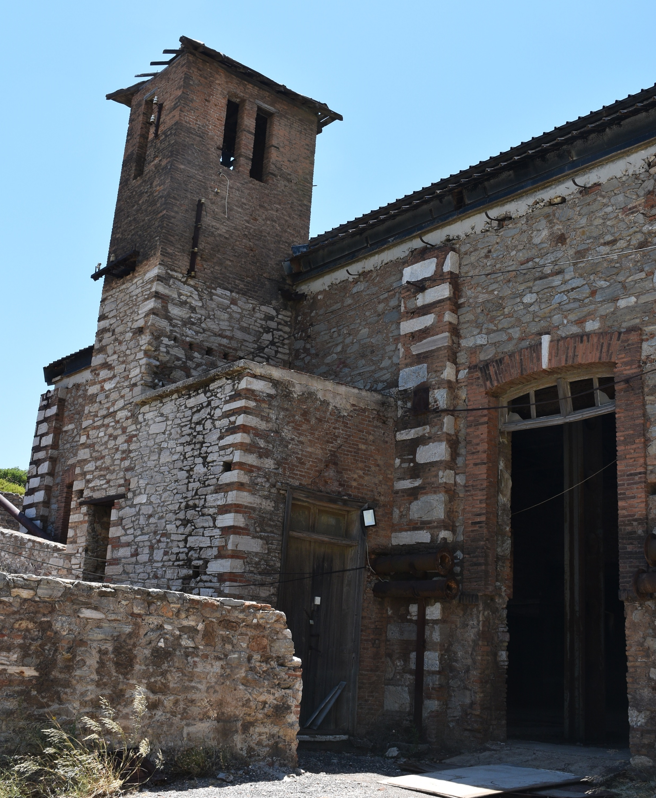
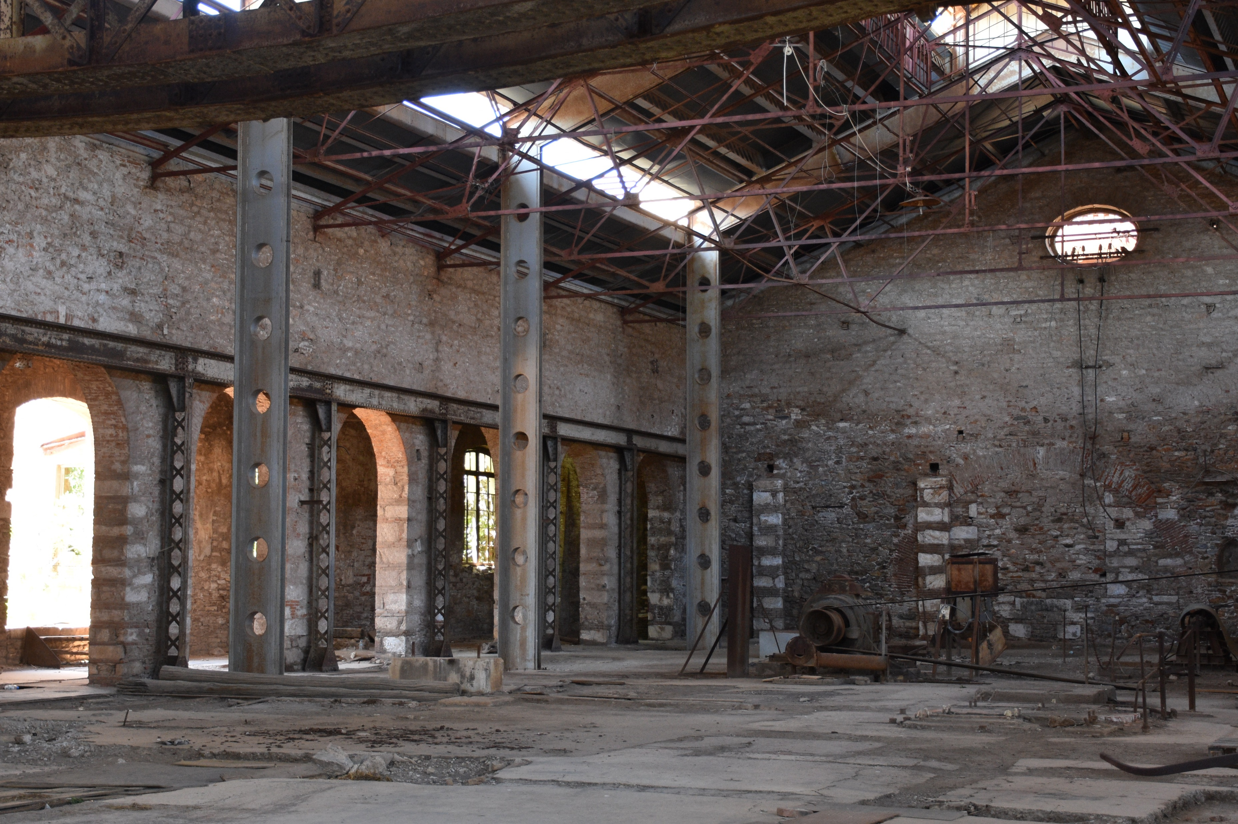
^{New National Supercomputer}
^{DAEDALUS}
2024 installation at the Lavrion Technological and Cultural Park
33Μ euros Build Cost (30% EuroHPC, 70% «Greece 2.0»)
30 Petaflops power
Low energy cost of operation (powered by renewable energy sources and cooled by environmental friendly technology)
Support of scientific research and innovative SMEs/industry with high computational capacity

Slide 15
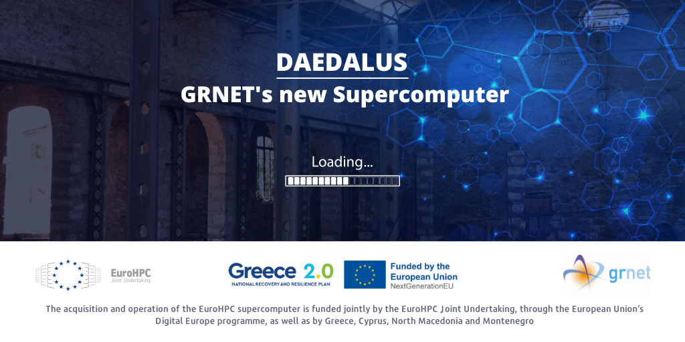
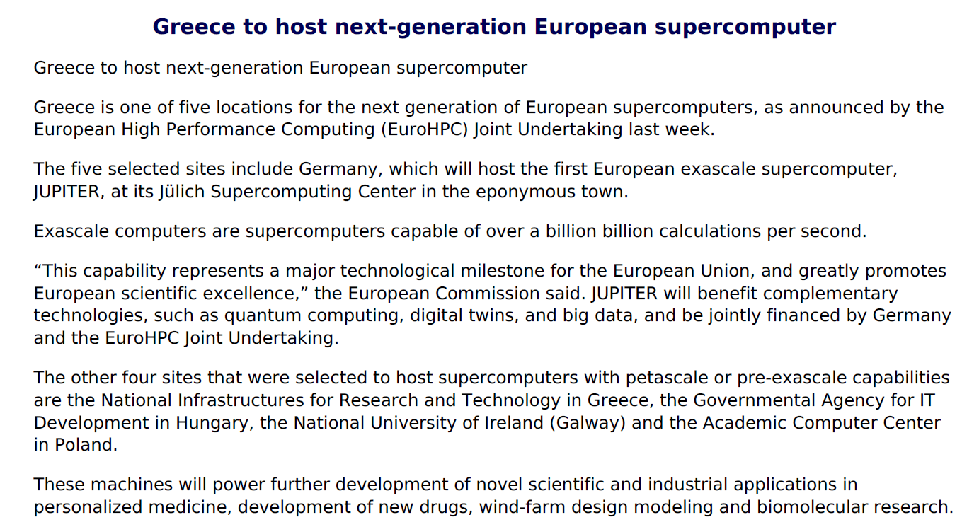

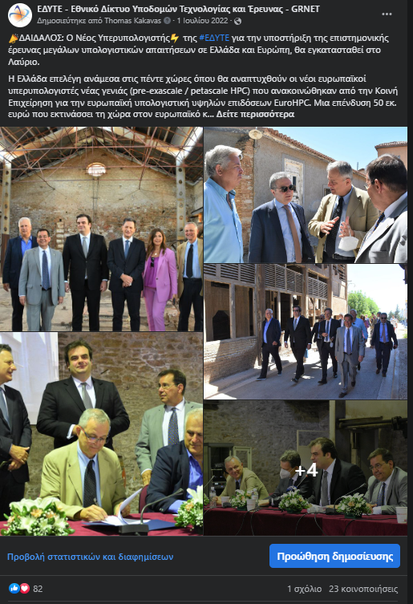
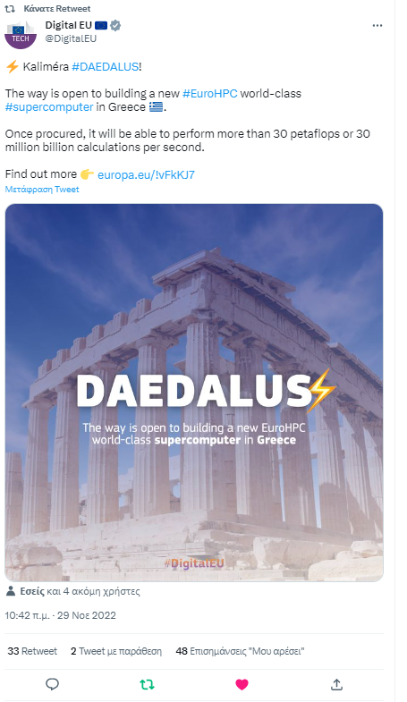
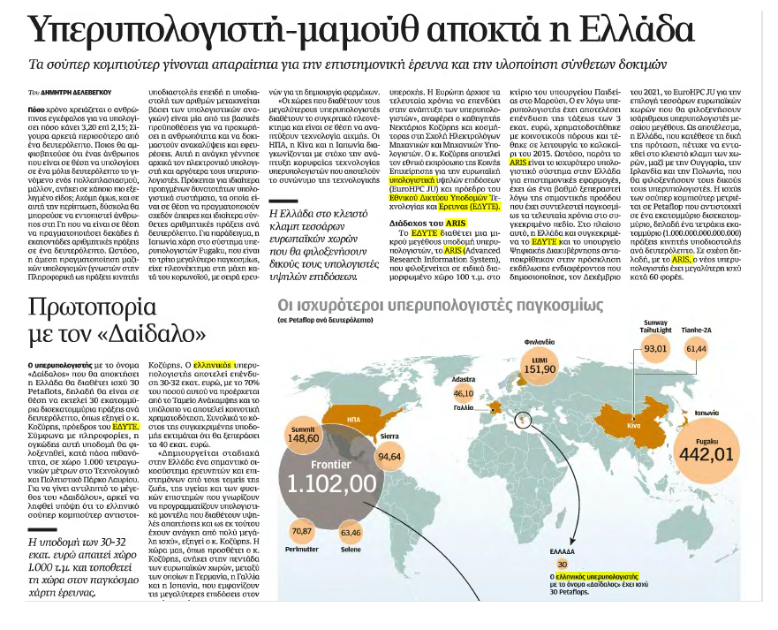



HPC DAEDALUS – Marcomms Strategy and Brand
New Project dissemination & exposure (future infrastructures location visit, banners, Press Release, Social Media, editorials)
Over 70 press articles
Next step: Logo creation
Drafting logo brief, brainstorming with the supercomputer’s architects, in contact with graphic designers

Slide 16




^{EUMaster4HPC - Dissemination}
Project dissemination & promotion (social media posts, promotional campaigns – GRNET & EuroCC@Greece)

Slide 17
^{Thank you!}
^{Ευχαριστούμε!}
^{Kiitos!}

Slide 18





STAY INFORMED
www.grnet.gr
^{FOLLOW US}
grnet.gr
grnet_gr
grnet sa
grnet edyte
grnet.gr
CORPORATE PRESENTATION

