Slide 1
GRNET MarComms work organization: delivering all dissemination activities on time.
Artemis Psarianou, Head of Marketing and Communications – GRNET
Thomas Kakavas, Marketing and Communications Coordinator – GRNET

Slide 2






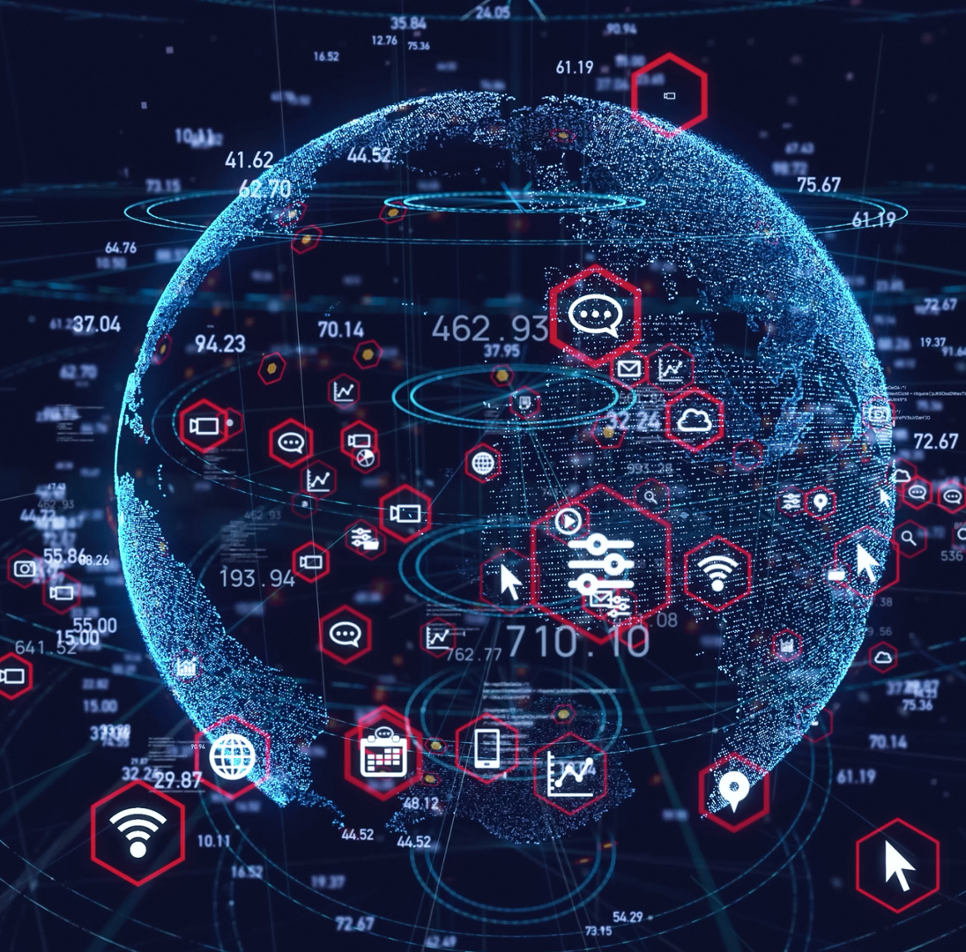
^{GRNET at a glance}
Develops advanced information systems and e-Infrastructures to achieve Greece's Digital Transformation goals
Develops and operates the single digital gateway
^{Gov.gr}
^{Manages a portfolio of}
^{40 advanced Services}
45 National and European Projects
^{Serves hundreds}
^{of thousand}
^{of users}
Operates the optical fiber network
_{10.000 km}
^{Develops and maintains}
^{National Infrastructure}
^{6 Data Centers}
National Supercomputing Infrastructure
^{National HPC Competence Center}
^{GR-IX Greek Internet Exchange}
Develops lessons and initiatives for the digital skills of citizens
Connects International Research and Academic Communities for the dissemination of research and science

Slide 3


^{Marketing} ^{Mission}
Promote the GRNET brand and the key characteristics and benefits associated with the utilization of existing infrastructure and services by the Research and Education communities, Health and Culture organizations and Public Sector entities.
Drive Corporate, Infrastructures, Services and Projects MarComms strategy formulation and execution towards market growth and stakeholder’s engagement.
Direct goal
Increase number of Institutions and end users from all different target audience groups and sub groups, that use existing and new services and infrastructures.
Increase the number of services utilized per existing Institution/user.
Indirect goal
Strengthening of corporate GRNET’s name/brand (enhance brand identity & awareness) – direct association to services/infrastructure/projects it provides, coordinates and participates.

Slide 4
MarComms Department Role – Horizontal Responsibility
Corporate, Infrastructures, (45) Services, (50) Projects
Marketing and Communications strategy, create and develop respective execution plans
Manage the corporate brand (logos, annual report, core ppt, ppt templates, zoom templates, banners, brochures, corporate video and company profile)
Public Relations: Writing and distributing press releases, media monitoring, creating media editorials, national/international PR relations with all key government bodies
Manage brand and content for key marketing channels including for GRNET and all projects/services: Social media, website and email marketing
Collect information, create reports, statistics and charts
Coordination of promotional activities for EU, National and International funded projects
Organise and manage Conferences and Events (external and internal events)

Slide 5




^{MarComms Department Function}
Corporate, Infrastructures, Services, Projects
3. Coordinate and Communicate with Internal and External Audience/ Stakeholders
1. MarComms Strategy and Execution Plan
^{2. MarComms Dept Organisation}
^{of Tasks & Tools}
4. Dissemination and Reporting → Feedback next year’s MarComms Strategy and Plan

Slide 6
^{MarComms Tools}
  1. MarComms Strategy and Execution Plan, 4. Feedback /Reporting
  E-Pasithea tool, Excel budget, Word
  2. MarComms Dept Organisation of Tasks, 3. Tools to Communicate with Audiences
  Task Manager: Excel -> Jira Project Management, Confluence
  Brand Design: Canva (collateral – infographics, banners, video, ppt)
  Internal Comms: Google Drive (excel, word, ppt, google calendar, gmail)
  External Comms: Microsoft OneCloud, DropBox, CMS tool: Moosend tool (registering forms, newsletters, campaigns, media kit on website and logo brand book)
  Cooperation Comms Channels: Slack, Skype, anyDesk, Webex, Jabber Cisco for telephone calls, What’s Up, Viber, Zoom, e:Presence, MS Teams
  Url shortner: Bit.ly, Translating quick reference: DeepL, Systran
  Social Media: TweetDeck, Social Media separate channels, https://fbicons.net/
  WordPress for Website + media kit on website
  Analytics: Yandex Metrica + wordpress tool Matomo
  Storage & Collaboration: WP/Wiki/Booking Rooms/VPN & Storage Room
  Events: Indico, Moosend
  Media Monitoring Service: Innews –(in future analytics) + adobe acrobat
  Procedures, Training and Operations Manual
  MarComms 3yr Strategy
  Flipbook for annual reports

Slide 7
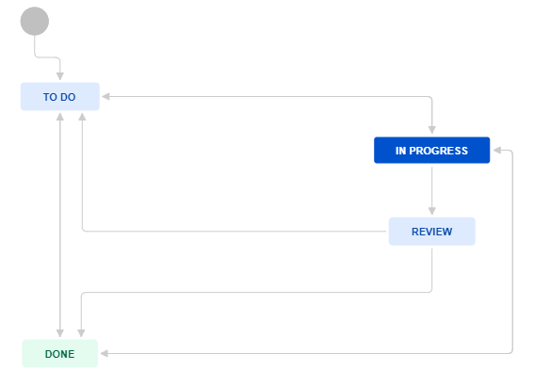
Atlassian-Confluence Jira Task & Project Management Software
GRNET organisation
7 Horizontal Departments one of which is MarComms and 7 Directorates
Introducing our 4 MarComms Team members: Head of Dept: Artemis Psarianou, Coordinators: Thomas Kakavas, Alexandra Malouta, George Marandianos
Organised MarComms work: 4 issue types, 4 components and a variety of standard labels
Task Steps
Assign Task to member
Start process – In progress, comments, collaboration tools
Review – comments/more coordination
Done
JIRA PROJECT | ISSUE TYPE AND ISSUE SUB TYPE | COMPONENT | LABELS
GRNET MarComms Department | Corporate | MARKETING MΑΤERIALS | print, audiovisual, banners/signs, presentation, newsletter, email campaign, Social Media posts, Social Media paid add, website
 | Project | PR | copywrite, contacts, communication, press release
 | Service | EVENT | logistics, production
 | Directorates | MNGT Report | strategy, deliverable, admin, coordination

Slide 8
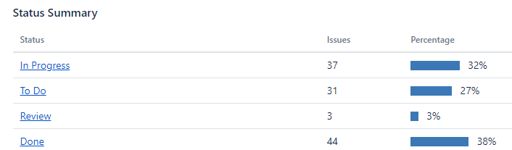
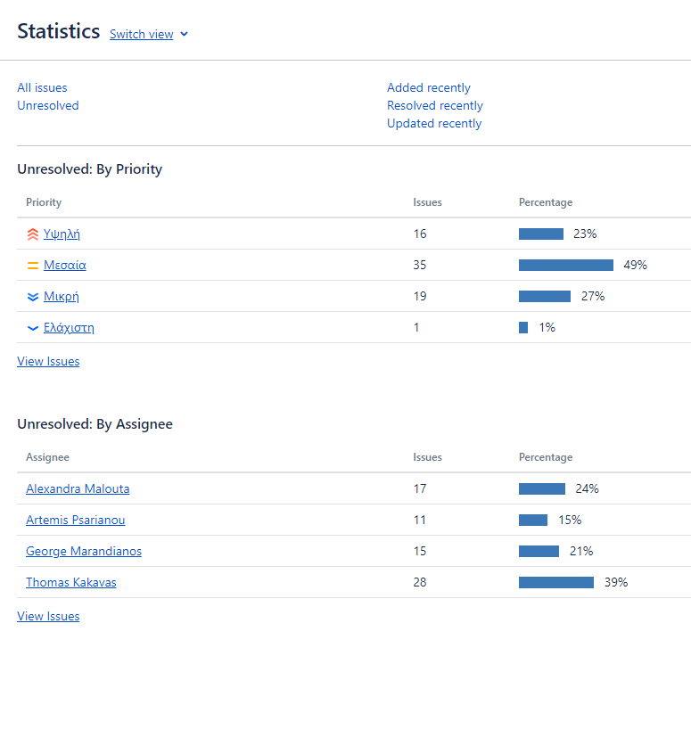
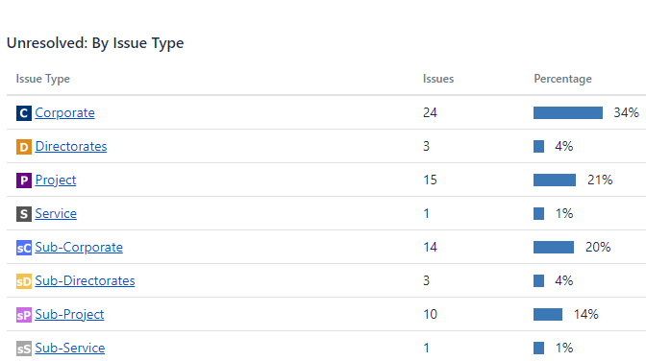
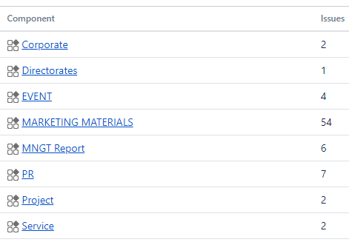
Atlassian-Confluence Jira Task & Project Management Software

Slide 9
GRNET MarComms Highlights 2022 vs 2021 (1/2)
MarComms Media & Tools | 2022 | 2021 | % Change ‘22 vs ‘21
Website posts in Greek | 156 | 98 | 59
Website posts in English | 134 | 76 | 76
Facebook Followers | 10.011 | 9.013 | 0
Facebook Posts | 220 | 213 | 3
Instagram Followers | 1.095 | 985 | 11
Instagram Posts | 184 | 162 | 14
Twitter Followers | 3.318 | 3.162 | 5
Twitter Posts | 612 | 185 | 231
LinkedIn Followers | 8.699 | 7.127 | 22
LinkedIn Posts | 192 | 160 | 20
YouTube Subscribers | 450 | 380 | 18
YouTube uploads | 31 | 33 | -6
Banners designed | 300 | 180 | 67
Events organised | 4 | 2 | 100
Events disseminated | 41 | 16 | 156
Newsletters / campaigns | 14 | 12 | 17
Website Visitors | 4.763 | 4.106 | 16
Media Clippings | 2.008 | 3.811 | -47
Press Releases | 32 | 14 | 129

Slide 10
GRNET MarComms Highlights 2022 vs 2021 (2/2)

Slide 11
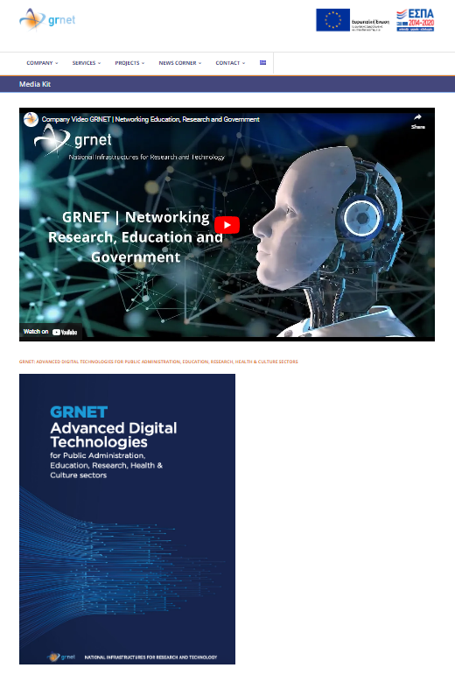
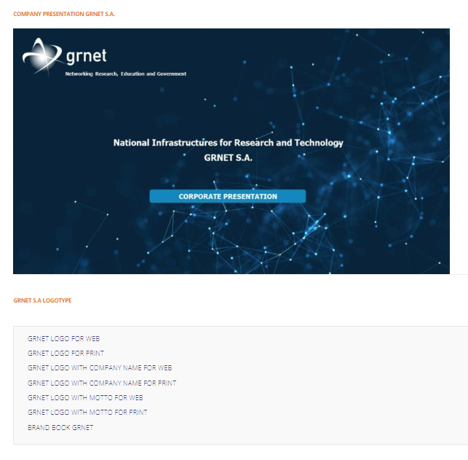
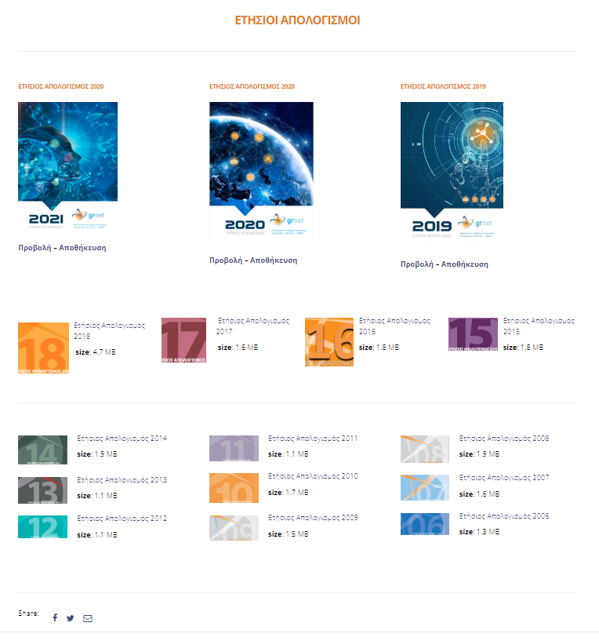
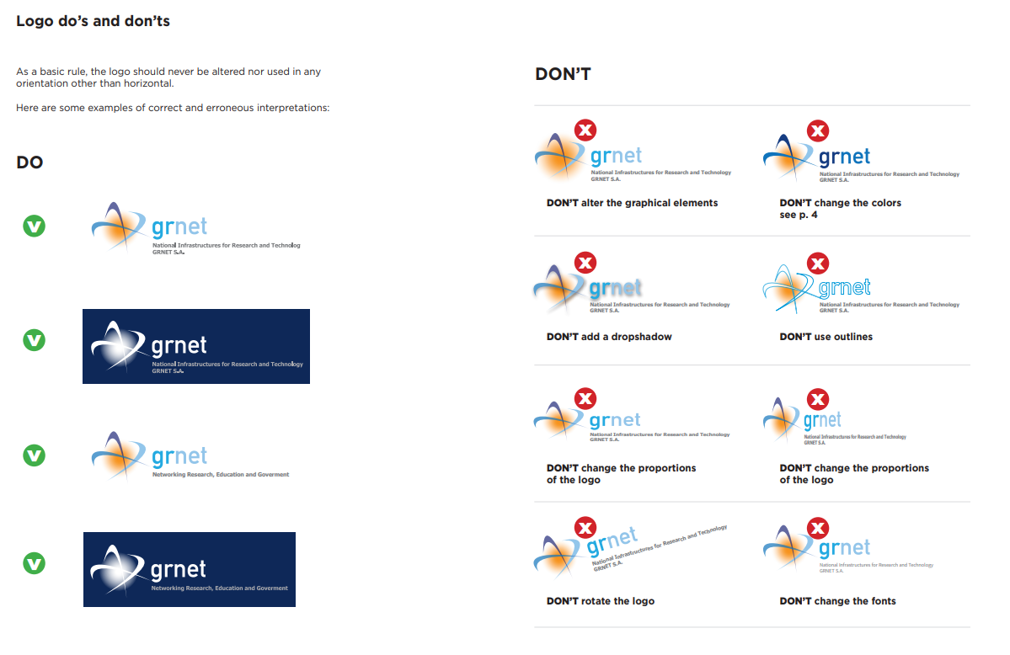
Brand Consistency
Company ppt
GRNET Annual Report Flip Book
Corporate Video
GRNET Website
Media Kit
Logo & Brand Book
Company
Brochure

Slide 12
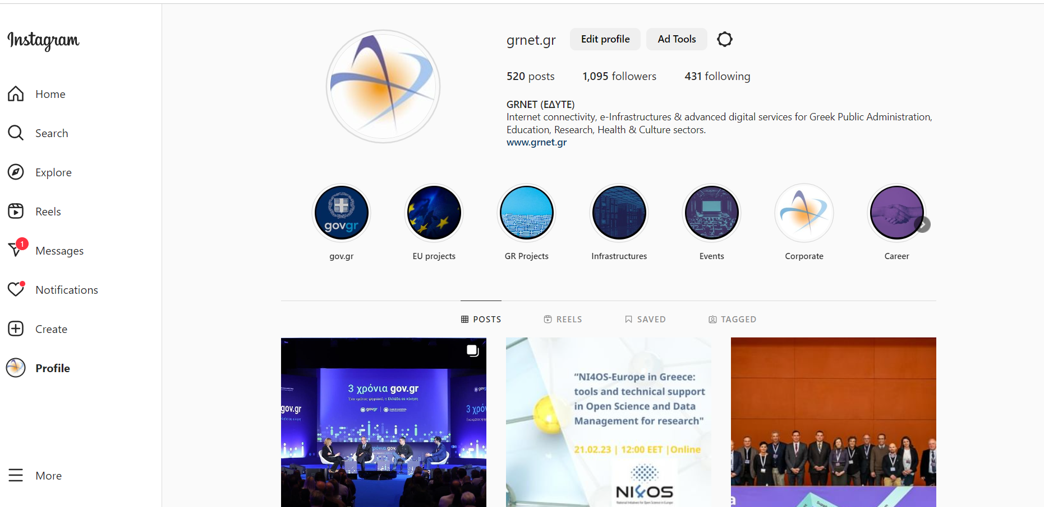
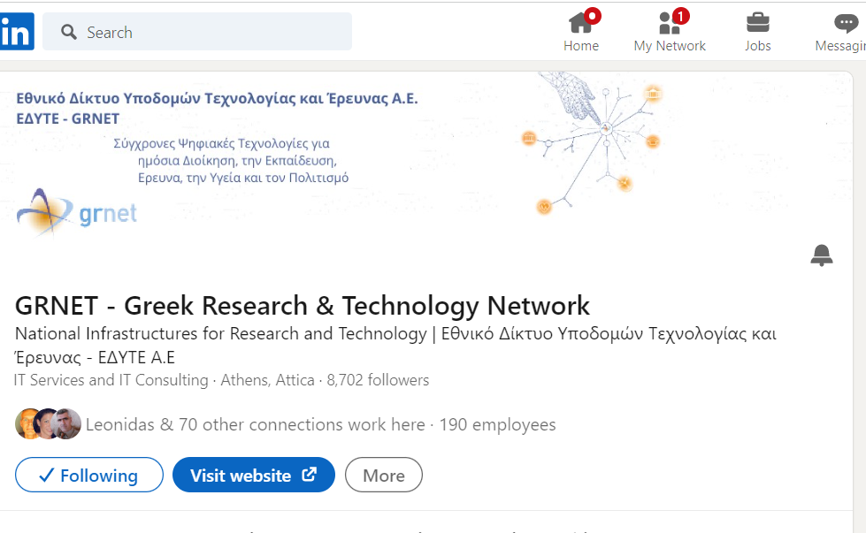
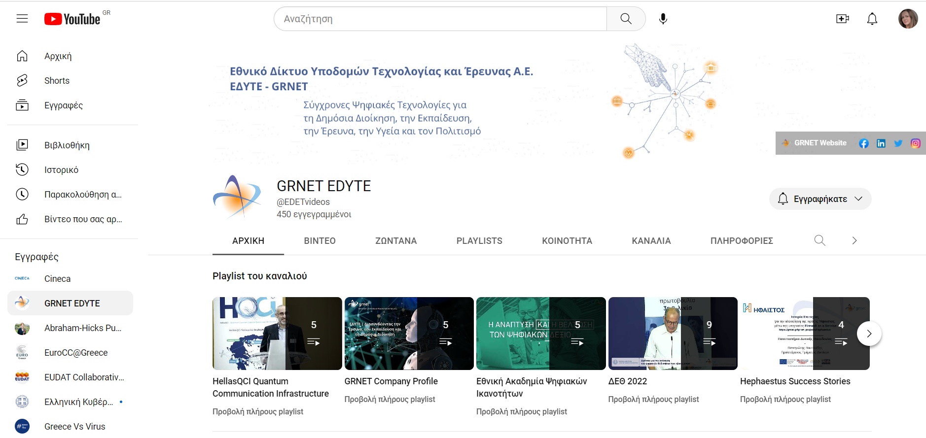
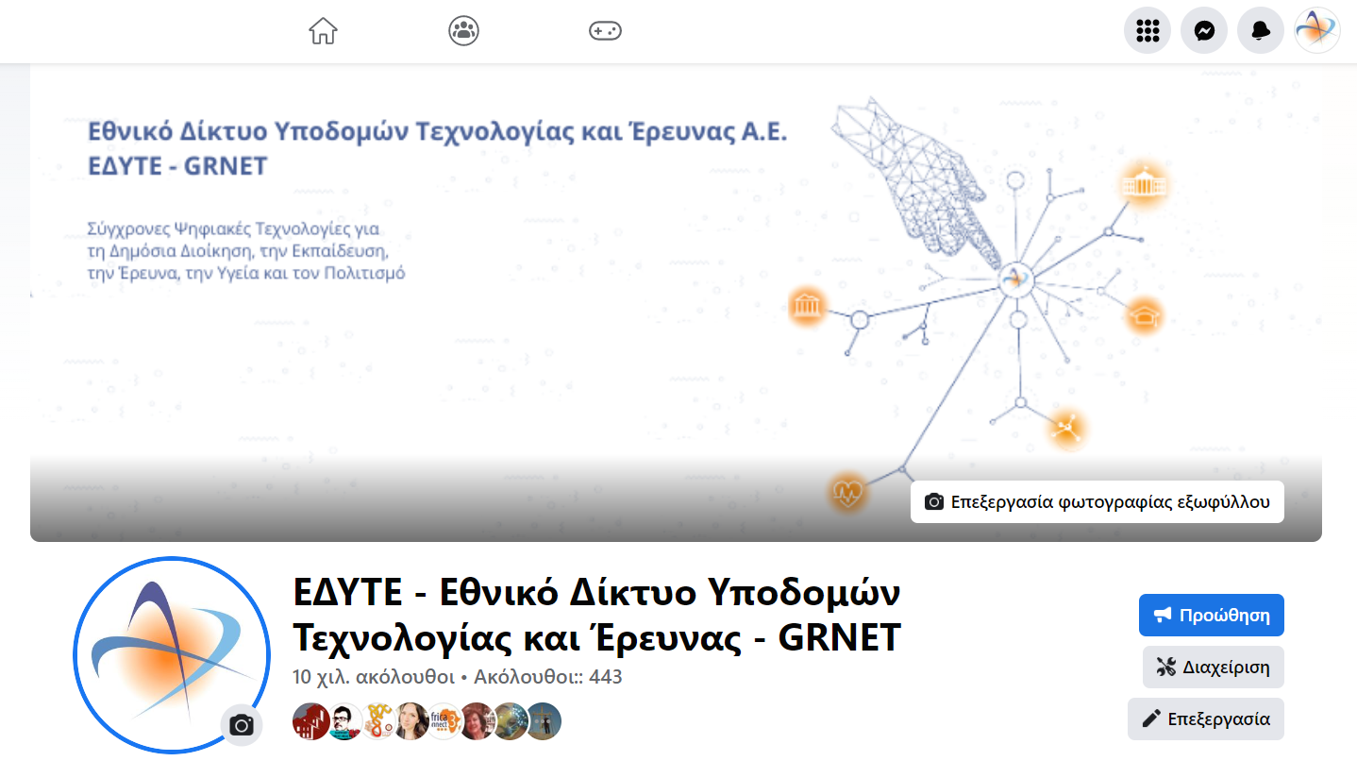
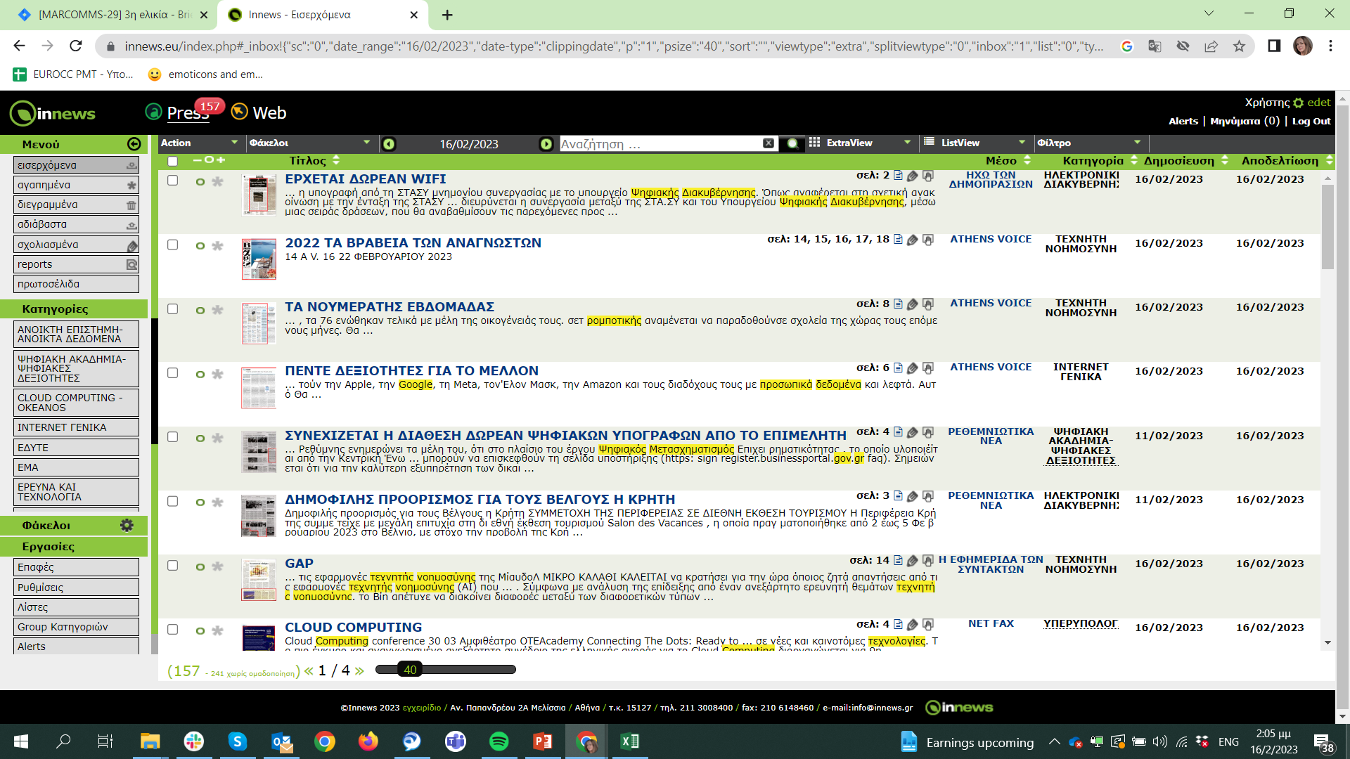
GRNET Online Media Channels Brand
GRNET Press Clippings
Innews Tool

Slide 13








Brand Consistency
New Banners

Slide 14





STAY INFORMED
www.grnet.gr
^{FOLLOW US}
grnet.gr
grnet_gr
grnet sa
grnet edyte
grnet.gr
marcomms@grnet.gr

