Slide 1


NRENs and their contribution to UN SDGs
Naira Kocharyan
SIG-Marcomms Spring meeting, February 21-22 2023

Slide 2


The Agenda 2030
17 Goals
169 targets
over 230 indicators to measure the progress

Slide 3
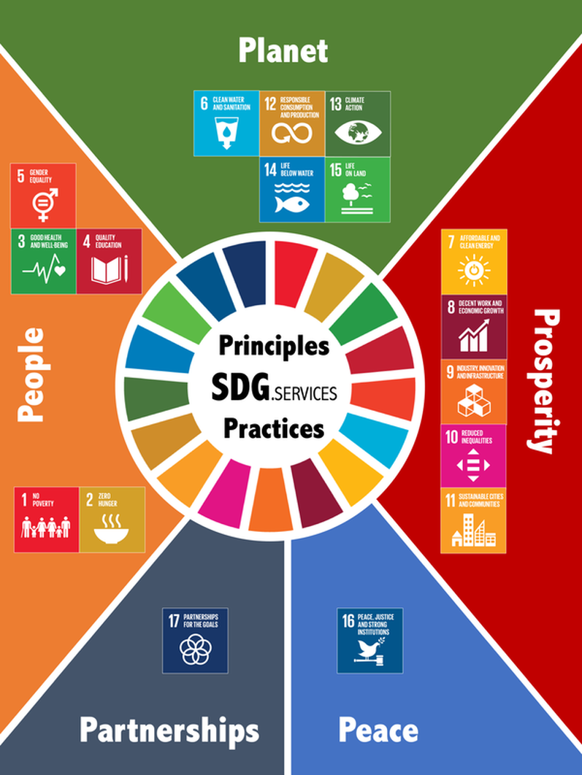
Comprehensive action plan for people planet and prosperity
Five Pillars
social
environmental
economic
peace
partnership
Four fundamental principles embedded
integration
universality
inclusivity
leaving no one behind

Slide 4
Promoting NRENs' mission and work through the lenses of the United Nations Sustainable Development Goals.
UN SDGs - in line with the impact of the scientific endeavours of the European R&E community and its funding.
GÉANT (GN5-1)
Focus on
  SDG 4: Equitable Quality Education.
  SDG 9: Inclusive Infrastructure to Foster Innovation.
  SDG 17: Implementing Global Partnerships for Sustainable Development.

Slide 5
The Goals may seem
overwhelming
and complicated
The SDGs is to create focused collective action to tackle global issues
There aew global challenges no company could tackle alone
The role of individual companies is to align their efforts with the most relevant SDGs.
Understand and align SDGs
Define Priorities
Identify SDG targets,
set the goals
Report and communicate
Integrate,
Innovate and collaborate

