Slide 1
GRENA's work to promote EOSC through the lenses of
the UN SDGs
Tamara Gvenetadze

Slide 2
Open Science as a cornerstone of the
UN’s Sustainable Development Goals
The UN’s SDGs (Sustainable Development Goals) are the UN’s approach to address the global challenges that humanity faces. Open Science is a key cross-cutting contributing factor, supported by developments in Science Technology and Innovation (STI) and the importance that immediate access to international research outputs is available for all.
As these critical human challenges are developed and solutions discovered, the UN needs a way to advance progress and gather output of each of the SDG programmes. For this reason, they have launched the UN Connect 2030 Platform which will serve as a gateway for information on STIs in and beyond the UN, including access to open access publications.

Slide 3
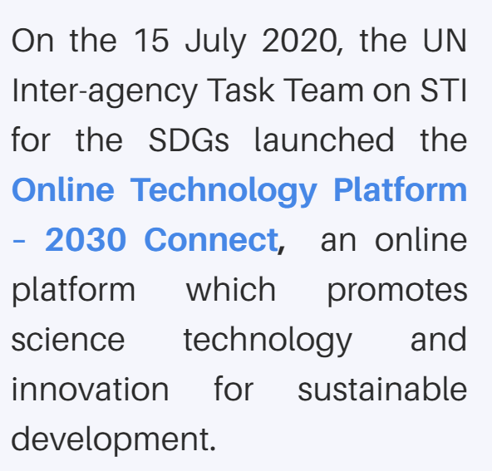
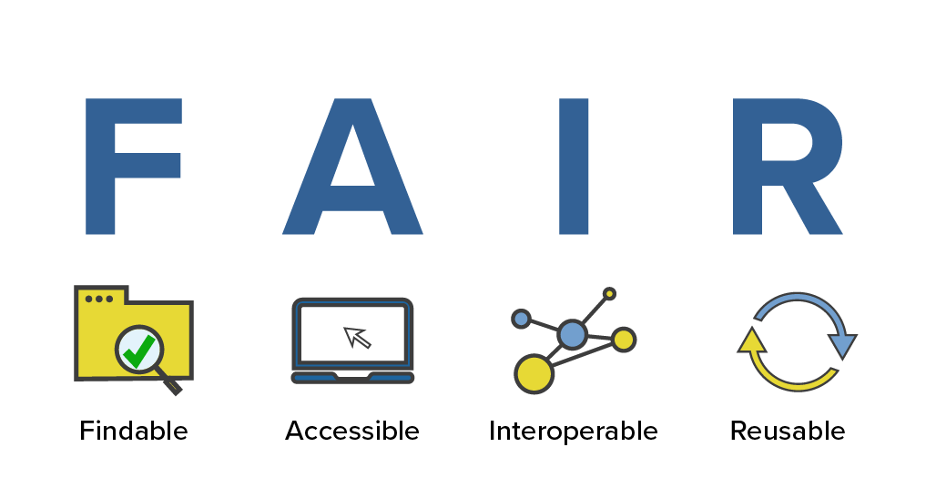

Slide 4
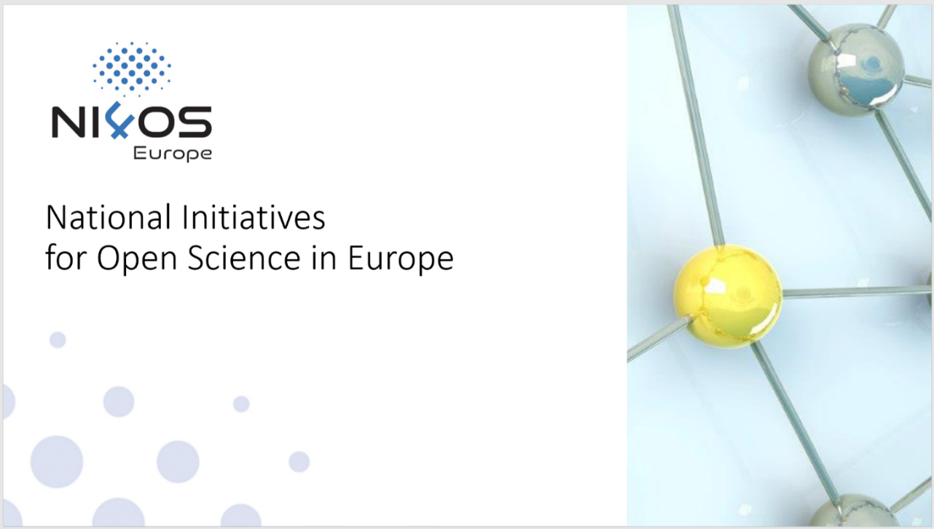
NI4OS Europe
NI4OS-Europe project intends to support the development of national Open Science Cloud schemes in 15 EU Member States and associated countries. The project aspires to enable researchers of the region to store, manage, analyze and share open scientific data, enhancing their work, boosting innovation in Science.

Slide 5
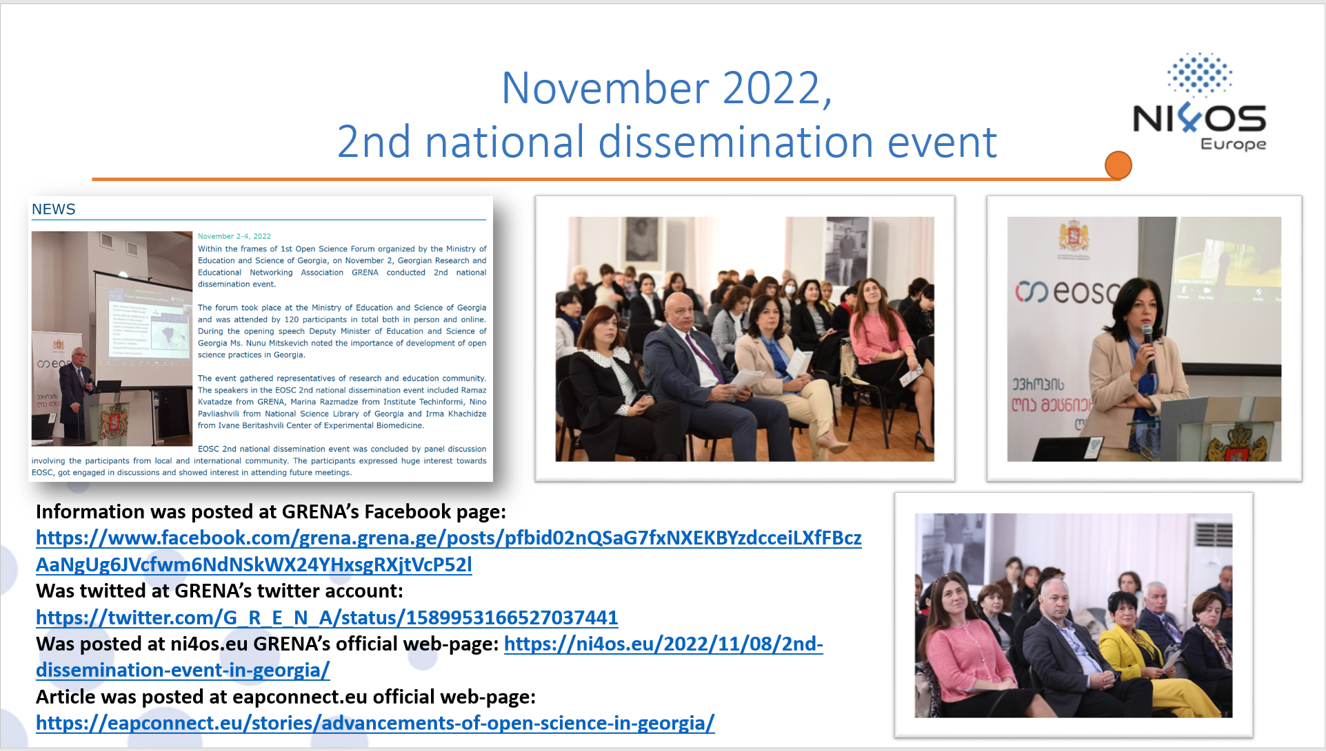
NI4OS Europe

Slide 6
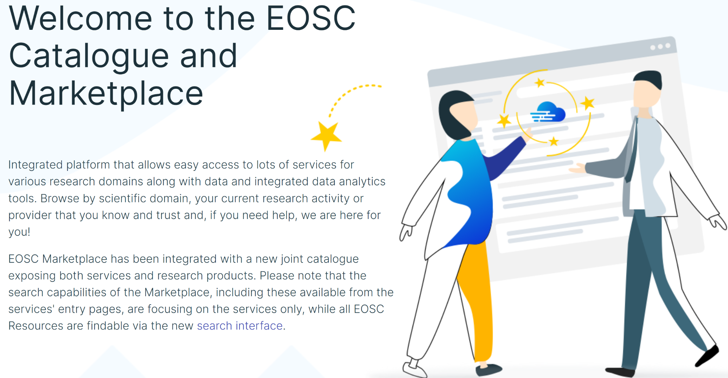
EOSC MARKETPLACE

Slide 7
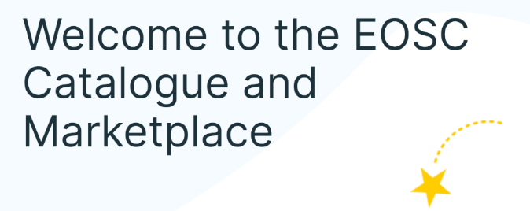
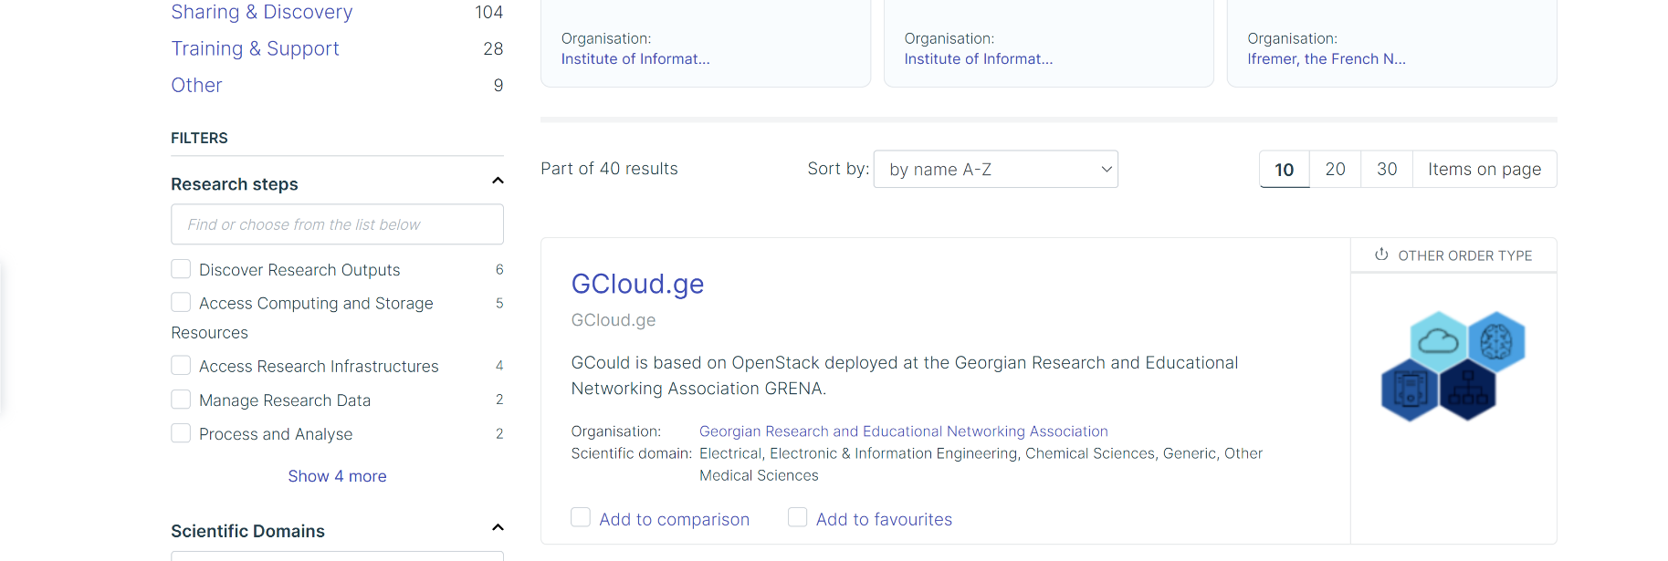

Slide 8
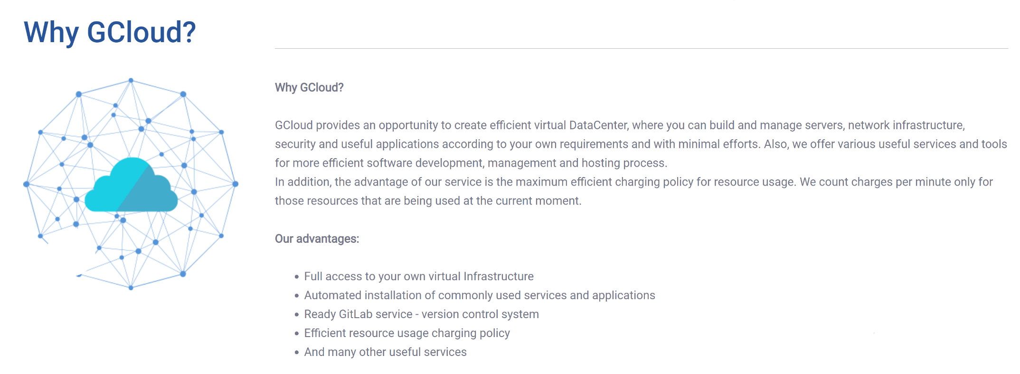
GCloud.ge

Slide 9
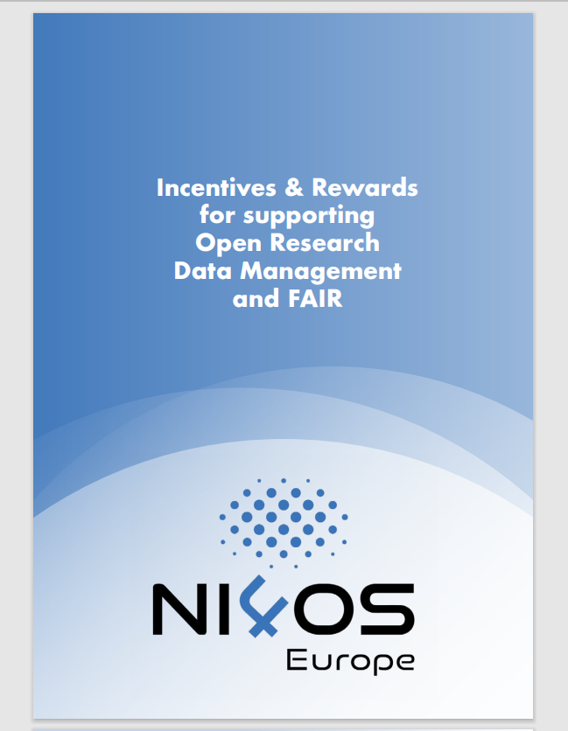
Awareness
Translation of "Incentives and rewards for supporting ORDM and FAIR"was completed. The material was translated from English into Georgian language.

Slide 10
Thank you for your attention.

