Slide 1
GRENA's work to promote EOSC
Tamara Gvenetadze

Slide 2

NI4OS Europe
NI4OS-Europe project intends to support the development of national Open Science Cloud schemes in 15 EU Member States and associated countries. The project aspires to enable researchers of the region to store, manage, analyze and share open scientific data, enhancing their work, boosting innovation in Science.

Slide 3
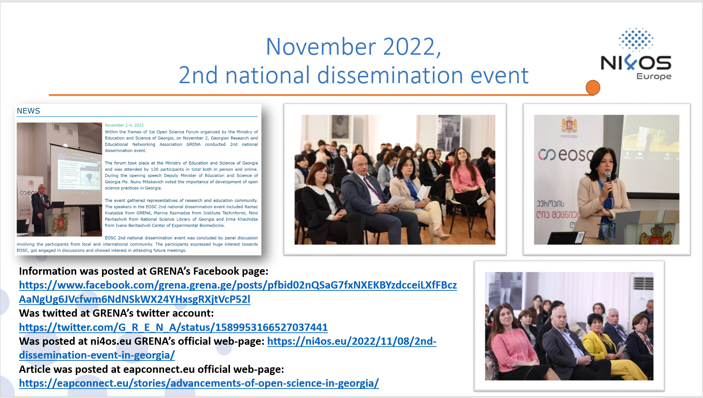
NI4OS Europe

Slide 4
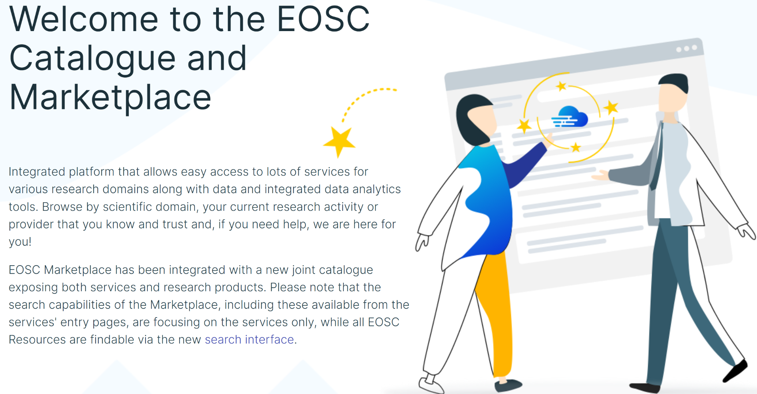
EOSC MARKETPLACE

Slide 5

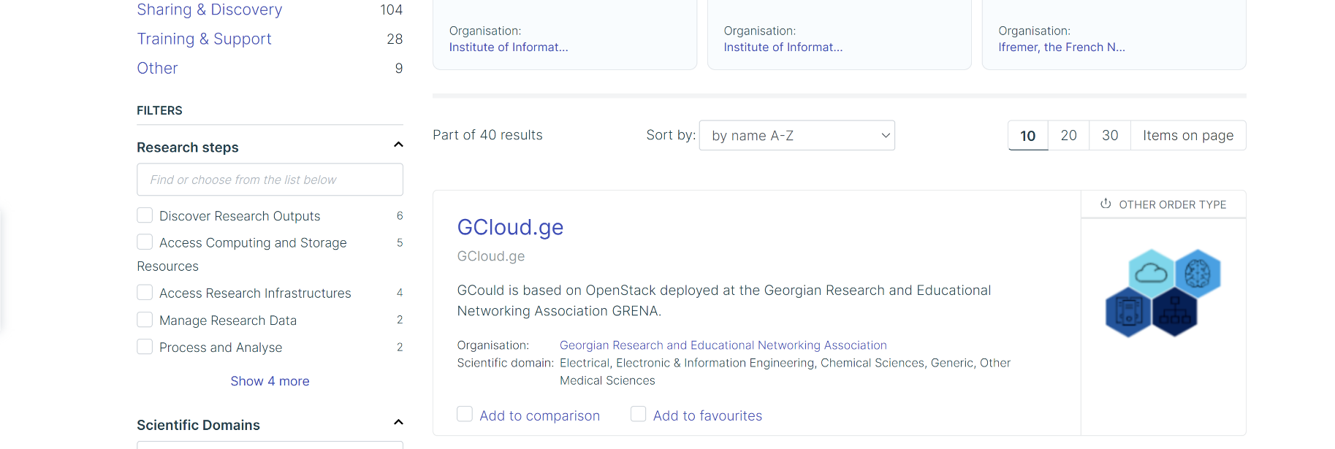

Slide 6
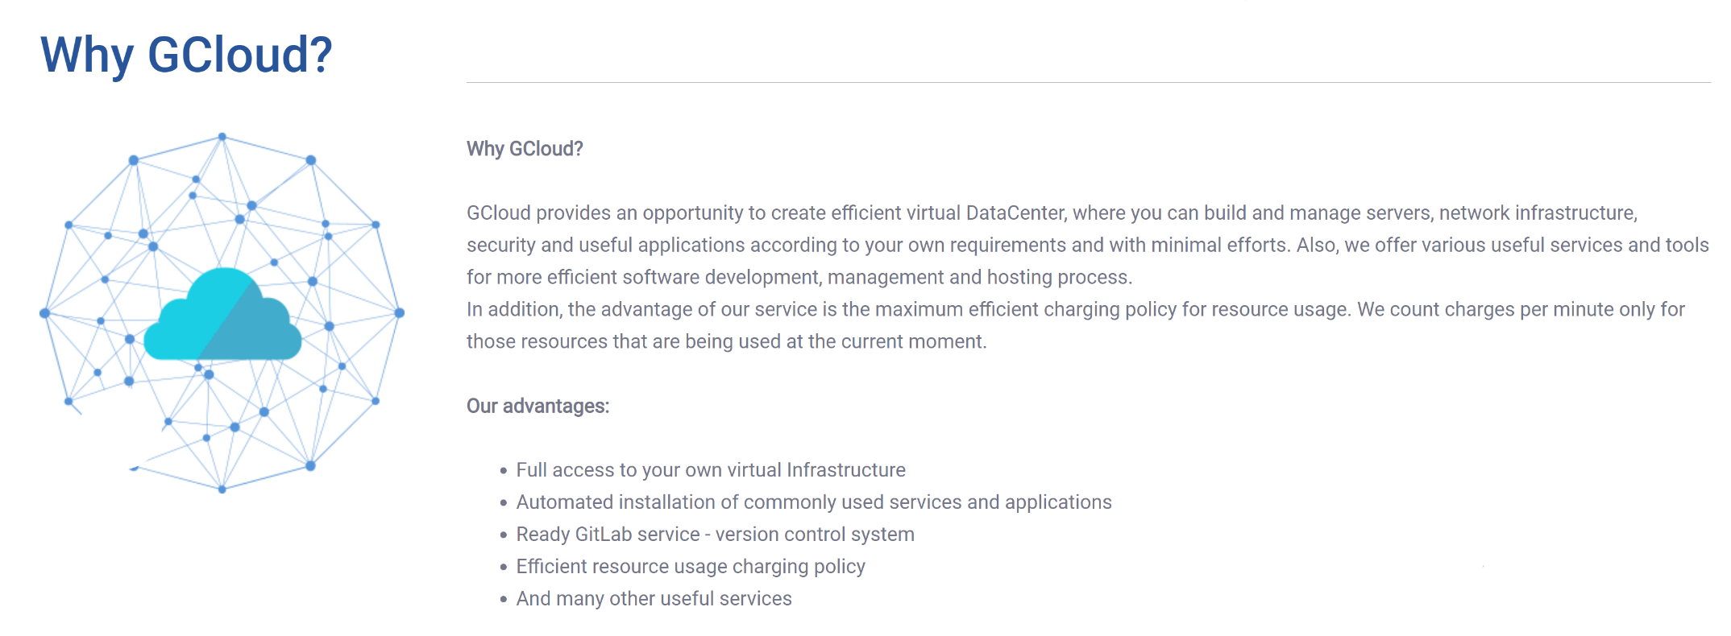
GCloud.ge

Slide 7
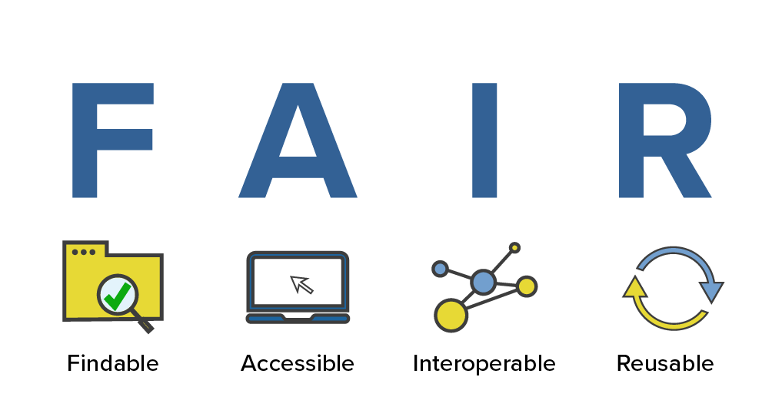

Slide 8

Awareness
Translation of "Incentives and rewards for supporting ORDM and FAIR"was completed. The material was translated from English into Georgian language.

Slide 9
Thank you for your attention.

