Slide 2

AI Tool kit

Slide 3
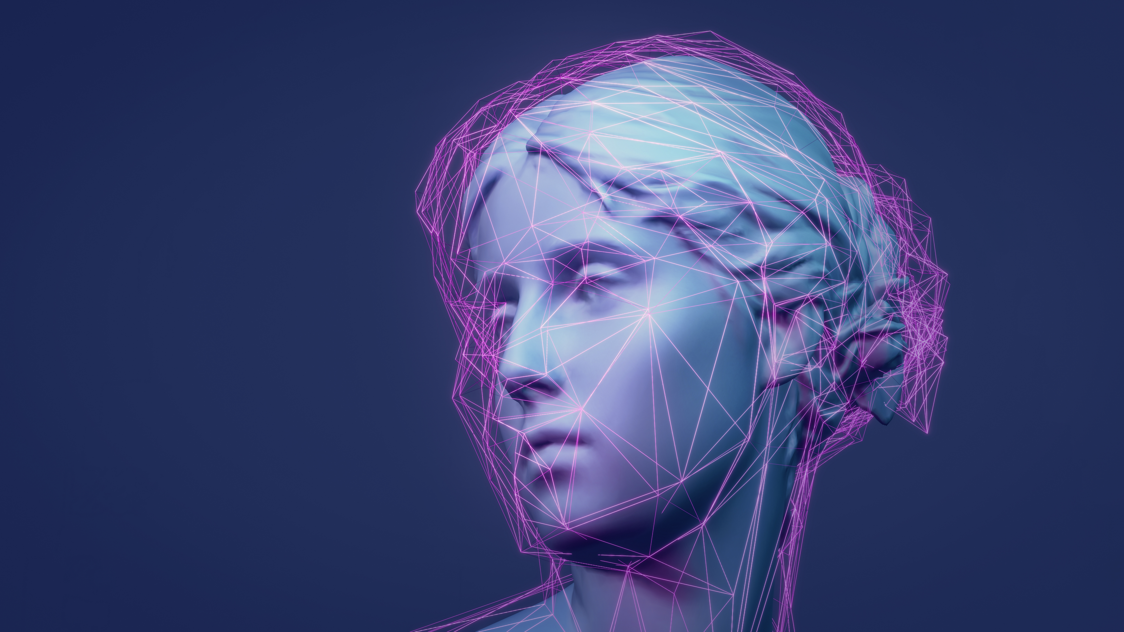
Don’t be afraid
Hundreds of apps have been developed in the last years.
Not only big players like Google and Microsoft but also small start-ups are implementing AI in other fields.

Slide 4
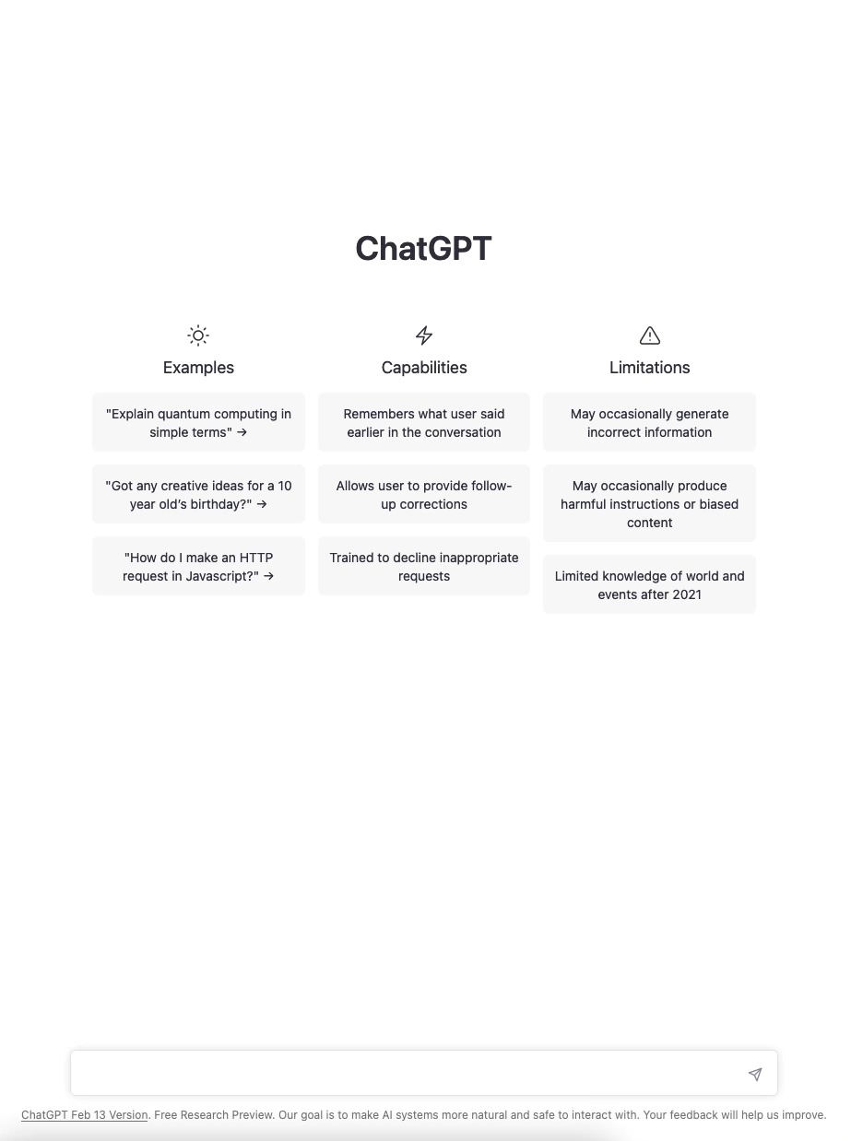
Generative pre-trained transformer
ChatGPT
It gives you any kind of answer
It is used to write marketing plans, social media posts, essays and even HTML code.

Slide 5
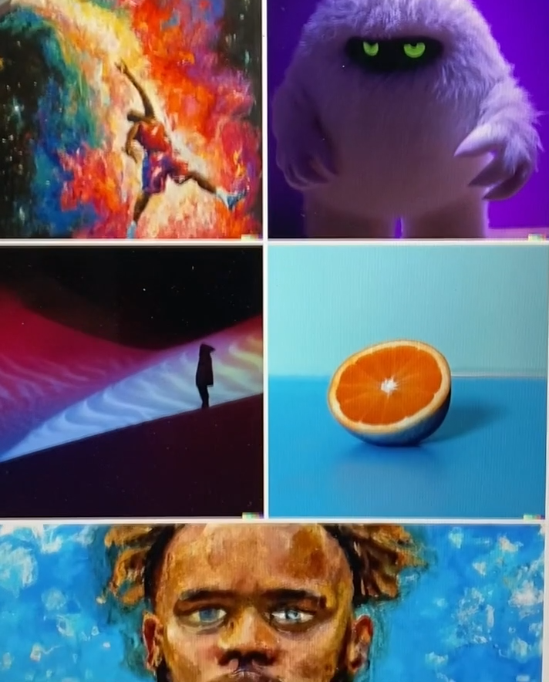
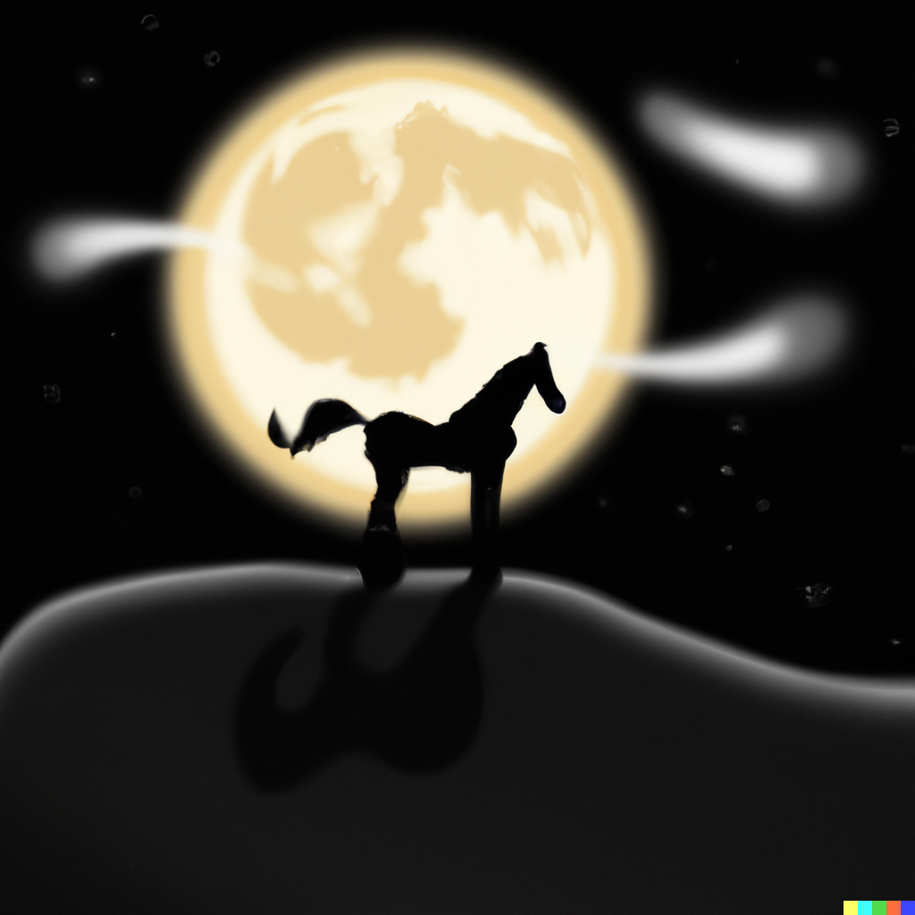
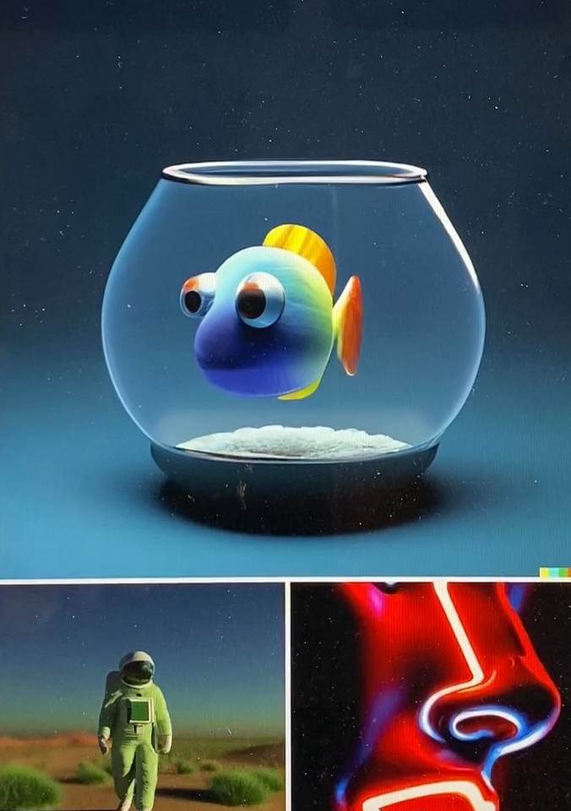

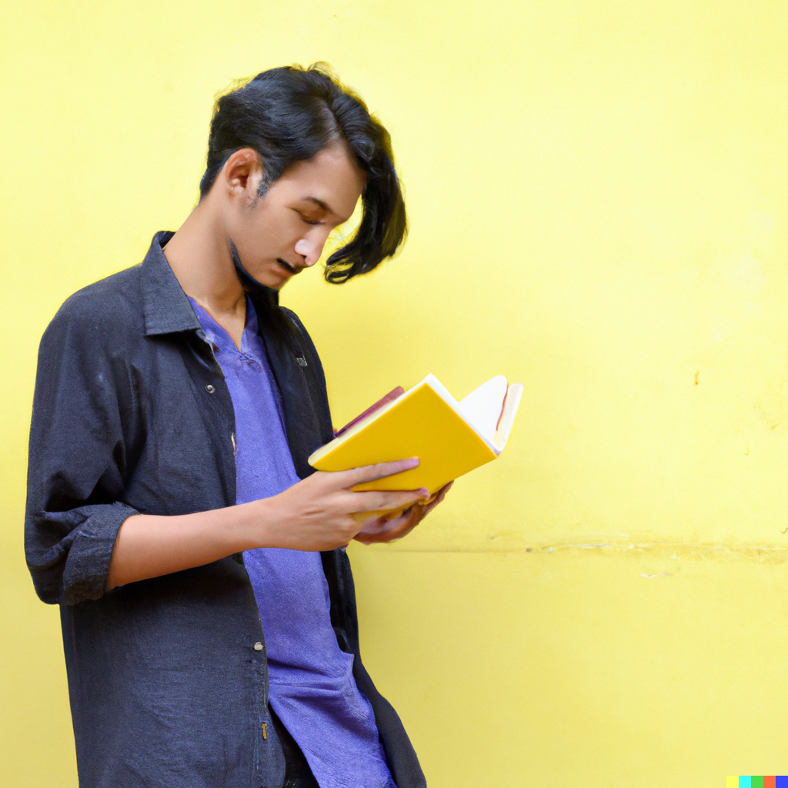
images
DALL-E 2
It creates images from your descriptions
Descriptions must be very detailed and accurate
It gives the opportunity to keep modifying the picture and fixing bugs

Slide 6
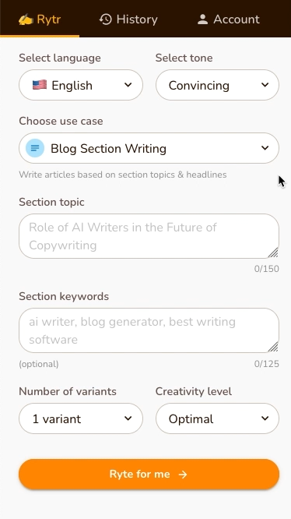
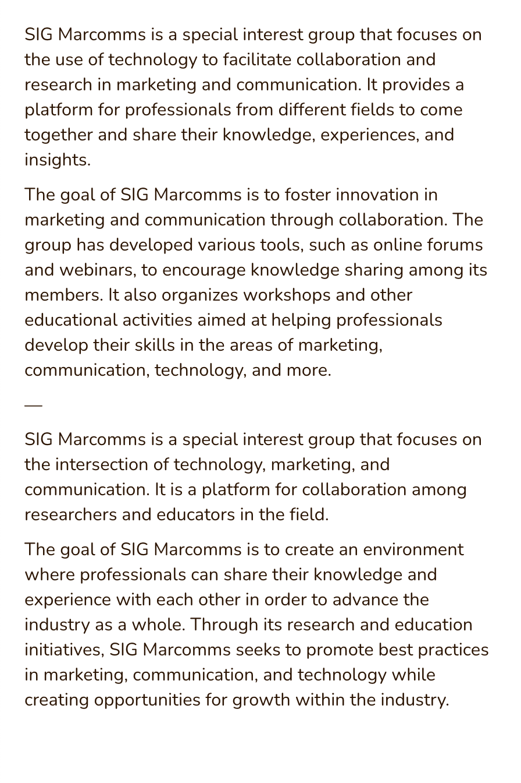
Text generator
RYTR
Easier than ChatGPT, keywords, not prompts
It makes you choose amongst case studies
The free version is limited to a certain amount of credits

Slide 7
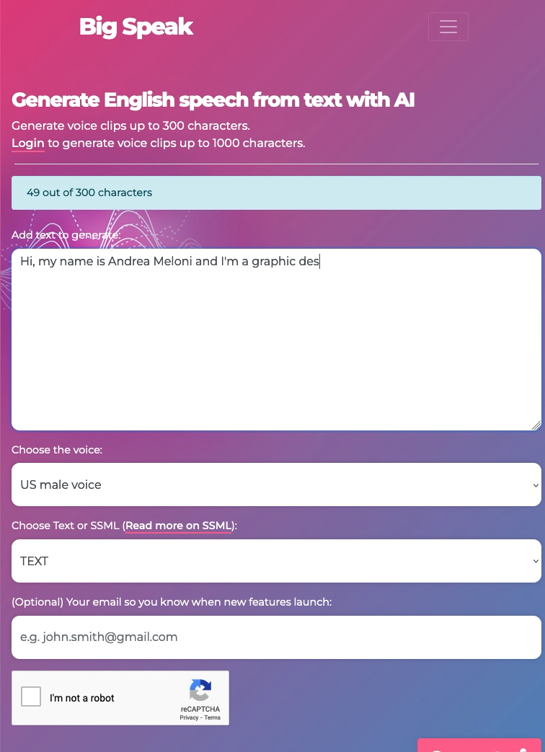
audio
BIG SPEAK
It creates voice-overs from text
Audio files are limited to 300 characters each
Limited number of voices and not too natural

Slide 8
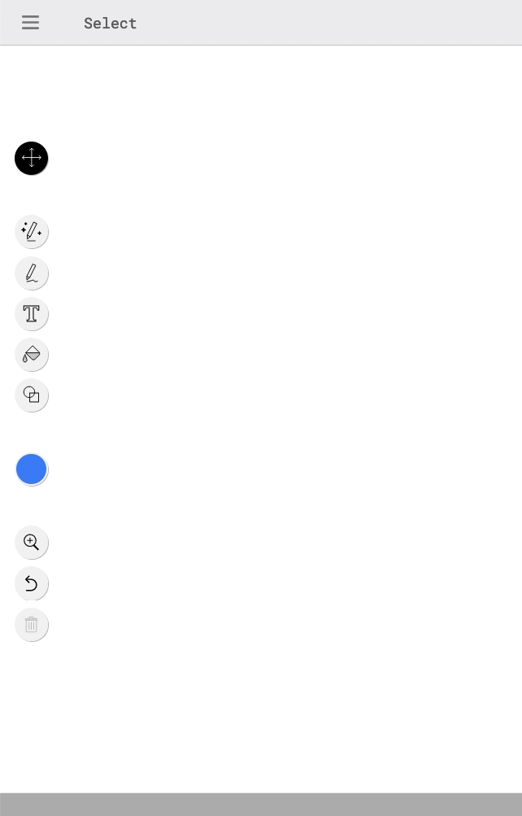
ICONS
AUTODRAW
It creates icons in seconds guessing from your scribbles
You can choose from hundreds of options available
Only download .png, not vector

Slide 9
AI tools can do almost everything
Jasper.ai: write anything
Copy.ai: copywriting
Synthesia: create talking avatar
Grammarly: perfect English
Jenni.ai: write essays
FakeYou: deep fake voices
Fireflies: note taking
Khroma: colour palette
Murf: text to speech
ImgUpScaler: high quality images

Slide 10
END
thank you
Andrea Meloni
Senior Graphic and Motion Designer, GÉANT
@mirtobuffendi
@ELOEstudio

