Slide 1


Mastodon: the open source social media attracting researchers and academics
SIG-Marcomms February 2023
Leonardo Marino
Communications Officer - Géant
SIG-Marcomms, Kajaani, Finland
22 February 2023
Public

Slide 2


Mastodon: Overview
Mastodon is an open-source microblogging platform
Might have a similar feeling to Twitter but it’s also very different
While Twitter is centrally controlled by a single company, Mastodon is decentralised.
Non for profit
Interoperable with the whole “Fediverse” - an ensemble of federated servers used for web publishing.
Notes:
- At a superficial view appears very similar to Twitter. It looks a bit like it and partly replicates its feel, but it’s at the same time very different.
Each Mastodon server is a completely independent entity, able to interoperate with others to form one global social network.
Other than Mastodon, software platforms in the Fediverse include Wordpress, Nextcloud, Drupal, Peertube, GNU Social, soon Tumblr and Flickr and more.

Slide 3

The Elephant in the room
Despite being around for a few years already, it’s Musk’s acquisition of Twitter that led to a huge growth in Mastodon’s user base.
Mastodon reported that an impressive 2.6 million active monthly users (+602%) as of Friday 1 December 2022.
Not “the digital town square”, but maybe the town square for some communities already?

Slide 4

Mastodon - Specificities
No tracking – Great for privacy (not so much for Marcomms)
Anti-virality by default – No quote tweets
No global search feature
Community-based moderation
Multiple timelines
No Ads
Crowdfunded
Notes:
Why aren’t we registering a single referral link from Mastodon despite the posts talking about GÉANT? First of all, Mastodon is not a single server / domain, but most importantly it adds a no-referrer attribute to all outgoing links, so that none of the Mastodon links are actually tracked! This is great for privacy, not so much for reporting purposes and for social media strategies.

Slide 5
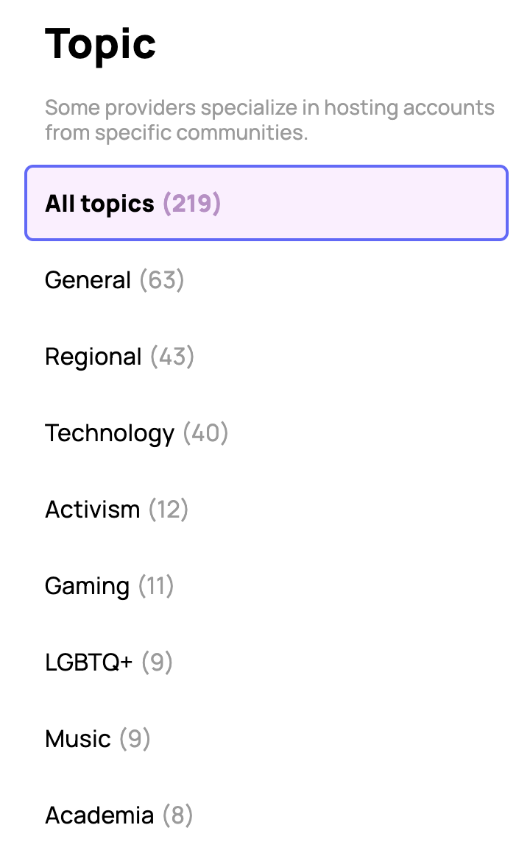
Mastodon: Who’s on it?
Having a look at the main Mastodon servers gives a feel of early days internet…
Among main user communities are:
  Techies (network engineers, software developers, security experts)
  Research and academia
  Activists
  Local communities
  Journalists (more recently)
Politicians and influential figures mainly remained on Twitter and other legacy social media, with few notable exceptions.
Overall tendency for new users is currently to join generic servers (perhaps with the intention to move elsewhere in a second moment).

Slide 6
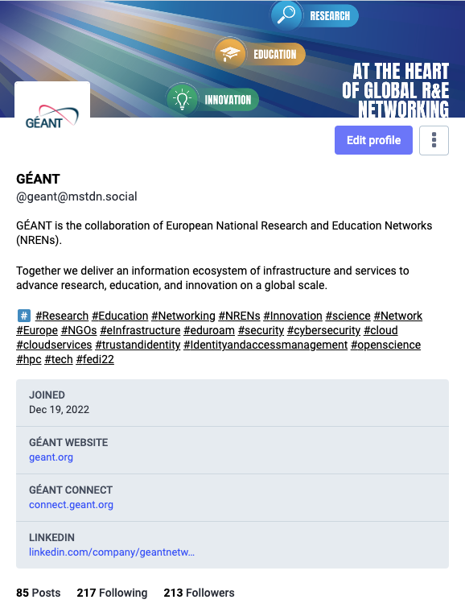
GÉANT on Mastodon
After an initial analysis we decided to open a Mastodon account on 19 December 2022 @geant@mstdn.social
Now at >200 Followers
Considering community solutions for a later stage
On hindsight it was good to open on mstdn.social – mastodon.social got defederated from some instances due to high numbers and temporary difficulties in moderation
Notes:
Discuss analysis and method

Slide 7


SURF’s Mastodon Pilot
SURF launched with NL universities on a Mastodon pilot for the Dutch research and education sector.
Full announcement here. More Info here.
Launched in February 2023. Pilot until end 2023.
Login via SURFconext
Many members of SURF are already present and active on Mastodon.
Notes:
General overview from an external perspective – and here’s a platform to talk more about your view
Love the logo btw and SLURF admin
Highly covered by media

Slide 8








Position of other NRENs about Mastodon
Jisc had also conducted initial research on a similar pilot and on their presence on Mastodon, but for the moment they decided not to proceed and not to use Mastodon
Arnes investigating setting a Mastodon instance for their community. Discussions opened in SIG-Marcomms mailing list on whether this service should be offered at an NREN level or GÉANT level.
RENATER for the moment just opened a Mastodon account on the same general server as GÉANT. Not yet posting.
SUNET was an early adopter of Mastodon. Server with a couple of hundreds of users. Not actively using the account to post.
A technical discussion about opening Mastodon servers took place in the nren.slack.com channel, with pros & cons for NRENs of offering it as a service.
Notes:
General overview from an external perspective – and here’s a platform to talk more about your view

Slide 9

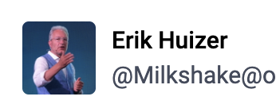
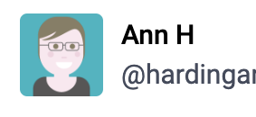
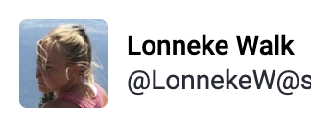
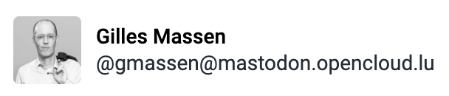

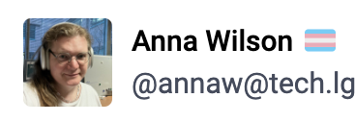
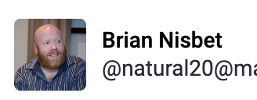
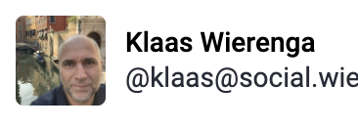
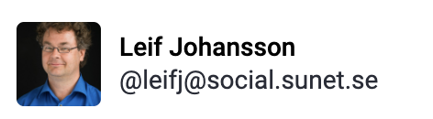

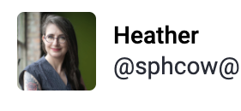
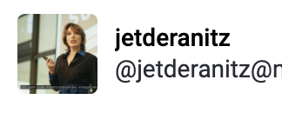

Mastodon: Members of our community
So, who in our community is actually moving to Mastodon?
Among these community members, only some seem to have abandoned Twitter entirely, while most tend to post on both platforms. The same goes for EC accounts.

Slide 10
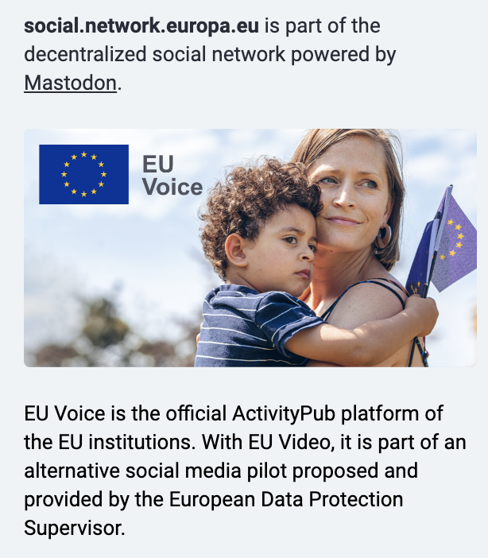


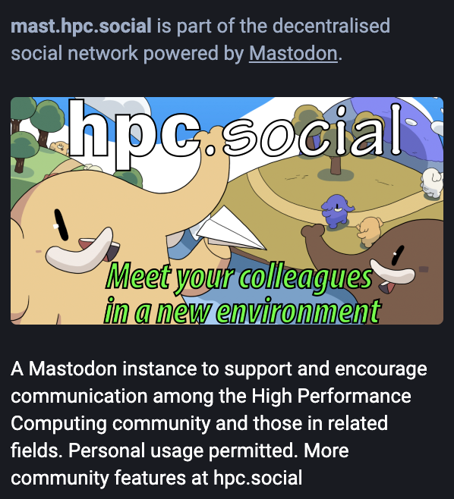

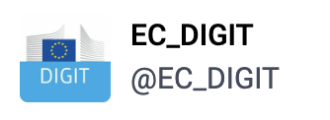




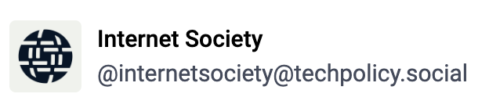

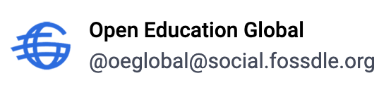
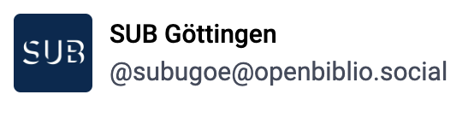
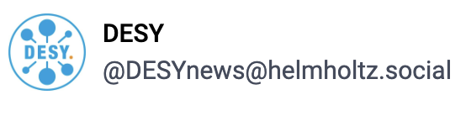
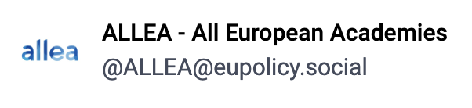

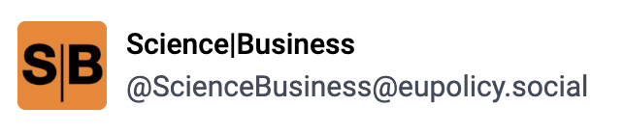
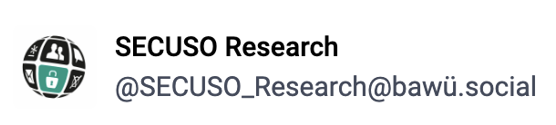
Mastodon: Other notable communities
@social.network.europa.eu
Among the main sponsors of Mastodon. GÉANT was part of NGI_Trust.
Early adopter of Mastodon. Registrations open only for EU institutions, bodies and agencies.

Slide 11


Opening a Mastodon account – Pros and Cons other considerations
Pros
Free and open-source software developed by a non-profit organization
In line with values of our community
Part of our community was already there before Twitter started to crumble
Another part of our community just joined or is in process of joining
Unexplored land. Seeing a lot of traction for users who are moving now.
No algorithm choosing what gets displayed on users’ feeds.
No ads and no unbalance towards power of advertised posts.
Control over data with own server, and possibility to cancel all data.
Functionality to filter out of timeline unwanted profiles or specific words.
Possibility to move profile to different servers without losing followers

Slide 12

Opening a Mastodon account – Pros and Cons other considerations
Cons
A bit more complex to use than Twitter and sometimes a bit confusing
Separate local feeds and no universal search function.
Not a main source for news… but new functionalities just came in
No insurance to regain the same user base as Twitter by joining Mastodon or the same impact that our communications had on Twitter
No insurance that Mastodon will last as a social media and that users will remain active on the long term
Not yet tested against accessibility regulations.
Duplication of work, while still keeping Twitter and all other SM accounts.

Slide 13

Opening a Mastodon account – Pros and Cons other considerations
Some points that are both Pros and Cons
No tracking – Great for privacy, but not so much for reporting purposes and for social media strategies.
Democratisation of posting and absence of algorithm removes the effect of virality that was one of the key aspects of Twitter.
No quote posts like Twitter, also contributing to the end of the virality effect
Possible risks
Single point of failures?
Security of each server: e.g. having a single main server for all journalists may easily turn into a honeypot to be hacked into. At the same time, Twitter security issues are also very concerning at the moment.
Risk of splintering due to software updates to the servers being responsibility of each server.
Mastodon might not prove attractive enough to build critical mass.

Slide 14

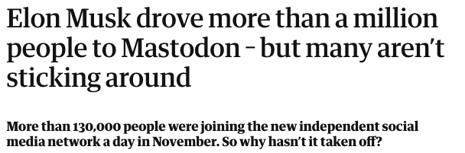
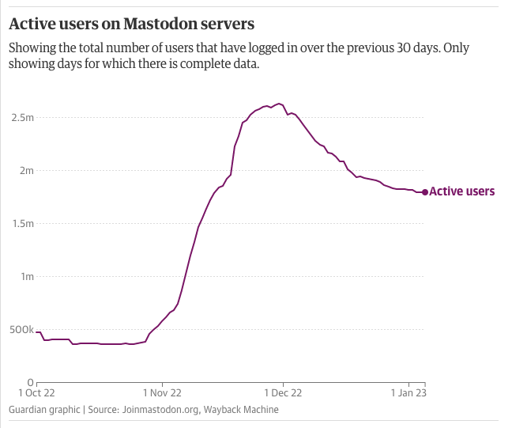
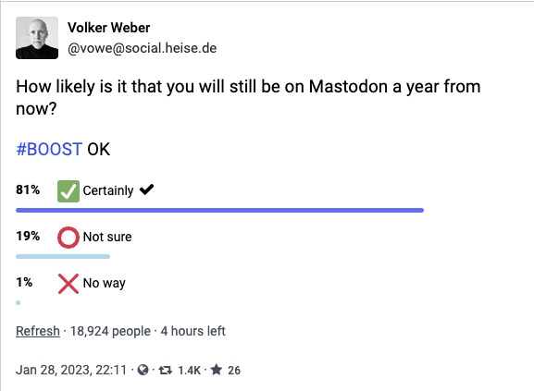
Will people remain on Mastodon?
Notes:
Numbers are now down but steady. Growing adoption of Fediverse ecosystem

Slide 15

How to get started: Choosing a server or setting your own
Not as straightforward as starting on Twitter. Many users were pushed back when asked to choose one of the many servers available and a big part of them opted for the main generic servers – at least the ones still open for new accounts.
Two NREN servers available on Mastodon: SURF @social.edu.nl and SUNET @social.sunet.org
Get to know your server… Check rules, hosting…
No worries – you can always relocate! As Mastodon allows to move profiles to different servers without losing followers, it’s also possible to start on a server to then move to another one or to open your own server.
Notes:
Choose your server. Hardest step

Slide 16

How to get started – Setting your profile
Here your bio and profile info are more important than ever!
  Clear profile description
  Avatar and Header
  Add hashtags and links to your websites and channels (can be verified)
Set up Preferences
  Suggest account to others
  Dark mode Vs light mode
  Advanced mode (which looks like Tweetdeck or CounterSocial)

Slide 17
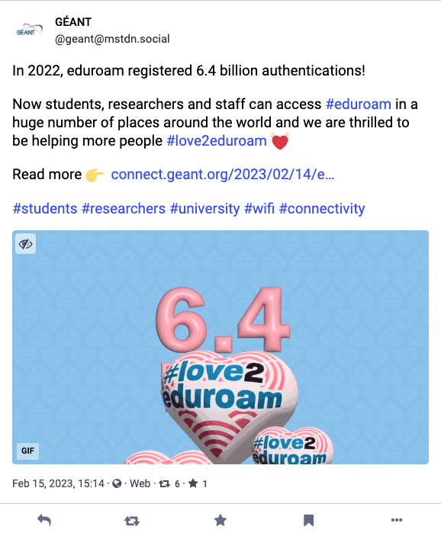
How it actually works - Posting
Boosts: not possible to “re-post with comment”
Favourites: are not shown to followers
Longer posts than Twitter: 500 characters
Possiblility to edit posts
Images are cropped to 16:9 on most displays (can be expanded)
Replies
Boosts
Favourite
Bookmark
Options

Slide 18
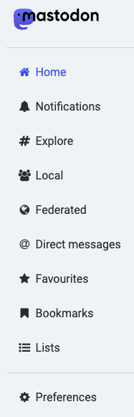
How it actually works – Sidebar and Timelines
Timeline 1: Showing posts and boosts from the accounts you follow
🏠 Your home
With many filters
Search: posts / hashtags / news / for you
Timeline 2: Showing posts and boosts from your server
🪐 Your Planet
Timeline 3: Showing posts and boosts from your server & all federated servers
🌌 Your Galaxy
DMs on Mastodon work like private posts

Slide 19

How can you find profiles to follow on Mastodon?
Check on Twitter – Many users indicated Mastodon handles in their names or bio
Check GÉANT follows
See who key people in your community are following
Check directories (fedi.directory, fediverse.info, Trunk)
Some tools like Movetodon, Twitodon and Debirdify allowed you to find Mastodon profiles for accounts you followed on Twitter – Now not working or being limited due to shutdown of Twitter free API, but still worth a try.
And if you join – let’s support each other!

Slide 20

Best practices and suggestions
#Introduction posts – We’re all new here so an intro is recommended. Good to pin it to your profile.
Hashtags: A primary way to find content on Mastodon. You can even follow them. Good to add them in bio.
Alt text: This community really cares about accessibility! Good practice to add alt text in images
Content warnings: Good practice to add a wari if you post

Slide 21
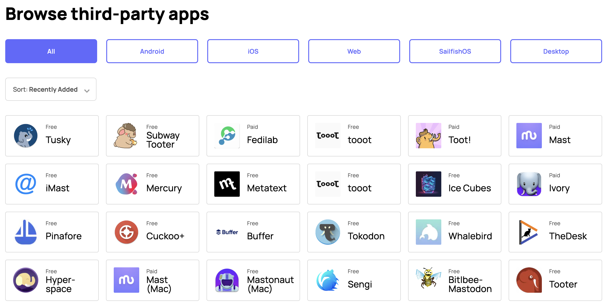
Third-party apps
Not single Third-party app, but many options, both paid and free.

Slide 22

What about opening community instances?
Setting a new instance is not too difficult from a technical point of view…
  Technical complexity comes in making sure that the server gets backed up, monitored, upgraded
  Possibility of integration with eduGAIN?
Responsibility and liability of content moderation – most complex aspect
  Not to be taken lightly.
  Will inevitably grow exponentially with increase in members and content.
Uncertainties around the long-term and about continued interest in the platform from our communities.

Slide 23

Conclusions and open questions
Mastodon is an interesting alternative but currently it seems far from widespread success. At the same time, change does not happen overnight…
Twitter is still a powerful social media. Moving out of it might kill our social media presence – however we still need to be aware of many concerns around it and consider alternatives, even better if based our community values.
Would you like to share your approach? Do you have a strong opinion on this matter? Are you taking action or do you have intentions to do so?
Notes:
Points to spark discussion

Slide 24

Thank You
Any questions?
www.geant.org

