Slide 1


The year that changed Twitter / Social Media in the era of content creators
SIG-Marcomms February 2023
Leonardo Marino
Communications Officer - Géant
SIG-Marcomms, Kajaani, Finland
22 February 2023
Public

Slide 2
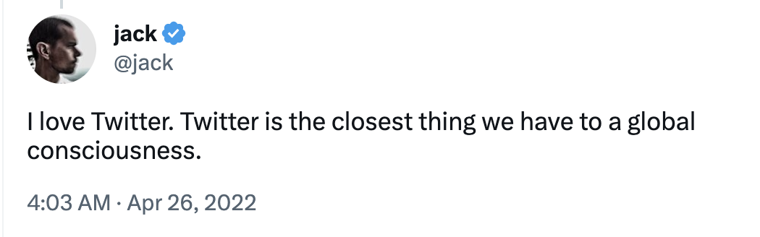

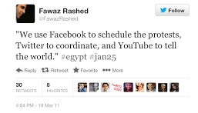
The Twitter we know and love… the digital town square?
Founded in 2006 in San Francisco
Simple but very powerful social media…
Important figures on Twitter make public announcements or statements that have real world consequences.
And at the same time a fundamental tool for bottom-up movements and for the so-called “Twitter revolutions”.
Twitter co-founder and former CEO Jack Dorsey
It’s what’s happening
Notes:
Virality effect

Slide 3
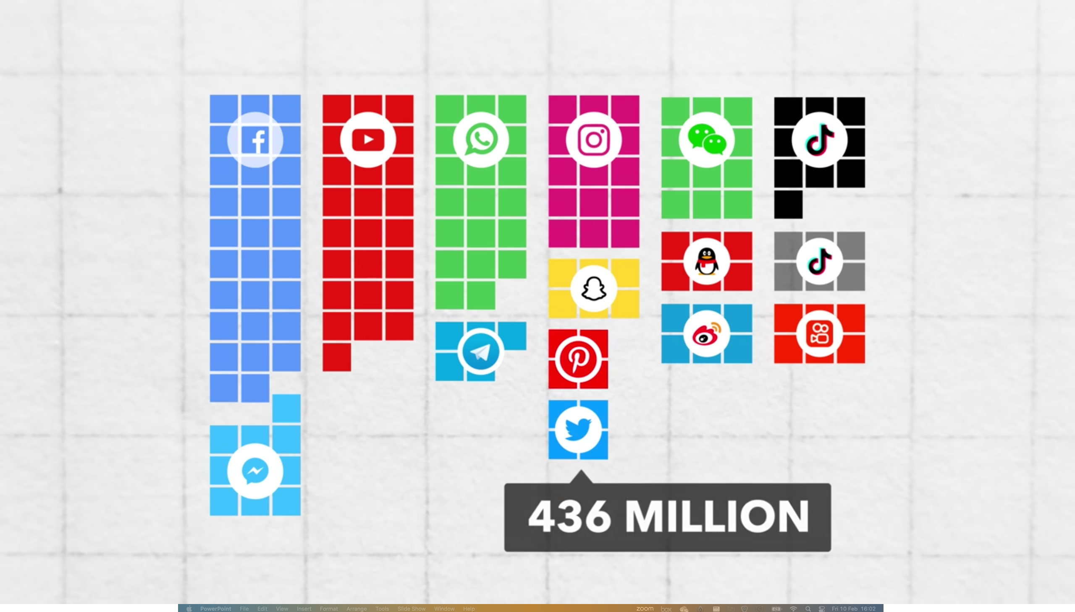
Twitter was always a small social media
Source: TLDR Business. “How Elon Destroyed Twitter in 2 Weeks”. https://www.youtube.com/watch?v=OeUatBoSV88
Notes:
Twitter 101 Million users in Europe
Considering its overall number of users, Twitter is a relatively small social media.
Surprisingly, in terms of users it ranks not only after Facebook, Instagram and TikTok, but also after many other platforms… even lower than Pinterest!
in the EU

Slide 4
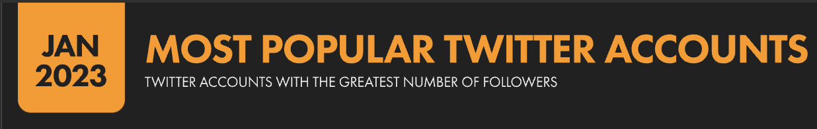
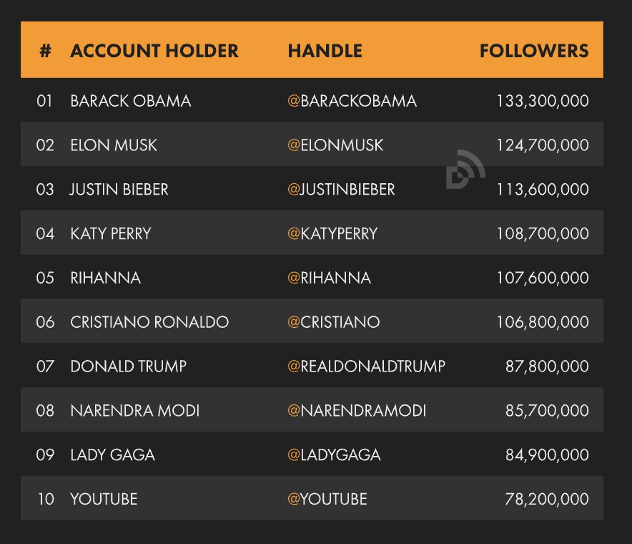
Not big but influential
The real power of Twitter doesn’t lie in a large user base, but in the type of users it attracts:
Influential figures / public figures
Politicians
Organisations / companies
Celebrities
And more specifically for our interest… researchers, scientists, academics

Slide 5
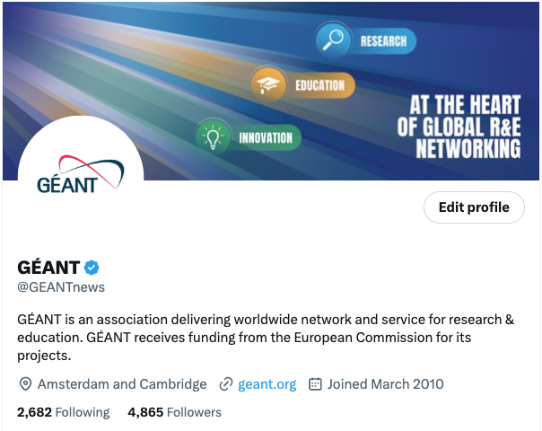
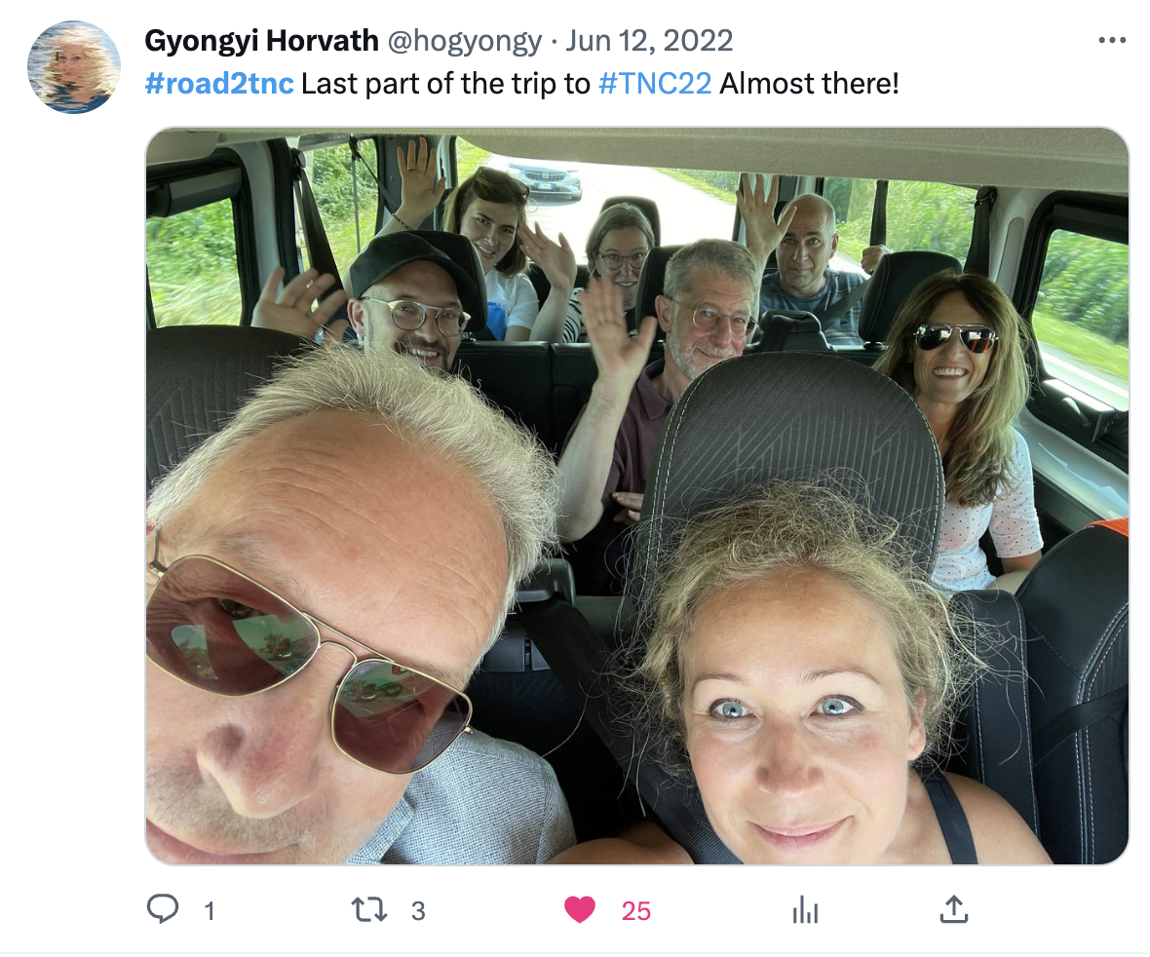
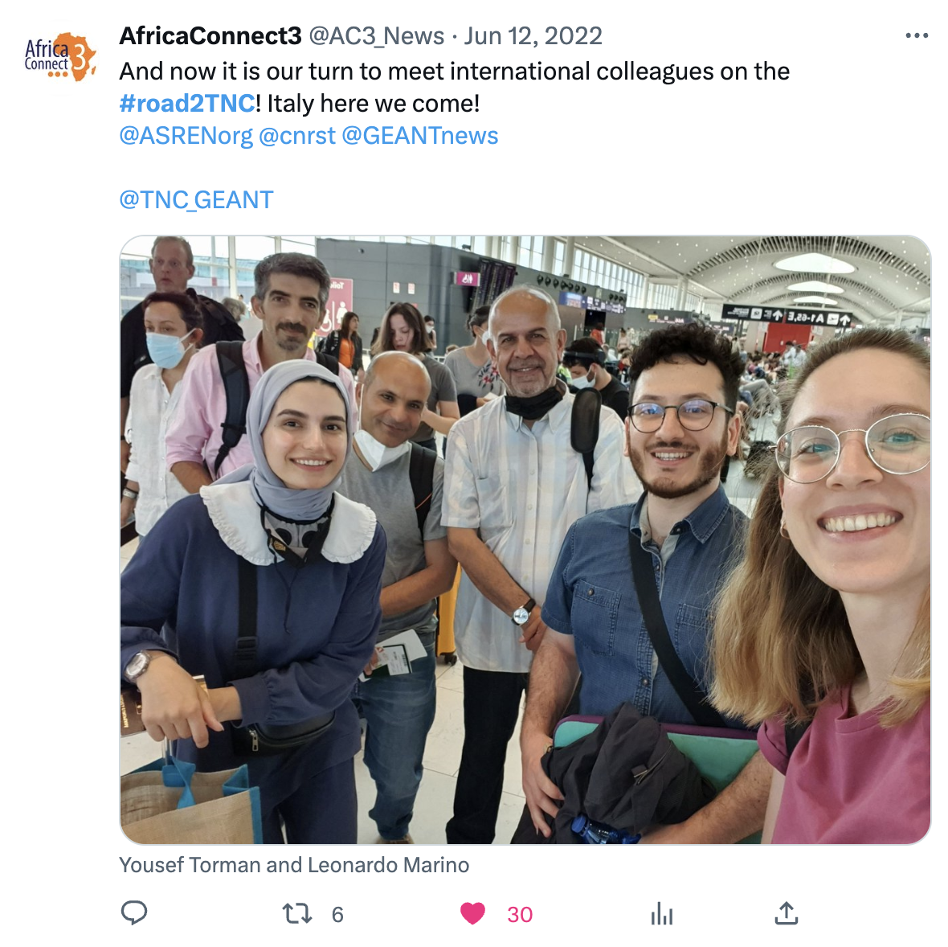
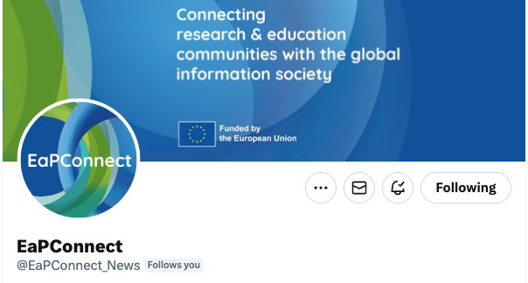
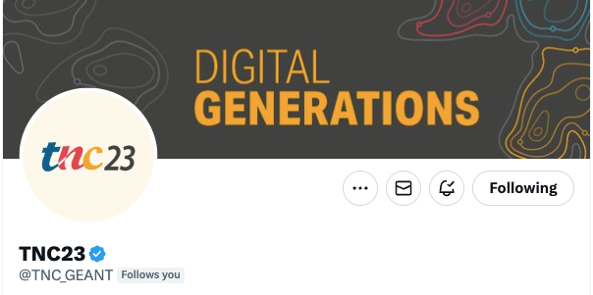

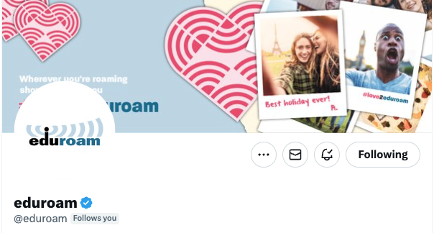
It’s an important social media for our community
GÉANT Twitter account created in 2010 and active since 2014!
Out of the 46 National, Representative and Associated Members of the GÉANT association - 35 have at least one Twitter account!
Notes:
Like its community GÉANT found in Twitter its preferred social media. The GÉANT Twitter account @GEANTnews has been around since 2010 and was active since 2014.
And then accounts of TNC, BELLA, eduroam, eduVPN, EaPConnect, AfricaConnect
And campaigns TNC, CyberSecMonth, WomenInSTEM
For eight long years this account has been at the centre of GÉANT’s social media strategy and presence, hosting all the main announcements, news, campaigns, live posting, community discussions and also lighter content and informal chatter.
If we look in particular at our community, we see that a substantial part of it is (or was) very active on the platform. For many years Twitter has been the preferred social media of most NRENs and RRENs (with notable exceptions), of the European Commission and of its various branches, of policy makers, of many organisations in our community, of e-infrastructures, of researchers and research institutions, of universities, of European projects, of influential professionals in our community, of experts in technology, networking, open science, security, privacy, education, and many other areas of interest for GÉANT.

Slide 6
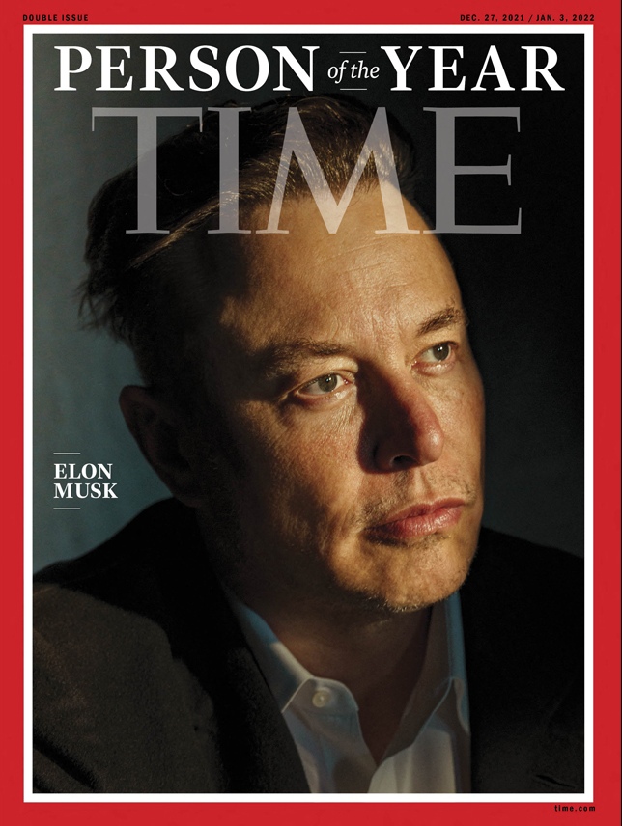
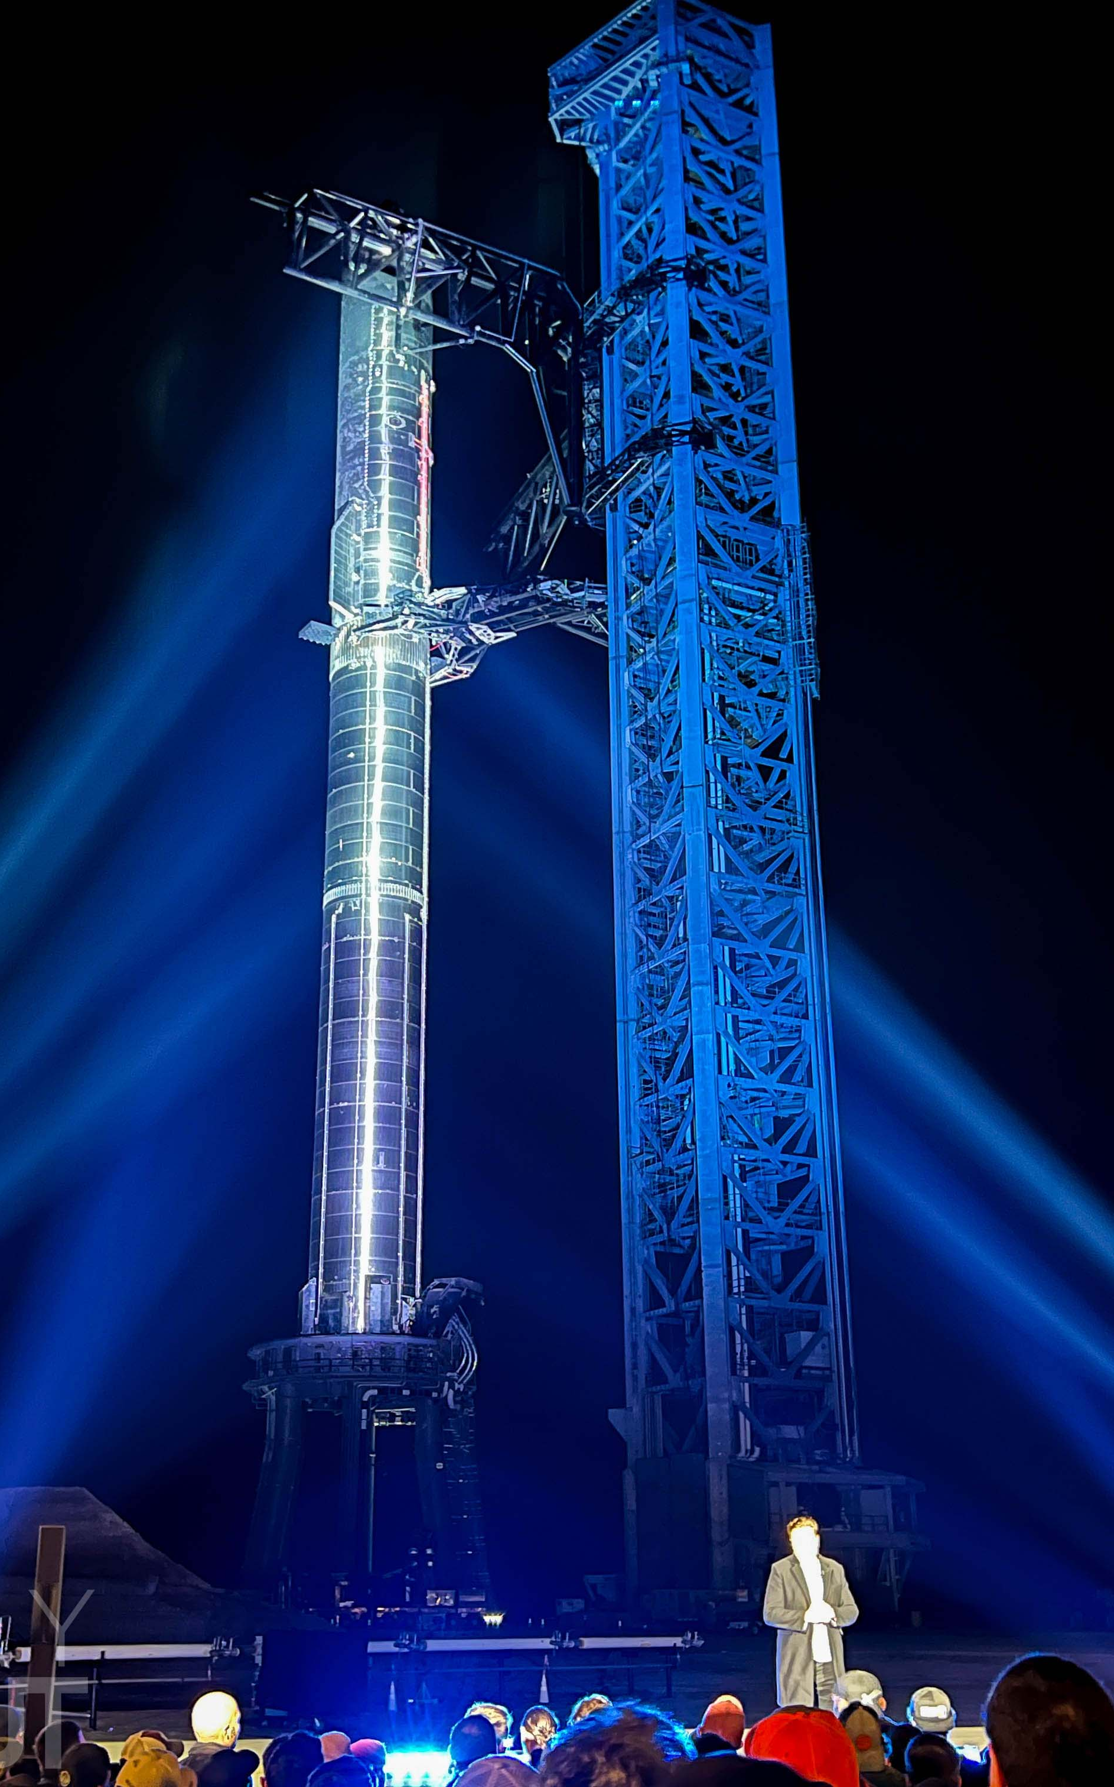
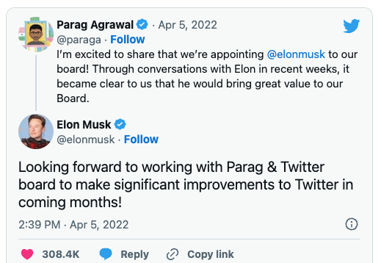
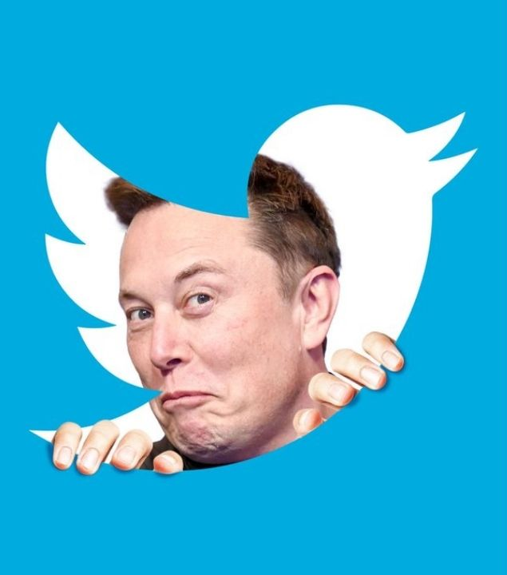
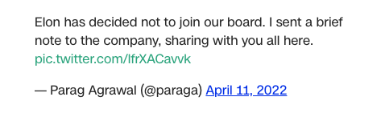
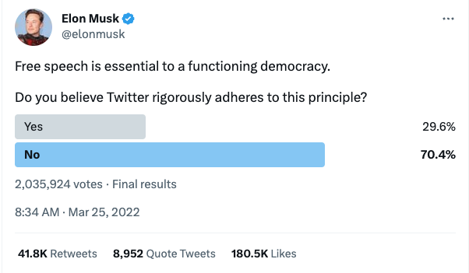
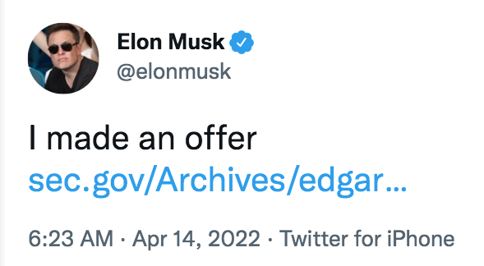
Elon Musk takes over. A brief recap of the year that changed Twitter
January 2022
February 2022
April 2022
March 2022
Notes:
This is Netflix series material
Jan 2022 Elon Musk starts building stake
March 2022 - Elon starts criticising Twitter
April 2022 – he goes public on owning 9.2% of Twitter
Join the board… Not
He makes his offer

Slide 7
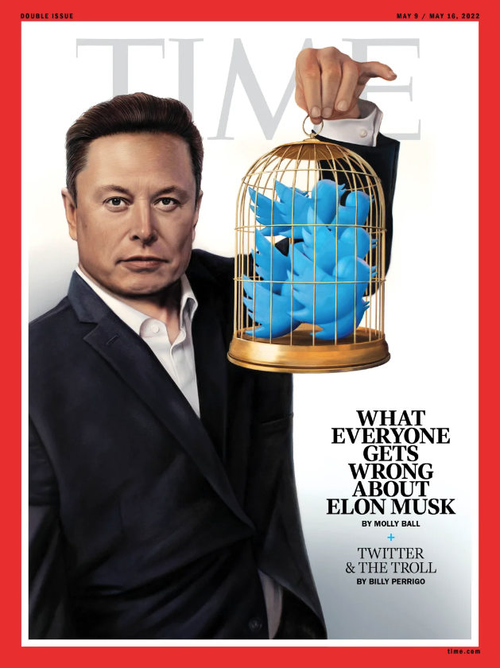
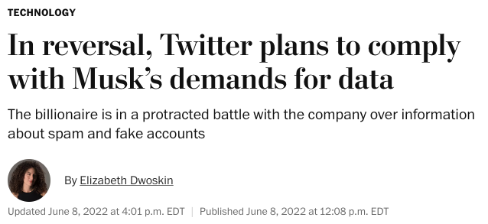
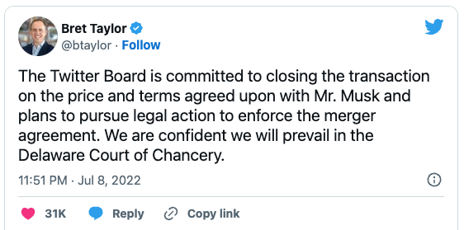
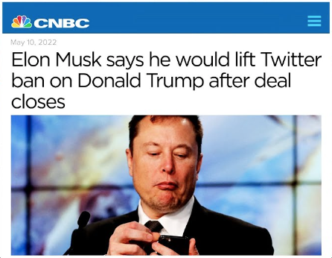
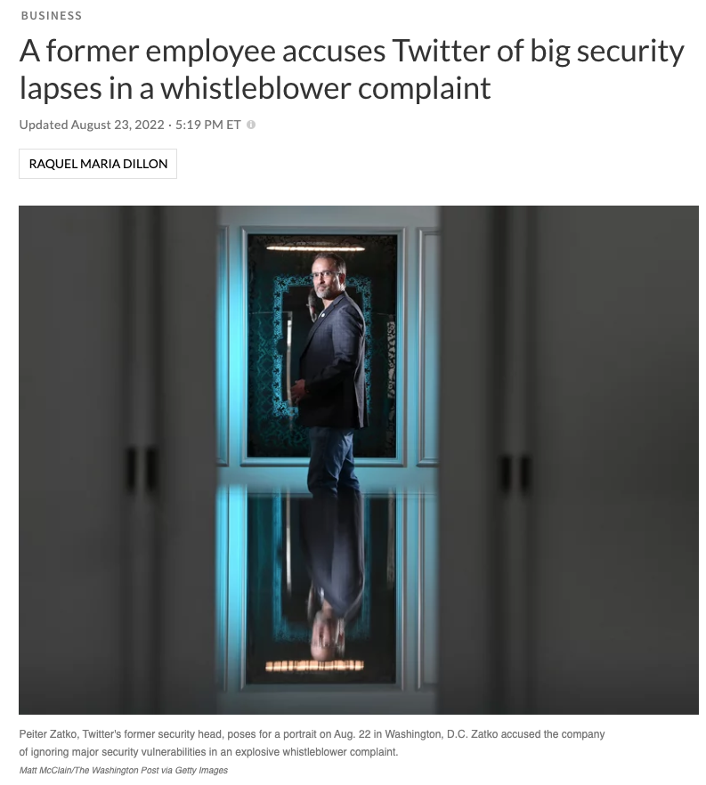
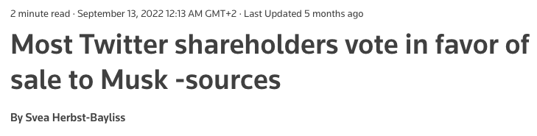
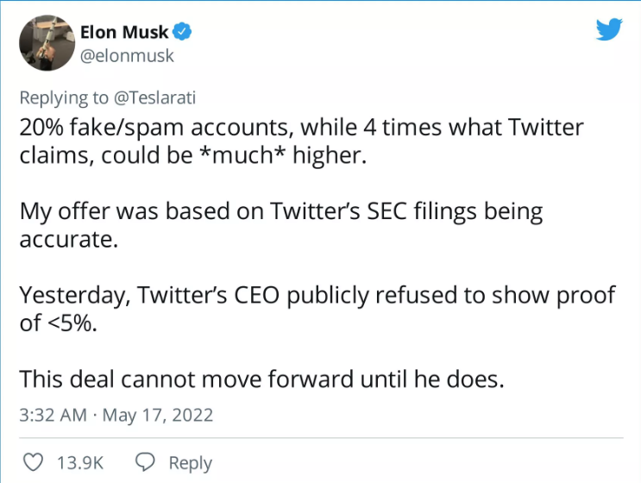
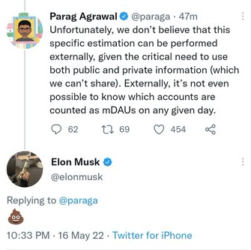
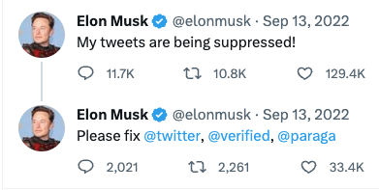
Elon Musk takes over. A brief recap of the year that changed Twitter
May 2022
June 2022
July 2022
August 2022
September 2022
Notes:
May 2022 – Times cover now on Twitter. Is he freeing the bird or caging it?
- Reverse ban on Donald Trump
- Deal on hold – fault goes to bots… Claim on 20% bots
- Twitter shares drop
- Poop emoji answers to Agrawal on bots
June 2022 – Musk Threatening the agreement
July 2022 – is he walking away? Twitter files lawsuit
August 2022 – Musk files Counter-sue. Whistleblower on bots
September 2022 – Twitter shareholders in favour of Elon’s acquisition

Slide 8
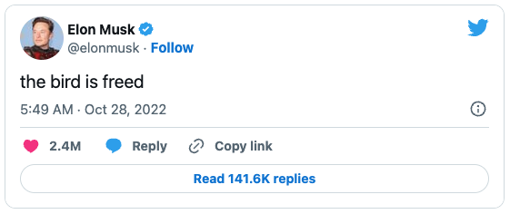
Elon Musk takes over A brief recap of the year that changed Twitter
#TwitterMigration
October 2022
#GoodbyeTwitter
#TwitterIsDead
#Mastodon
#JoinMastodon
#TwitterShutdown
Notes:
October 2022 – No Trial, they reach an agreement on acquisition
27 October – acquisition is complete
Twitter is now private
Let that sink in
Prepare for chaos

Slide 9
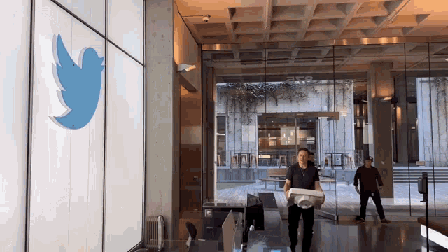
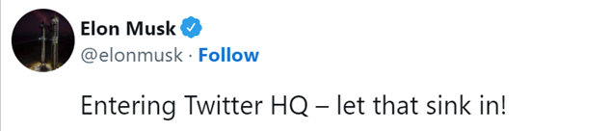

Slide 10
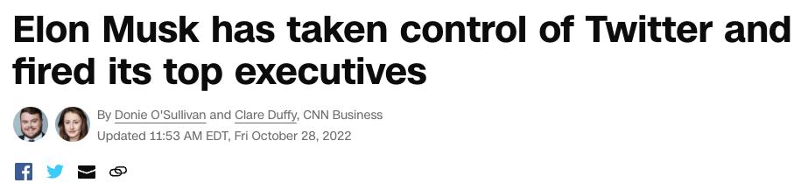
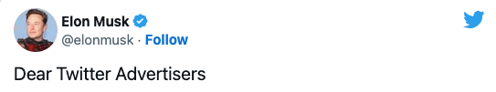
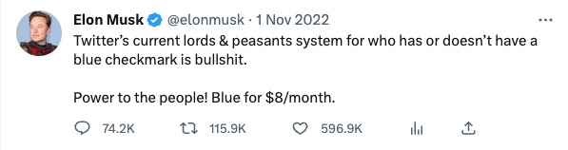
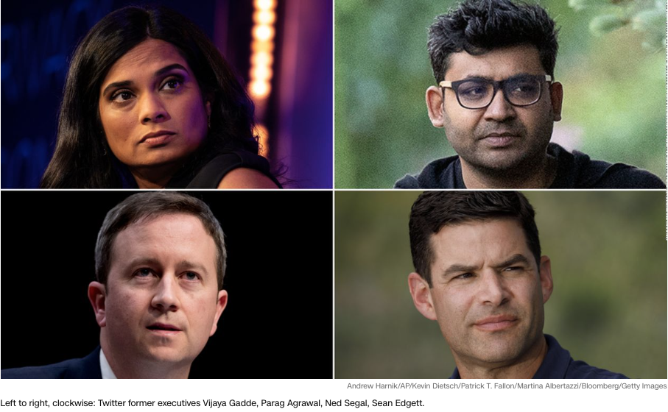
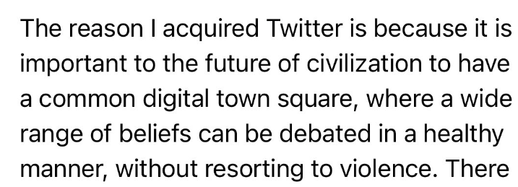
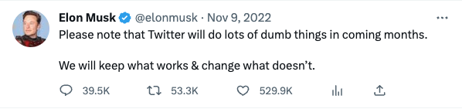
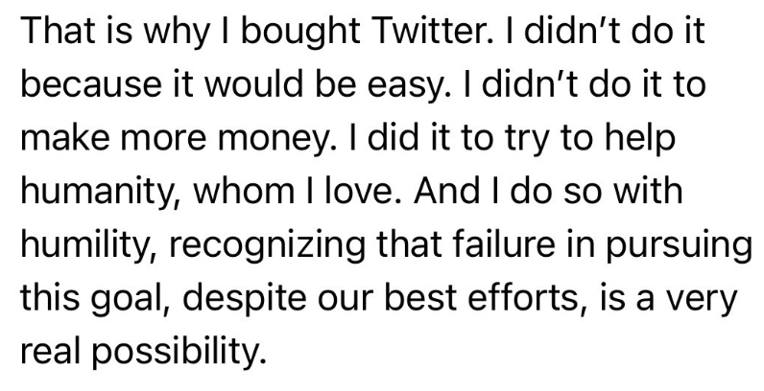
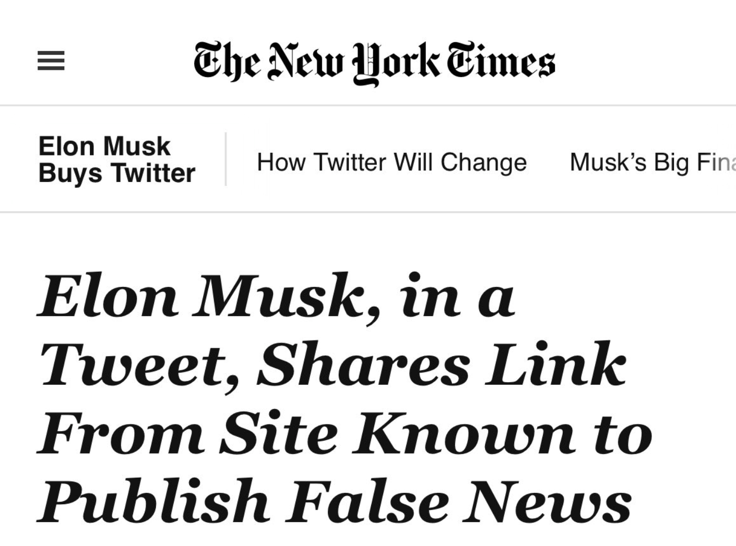
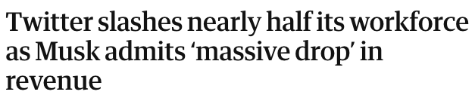
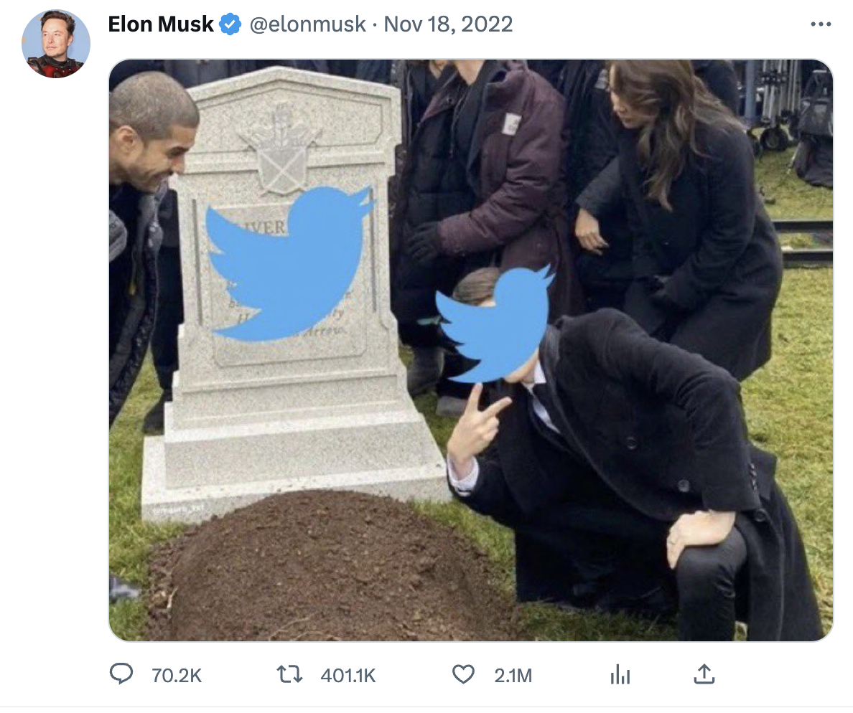
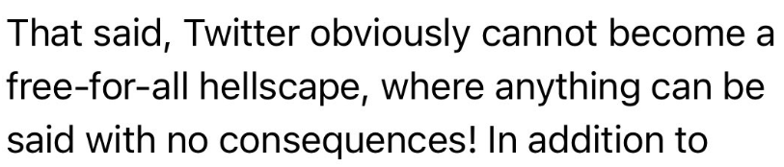
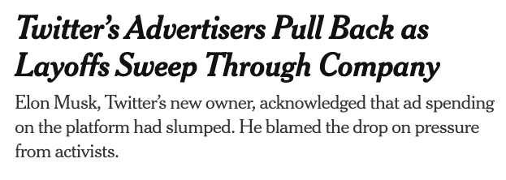
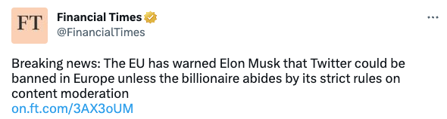
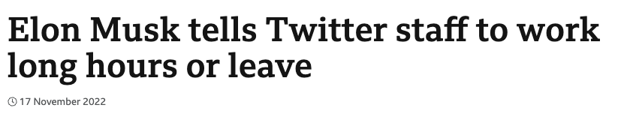
Elon Musk takes over Twitter. A brief recap of the year that changed Twitter
October 2022
November 2022
Notes:
October 2022 CEO and key executives fired - Musk replaced the prior board as the sole director of Twitter and appointed himself as the CEO.
Dear Twitter advertisers
November 2022 –
November 2022 – Far right free to roam on Twitter
Advertisers start to pull back
New mass layoff – employees fighting misinformatiom
Twitter Blue new plans – charging access
Chaos with verified accounts
Firing engineers who criticise him
16 November – commit to working long hours or go email
On November 3, Twitter laid off approximately 3,700 employees, or about half of their staff. In the following week, the company's security, compliance, and privacy executives resigned.^{[29]} On November 16, Musk sent an email to remaining employees outlining a shift in the work culture of the company and requesting employees opt-in or leave by November 17, leading to hundreds of additional resignations.[

Slide 11
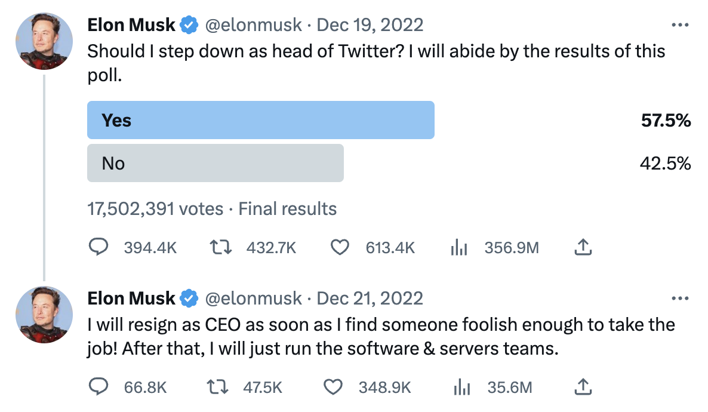

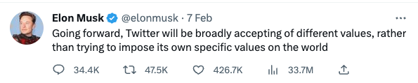
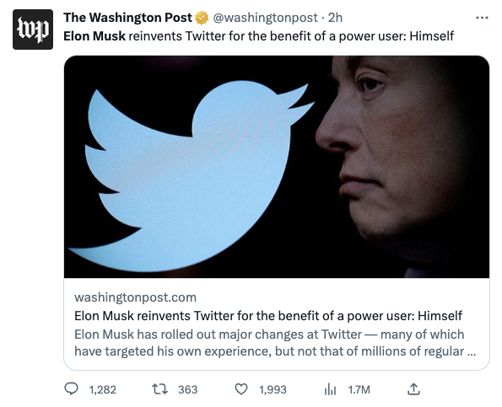
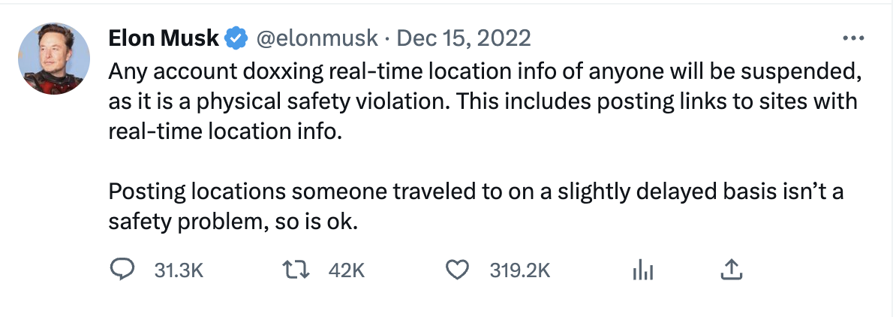
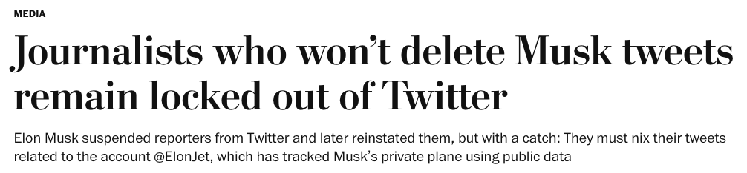
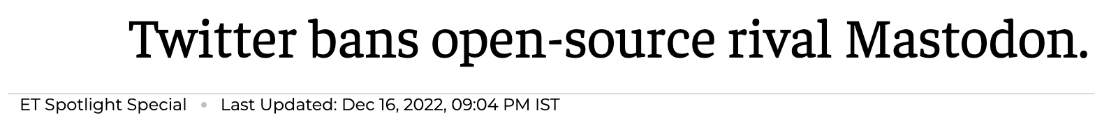

Elon Musk takes over Twitter. A brief recap of the year that changed Twitter
December 2022
2023
Notes:
- October 2022 CEO and key executives fired

Slide 12






Where we are now
Notes:
Let’s admit it: this story would be really funny, if it wasn’t also worrisome…

Slide 13



But is the Twitter chaos and decline all due to Elon’s acquisition?
Even before Musk’s acquisition, internal Twitter research was showing an overall decline of Twitter and especially lower activity of its most influential users:
The “Heavy-tweeters”
Accounting for <10% of monthly overall users
But generating 90% of all tweets and half of global Twitter revenue.
Less and less present on Twitter since 2020, with cascading effect on overall engagement.
Reuters. 26 October 2022.
Shift in interest from topics that once made Twitter popular - as news, sports and entertainment - towards controversial topics - as cryptocurrency and "not safe for work" (NSFW) content
Musk’s acquisition of Twitter highly accelerated both these trends, with common users and heavy-tweeters leaving, and with a lack of moderation leading to a surge in hate speech and controversial topics.
Notes:
It’s actually part of a trend that has been going on for some time already…
The study made no specific conclusions about why heavy users were declining.
In 2020, it was estimated that approximately 48 million accounts (15% of all accounts) were fake.

Slide 14


How did this affect GÉANT’s Twitter channel(s)?
2022 (compared to 2021)
Impressions: -39%
Followers: +490
Engagement rate: +115.5% (+1.74 relative)
Overall Engagement: +21.1%
Our posts are being shown to less and less users.
But engagement kept growing! So the posts reach the right users (our community and users interested in our content).
This includes new followers, that also grew at a faster rate.
On other social media (Facebook and LinkedIn) we registered massive growth on all fronts instead.
Among other profiles the exception was TNC22, which was very successful on all fronts in 2022.

Slide 15

Twitter 2.0?
Elon Musk claims to be working on Twitter 2.0, the “Everything app”.
In a similar way to WeChat in China, this would include many other apps and functionalities, including payments.
However, it seems unlikely that Musk will achieve this result, and and even more on a global scale…
WeChat managed to achieve this in a very different environment, only relatively to China, and with time advantage, while other organisations with more expertise and resources like Meta and Google have already been trying to do this for longer and with limited results.

Slide 16




The present situation - Is Twitter doing ok?
The truth is that Twitter is not looking that well at the moment…
Add updated data and articles on Twitter users Vs Mastodon users
Until recently Twitter was considered one of the most secure and stable social media platforms
Twitter during the October 2021 outage at Meta
Notes:
What was with all the Twitter errors yesterday?
The “you are over the daily limit for sending tweets” messages apparently happened because “an employee had inadvertently deleted data for an internal service that sets rate limits for using Twitter,” according to Platformer. The team behind the service, however, has been gone since November.

Slide 17













Chaos with the verified accounts
Notes:
Blue = legacy (GÉANT, eduroam)
Gold = Twitter blue paying subscriber (why not blue?)
Grey = Re-verified legacy account
Blue but square = verified organisation
You know who has a legacy blue tick? You guessed right…

Slide 18






Some recent changes to Twitter – Twitter Blue and Twitter API
Notes:
Very often these changes are reverted…
API: fundamental building block
- Now postponed indefinitely
- Bots and automated accounts
- Terrible for the research community and for open access to data…
- Change logins for apps where you’ve signed in with Twitter
- Was also fundamental in finding your community on Mastodon
- Delete old tweets…
Ads ads ads and possibility to block them with paid subscriptions

Slide 19




Some recent changes to Twitter – Features
Notes:
Very often these changes are reverted…

Slide 20



Some recent changes to Twitter – The “algorithm”
Notes:
Very often these changes are reverted…

Slide 21



Twitter and the EC - Digital Services Act
Notes:
All social media designated as VLOP will have to adhere to requirements to limit disinformation and better protect children online.
fines of up to 6 percent of companies’ annual global revenue

Slide 22
Some possible scenarios – where is Twitter going?
The noise is not justified, despite initial issues Twitter evolves into a powerful and stable Twitter 2.0 with global success. Better version of the current Twitter..
After a period characterized by technical issues and loss of users, Twitter survives and starts growing and being maintained again. It somehow changes into a Twitter 2.0 but with many concerns.
After a period characterized by technical issues and loss of users, Twitter survives and starts growing and being maintained again. It evolves into the Twitter 2.0 announced by Elon Musk, but its spread is limited only to certain categories of users, or only to the US and with many public concerns.
Twitter survives, but due to technical issues and safety concerns most users leave the platform. It remains as a legacy social media, with just a relatively small and not too active user base.
Twitter survives, but its user base changes drastically and it becomes a very hostile place. Or it is mainly populated by bots. Or it is possibly limited in the EU.
Due to unsolvable technical issues or bankruptcy Twitter is forced to shut down. Its data might be leaked or sold.
Tweet listing some real threats to the integrity of Twitter, that might lead to the worst possible scenarios: https://twitter.com/MosquitoCapital/status/1593541177965678592?s=20&t=hv4I0mCW3dhI-8n5xCQfpg
Notes:
After all this chaos, let’s take a moment to breathe and to reflect.

Slide 23




How can you prepare for a possible Twitter meltdown?
Saving up the historical data and stats – You request your archive via Twitter settings
Archiving all your Tweets on the Internet Archive with the Wayback Machine – if you are aiming at long-term preservation
Enabling Multi Factor Authentication (MFA) on all Twitter profiles – Even EC accounts were hacked recently…
Opening social media accounts on alternative platforms (e.g., Mastodon) – to diversify and start building community
Sharing your account details for new social media accounts also on Twitter and on your other channels to inform your community (when you feel ready for it)
Continue monitoring the situation and keeping ready in case urgent action is required
Keeping your Twitter account active? – At GÉANT we decided to do it, at least unless things start to go really wrong…
Notes:
Saving up the historical data and stats – We already did this, collecting post data back to 2019 and general social media data back to 2014.

Slide 24

Where are the tweeters flocking to?
TikTok? Instagram? Discord? Good (not) old Facebook? Solid and steady LinkedIn?
Or are these users dropping social media entirely?
Source: Protocol.com

Slide 25

Notes:
Data on users (here referred to as “advertising audience”…). Registering unexpected growth.
Not only Twitter data, this is also supported by detailed analysis of various third-party apps… Not probable then that it’s due to bots.

Slide 26

Notes:
Twitter is still a key source of social media referrals.
Twitter now ranks second at a worldwide level when it comes to the share of websites referrals originating from social media.
Data from Statcounter reveals that Twitter drives more than 10 percent of the world’s social media referral traffic, behind Facebook’s 67 percent.

Slide 27




Social media gaining popularity during the #TwitterMigration
While hundreds of thousands of active users deactivated their Twitter accounts or were suspended and while previously banned users were set to return, a number of relatively new and relatively small social media platforms saw overall growth of their user base.
Mastodon
Hive
Counter.Social
Post.
Peaked at 2.6 million users
Peaked at 2 million users
Claims 63 million visitors per month
>200k users + waitlist…
Decentralised social media
Attracting the K-Pop community
Has VR element on CoSo Realms
Still in beta
Attracted the most attention in the past months
Facing major cybersecurity issues
Blocking some countries (Russia, China, Pakistan…)
Main focus on news
However, none of them are exactly “the new Twitter” or are able to entirely substitute it, but they might present new possibilities and ways to communicate.
Notes:
Unfortunately, some are still in an early stage of development and might seem half-baked.
Most of the rising platforms are not yet big enough to be included in a social media strategy for GÉANT or for GÉANT to consider opening a company account.

Slide 28








Legacy social media
Existing popular platforms like Facebook, Instagram, LinkedIn continue to grow and maintain their relevance.
Facebook
Instagram
YouTube
LinkedIn
TikTok
Reddit
Tumblr
Still the main social media in terms of users
Recent changes met with users’ criticism -> risk of decline
Undiscussed ruler of broadcasting model, registering continuous growth
Solid and steady, working very well for GÉANT
SM registering quickest user growth (+142% year-on-year)
Its success still relies on communities – be them big or niches
Registering a small revival, mainly due to change in policy re-allowing NSFW content
Both platforms heavily investing in reels and short videos
“The funniest thing you can do on a smartphone”
Soon to join the Fediverse
Notes:
However, with all the recent developments and chaos in the social media world, a mantra is resonating increasingly…

Slide 29



Social Media is dead, long live Social Media
Are social media platforms dead? Many clickbait articles claim so…
Then why should we care?
Why would the (former) richest man in the world buy a social media platform for $44 billion?
Notes:
social media networking is already dead, so why should we be worrying at all?
This affirmation might sound far-fetched, especially right after we saw the richest man in the world pay a disproportionate amount of money to buy a declining social media platform and while we are witnessing complex geopolitical battles happening over the control and growth of one social media over the other.

Slide 30

Notes:
Reality – social media usage is continuously growing
Figures not comparable with previous period
Social media Users don’t necessarily mean unique users or even real users – a single user might have multiple accounts, or an account might be managed by a bot

Slide 31

Notes:
This increase has occurred despite the decline in overall time spent using the internet
4 in every 10 minutes spent online now attributable to social media activities

Slide 32


Slide 33


Slide 34

The reality
The social media ecosystem and the way these are used are heavily changing, but this doesn’t mean users are abandoning them.
However, there is at least one defining aspect of social media that has been disappearing from some of the platforms – the social aspect.

Slide 35

Are social media dead? – The social aspect
Social media platforms were initially created and developed with the idea of:
Re-creating social aspects online
Building communities
Generating genuine interaction
Re-connecting with old friends and finding new connections, friends and discussions.
This purpose was slowly taken away by the profit-driven and centralised social media now dominating the market, where content consumption is dictated by non-transparent algorithms and revenues are mostly based on selling users’ data.
Notes:
Now everything’s an ad
Post-Pandemic world – significant impact on digital behaviour

Slide 36


Slide 37


Slide 38

Influencers are out, now we’re all content creators
A social media timeline:
  From an initial era marked by communities of mutual
  we then saw the rise (and now the fall) of influencers
  + the continuously increasing power of advertisers
  we are now witnessing to another fundamental change, the shift to content creators.
From connection to consumption
From polydirectional communication to unidirectional
10% of content creators actively producing streams of content
The remaining 90% of users passively consuming.
It’s the broadcasting model, of which TikTok is the perfect example (but also YouTube, Twitch and Discord).

Slide 39



Are social media dead? – Our bubble
The situation is still a bit different for our community, which is quite unique and solid.
In our bubble we are still maintaining a real sense of community, regardless of the platforms.
But we are subject to the rules – both written and unwritten – of these platforms and to their algorithms.
In the future we will have to consider the right channels and ways to involve younger generations. TNC23, with its main theme “Digital Generations” will be a great platform to continue discussions.

Slide 40


