Slide 1
JRA3 T2 (RASP) Overview
Lukas Hämmerle, SWITCH
lukas.haemmerle@switch.ch
JRA3 T2 eduGAIN Service Development – Research and SPs

Slide 2
RASP in Numbers
Facts and numbers for JRA3 T2:
Full Name:
eduGAIN Service Development – e-Research and SPs
21 participants (incl. task leader)
172 person months = 5.40 people working 100%

Slide 3
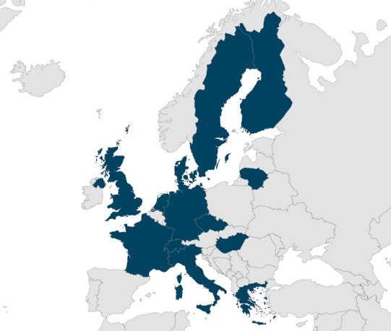
RASP in Countries
Task participants
from organisations
in 13 countries
LT, DE, NL, FI, EE, GR, HU,
UK, FR, SE,
IT, CZ, DK, CH

Slide 4
RASP in Objectives
Overall Objectives:
"This Task delivers developments focused on serving e-Research and service providers. These developments typically enhance eduGAIN or provide an additional layer of functionality above eduGAIN.
It aims to develop services that integrate with and enhance eduGAIN specifically for the more complex requirements of research communities and the differing trust models of industry providers, enabling a more sophisticated use of federated identity. "

Slide 5

What the hell is RASP?
GÉANT 4-2 JRA3 T2
eduGAIN Service Development – Reserach And SPs
What can a RASP do?

Slide 6
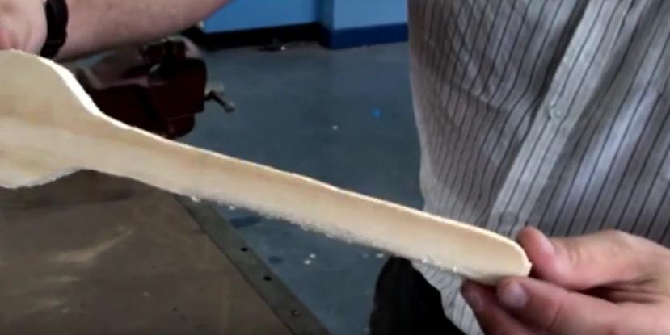
eduGAIN today

Slide 7
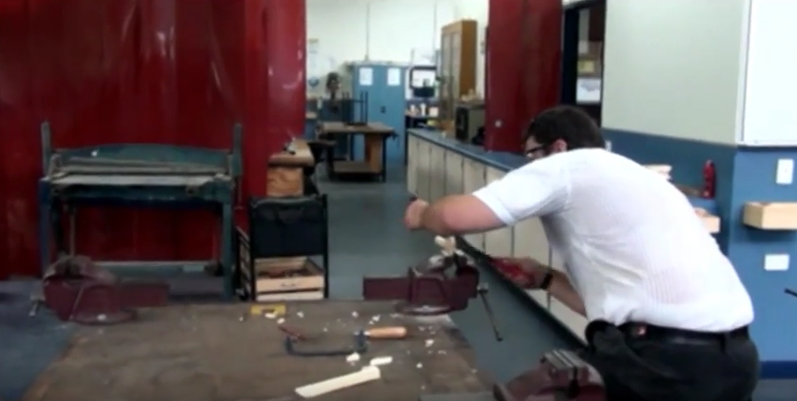
So we start RASPing

Slide 8

... and continue rasping

Slide 9
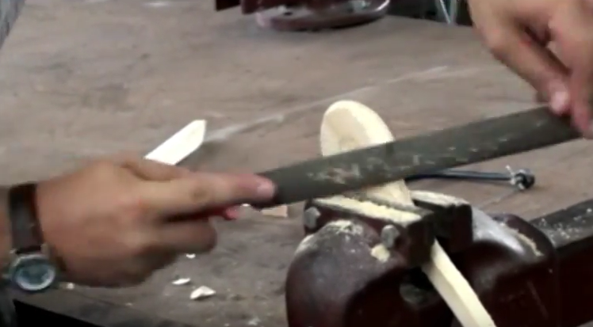
... and some more rasping

Slide 10
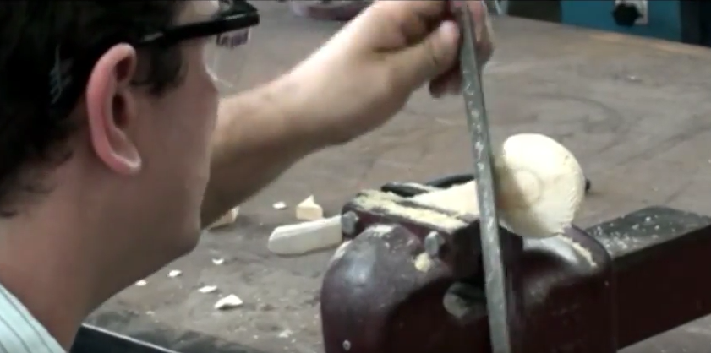
... and some more

Slide 11
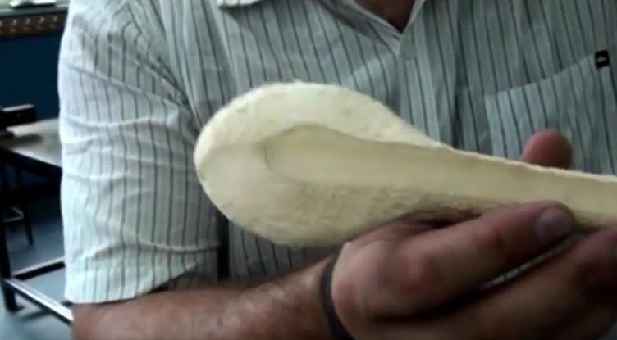
... till it resembles

Slide 12
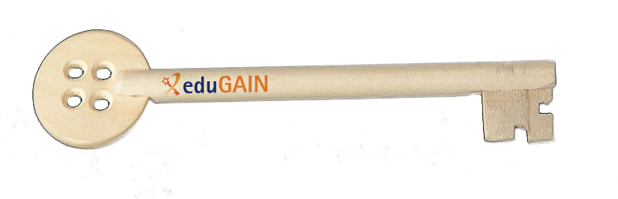
eduGAIN at end of GÉANT 4-2
At the end we get...
eduGAIN = the key to securely access education and research resources world wide

Slide 13
T2.1 Enhanced e-Science Support
Work Package T2.1:
Development of enhanced e-Science support in eduGAIN
In coordination with GÉANT Association and AARC, develop a model to enable GÉANT to combine NREN and federation support into a virtual “competence centre” to deliver expertise and support for concrete e-Science service deliveries on an ongoing basis and to collaborate with other similar teams in other e-infrastructures for integrated delivery.
  Facilitate the integration of federation experts on a case-by-case basis for service delivery.
  Provide a framework under which these support cases can be handled.
􏰀Where AARC and other appropriate projects base their developments on GÉANT infrastructure, advise and support them in their pilots.
"Create a Helpdesk that complements eduGAI OT"

Slide 14
T2.2 InAcademia
Work Package T2.2: InAcademia
Complete the pilot of InAcademia that commenced in GN4-1. Hand over to Operations together with an account management facility within GÉANT Association, including financial processes.
"Finish service, pilot it and start making some money. Probably will become the first service ever that GÉANT charges for!"

Slide 15
T2.3 SSPRP
Work Package T2.3:
Service provider simplified registration to eduGAIN
􏰀Complete the pilot of simplified registration to eduGAIN that commenced in GN4-1. Hand over to eduGAIN Operations.
"Pilot this process and decide whether to integrated it in e-Science Support or not."

Slide 16
T2.4 Assurance Services
Work Package T2.4:
(Identity) assurance service
􏰀Develop an operational model within eduGAIN to support assurance profiles for e-Research recommended by AARC. This will include investigating delivery models such as step-up, aggregation or reuse of NREN assurance services, and use of other systems such as eIDAS where applicable; recommending one or two preferred approaches; preparing the cost-benefit analysis; and proceeding to design, development and pilot.
"No clue yet what to do... Maybe implement AARC Assurance Profile self assesment tool."

Slide 17
T2.5 VOPaaS
Work Package T2.5:
􏰀Virtual organisation platform service development
Complete the pilot of Basic (Phase 1) service with basic group and attribute management, and transition to production.
  􏰀Support AARC/AARC2 pilots that are using VO platform and may have advanced needs beyond the scope of the Phase 1 production service.
  Collaborate with AARC/AARC2 to identify complex use cases with platform innovation aspects.
􏰀Develop and implement Advanced version of VO platform, including complex use cases.
"Find a better name, pilot it, compete."

Slide 18
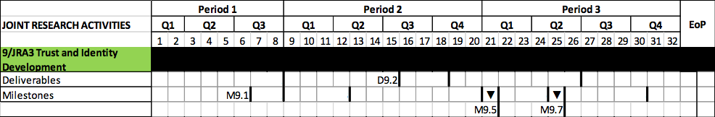
Milestones and Deliverables
Deliverables
D9.2 Virtual Organisation Platform Phase Two Service Specification (M15, July 2017)
Milestones
M9.1 e-Science support Business Case/Cost–Benefit Analysis
(M6, October 2016)
M9.5 InAcademia Pilot review (M21, January 2018)
M9.7 VO Platform Advanced Services Pilot (M25, May 2018)

Slide 19
KPIs
(Internal) Key Performance Indicators
Pilot participation InAcademia:
Month 6 (Oct 2016): 2 organisations
Month 20 (Dec 2017) 4 organisations, 6 planned for post transition to service.
Pilot participation VO Platform:
Month 8 (Dec 2016) - 1 Basic Service pilot user communities
Month 20 (Dec 2017) - 2 Basic pilot user communities, grow to 4 planned post transition to service.
Month 32 (Dec 2018) - 1 Advanced pilot user community

Slide 20
Teams
Teams according to work packages:
Enhanced e-Science Support Team (T2.1)
InAcademia Team (T2.2)
SSPRP Team (T2.3)
Assurance Service Team (T2.4)
VOPaaS Team (T2.5) – 4 sub teams
  Architectur/Design Team
  Development Team
  Marketing and Support (for Pilot Participants) Team
  Transition (Towards to Production) Team

Slide 21
Work Allocation
Participant | Surname | Organisation | T2.1 e-Science Support | T2.2 InAcademia | T2.3 SSPRP | T2.4 Assurance Service | T2.5 VOPaaS
Lukas | Hämmerle | SWITCH | x | x | x | x | x
Slávek | Licehammer | CESNET |  |  |  | x | x
Tangui | Coulouarn | DEIC/NDN |  | x |  |  | x
Daniela | Pöhn | DFN |  |  | x | x
Wolfgang | Pempe | DFN | x |  |  | x
Andres | Ehrenpreis | EENET
Sven | Hysson | EENET
Simone | Visconti | GARR |  |  |  |  | x
Mandeep | Saini | GÉANT |  |  |  |  | x
Ioannis | Kakavas | GRNET | x, EARCS |  | x
Andrej | Sliamin | LITNET | x | x
Mihály | Héder | NIIF | x |  |  |  | x
Kristóf | Bajnok | NIIF |  |  |  |  | x
Henri | Mikkonen | NORDUNET/CSC |  |  |  | x | x
Janne | Lauros | NORDUNET/CSC |  |  |  | x | x
Jean-Marie | Thia | RENATER/CNRS |  |  |  |  | x
Sébastien | Médard | RENATER | x
Hans-Peter | Ligthart | SURFmarket |  | x
Niels | van Dijk | SURFnet |  | x |  |  | x
Thomas | Bärecke | SWITCH | x
Rebecka | Gulliksson | Umea University |  | x |  |  | x
Total | 21 people |  | 7 people | 6 people | 3 people | 6 people | 12 people

Slide 22
Additional Work Items
 | Interested Team Members | Allocated Team Members
eduGAIN Attribute Release Check Service (EARCS) | Ioannis, Andres, Sven, Kristof?
eduGAIN Access Check Service (EACS) | Sebastien, Jean-Marie | Sebastien
eduGAIN Connectivity Check Service (ECCS) |  | eduGAIN OT/Marco takes care of operation and small changes, only relevant for JRA3 T2 if ECCS needs major development
eduGAIN isFederated Check Service (EIFCS) |  | (Lukas)
eduGAIN Historical Statistics | Andrej, Jean-Marie
eduGAIN Usage Statistics (F-Ticks) | Ioannis | Daniela's task JRA3 T1 takes care of this, potentially with help from Joannis
eduGAIN Wiki Restructuring |  | (According to Tomasz AARC would like to move existing wiki to new wiki system, restructuring at the same time would be reasonable)
- Guide for SP admins on how to best use SAML attributes (displayName or givenName+surname)
IdP Name Collision Detector |  | Andrej
EntityCategory-based Release for SSP |  | Andres, Sven

Slide 23
Mailing Lists
Task Mailing List: rasp@lists.geant.org
 | Internal | External/Moderated
T1. E-Science Suppport | escience-support@lists.geant.org | edugain-integration@geant.net
T2. InAcademia | inacademia-discussion@lists.geant.org | inacademia-users@lists.geant.org
T1. SSPRP | None
T1. Assurance Service | assurance-service@lists.geant.org
T1. VOPaaS | vopaas@lists.geant.org

Slide 24
Our Stakeholders
} SPs
Research Communities
Publishers
Cloud Providers
Service Providers in general
Other JRA3 tasks
  T1:eduGAIN Development – Federation and Campus (Daniela Pöhn)
  T3: Trust & Identity Technology Development (Maarten Kremers)
Other GÉANT activities
  SA2: Trust & Identity and Multi-Domain Services (Marina Adomeit)
  NA3 Partner, Users and Stakeholder Relations (John Cheevers)
Federation Operators
e-Infrastructures (EGI, EUDAT, ...)
NRENs

Slide 25
Questions and Comments

