Slide 1
Trust & Identity Development
Kickoff JRA3
Ann Harding
SWITCH
Zürich
July 2016

Slide 2
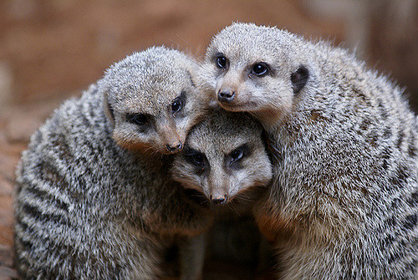
Agenda Bashing - Day 1 https://wiki.geant.org/display/gn42jra3/Kickoff+12-13+July+2016
First session – everyone’s current planning (Mod Ann)
  Listen, take notes, ask some questions where needed
  Keep to time!
Second Session - Shared general discussion on plans (Mod Ann + Justin)
  Overlaps, Concerns, Priorities
  Planning process & support
  Use whiteboards and postits
Third session – Business development (Mod Brook)
  What do you need from Bus Dev and what does it need from you?
  Wider project context
Fourth session – Monitoring (Mod Miro)

Slide 3
Agenda Bashing – Day 2https://wiki.geant.org/display/gn42jra3/Kickoff+12-13+July+2016
First Session – Transition to Service (Mods Marina & Alessandra)
  Listen, take notes.
  Determine transition schedule for your Y1 & Y2 services
  Provide requirements for key ops tools
Second Session – Parallels (TBD)
  Attributes & Tools x-task work (Propose Mod Lukas)
  Security & Assurance x-task work (Propose Mod Daniela)
  eduroam
Third session
  Wrap-up on actions, changes etc.

Slide 4
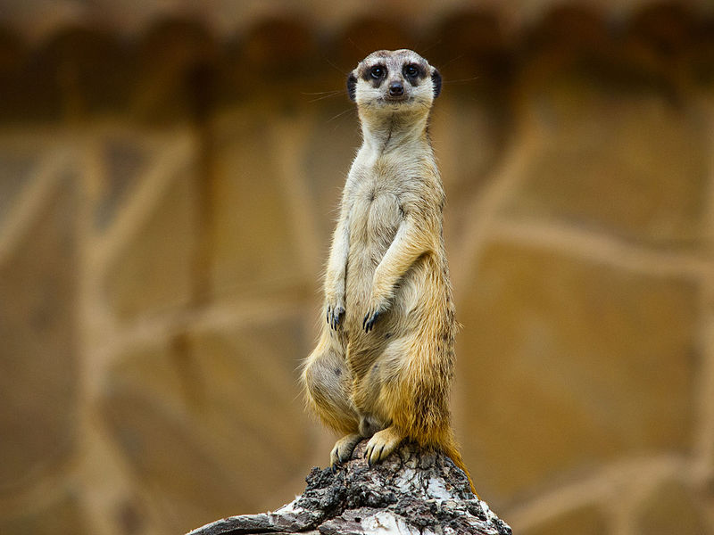
Organisational & Project Updates
EC still not finally signed GN4-2 contract
  technical issues entering info in portal
  4 month quarter likely but not finally approved -> start putting stuff in Quarterly Report now in case it is M3
  Theoretically can make changes to contract – please don’t unless critical
JRA3 Admin updates
  Updated team members from LRZ, RENATER, HITSA
  Change requests needed for device budget in eduroam (DONE) and standards engagement (NOT DONE)
  Slow start for M1 – OK but share any worries!

Slide 5
Organisation & Project Updates
One CPO, GEANT Project Manager – Matthew Scott
NA1
  IT, IPR –Now Dimitri van Zantvliet Rozemeijer. Anand Patil no longer with GEANT
  Tech coord – ad interim GÉANT Org Exec team, looking to co-opt extra specialists
  Product Management – Tor Bloch ad interim. Richard Lui no longer with GÉANT, Domenico moved to training team. A permanent recruitment taking place.
NA2 – Now Cathrin Stöver; Melanie Pankhurst no longer with GEANT. Karl delegated as our initial PoC for workplans
NA3 – Now Cathrin Stöver; John Chevers no longer with GEANT, Annabel delegated as our initial PoC for workplans
  User Liason – Now (Vinc)Enzo Capone; Roberto Sabatino no longer with GÉANT
  Intelligence Gathering – Ad interim Nadia Sluer, then Nathalie McKenzie
  Account management – Beatrix Weber + Annabel Grant
  e-Infras coord – Annabel Grant

Slide 6
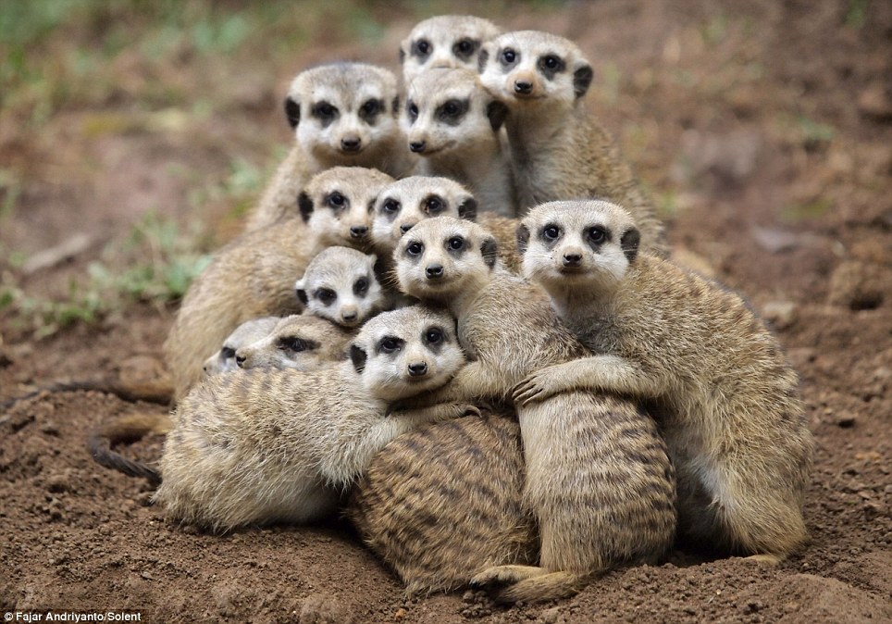
Over the next two days…
…and years
Listen
Identify problems
  And help find solutions
Ask questions
Ask for help (now or later)
Remember
Contribute
Focus on your work in context, not in silos
  We all depend on each other
  And on users

