Slide 1
Update on eIDAS
Christos Kanellopoulos
eduGAIN TownHall, Vienna
February 21st, 2017

Slide 2
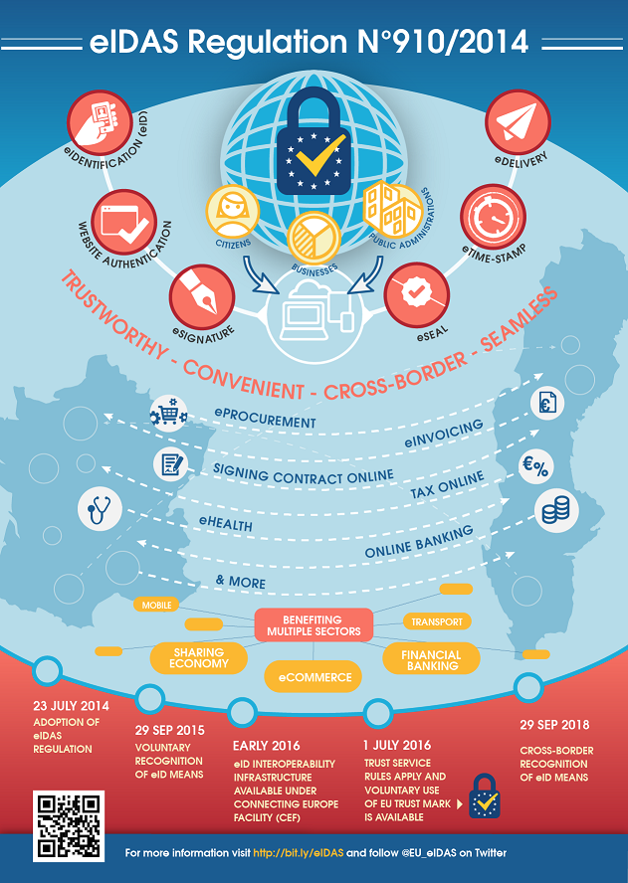

Background information
23 JUL 2014
Adoption of eIDAS regulation
29 SEP 2015
Voluntary recognition of eID means
EARLY 2016
eID Interoperability Infrastructure available under Connecting Europe Facility (CEF)
1 JULY 2016
Trust Service rules apply and voluntary use of EU
Trust Mark is available
29 SEP 2018
Cross-border recognition of eID means

Slide 3
Use cases
The use of eIDAS eIDs in the context of academic research services.
  The use case scenario is a researcher participating in an international collaboration, who will be accessing services available in eduGAIN using eIDAS eID assertions as a means of identifying herself. There is an important benefit here for eduGAIN as there are cases in which researchers do not have eIDs from an academic institution but may have access to national eID through eIDAS
The use of eIDAS as a mean to access services that require higher LoA
  The use case scenario is a researcher participating in an international collaboration (e.g. a Bio-bank), who will be accessing services available in eduGAIN using eIDAS eID assertions as a mean to elevate the LoA of the identity assertion. This is an existing problem for eduGAIN as there are no higher levels of assurance currently.
The combination of eIDAS eID assertions and user attributes coming from a university
  The use case scenario will mimic the user journey of an individual registering at a university in country B (eIDAS eID assertion- from IDPs) and asserting proof of their academic attributes from an institution in country A (attribute enrichment). The user will register to enrol at a university in country A by asserting an identity and additional attributes established in country B. It is noted that the US does not currently have a national eID service meaning that
  **this element of the alpha will focus on user research rather than technical implementation aspects**.

Slide 4
Cross-sector interoperation with eIDAS
2016-07 – 1st meeting in Brussels between AARC, GN4 and eIDAS Reps
  Investigate the possibility of an interoperation pilot between eduGAIN and eIDAS
2016-09 – 2nd meeting in London (AARC, GN4, Internet2, eIDAS Reps)
  Draft proposal for an interoperability pilot between
  3 Use cases:
    Use case 1: authenticate to eduGAIN service with eIDAS eID
    Use case 2: authentication to an eduGAIN service where a higher LoA is required
    Use case 3: registering at a university online with cross-border attribute provision
    [** This use case is only going to be a study and not an actual implementation ]
2016-10 – eduGAIN Steering Group
  Internal analysis and recommendation on the interoperation scenarios:
    Establish bridge/proxy at the national level?
    A distributed bridge/proxy at the GÉANT/eduGAIN level?
    eIDAS as an Identity Federation in eduGAIN?

Slide 5
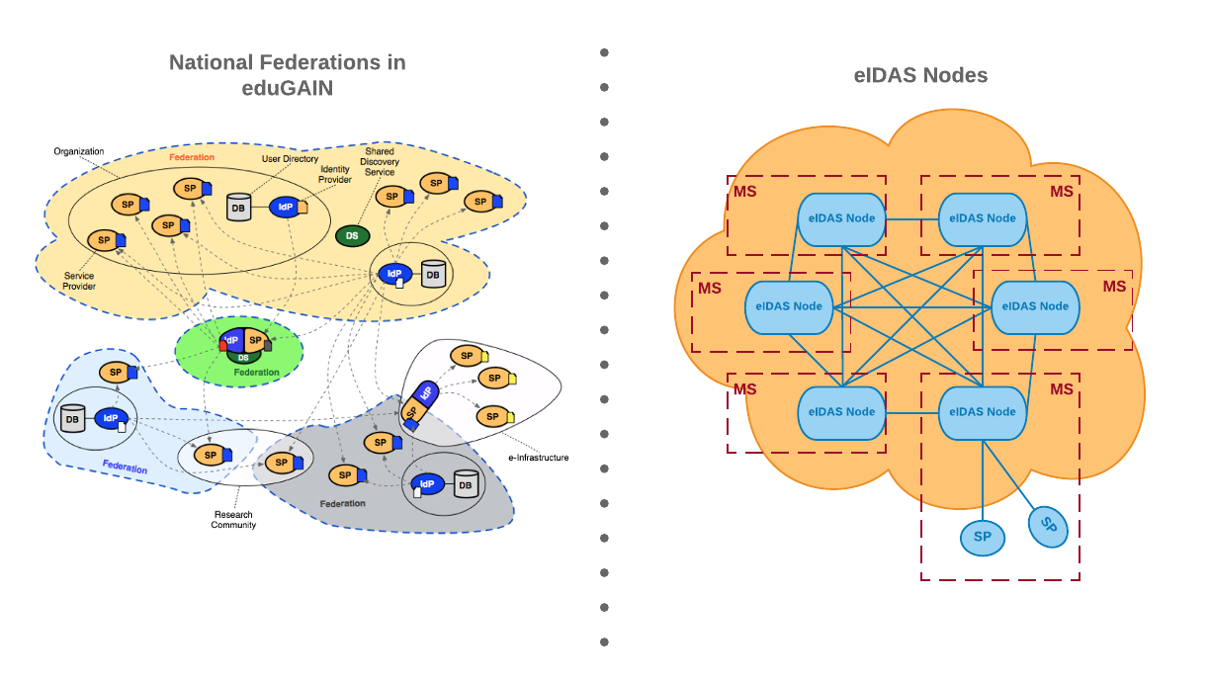
eduGAIN – eIDAS Comparison - https://goo.gl/tLbXE4
C. Kanellopoulos/AARC - GN4, Licia Florio/GÉANT – AARC, Maarten Kremers/SURFNET – GN4, Wolfgang Pempe/DFN, Davide Vaghetti/GAAR, Ioannis Kakavas/GRNET, Nicolas Liampotis/GRNET

Slide 6
eduGAIN – eIDAS Comparison - https://goo.gl/tLbXE4
eduGAIN
Architecture
  Dynamic topology (proxied and full mesh federations
  IdPs and SPs published in eduGAIN MDS
Service Providers
  Requested attributes in the metadata
Attributes
  eduPerson
eIDAS
Architecture
  “Static” topology (proxies)
  Static trust relationship between eIDAS Nodes
Service Providers
  Requested attributes in AuthN request
  SPType: Private or Public
Attributes
  Surname, Name, Date of Birth, Unique Identifier, First name at birth, Family name at birth, Place of birth, Current address, Gender

Slide 7
eduGAIN – eIDAS Comparison - https://goo.gl/tLbXE4
eduGAIN
SAML AuthN Request
  Dynamic topology (proxied and full mesh federations
  RequestAuthnContext MAY be set and comparison attribute SHOULD NOT me provided or be set to “exact"
SAML AuthN Response
  MUST be signed
  Unsolicited responses MUST be accepted
eIDAS
SAML AuthN Request
  Force auth must be set to True
  SPType must be set to Public or Private <eidas:SPType>
  Requested attributes <eidas:RequestedAttributes>
  RequestAuthnContext MUST be set and comparison attribute MAY be provided
SAML AuthN Response
  MAY be signed
  Unsolicited responses MUST NOT be accepted

Slide 8
Interoperability Scenarios
Scenario 1: A service with global scope that would function as a gateway between any entity in the eduGAIN inter-federation and the eIDAS Network
Scenario 2: An implementation with national scope that would function as a “gateway” between the national academic federation and the eIDAS-Node in the specific country.

Slide 9
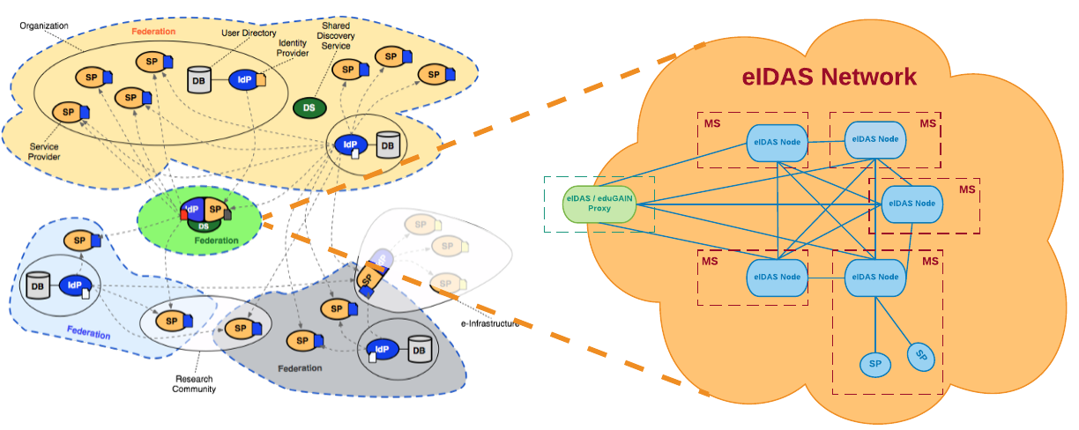
Interoperability Scenarios | Scenario 1

Slide 10
Interoperability Scenarios | Scenario 1
Taps directly to eIDAS Interoperability Framework, which is the only common standardized interface across all the national eID schemes
Just one service for all the federations participating in eduGAIN
No extra burden to the federation operators
SPs can treat the service as a proxy IdP
Flexibility on how eIDAS becomes visible to the federations
Avoid creating islands in which some federation will be able to use the local eGOV ID scheme, while there is no support in others
SPs worldwide could potentially benefit from such a bridge
Not under the direct control of each Federation
Has to be operated as an eduGAIN service
Increased burden (and possible liability) for the organization(s) operating the service
eIDAS is a European specific service, why should federations outside of Europe care about this?

Slide 11
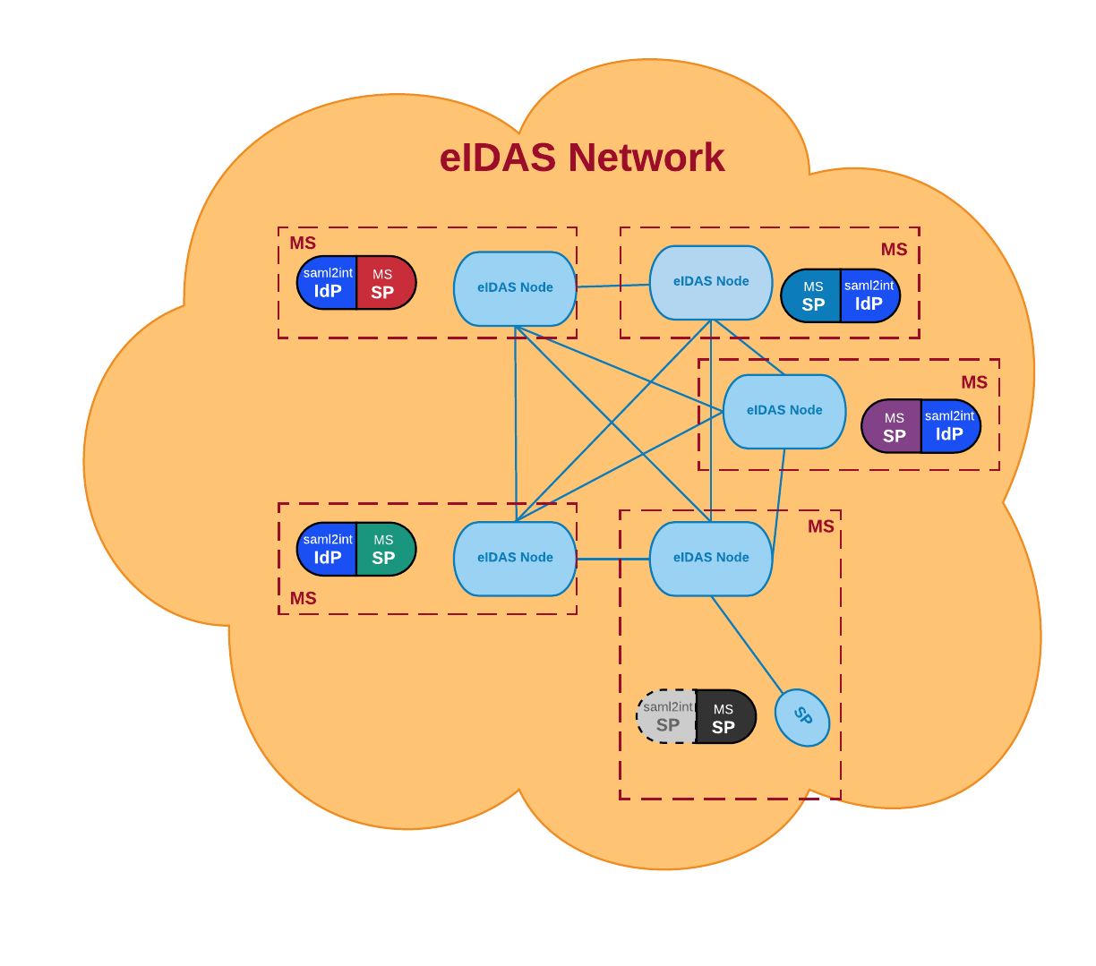
Interoperability Scenarios | Scenario 2

Slide 12
Interoperability Scenarios | Scenario 2
Tailored to the needs of each federation
Fully controlled by the federation
The burden and liability of the implementation is distributed to the federations
The implementation could be more lightweight for some cases
Each implementation would be specific to each country
Dependency on the willingness or the reluctancy of each country’s eGOV ID governance to accomplish the integration with the local R&E identity federation
Extra burden (and possibly costs) on the operators of the federation

Slide 13
skanct@gmail.com

