Slide 1


eduTEAMS – Current status & Future Plans
Christos Kanellopoulos, Ann Harding
EOSCPilot WP5 AAI call
July 2017

Slide 2
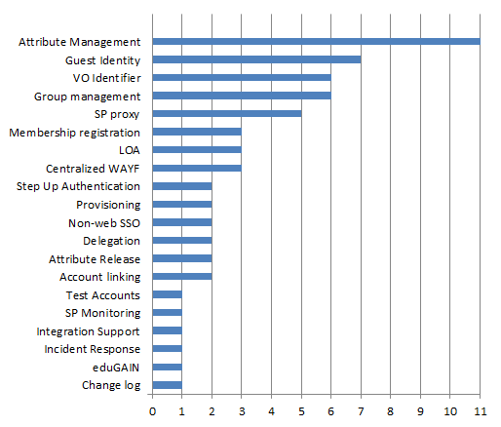
Background - Market Analysis Results
http://www.geant.org/Projects/GEANT_Project_GN4-1/deliverables/D9-2_Market-Analysis-for-Virtual-Organisation-Platform-as-a-Service.pdf
Notes:
Conducted Market Analysis including
FIM4R paper
Interview Vos
include AARC findings

Slide 3
eduTeams – Makes managing virtual teams easy
A suite of services to support research collaborations
Built on top of eduGAIN, takes full advantaged of federated AAI
Simplify the management of group and authorization information
Enables the integration users from a wide range of environment
Connects users to services

Slide 4

Components – Service Suite approach
Users choose how much of the platform they want
eduTEAMS Membership Management service
  VO specific workflows for onboarding members
  Registry for VO persistent Identifier
  Limited set of attributes to maximise interoperability
    Use of eduperson entitlement to carry richer info
  Accessible through eduGAIN
eduTEAMS Identity Hub
  One persistent (SAML) IdP for many ‘Guest’ Identity Providers
  Provides Account recovery if users change main a/c
  Available and accessible through eduGAIN
  Supports Research and Scholarship Entity Category
Discovery Service
  Provided by CESNET

Slide 5

eduTEAMS ecosystem
IdP
AuthN:
ID + attributes
SP or SP Proxy
eduTEAMS
Membership
Management
eduTEAMS Identity Hub
External IdP

Slide 6
Components – Membership Management
SPs
SPs
SPs
Identity
Hub
SPs
Community Services
Comanage v.20
REST AA
Get persistent Identifier
& VO specific groups and attributes
SAML AA
e-Infrastructure
Resources
Infrastructure
AAI proxy
SPs
Membership
Management
SPs
SPs
Notes:
- The research community uses eduTeams to manage itself
Users register on the community group(s) on eduTeams
Users can access resources based on the group membership
How it works?
Communities set up their groups on eduTeams
Users register on eduTeams via eduGAIN (or via a guest identity provider service) and are assigned to groups (many registration and group management strategies are available)
Service and Infrastructure AAI proxies use eduTeams as a trusted Attribute Authority

Slide 7










Components Identity Hub
SPs
Implemented
Identity
Hub
SPs
SPs
SPs
Committed (first Oauth case)
Comanage v.20
REST AA
LOA
Community Services
Persistent ID
SAML AA
Future, via
Oauth Support
Membership
Management
Infrastructure
AAI proxy
SPs
SPs
SPs
Notes:
Zoom in a bit on eduTEAMS Identity Hub
Leverage existing patchwork of ID services
Let the user choose the IdP it wants to use
Persistent identity for the Servcices
LOA information

Slide 8
Service offerings available to pilot now.
Multi-tenant
  Membership management, ID Hub (Discovery)
  Shared infra – every collab is a group
  Free at point of use to groups
  No contracts needed, no legal form required
    Limitations on personal data etc.
Single tenant
  Membership management, ID Hub, Discovery Dedicated instance on a VM
  Greater control over data – contract needed.
  Could be used by an NREN to scale multi-tenant nationally
  Possibility on case by case basis to support interface with more complex systems
    Lead time TBD depending on complexity of case – HEXXA/PERUN/Grouper/Other examples

