Slide 1
Communities you represent
Please describe who you provide services for:
GÉANT members and their communities ie. Research and education collaborations all over Europe
Main requirements/use-cases:
Long tail of research – allow non-organised collaborations without legal entities manage group and attribute information to access a range of services
NRENs: enable NRENs to provide group and attribute management to collaborations needing access to their services e.g. cloud, filesenders, collab platforms etc.
Research Infrastructures: Enable large research infras to manage complex group and attribute workflows for access to their services, ensuring interop with established AAIs
GEANT-as-a-VO: 40+ country collaboration needing access to a diverse set of services withfine grained authZ.

Slide 2

About your AAI
What AAI do you have in place:
GÉANT VO Infrastructure
(Near service) Pilot platform for long tail
(Near service) Pilot platform for large VOs
Which AAI would you envisage to have in 3 years time:
Long tail platform
Large VO custom services as per LifeSci, with GÉANT’s own case being one of several

Slide 3
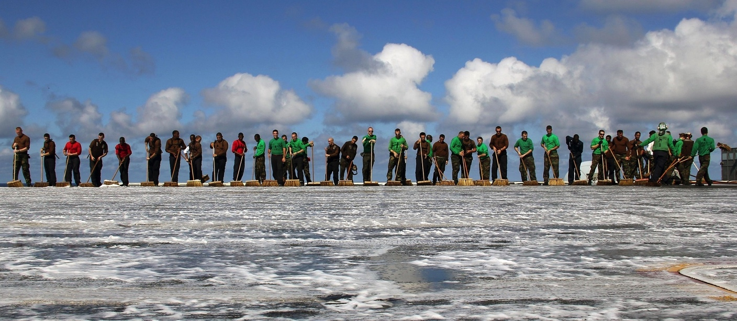
eduTEAMS
Moving up the AAI stack
Collaboration platform to enable use of federated identity in research communities
Supports AARC architecture
Neutral partner for any e-Infra or Research Infra inc. “long tail”, informal groups
Notes:
Emphasise, these are *delivered* not concept.
Context of use of these pilots in TRL8
https://pixabay.com/en/teamwork-group-cooperation-job-1788413/

Slide 4
Components – LEGO approach
Advanced Users choose how much of the platform they want
eduTEAMS Membership Management service
  VO specific workflows for onboarding members
  Registry for VO persistent Identifier
  Limited set of attributes to maximise interoperability
    Use of eduperson entitlement to carry richer info
  Accessible through eduGAIN
eduTEAMS Identity Hub
  One persistent (SAML) IdP for many ‘Guest’ Identity Providers
  Provides Account recovery if users change main a/c
  Available and accessible through eduGAIN
  Supports Research and Scholarship Entity Category
(Discovery Service
  Provided by CESNET)

Slide 5

eduTEAMS ecosystem
AuthN:
ID + attributes
IdP
SP or SP Proxy
eduTEAMS
Membership
Management
eduTEAMS Identity Hub
External IdP

Slide 6
Components
Membership Management
Service Provider
(1)
IdP
Authenticate
(2)
eduTEAMS Identity Hub
Comanage v.20
REST AA
Get persistent Identifier
& VO specific groups and attributes
SAML AA
SPs
SPs
eduTEAMS
Membership
Management
SPs
(NREN) proxy
SPs
SAML
or OIDC
Notes:
Non SAML AA pending OIDC work.

Slide 7












Components
Identity Hub
Implemented
eduTEAMS Identity Hub
Persistent ID
linkedin
LOA
Account
Recovery
Future, via
Oauth Support
Notes:
UPDATE END AUGUST – new Oauth
Homeless user solution (was in scope also for T3, solved here for non eIDAS cases)
Zoom in a bit on eduTEAMS Identity Hub
Leverage existing patchwork of ID services
Let the user choose the IdP it wants to use
Persistent identity for the Services
LOA information

Slide 8
Service offerings available to pilot now.
Multi-tenant – long tail
  Membership management, ID Hub (Discovery)
  Shared infra – every collab is a group
  Free at point of use to groups (use sponsored by NRENs)
  No contracts needed, no legal form required
    Limitations on personal data etc.
Single tenant – complex VO needs, dedicated instance
  Membership management, ID Hub, Discovery Dedicated instance on a VM
  Greater control over data – contract needed.
  Possibility on case by case basis to support interface with more complex systems
    Lead time TBD depending on complexity of case – HEXXA/PERUN/Grouper/Other examples

Slide 9





eduTEAMS
Moving up the AAI stack – from design to pilot
Research communities and e-Infrastructures
  AARC2-as-VO (Pilot committed)
  LifeScience AAI (Integrated e-infra proposal)
  Umbrella (Pilot underway
  EUDAT (Pilot committed )
  EGI (Pilot committed)*
  * as part of AARC2 interoperability activity)
NRENS
  JISC (Pilot committed)
    Moonshot Pathfinder project
  SURFnet (Pilot committed)
    Science Collaboration Zone project
  GARR (Pilot interest)
  SWITCH (Pilot interest)
    SWITCH eduID
    Swiss Personalised Health Network
    Swiss Data Science Center
    Swiss National Supercomputing Centre
Notes:
Emphasise, these are *delivered* not concept.
Context of use of these pilots in TRL8
https://pixabay.com/en/teamwork-group-cooperation-job-1788413/

Slide 10
ß

