Slide 1



eduTEAMS
An AAI solution for collaborations at scale
Christos Kanellopoulos, GÉANT
DI4R17
30 November 2017
Brussels, Belgium

Slide 2

eduTEAMS
A suite of services for using federated AAI for collaborations
Collaboration suite to enable use of federated identity in research communities
Partner for any e-Infra or Research Infra inc. “long tail”, informal groups
Components
eduTEAMS Membership Management service
eduTEAMS Identity Hub
Characteristics
Documentation, Cookbooks, Privacy Policy etc available
https://wiki.geant.org/display/ED
eduTEAMS Discovery Service
2 monthly release cycle
Supports AARC architecture
Single- and multi-tenant options
eduTEAMS Proxy

Slide 3






eduTEAMS - Pilots
Engaging with communities, eInfras and NRENs
Research communities and e-Infrastructures
  AARC2-as-VO (Pilot committed)
  LifeScience AAI (Pilot)
  Umbrella (Pilot committed)
  HPC-Europe (Pilot interest)
  EUDAT (Pilot committed)*
  EGI *
  * as part of AARC2 interoperability activity
NRENS
  JISC (Pilot committed)
    Moonshot Pathfinder project
  SURFnet (Pilot committed)
    Science Collaboration Zone project
  GARR (Pilot interest)
  SWITCH (Pilot interest)
    SWITCH eduID
    Swiss Personalised Health Network
    Swiss Data Science Center
    Swiss National Supercomputing Centre

Slide 4
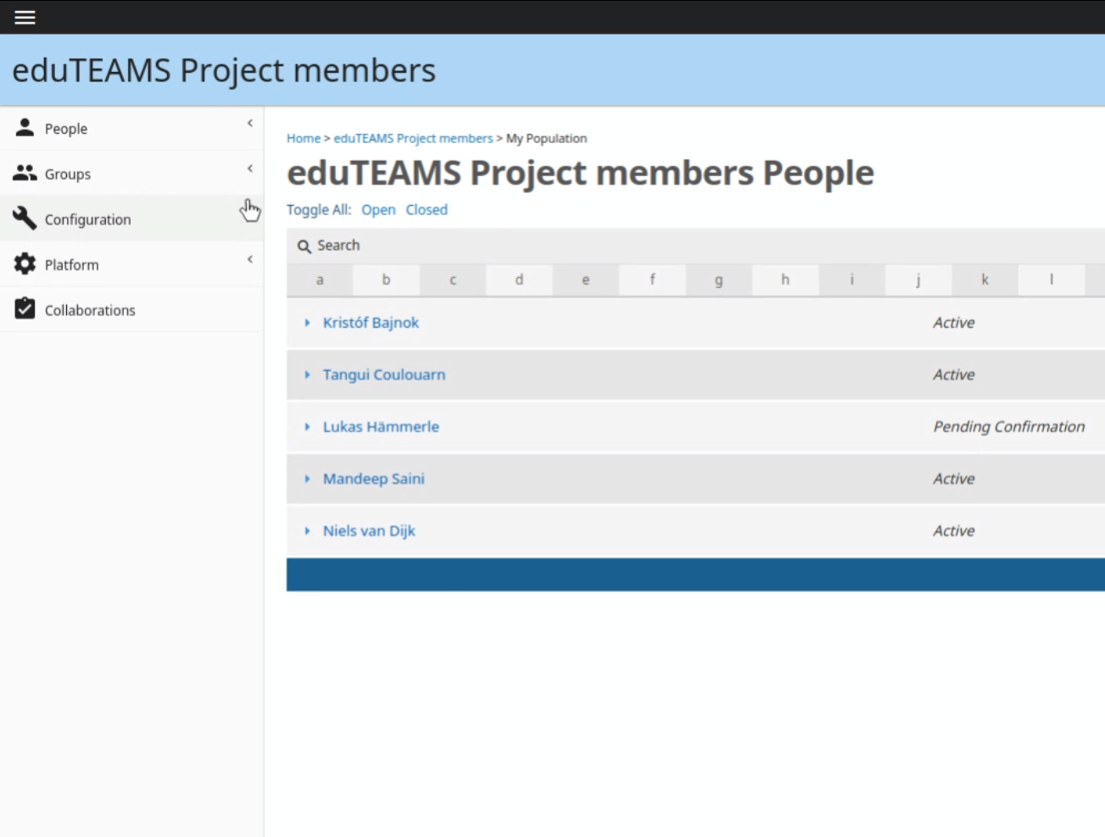
eduTEAMS
Membership Management Service (MMS)
Manage Roles and Rights
  Available trough eduGAIN
  CoCo and R&S supported
  Strong focus on privacy and GDPR
  part of AARC2 interop activity
  Technical and cookbooks:
  https://wiki.geant.org/display/ED/Membership+Management+Service
  Service:
  https://registry.eduTEAMS.org
NRENS
  JISC (Pilot committed)
    Moonshot Pathfinder project
  SURFnet (Pilot committed)
    Science Collaboration Zone project
  GARR (Pilot interest)
  SWITCH (Pilot interest)
    SWITCH eduID
    Swiss Personalised Health Network
    Swiss Data Science Center
    Swiss National Supercomputing Centre

Slide 5

eduTEAMS
Membership Management Service (MMS) - ecosystem
IdP
Service Provider
COmanage
AuthN:
ID + attributes
REST AA
SAML AA
eduTEAMS
Membership
Management
eduTEAMS Identity Hub
External IdP

Slide 6

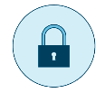
eduTEAMS
Discovery Service
Component of eduTEAMS, but generically usable for eduGAIN SPs
Based on proven service from CESNET
Engaged in RA21 Pilot – Resource Access for the 21st Century (https://ra21.org)
  Publishers, libraries and users
https://wiki.geant.org/display/ED/Discovery+Service

Slide 7















eduTEAMS
Identity Hub
Implemented
eduTEAMS Identity Hub
Persistent ID
LOA
Account
Recovery
Future
https://wiki.geant.org/display/ED/Identity+Hub

Slide 8
eduTEAMS
Proxy
eduTEAMS Identity Hub
COmanage
OIDC
SAML
LDAP AA
REST AA
eduTEAMS Proxy
eduTEAMS Discovery
SAML AA
eduTEAMS
Membership
Management
SAML
OIDC
SP
SP
SP

Slide 9
Service offerings available to pilot now.
Multi-tenant – long tail
  Membership management, ID Hub, Discovery
  Shared infra – every collab is a group
  Free at point of use to groups (use sponsored by NRENs)
  No contracts needed, no legal form required
    Limitations on personal data etc.
Single tenant – complex community needs, dedicated instance
  Membership management, ID Hub, Discovery, Proxy Dedicated instances on a VM
  Greater control over data – contract needed.
  Possibility on case by case basis to support interface with more complex systems
    Lead time TBD depending on complexity of case – HEXXA/PERUN/Grouper/Other examples

Slide 10
eduTEAMS Component | Multi-tenant | Single-tenant
Membership Management Service | ✔ | ✔
Discovery | ✔ | ✔
Identity Hub | ✔ | ✔
Proxy |  | ✔

Slide 11

Thank you
Any questions?

