Slide 1
Collaborative Organisation Platform as a Service
Mandeep Saini
Product Manager, GÉANT, U.K.
Niels Van Dijk
Technical Product Manager, SURFnet, The Netherlands
AARC/CORBEL Workshop
June 1, 2016, Paris

Slide 2
Outline
Introduction
Problem statement
COPaaS offering
What's in it for R&E communities?
Our roadmap
How to join us?

Slide 3
Introduction
GÉANT project
  Europe’s leading collaboration on network, related infrastructure and services.
CO Platform as a Service
  Offers a simple, consistent way for using federated services for COs, including group management, attribute authorities.
  To support uptake of federated technologies while improving the quality of AAI for COs.

Slide 4
Collaborative/Virtual Organisation (CO/VO)
Organisational representation of network of people and resources
  Spread across different organisations in multiple geographical locations
Enable group of people to share set of resources.
Access to resources (or Services) often needs to be managed
  Requires authentication and authorization.

Slide 5

Collaborative Organisations and AAI
With Federated Authentication
  Home oragnisation operates Identity provider (IdP)
  Allows authentication towards a Service Provider (SP)
Identity Federations
  E.g. InCommon or SURFconext,
  Provides trust frameworks between SPs and IdPs.
Inter-federation
  E.g. eduGAIN,
  Interconnects national identity federations.
  Successfully addresses authentication in heterogeneous environment.

Slide 6
Collaborative Organisations and AAI
To be able to grant access, a Service needs information beyond Authentication
Identity Federations often conveys it using attributes
However, often attributes issued by home organisation alone are not enough
  CO services need attribute information in the context of the CO
Requires COs to manage and provide additional attribute towards Services, independently from the home organisation.

Slide 7
CO Platform as a Service
Goal:
Investigate the conditions that would allow GÉANT to provide services for supporting COs
  Focus on delivery of Technical services
  Out of scope:
    Technical development
    Policy & LOA development
Activities:
  Collected requirements and priorities with/from communities
  Evaluated existing tools and technologies
  Looking into delivery model
  Investigating business case & sustainability
  Operations and Market

Slide 8
Requirements for building on Federated AAI as a CO
COPaaS conducted a survey
  For several small and large Pan-European COs
  Re-validates the FIM4R requirements.
  Results outlines functional requirements.
The FIM4R paper (April 2012)
  Outlines collective requirements for using Federated AAI for COs.

Slide 9
COPaaS Market Analysis
Interviews and desk study conducted with:
  Umbrella (Large neutron and photon facilities)
  CLASSe (Shared IaaS)
  DARIAH (Humanities)
  CERN (High Energy Physics)
  CLARIN (Humanities and social sciences)
  Virtual Campus Hub (eLearning, Renewable Energy)
  ELIXIR (Life Sciences, Bioinformatics)
  GÉANT VAMPIRE (NREN collaboration).
Broad NREN/federation participation:
  AMRES, CESNET, DFN/LRZ, GARR, IUCC, NIIF, RENATER, SUNET, SURFnet, SWITCH
Market Analysis
http://www.geant.org/Projects/GEANT_Project_GN4-1/deliverables/D9-2_Market-Analysis-for-Virtual-Organisation-Platform-as-a-Service.pdf

Slide 10
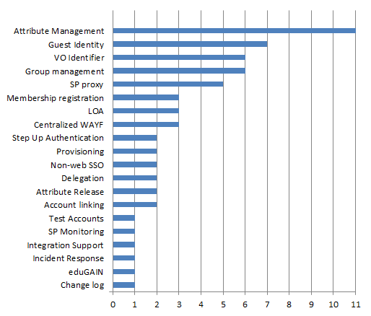
COpaas Market Analysis Results

Slide 11
COPaaS - Function requirements
Persistent Identifier
  Allows CO to identify the user even if (s)he changes IdP
CO Membership Registration
  Workflows for CO member registration
‘External’ Identities
  Many CO users’ IdP will not be in eduGAIN
Attribute Management
  Attributes beyond the IdP are needed for CO roles and rights, or
  To provide extra context (e.g. ORCID, Grant number)
Group Management
  Groups may also be used to define roles and rights
(de)Provisioning
  Identity, attributes and groups need to be provided to Services
Service Proxy and Attribute Aggregation
  A centralised infrastructure to operate on behalf of the CO Service Providers

Slide 12
COPaaS Deployment model
Basic Services
Operated by GÉANT
Multi tenant service
Also for COs that are not legal entities
Operated as a (set of) Services
Advanced Services
Operated by GÉANT on behalf of a CO
Single tenant service
Somebody – a legal entity - must take responsibility for the data
Operates as per CO applications on VM ‘boxes’

Slide 13
Basic Services
CO Membership service
  Registry for CO persistent Identifier
  CO specific Workflows for onboarding
  Limited set of attributes
  Accessible through eduGAIN
Transparent External Identity proxy (TEIP)
  One persistent (SAML) IdP for many ‘Guest’ Identity Providers, including:
    Social (Google, Twitter, Linkedin, Facebook)
    NREN operated & Commercial Guest IdPs (OpenIDP, UnitedID.org, eduID.se)
    eGOV (STORK)
    BankID
  Provides LOA: eIDAS by default, others upon request from SP
  Available and accessible through eduGAIN

Slide 14








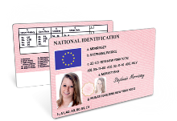
Transparent External Identity proxy (TEIP)
Social
(OIDC & Oauth)
SaToSa Proxy
SAML2INT
SP
VHO
Account Recovery
TEIP
BankId & eGOV

Slide 15
Advanced Services
(advanced) Attribute Management
  Whatever you can come up with
(advanced) Group Management
  Groups hierarchy etc.
Provisioning
  For web and non-web resources, ‘application specific connectors’
Service Proxy and Attribute Aggregation
  To have a central point for technology and policy
  Accessible through eduGAIN
  May be delivered as a paid service

Slide 16





Tools
Basic Services
CO Membership service: COmanage
Transparent External Identity Proxy (TEIP): SaToSa
Advanced Services
Attributes and Groups: HEXAA, PERUN and COmanage
SP Proxy: OpenConext

Slide 17
Architecture
VOOT
Service Provider
COmanage
AuthN:
Id + attributes
IdP
SAML AA
Oauth
TEIP
CO persistent Identifier
+
CO attributes
COPaaS
eduGAIN

Slide 18
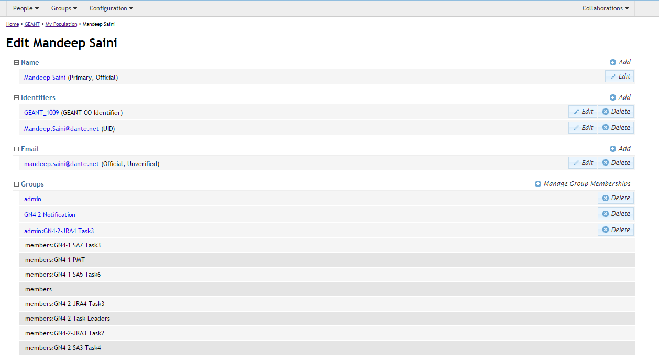

Slide 19

What's in it for R&E communities
AAI is complex, subject matter experts are required.
Save time and efforts
  Why to re-invent wheel?
  Invest on research topics rather than building AAI
COPaaS
  Delivery vehicle for trusted technologies.

Slide 20

Roadmap
Q3 2016
Delivery Model
Deploy pilot platform
Q4 2016
Run pilots with Basic Services, in collaboration with AARC
Support application integrations
2017
Production service for Basic Services
Finalise specification for Advanced Services
2018
Deploy Pilots for Advanced Services
Possibly: pick up new services as developed within GEANT, AARC or others

Slide 21

Join Us
Interested to join COPaaS pilot or have any queries
  Contact us: vopaas@lists.geant.org

