Slide 1

Challenges of supporting education and research to make use of eduGAIN
Ioannis Kakavas, GRNET,GÉANT

Slide 2
Outline
Quick eduGAIN primer
Challenges
Work with research communities
Suggestions and best practices

Slide 3
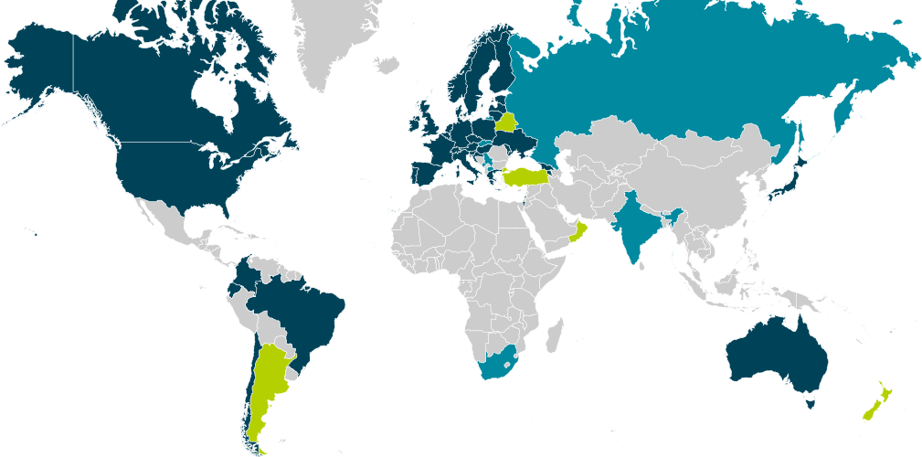
eduGAIN
https://technical.edugain.org/status
Service developed by the GÉANT project
Interconnects SAML2 Identity Federations
Simplifies access to resources and services

Slide 4
eduGAIN – The numbers
38 participating national identity federations
5 continents
2079 Identity Providers
1197 Service Providers

Slide 5
eduGAIN benefits
Researchers gain access to a wide range of services
Researchers can use existing credentials
Services gain exposure to an international audience
Services can offer easier onboarding – no registration
World wide collaboration

Slide 6
Challenges
Identity Providers coverage in eduGAIN
  Not all federations participate in eduGAIN
  Not all organizations participate in federations
  Not all participating organizations are published in eduGAIN
FIM specific competence and experience
  Complex topic with steep learning curve
  ROI not immediately clear

Slide 7
Challenges
LoA (or rather the lack thereof)
  Different, not standardized processes for identity vetting
  No adopted standard for levels of assurance
Attribute release
  The holy grail of federated identity
  Privacy vs Availability

Slide 8
“What have you done?”
Worked closely with research communities
Implemented new services
Created material for training and guidance
Continuously support research communities and Campus IT

Slide 9
“What have you done?”
Defined frameworks to facilitate attribute release
  GÉANT Code of Conduct
  Research and Scholarship
Work on Levels of Assurance
Interoperability and categorization of services

Slide 10



Work with research communities
  DARIAH (Humanities and Social Sciences)
  Bring Dariah services to eduGAIN and help
  establishing GÉANT Data Protection Code
  of Conduct
  ELIXIR (Life Sciences )
  Access to European Genome Archive and integration
  of Resource Entitlement Management System (REMS)
  UMBRELLA (Photon/Neutron research)
  Bridging for Umbrella/eduGAIN.
  Moonshot pilot to provide SSH login with final goal to remotely control experiments.

Slide 11


Work with research communities
CERN
Connect CERN's ADFS-based web single
sign-on system to eduGAIN
Bilateral login possible.
ESA
"Distributed" organization in 5 countries.
Pilot project ended early 2015.
ESA is joining eduGAIN via IDEM (IT).

Slide 12


Work with research communities
CLARIN (humanities and social sciences)
Clarin Service Provides published in eduGAIN via DFN-AAI
Shibboleth SP custom error pages for insufficient attribute release
EIDA (seismic studies)
Implementation of portal accessible via eduGAIN
Enable secure and authenticated data retrieval

Slide 13
Services
eduGAIN isFederated Check Tool
Is my target user group federated?
https://wiki.edugain.org/isFederatedCheck/

Slide 14
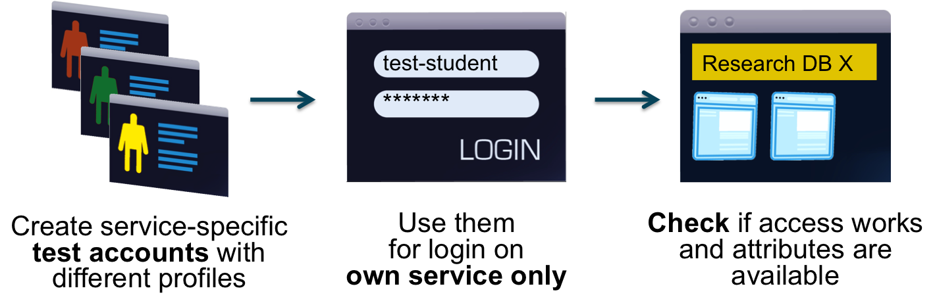
Services
eduGAIN Access Check
Have I set up my Service Provider correctly?
https://access-check.edugain.org

Slide 15
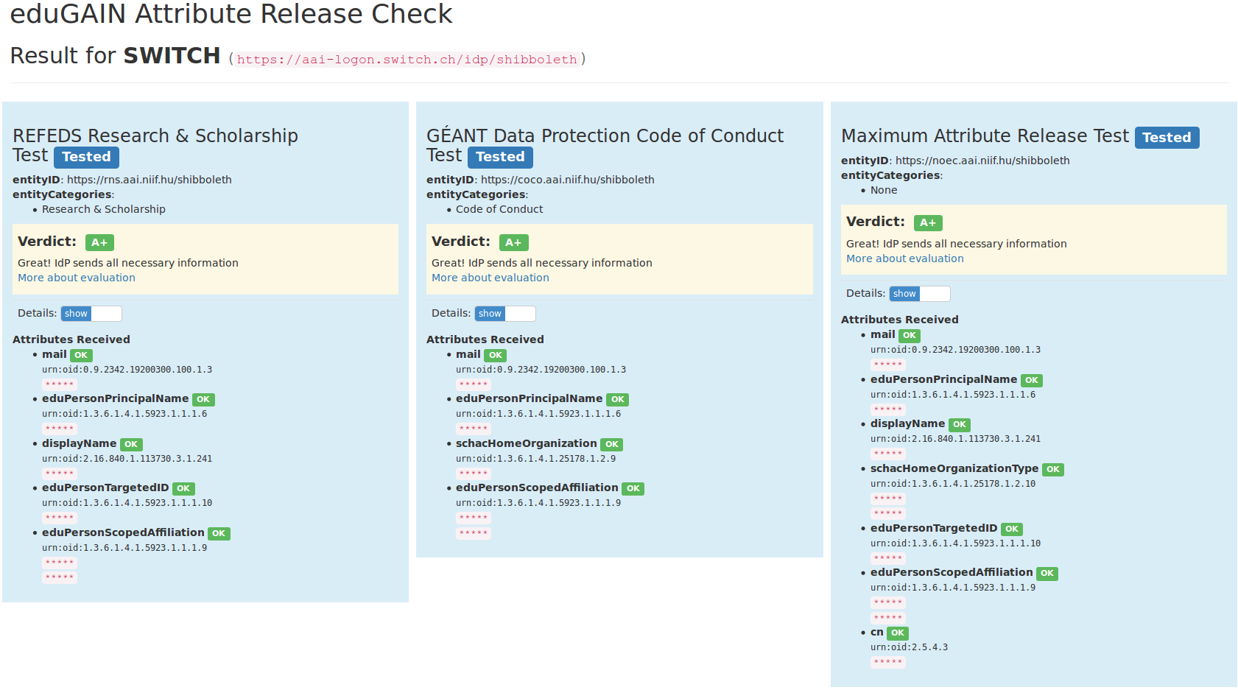

Services
eduGAIN Attribute Release Check
Am I releasing the necessary attributes?

Slide 16
What can campus IT do?
Join your local federatrion⁰
Get your Identity Provider published in eduGAIN
Support GEANT Code of Conduct entity category
Support REFEDS Research & Scholarship entity category
Implement Attribute release based on CoCo and R&S
Check your attribute release policy
[0] https://refeds.org/federations/federations-map

Slide 17
What can campus IT do?
Support your users
Enable collaboration
Of course keeping their privacy in mind

Slide 18

One last thing

Slide 19
Thank you !
Questions / Comments ?

