Slide 1
GÉANT VOPaaS
Towards a platform for supporting collaboration
Marina Adomeit
Activity Leader of SA for T&I services, AMRES, Serbia
Mandeep Saini
VOPaaS Product Manager, GÉANT, U.K.
Niels Van Dijk
VOPaaS Technical Product Manager, SURFnet, The Netherlands
TNC16 Conference, Prague
14.06.2016

Slide 2
Outline
Introduction
Problem statement
VOPaaS offering
Our roadmap
How to join us?

Slide 3

GÉANT and Trust & Identity
GÉANT project is Europe’s leading collaboration on e-infrastructure and services for the benefit of research and education.
eduGAIN interconnects R&E Identity federations around the world.
In order to support the uptake of federated technologies and enable more communities to use eduGAIN, GÉANT initated a task to develop and offer federation supporting services.
First service developed in this family was Federation as a Service - FaaS aimed to support federation operators.

Slide 4

Collaborative Organisations
Organisation of people and resources, spread across different organisations in multiple geographical locations.
In order for Collaborative organisations to work together, its esential to enable group of people to access and share set of resources.
Access to resources (or Services) often needs to be managed and requires authentication and authorization.

Slide 5
Federated Identity Stakeholders
With Federated Authentication
  Home organisation operates Identity provider (IdP)
  Allows authentication towards a Service Provider (SP)
Identity Federations
  E.g. InCommon or SURFconext,
  Provides trust and technology frameworks between SPs and IdPs.
Inter-federation
  E.g. eduGAIN,
  Interconnects national identity federations.
  Successfully addresses authentication in heterogeneous environment.
Collaboartive organisation
  Typically operates number of SPs
  Many VOs have chosen to build the AAI infrastructure using the eduGAIN
  Identity Federations and Identity providers are however traditionally focused on campus use cases, which introduces a number of challenges in leveraging Federated AAI for Collaborative organisations

Slide 6
Challenges for Collaborative Organisations
Challenges in Authentication space
  Collaborative organisations work with people outside scope of R&E communities as well
  Requires Collaborative organisations to peer with other non R&E Identity providers (such as social identites provider) or maintain an additional Identity provider
Challenges in Authorization space
  Services run by Collaborative organisations often need attribute or group related information in the context of their collaboration, which are not issued by Identity providers
  Requires Collaborative organisations to manage and provide additional attributes and groups towards their services, independently from the Identity provider

Slide 7
VO Platform as a Service - VOPaaS
Goal
  Investigate the conditions that would allow GÉANT to provide services to support Collaborative organisations
  Focus on delivery of technical services
  Out of scope:
    Technical development
    Policy & LOA development
Activities
  Gather requirements and priorities with/from communities
  Look at existing tools and technologies
  Look into delivery model
  Investigate business case & sustainability
  Pilot with communities
  Operations and Market

Slide 8







VOPaaS Market Analysis
The FIM4R paper (April 2012) was one of the first to articulate collective requirements for using Federated AAI for VOs.
The VOPaaS has performed a survey among several small and large Pan-European VOs to (re-)validate the FIM4R requirements.

Slide 9
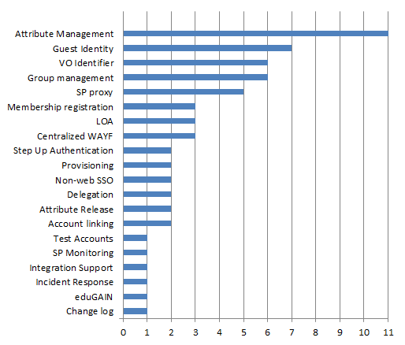
VOPaaS Market Analysis Results

Slide 10
Deployment model
From the results of this survey, functional requirements were analyzed and a number of services were proposed to be put in place
http://www.geant.org/Projects/GEANT_Project_GN4-1/deliverables/D9-2_Market-Analysis-for-Virtual-Organisation-Platform-as-a-Service.pdf
Basic Services
  Offered to „smaller“ Collaborative organisations with generic AAI requirements
  Operated by GÉANT
  Multi tenant service
  Also for VOs that are not legal entities
Advanced Services
  Aimed to „larger“ Collaborative organisations with advance AAI requirements
  Operated by GÉANT on behalf of a VO
  Single tenant service
  Somebody – a legal entity - must take responsibility for that data

Slide 11



Basic Services
VO Membership service
  Registry for VO persistent Identifier
  VO specific Workflows for onboarding
  Limited set of attributes
  Accessible through eduGAIN
Transparent External Identity proxy (TEIP)
  One persistent (SAML) IdP for many ‘Guest’ Identity Providers, including:
    Social (Google, Twitter, Linkedin, Facebook)
    NREN operated & Commercial Guest IdPs (OpenIDP, UnitedID.org, eduID.se)
    eGOV (STORK) and BankID
  Provides Account recovery
  Available and accessible through eduGAIN
SaToSa

Slide 12
VOPaaS Basic Services Offering Architecture
VOOT
Service Provider
COmanage
IdP
AuthN:
Id + attributes
SAML AA
TEIP
Oauth
VO persistent Identifier
+
VO attributes
VOPaaS
eduGAIN

Slide 13



Advanced Services
(advanced) Attribute Management - Whatever you can come up with
(advanced) Group Management - Groups in groups, etc.
Provisioning - For web and non-web resources, ‘application specific connectors’
Service Proxy and Attribute Aggregation – have a central point for technology and policy
  Accessible through eduGAIN

Slide 14
What's in it for R&E communities and Federation Operators
For R&E communities
  Deploying AAI is complex and subject matter experts are required
  Using VOPaaS as a AAI service offering will save time and effort
  R&E communities should focus on thier research topics, rather than building AAI solutions
For Federation Operators
  Many Federation Operators dont have a way to support Collaborative organisations in which their communities are participating
  They can leverage their communities to the VOPaaS offering
  Federation Operators can still have a role in the VOPaaS delivery model:
    Support for enabling SPs to interconect with VOPaaS platform is needed
    Approve/sponsor requests for VOPaaS offering, intiated from their communities

Slide 15
Roadmap
Q3 2016
Delivery Model
Deploy pilot platform
Q4 2016
Run pilots with Basic Services, in collaboration with AARC
Support application integrations
2017
Production service for Basic Services
Finalise specification for Advanced Services
2018
Deploy Pilots for Advanced Services
Possibly: pick up new services as developed within GEANT, AARC or others

Slide 16

Join VOPaaS pilot !
Interested to join VOPaaS pilot or have any queries
  Contact us: vopaas@lists.geant.org

