Slide 1
Gaming e-Infrastructures to improve Interfederation Readiness
Brook Schofield
eduGAIN Product Manager (or something like that).
NORDUnet 2016 Conference
Helsinki, Finland – 20th September 2016
Notes:
The evolution of identity federations over the past 10 years has culminated in REFEDS and the GÉANT Harmonisation activity developing a suite of best practices and improvements for SAML Identity Providers, Service Providers, VOs and the eInfrastructure projects.
The uptake of these hasn't been universal and the adoption of some developments have been rather disappointing.
While the collective wisdom of the federated community believes these practices are a good idea - how can we enable widespread adoption of these practices and ensure their support is visible to the wider community.
REFEDS created some New Years Resolutions to engage the federation community behind a few simple practices as a first step in this direction.
This presentation will show how eduGAIN has been working to present the adoption of these (and other) best practices, highlight areas for improvement and push e-infrastructures toward their acceptance.
How far are we away from universal interfederation?
Who's succeeding and who is falling behind?

Slide 2
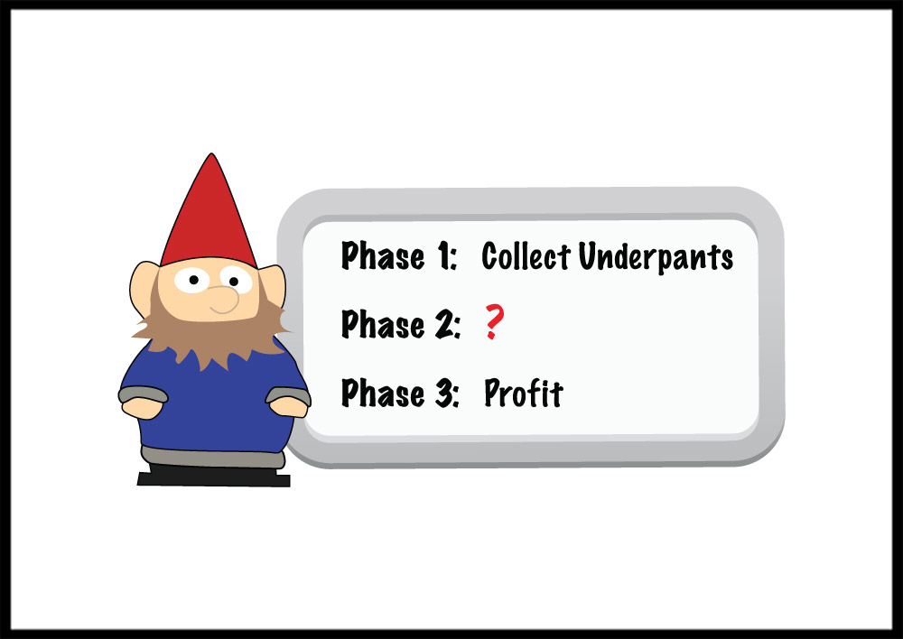
In the beginning: eduGAIN in 3 easy steps
Federations
http://www.tshirtlaundry.com/The-Underpants-Gnome_p_1441.html
Notes:
Image: http://www.tshirtlaundry.com/assets/images/photos/UnderpantsGnome12_2009.jpg
Page: http://www.tshirtlaundry.com/The-Underpants-Gnome_p_1441.html

Slide 3
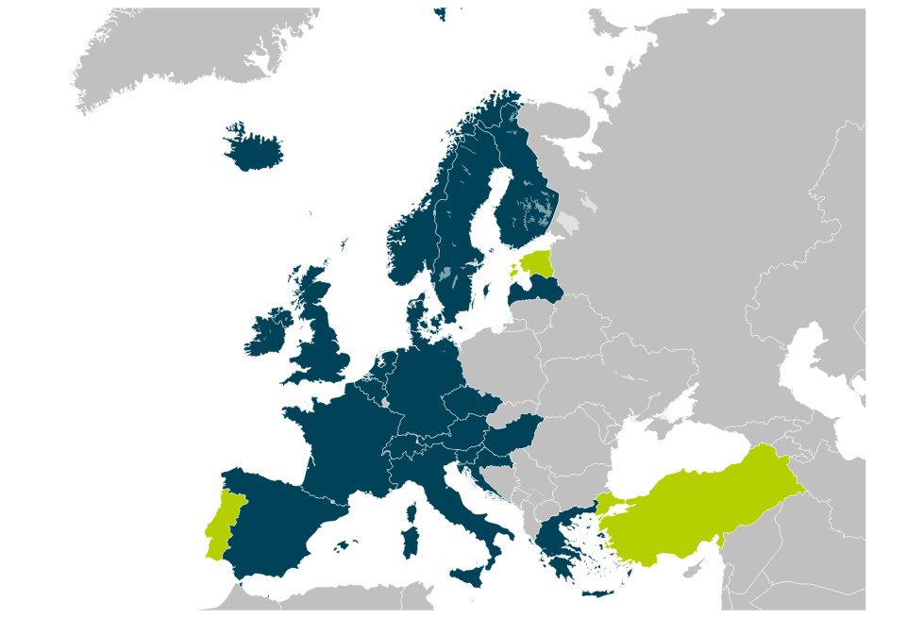
Early days of eduGAIN
eduGAIN Member
Joining eduGAIN
Candidate Federation
Known Federation

Slide 4
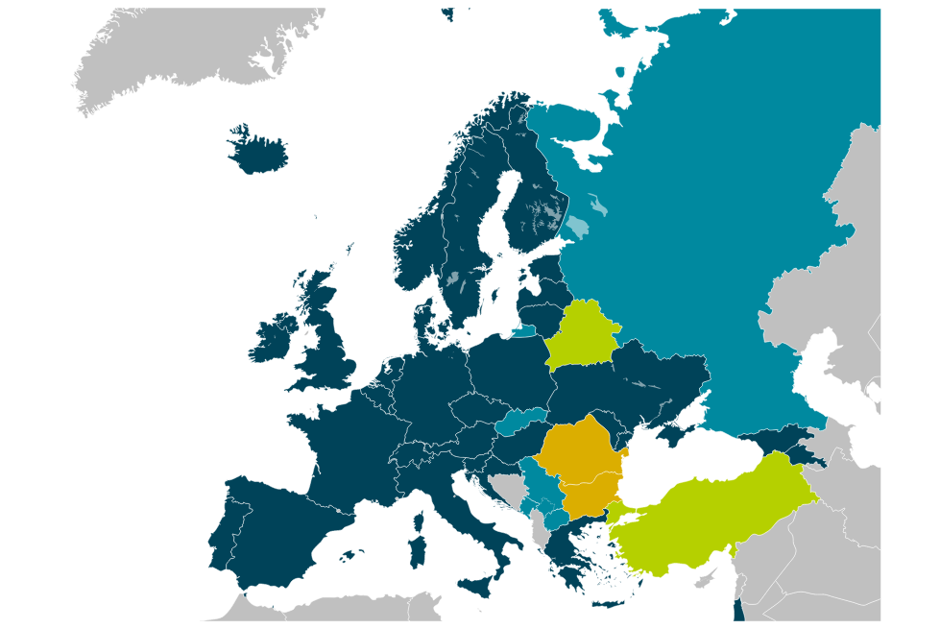


eduGAIN Initial Growth
eduGAIN Member
Joining eduGAIN
Candidate Federation
Known Federation

Slide 5
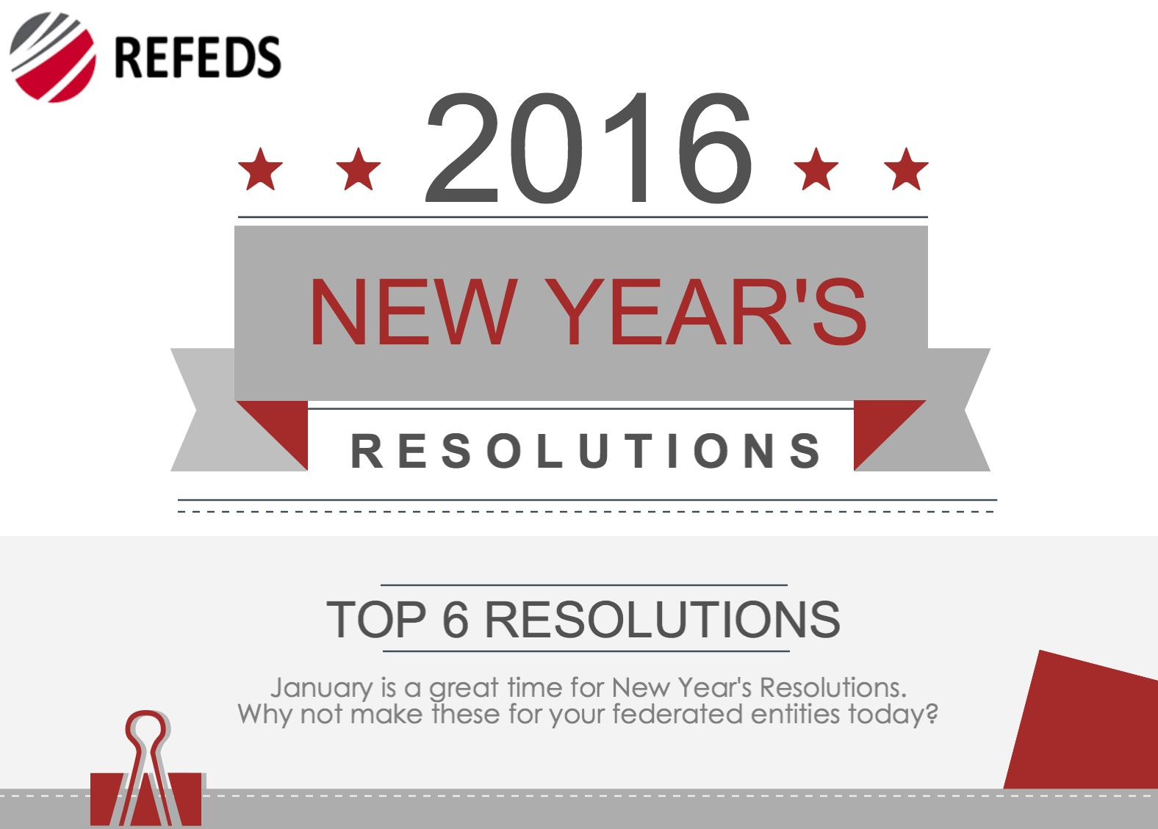
REFEDS New Year’s Resolutions 2016

Slide 6

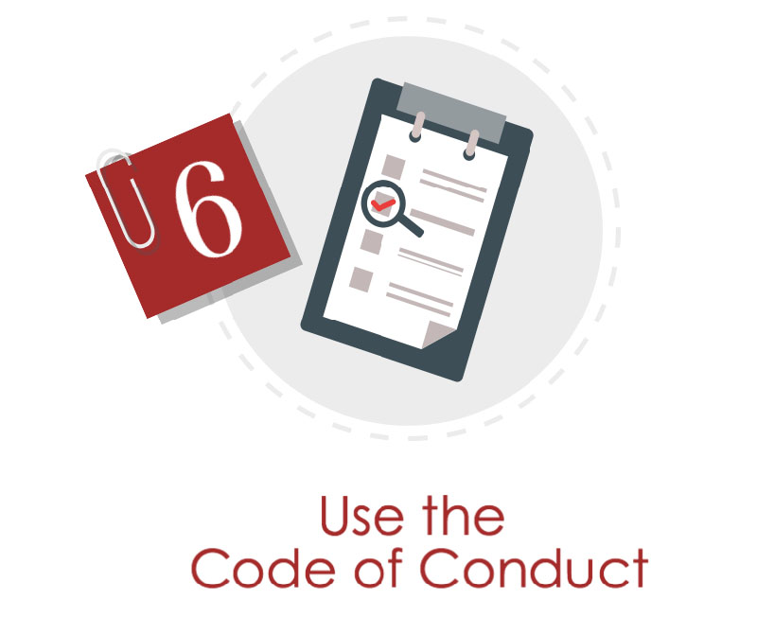
#1 & #6 relate to Attributes – Lukas will cover that soon!

Slide 7
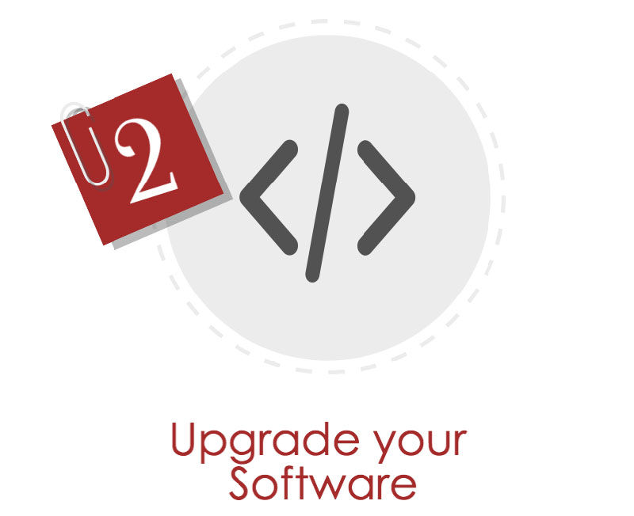



Keep your software up to date!
Our community software is great!
We find bugs!
…and fix them.

Slide 8
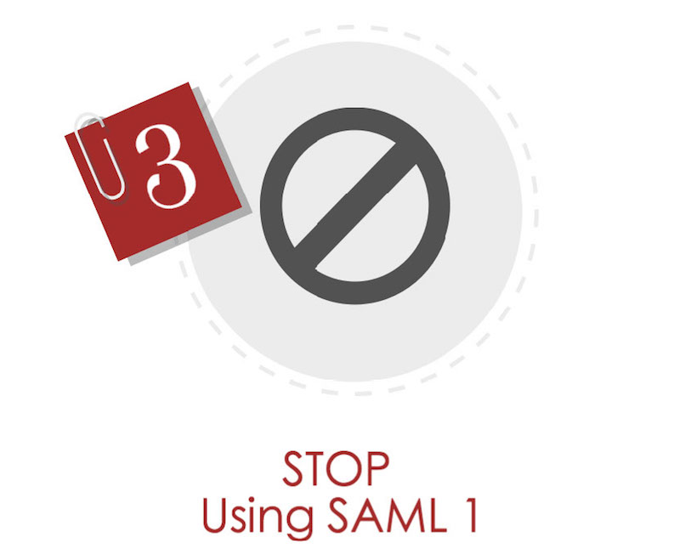
SAML2 is over 10 years old!
The SAML 2.0 protocol
celebrated its 10th anniversary
on 15th March 2015.
Despite this 10 year period, there
are still many entities in federations
using SAML 1.
eduGAIN
  SAML1.0 – 1 IdP / 694 SPs
  SAML1.1 – 1798 IdPs / 1048 SPs

Slide 9
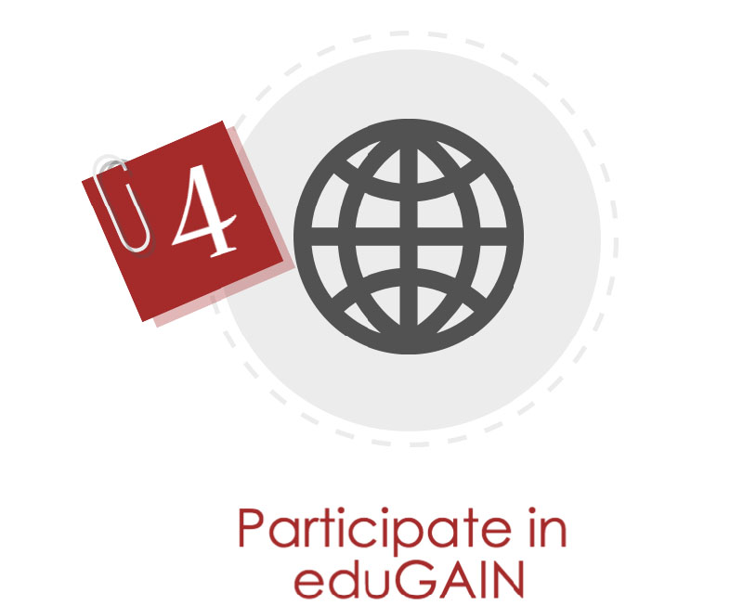
Participation is not just for federations!
Opt-in vs Opt-out
What ever you choose…
… understand why you made that
choice!

Slide 10

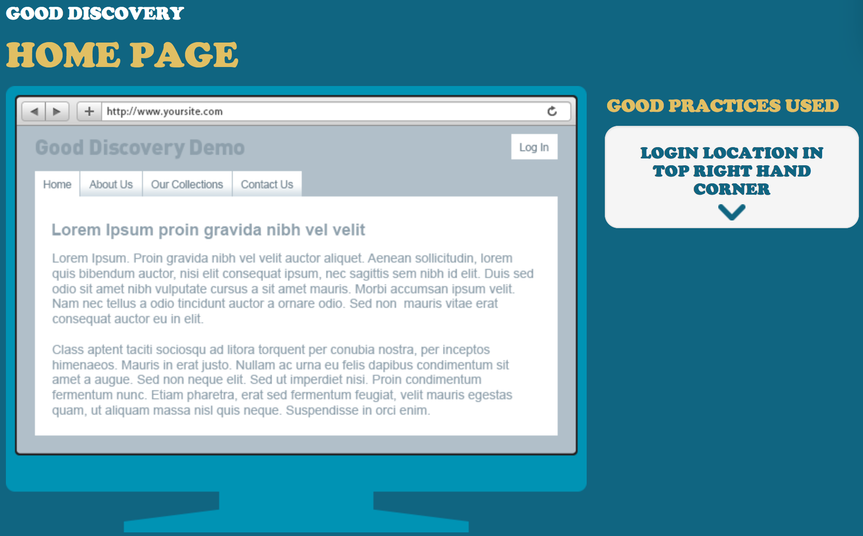
Discovery.REFEDS.org

Slide 11
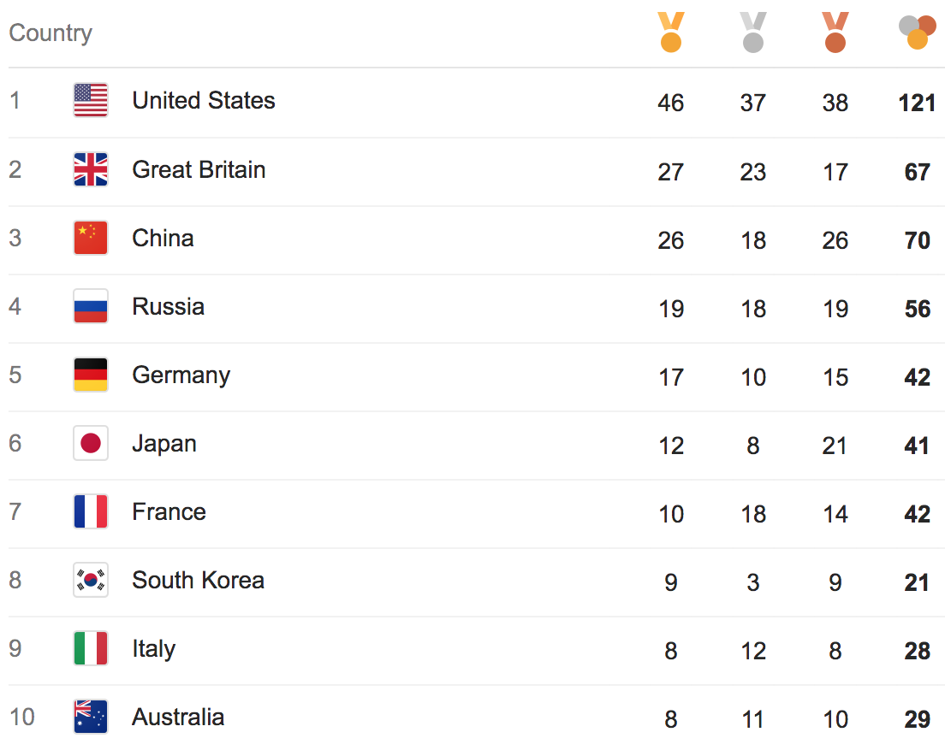
Olympic Medal Tally – Rio 2016

Slide 12
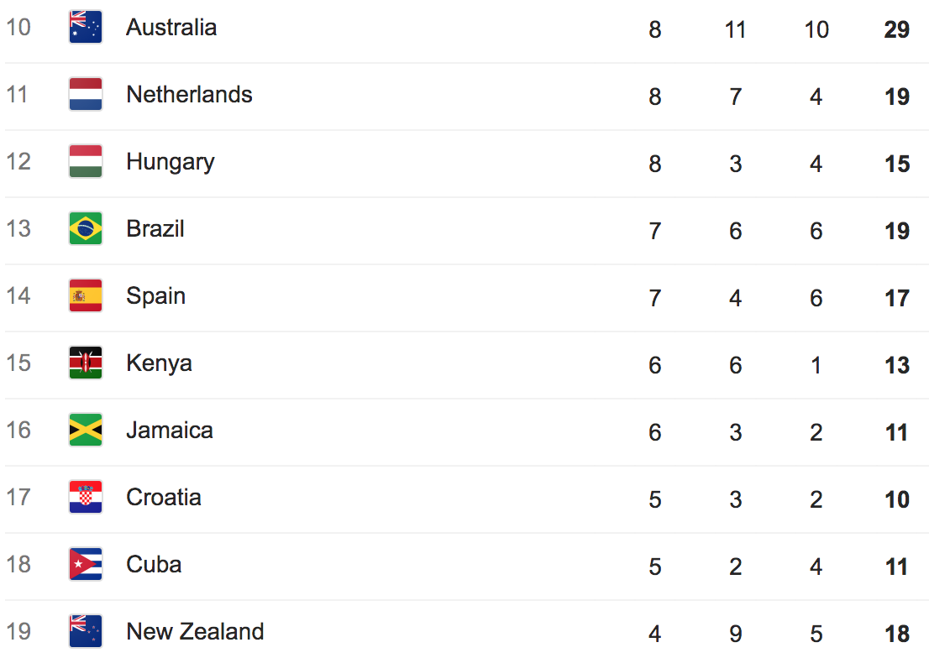
Olympic Medal Tally – Rio 2016

Slide 13
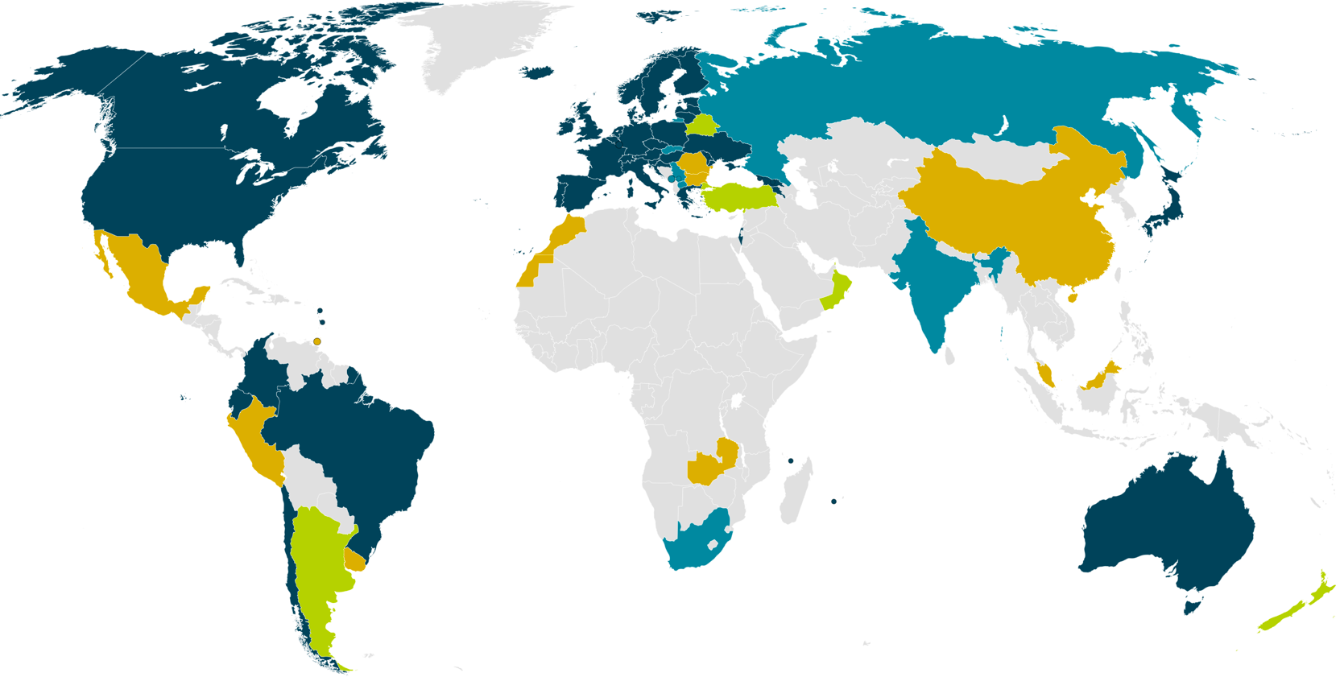
eduGAIN & Federation Status
38 eduGAIN Members
5 Joining eduGAIN
8 Candidate Federations
10 Known Federations
March 2016
Notes:
Big growth in new federations – many have aspirations to join eduGAIN and interfederate.

Slide 14
eduGAIN & Federation Status (% of entities)
15%
29%
78%
0.3%
38 eduGAIN Members
5 Joining eduGAIN
8 Candidate Federations
10 Known Federations
March 2016
Notes:
Australia: 1/252=
Brazil: 127/162=78%
USA: 482/3192 5720=8.4% (check this for eduGAIN content)
UK: 3131

Slide 15
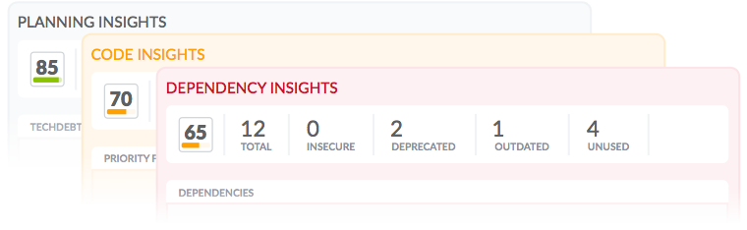
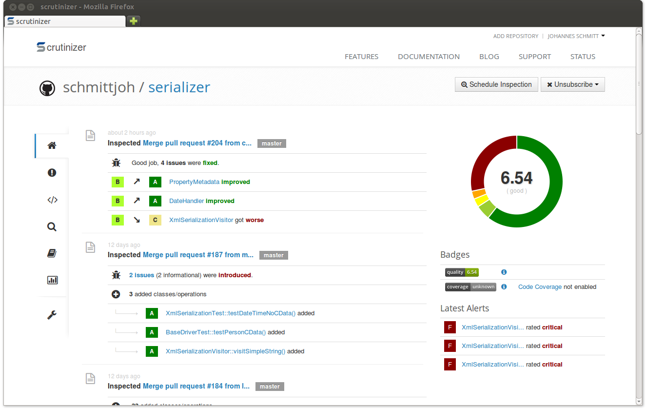
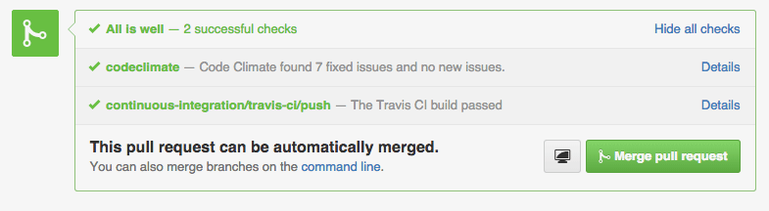
Raft of code quality tools
JS: bitHound, Code Climate
PHP, Python, Ruby/Rails:
Scrutinizer-CI, Codacy,
Code Climate
Scala, CSS: Codacy
…and more!

Slide 16
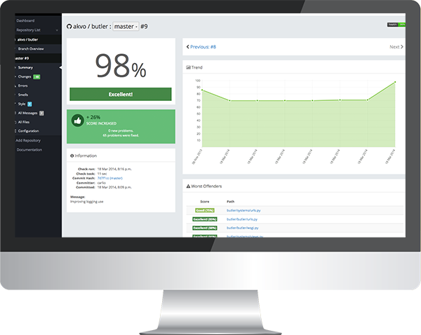
Gamed Leif Johansson to see if it works!
Convinced LeifJ to use
landscape.io to check
code quality of pyFF.io
Quality rose from 76%
to 83% in one night!
  3am bedtime
Additional tools now
in use.

Slide 17

SIRTFI
Combination of Security Practices that can be assessed or asserted.
Opportunity wider assessment using tools:
  SSL Labs Security Assessment
  Software Fingerprinting
  Metadata Description of SAML support
  Incident Response Readiness
  …more metrics.

Slide 18
Who's succeeding and who is falling behind?

Slide 19
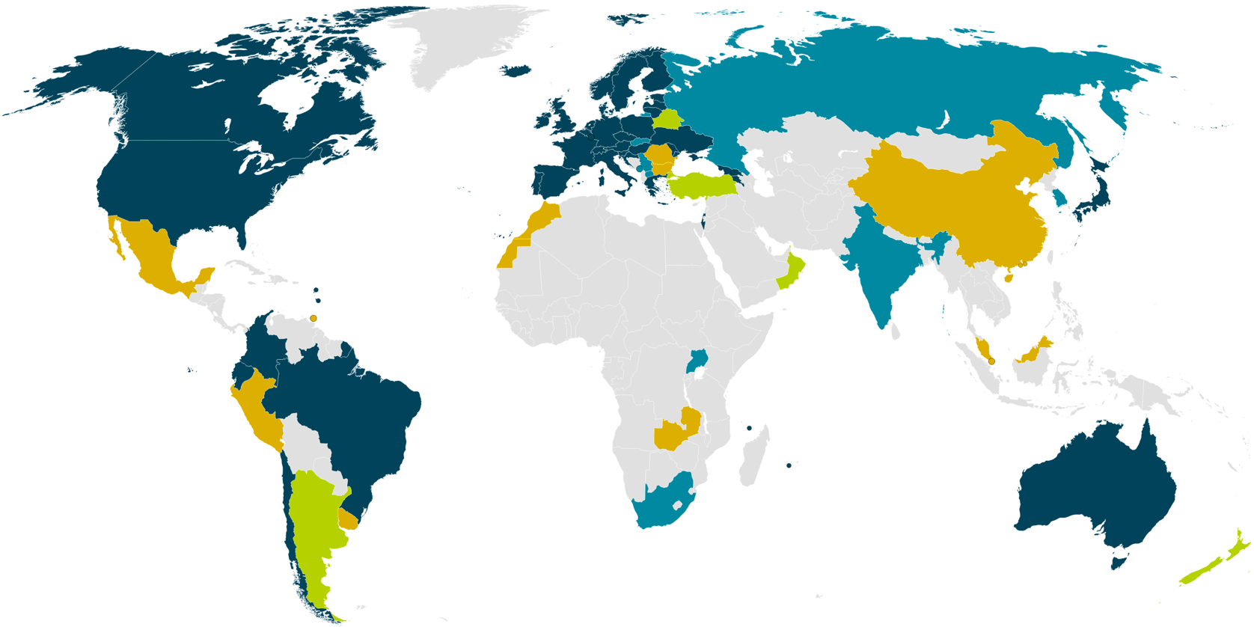
eduGAIN
38 eduGAIN Members
6 Joining eduGAIN
9 Candidate Federations
12 Known Federations
September 2016

Slide 20
Brook.Schofield@GEANT.org

