Slide 1
Releasing Attributes for Science!
Why does this seem so difficult?
Lukas Hämmerle / SWITCH
Task Leader eduGAIN Service Development
eResearch and Service Providers
NORDUnet 2016 Conference, Helsinki
20. September 2016

Slide 2
eduGAINs Problems over Time
Solved: 38 of 44 production federations are fully connected to eduGAIN. New federations directly start in eduGAIN!
Insufficient Federation Coverage
Almost solved:
More than 50% of all IdPs of production
federations world wide are in eduGAIN.
Move from Opt-In to Opt-Out helped a lot!
Insufficient IdP Coverage
Insufficient Attribute Release
To be solved: ... with help by some of you
Insufficient FIM know-how, Level of Assurance, ....
2011 2012 2013 2014 2015 2016

Slide 3

Why is attribute release topic important?
In 2012 only few services (<100) were in eduGAIN (chicken and egg problem)
From 2013 to 2016, Enabling Users task worked many small and large research communities to bring their services into eduGAIN ➔ More SPs in eduGAIN
However, often research communities are frustrated because their services don't get attributes of users!
Attributes

Slide 4
Is it easier to proof that gravitational waves exist than getting attributes?
« Now can LIGO have some attributes please? »
-- Scott Koranda, lead architect for the LIGO Identity and Access Management
12. 2.2016 (just after discovery of gravitational waves)

Slide 5
Why is it (apparently) even hard for some IdPs to release unpersonal information to services used by researchers?
« For the record, we would love to use affiliation attribute(s) if they were released by a reasonable number of IdPs which is not the case! »
-- Jozef Misutka, CLARIN Project, 16.3.2015
("staff", "student", "faculty", "affiliate",... )
This is unpersonal quite generic information!?

Slide 6
(Alleged) No. 1 cause for attribute release issue
«... because of data protection/legal compliance/our data protection officer!»
Really?

Slide 7
Is Data Protection argument just a flimsy excuse?
« I'm still to see any evidence that legal compliance is actually the issue, rather than a convenient excuse to cover some other barrier. "becos Data Protection" has a very long history of being (ab)used in that way »
-- Andrew Cormack, Chief Regulatory Adviser Janet, 30.6.2016

Slide 8
Are we making too much fuss about attribute release?
Is federated login (and attribute release) so different compared to a user sending an email via his university mail server to a research service where he needs to get access?
If you have an opinion on this? Read more and contribute on
https://docs.google.com/document/d/1xkB3NY8MFY91g-LV8BtoX5HZBl9BZgrH_3-Nxj9sR04/edit
And how about these public phone books that some universities have for their staff/researchers? Are these ok? Was consent retrieved from staff?

Slide 9
Some "Hackarounds"
What can SP Admins do to mitigate the attribute release issue?

Slide 10
Mitigation Strategy for SPs:
Live with it and inform IdP admin
Show nice error message and inform user's IdP
  Instructions (for Shibboleth) and Screencast:
  https://wiki.edugain.org/How_to_configure_Shibboleth_SP_attribute_checker
  Still better than "Access Denied"
  Also allows tracking (across several SPs) IdPs that don't release attributes
  Example: CLARIN's LINDAT service
  https://lindat.mff.cuni.cz/services/aaggreg/
➔ SPs have better things to do than convince their user's IdP (in foreign countries) to release attributes to their service...

Slide 11
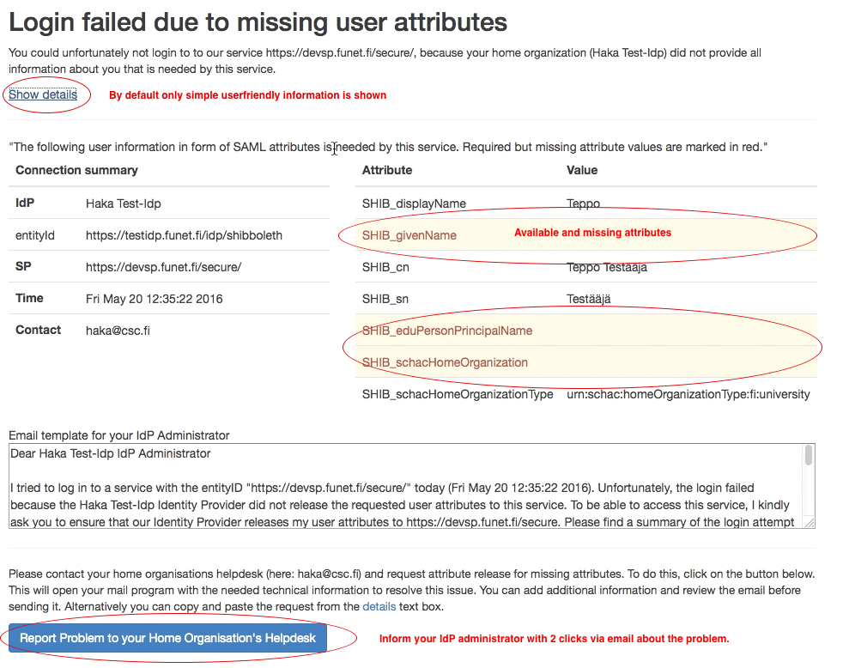

Slide 12
Mitigation Strategy for SPs:
Join all federations
Join all relevant national federations
  Because attribute release is better if your SP are local federation
  compared to have the SPs accessible eduGAIN
  Does not scale
  Example: "CLARIN SP Federation", publishers
➔ Unnecessary overhead on all sides for paper work, metadata registration, metadata updates, policy compliance, ...

Slide 13
Does every large research community have to join all federations worldwide to get some attributes?
«We need 100% IdP coverage per country. We cannot negotiate with 1'000 IdPs individually! We need a fully working solution. Today.»
-- Dieter Van Uytvanck, CLARIN Project, 11.2.2014

Slide 14
Mitigation Strategy for SPs:
Don't use eduGAIN
Research communities start own silo (own user management)
  Especially large projects can afford this
Rely on Google/Facebook Connect/...
  LIGO started allowing users with eduGAIN account to use social identities
Ask user to provide information about himself (directly or via one of the above)
➔ Do we want that researchers rather use services from commercial companies that care much less about
data privacy aspects?

Slide 15
Why doing federation at all?
« If federation is not about trustworthy attributes (and/or identity), i.e., if self-asserted data is actually good enough for SPs, why bother with federation? »
-- Peter Schober, ACOnet Identity Federation, 30.6.2016:
Self-asserted data = Ask the user to fill in a form with data that he provides...!?

Slide 16
It's not the SP's problem to solve attribute release!
What can Federation Operators do to solve the Attribute Release problem?

Slide 17
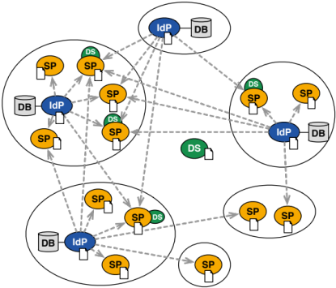
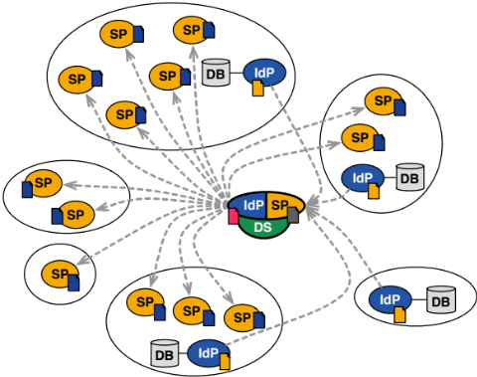
Different Federation Architecture = Different Challenge
Full-mesh Federations
  80% of federations
  Technical and policy challenges
Hub&Spoke Federations
  20% of federations
  Only policy challenge (hub always gets super set of attributes)

Slide 18
What are the Release Options?
Release ...
... fixed set of attributes to every SP
... only attributes that SP requests
... attributes based on ECs (CoCo/R&S, recommended good middle way!)
... only if federation operator approved attribute release
... only if IdP approves (each) SP
... nothing unless there is a bilateral contractual agreement
Very tolerant and
potentially legally dangerous
Very restrictive
and user unfriendly

Slide 19
Entity Categories:
Scalable and Convenient Method for Attribute Release
Easy to create attribute release rules with Entity Categories (EC):
  Allow releasing attributes to services that meet EC's requirements
  SPs flagged in SAML2 metadata
  Provide trust (and warm fuzzy feeling)
2 international ECs in use:
  REFEDS Research & Scholarship
  GÉANT Data Protection Code of Conduct
➔ R&S/CoCo are efficient way to solve attribute release issue!

Slide 20
Entity Categories Adoption in eduGAIN Over Time
Very slow adoption ☹ R&S a bit faster
Current stats: https://wiki.refeds.org/display/ENT/Entity+Category+Usage

Slide 21
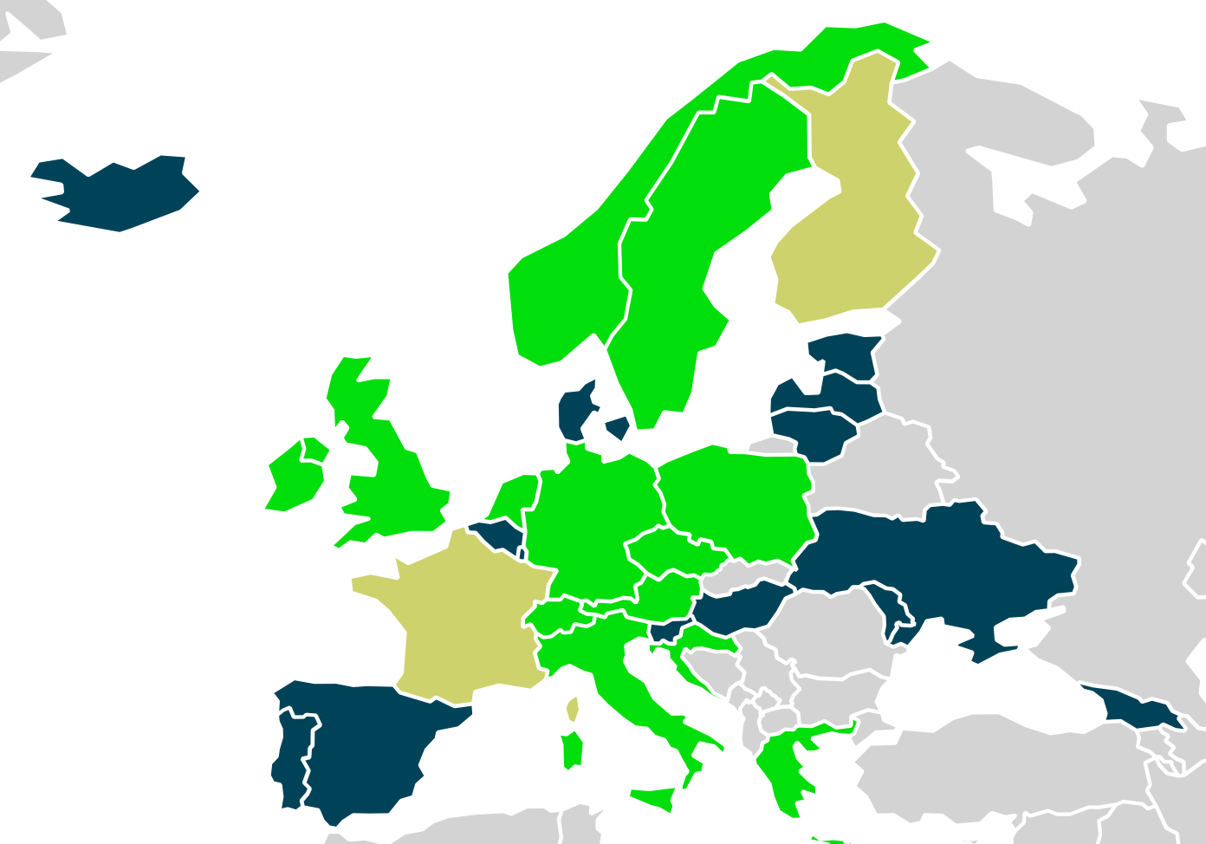
Federation R&S and CoCo Europe-wide
Adoption in eduGAIN
Stats from 9.9.2016:
38 Federations
2176 IdPs
Federations supporting CoCo:
15 (42%)
Federations supporting R&S:
16 (42%)
IdPs supporting CoCo:
91 (4.1%)
IdPs supporting R&S:
130 (6.0%)
◼︎ No EC support ☹ ◼︎ R&S Support 😐 ◼︎ CoCo support 😐 ◼︎ CoCo+R&S Support ☺

Slide 22
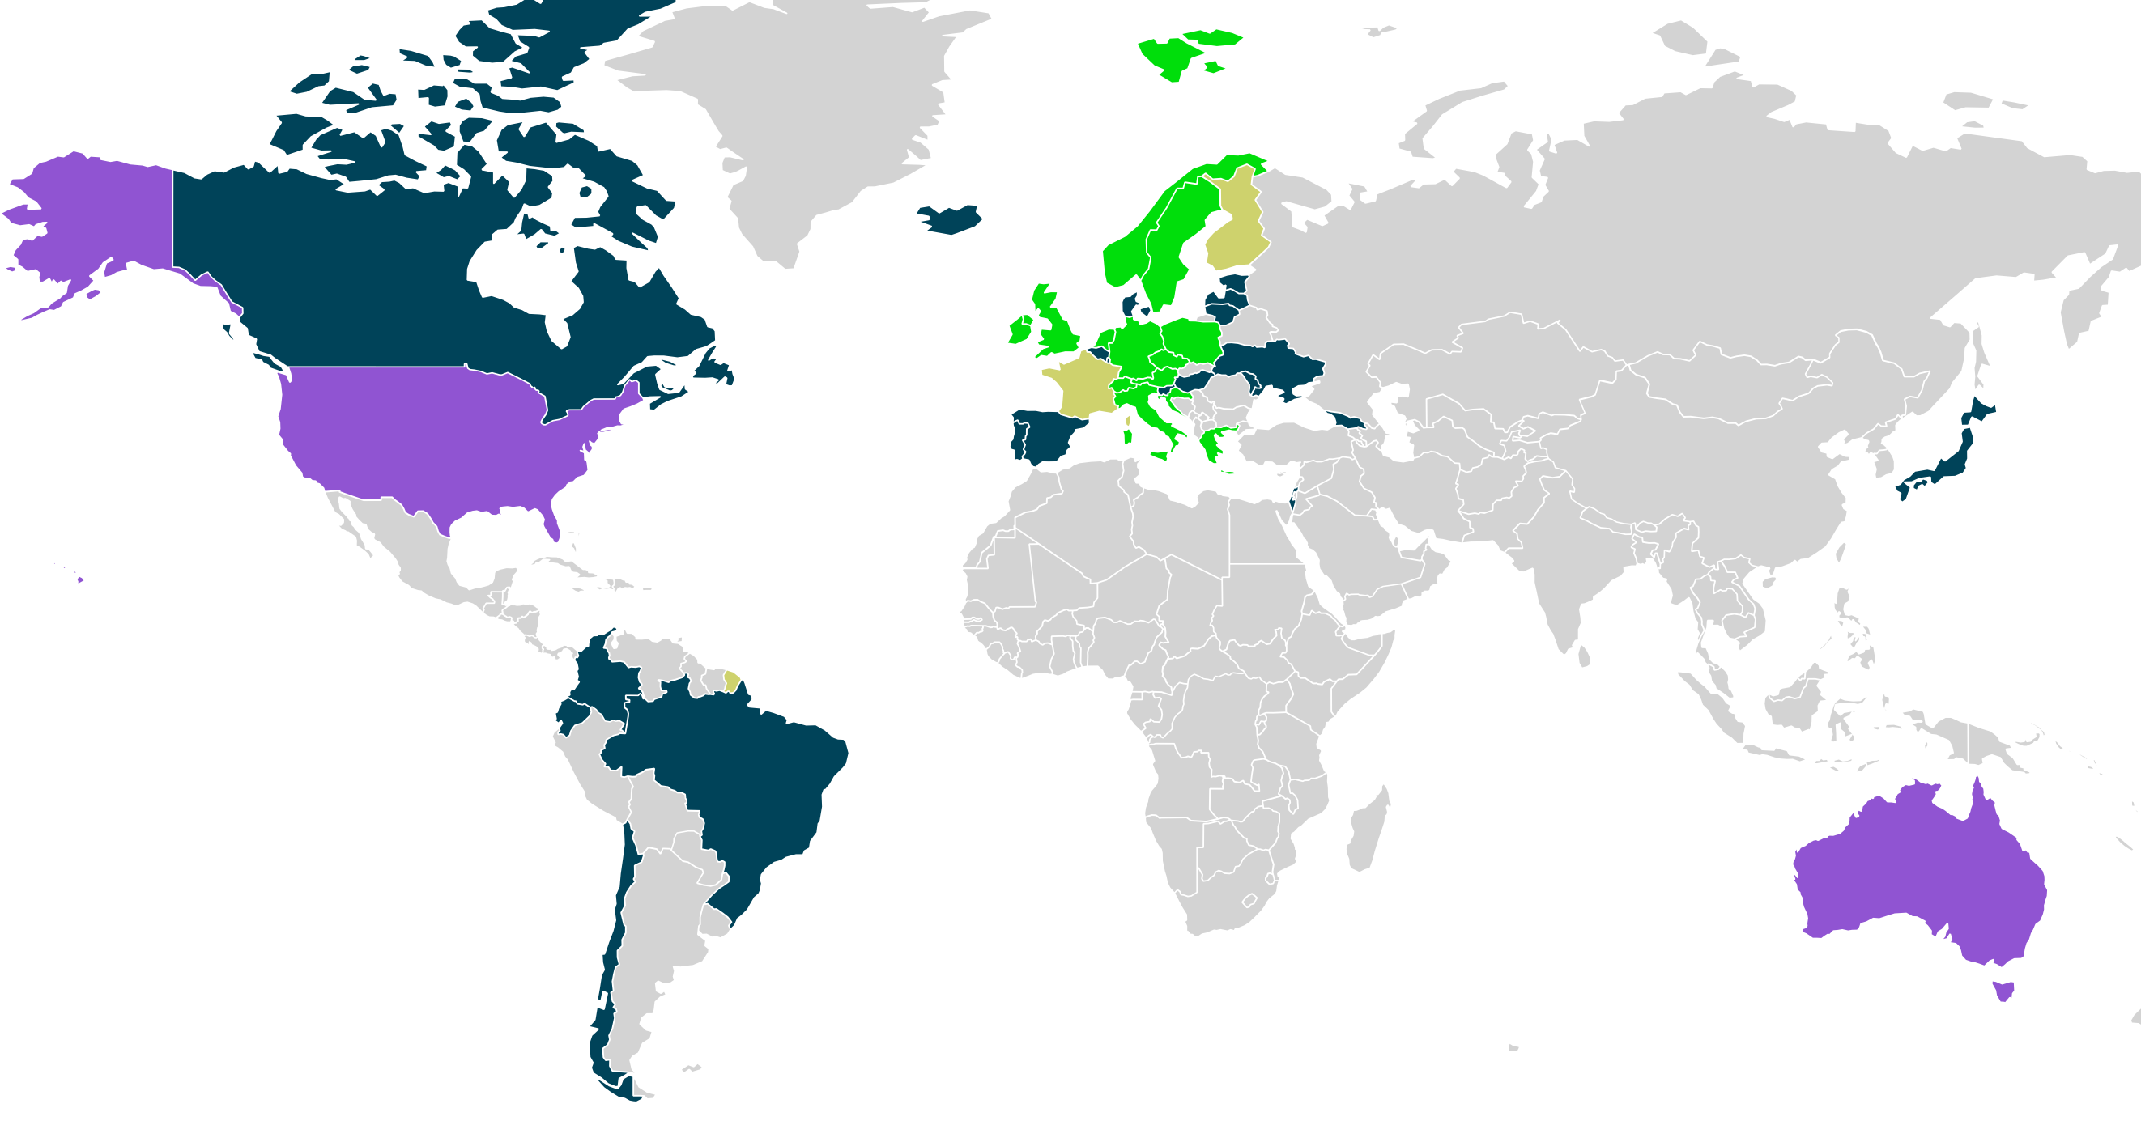
Federation R&S and CoCo Worldwide
Adoption in eduGAIN
◼︎ No EC support ☹ ◼︎ R&S Support 😐 ◼︎ CoCo support 😐 ◼︎ CoCo+R&S Support ☺

Slide 23
Important Factor for Attribute Release:
User Consent!
Increases transparency (and thus trust) for user!
  e-Learning admins don't like user consent:
  "makes (first) login too complicated"
(Academic) Discussions: Informed consent vs free consent
  Allowing user to decide on optional attributes has its own risks
  Therefore rather use: All or nothing consent.
➔ Recommendation: Use and advocate user consent: "Small" annoyance for Data Privacy pragmatists/unconcerned (=huge majority of users) but sufficient to please data privacy fanatics.

Slide 24

So why are there still federations with attribute release issues?
Some IdPs are but probably some federation operators also have to do their home work yet.

Slide 25
What is there to fear for releasing attributes if the user wants to access a research/education service?
11 years of production SWITCHaai operation and 9 years of participation in GÉANT project (building eduGAIN):
No cases known to me were organisation was sued for release of attributes in federation/eduGAIN!
  ... but I know of many problems and complaints regarding attribute release in the context of eduGAIN!
➔ Who could sue anyway over which "damage"? Staff members? Students? Even if user consent was in place?

Slide 26
Mitigation Strategy for non-green Federation Operators :
Start doing your job!
Support R&S and CoCo-based Attribute Release for your IdPs
Need help? Use AARC Attribute Release Training material:
Introduce mechanisms/documentation that allow IdP admins to easily configure attribute release and set reasonable (not too restrictive) defaults!
Invite your IdPs to take an attribute release test
(links at end of slide sets)

Slide 27
Recommendations
As Hub&Spoke federation:
Implement User Consent (WAYF.dk did a good job there)
Tear down unnecessary policy walls that hinder scalable attribute release!
As Full Mesh federation:
Provide recommendations/guides to implement User Consent at IdP
  Shibboleth 3 as well as SSP have (built-in) support for attribute release consent
Provide documentation and training (i.e. AARC material) on attribute release
Motivate IdPs to Support R&S/CoCo-based attribute release
Don't be a chicken! Most users want login to just work.
User consent to please the (very) few privacy fundamentalists

Slide 28
... and now there certainly are some comments ☺

Slide 29
Experience with R&S and CoCo support in SWITCHaai
No attribute release issues in SWITCHaai (even before CoCo and R&S) with pragmatic approach:
  Attribute release as easy as possible for IdPs
  (web interface in federation registry)
  Reasonable defaults that can be changed at any time by IdP admins.
  It just works (provided SP properly declare which attributes are needed)
SWITCHaai introduced R&S , CoCo based attribute release support in 2014.
Initial default for eduGAIN SPs was to release minimum R&S and release all required CoCo attributes.
Since August 2016 default is to release full R&S set. IdP admins can change default via web at any time. None did. No complaints. Attributes just flow.

Slide 30
Future and Outlook
Looking through the crystal ball:
Attribute issue will vanish in next 2 years... must vanish... otherwise eduGAIN will vanish.
  Is this a risk?
    Yes, but other technologies (OpenID Connect) probably would suffer from same problem
      Unless maybe user consent and attribute release are so conveniently built-in and easy to use

Slide 31
Attribute Release Tests
  CLARIN: https://lindat.mff.cuni.cz/services/aaggreg/
  CERN: https://sso-check.cern.ch/
  SWITCH: (not suitable for all federations)
  https://aai-viewer.switch.ch/interfederation-test/
  Official eduGAIN Attribute Release Check (Q4 2016)

Slide 32
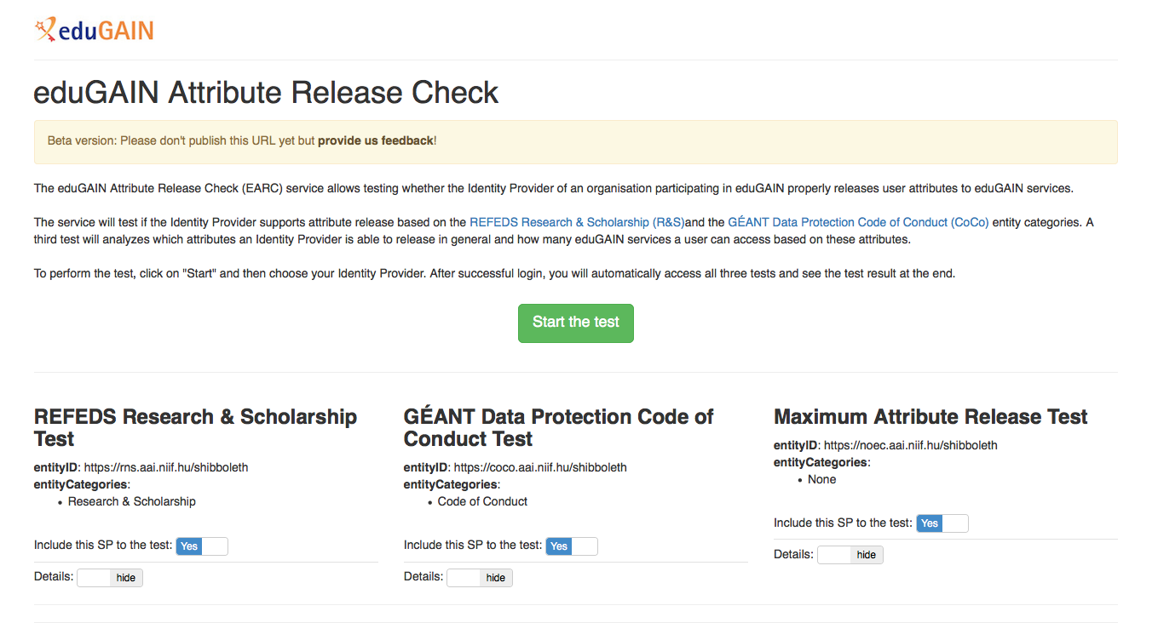
Preview of eduGAIN Attribute Release Check:

Slide 33
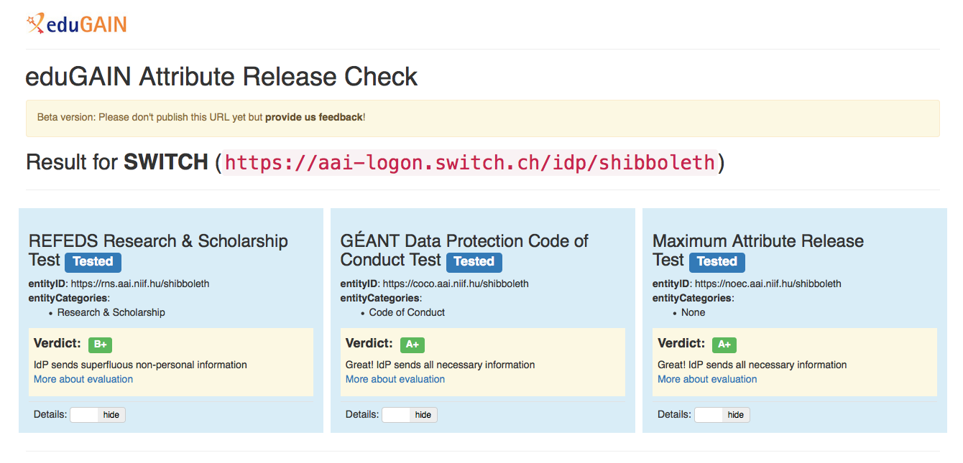
Preview of eduGAIN Attribute Release Check:
All results will be public! Every user can take the test!
as

Slide 34
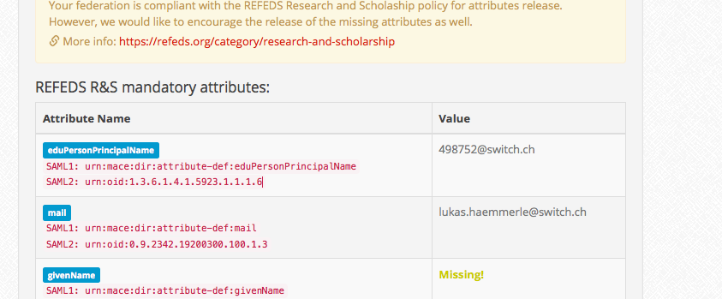
CERN Attribute Release Check

Slide 35
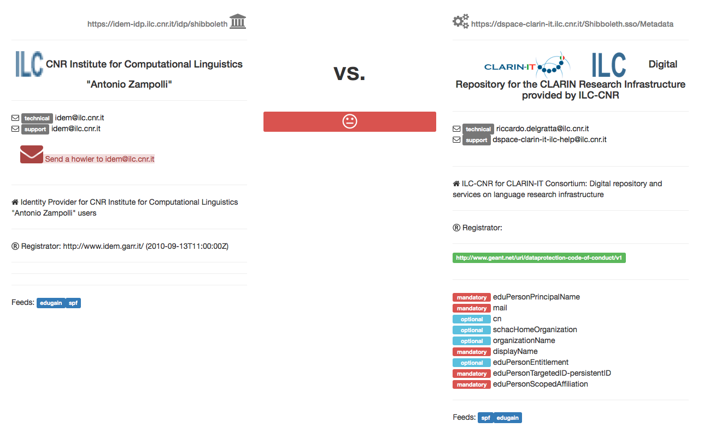
CLARIN LINDAT Attribute Release Check:

