Slide 1
eduGAIN – the GEANT perspective
Thomas Bärecke
GEANT project member Trust & Identity Development
SWITCH
Umbrella, Barcelona
22 September 2016

Slide 2
Outline
eduGAIN general status
(Some) available tools
(Some) future plans
2 more detailed roadmaps

Slide 3


































From local to global
3
Notes:
Ref growth, types of services
If we merge, add Brook’s intro slides after this one

Slide 4
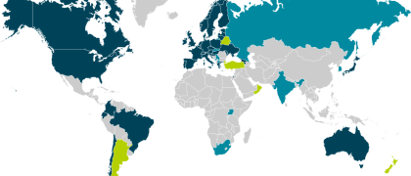
Global eduGAIN status
38 federations, 2192 identity providers, 1325 service providers

Slide 5




Science Requirements - the numbers and trends
Complexity
Notes:
If we merge our presentations, add the slides on how useful services are and how well they interoperate after this one.

Slide 6
eduGAIN isFederated Check
Is my target user group federated?

Slide 7
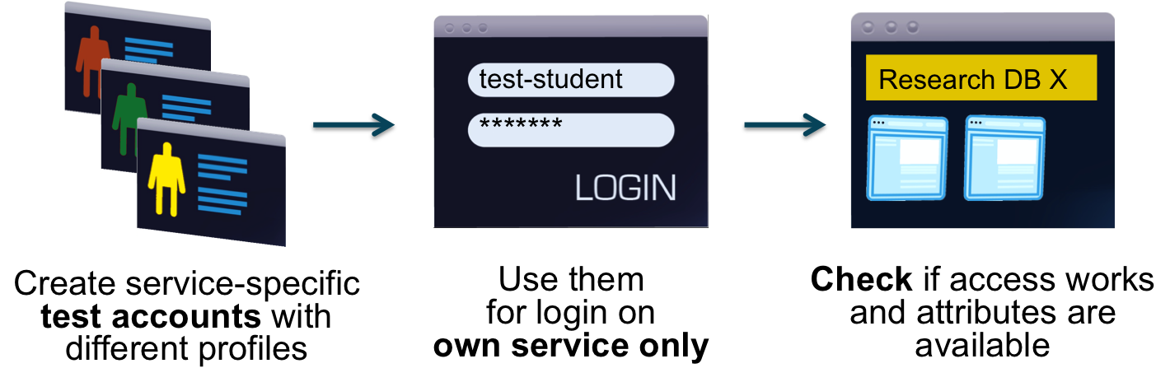
eduGAIN access check
Have I set up my Service Provider correctly?

Slide 8
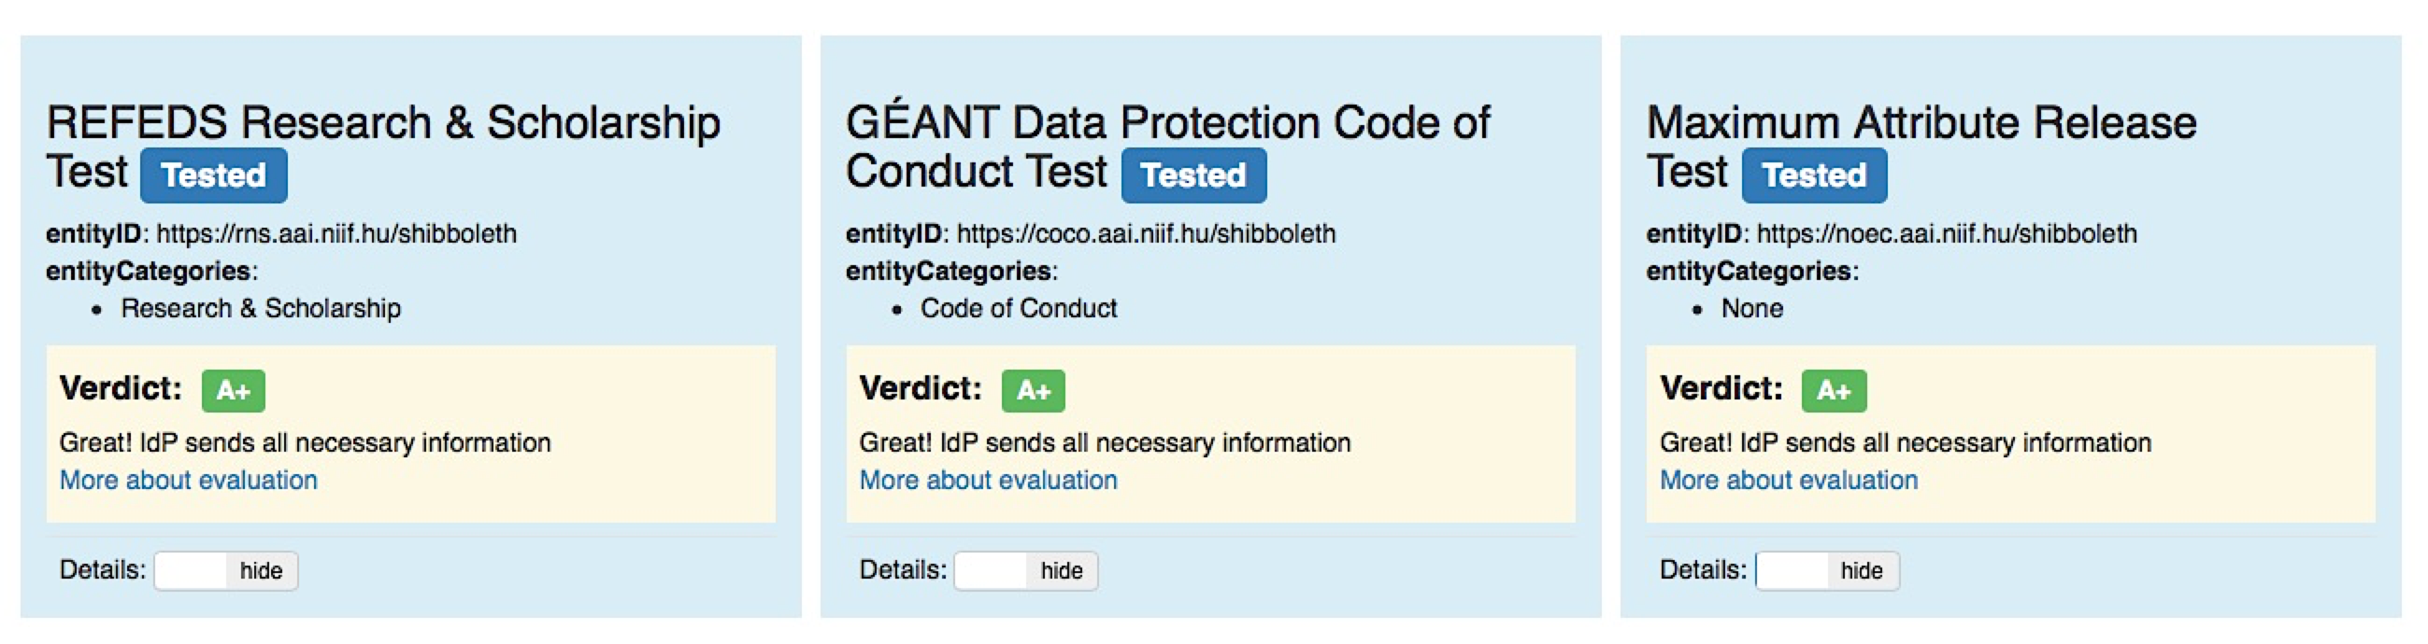
Finding the blockages - eduGAIN Attribute Release Check Service (EARCS)
GÉANT Data Protection Code of Conduct, REFEDS Research & Scholarship and general attribute release check (pilot)
Notes:
Ref Brook’s use of tool if earlier.

Slide 9
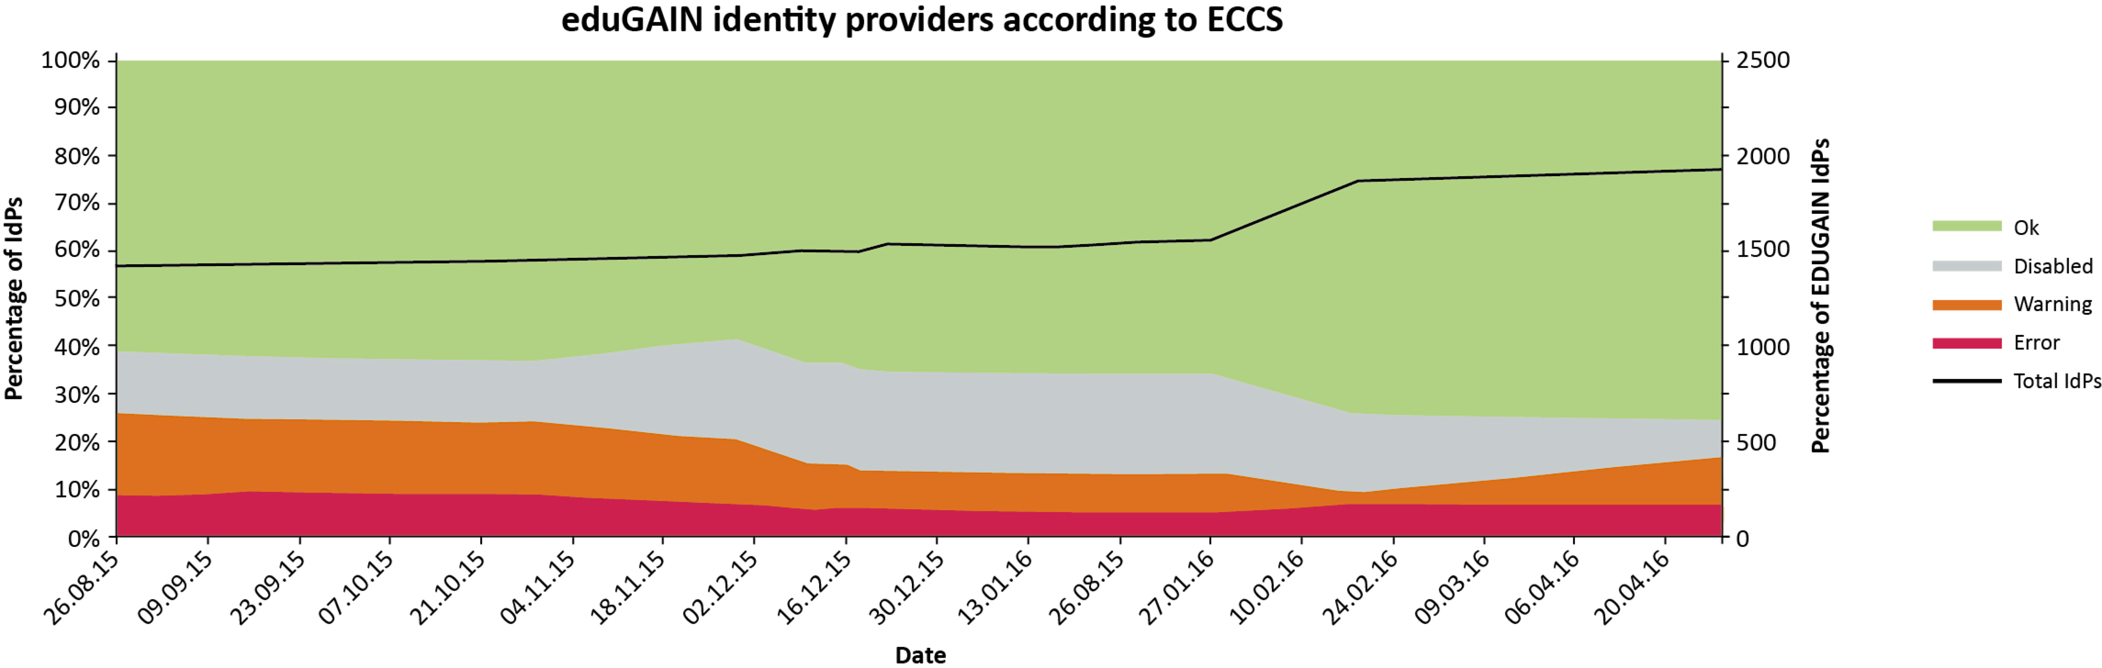
Finding the blockages – eduGAIN Connectivity Check Service (ECCS)
Imitates a user performing a federated login to a set of well-known test eduGAIN services
Notes:
Launch of ECCS was accompanied by a workflow to contact federations affected. About one third of all federations replied within the first week that they had fixed the problem or promised to fix the problems. This impact is visible in the following graph:

Slide 10
What is on the roadmap of the GEANT activity for eduGAIN development
Incident Management Development – Task 1.4
Enhanced e-Science support – Task 2.1
(Identity) assurance service – Task 2.4
eduTeams – Task 2.5
Federated identity, next generation – Task 3.1
Two-factor authentication in eduGAIN – Task 3.2
Cross-sector interoperability – Task 3.4

Slide 11
eduTeams (former VOPaaS) basic vs advanced
Features:
Basic Services
  eduTeams membership services
    VO specific workflows for onboarding members
    Regsitry for VO persistent Identifier
    Limited set of attributes
    Accessible through eduGAIN
  eduTeams identity hub
    One persistent SAML IdP for many Guest Identity Providers (social, NREN-operated, commercial, eGOV)
Advanced Services
  Advanced Attribute Management
  Advanced Group Management
  Provisioning for web and non-web ressources, application specific connectors
  Service proxy and attribute aggregation
  Accessible through eduGAIN
Delivery model:
Basic Services
  Offered to „smaller“ Collaborative organisations with generic AAI requirements
  Operated by GÉANT
  Multi tenant service
  Also for VOs that are not legal entities
Advanced Services
  Aimed to „larger“ Collaborative organisations with advance AAI requirements
  Operated by GÉANT on behalf of a VO
  Single tenant service
  Somebody – a legal entity - must take responsibility for that data

Slide 12
eduTeams current roadmap
Q4 2016
Run pilots with basic services in collaboration with AARC
Support application integration
Investigate new services, like SAML discovery, OIDC
2017
Production service for basic services
Finalize specification for advanced services
2018
Deploy pilots for advanced services
Possibly: pick up new services as developed within GEANT, AARC or others

Slide 13


What happens with AAI over a lifetime?
AAI
AAI
AAI
AAI
Community Work
Self-
Employment
Employment
School
University
education
Employment
School
Further
education
Post-
graduate
Research
Side Job
Side Job
Side Job
13

Slide 14
Persistency, uniqueness and open-ness
Swiss edu-ID
Community Work
Self-
Employment
Employment
School
University
education
Employment
School
Further
education
Post-
graduate
Research
Side Job
Side Job
Side Job
14

Slide 15
Main properties of the Swiss edu-ID concept
Persistency:
  Built to survive organisational affiliations
User-centrism:
  User issues his/her identity in a light-weight self-registration process
  User brings his/her identity to the university/employer (if pre-existing)
  User decides whether to pass on data (but usually not on its contents!)
Organisational backing:
  Organisations add or validate attributes of identities
Openness:
  Open to members of Swiss academia and people with relation to it
Scalable quality:
  Allow for low quality: Yes, this is a feature!
  Foresee validation processes to increase the quality level
  Offer quality transparency: relying parties can base decisions on quality level
Support mobile environments and non-web use cases

Slide 16
SWITCH and GEANT roadmaps combined
1999
2005
2010
2016
SWITCHaai
idea
pilot
service
International promotion
in GÉANT community
Service innovation
efforts
eduGAIN
“the internationalised SWITCHaai”
idea
pilot
service
Swiss edu-ID
“SWITCHaai next generation”
idea
pilot
International promotion
in GÉANT community
eduKEEP
“brainstorming usercentric eduGAIN”
idea

Slide 17
thomas.baerecke@switch.ch

