Slide 1

WISE SCIV2-WG
David Kelsey
STFC-RAL
2nd WISE workshop, XSEDE16, Miami
18 July 2016

Slide 2
Overview
A short history of the SCI group
  The Version 1 document
WISE SCIV2-WG
  Aims
  Workplan
  Next steps

Slide 3




A Trust Framework for Security Collaboration among Infrastructures
(SCI Version 1)
David Kelsey (STFC-RAL, UK)

Slide 4
Authors of the 1st SCI paper
K. Chadwick (FNAL)
I. Gaines (FNAL)
D. Groep (Nikhef)
U. Kaila (CSC)
C. Kanellopoulos (GRNET)
D. Kelsey (STFC)
J. Marsteller (PSC)
R. Niederberger (FZ-Juelich)
V. Ribaillier (IDRIS)
R. Wartel (CERN)
W. Weisz (University of Vienna)
J. Wolfrat (SURFsara)

Slide 5
Early days of
Grid Security Policy
Joint (WLCG/EGEE) Security Policy Group (JSPG)
In 2005
  EGEE, OSG, WLCG agreed a common version of the Grid Acceptable Use Policy
    Accepted by all users during registration with a VO
  And used by many other (Grid) Infrastructures
EGI and WLCG in general continue to use the same Security Policies
Often not easy to agree on identical policy words

Slide 6
Build a new
Trust Framework
Several large-scale production e-Infrastructures
  Grids, Clouds, HPC, HTC, …
Each has their own resources, users, policies and procedures
BUT subject to many common security threats
  Common technologies
  Common users (spreading infections)
Security incidents can spread rapidly
Need to share information and work together on security operations

Slide 7
Security for Collaborating Infrastructures (SCI)
A collaborative activity of information security officers from large-scale infrastructures
  EGI, OSG, PRACE, EUDAT, CHAIN, WLCG, XSEDE, HBP…
Developed a Trust framework
  Enable interoperation (security teams)
  Manage cross-infrastructure security risks
  Develop policy standards
  Especially where not able to share identical security policies

Slide 8
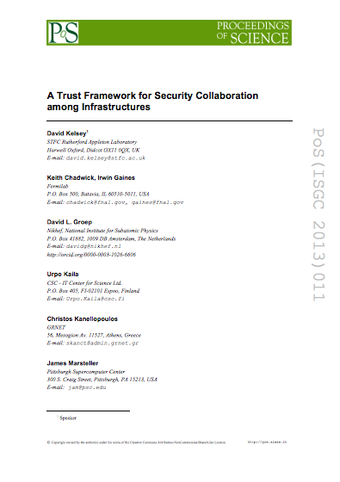
SCI Document – V1
Proceedings of the ISGC 2013 conference
http://pos.sissa.it/archive/conferences/179/011/ISGC%202013_011.pdf
The document defines a
series of numbered
requirements in 6 areas

Slide 9
SCI: areas addressed
Operational Security
Incident Response
Traceability
Participant Responsibilities
  Individual users
  Collections of users
  Resource providers, service operators
Legal issues and Management procedures
Protection and processing of Personal Data/Personally Identifiable Information

Slide 10
SCI Assessment
To evaluate extent to which requirements are met, we recommend Infrastructures to assess the maturity of their implementations
According to following levels
  Level 0: Function/feature not implemented
  Level 1: Function/feature exists, is operationally implemented but not documented
  Level 2: … and comprehensively documented
  Level 3: … and reviewed by independent external body

Slide 11
Further info
Security for Collaborating Infrastructures
http://www.eugridpma.org/sci/
SCI meetings
https://indico.cern.ch/categoryDisplay.py?categId=68
Sirtfi – Started from SCI V1
https://wiki.refeds.org/display/GROUPS/SIRTFI

Slide 12
Now to the WISE SCIV2-WG

Slide 13
SCIV2-WG Aims
Work towards a Version 2 document
Involve wider range of stakeholders
  GEANT, NRENS, Identity federations, …
Address conflicts in version 1 for new stakeholders
Add new topics/areas if needed
Give guidance on the assessment of infrastructures against the SCI requirements
We are not an operational security/trust group
  Not compete with other op sec trust activities
  But will seek feedback from such groups on our work

Slide 14
SCIV2-WG Workplan
Self-assessments against Sections 4 (Operational Security) and 5 (Incident Response) in SCI version 1
  To decide what guidance is needed and what words need to be changed. (completed)
Produce draft guidelines for sections 4 and 5.
  all topics considered and questions discussed (see wiki)
Tune words of sections 4 and 5. (before WISE3 at DI4R)
  And write the guidance for those sections
Move on to other sections. (after WISE3 at DI4R)
Aim for version 2 of the SCI document by the 12-month anniversary of the group (May 2017)
After version 2 produced consider re-merging text with Sirtfi and Snctfi work (AARC and REFEDS)

Slide 15
Meetings & Next steps
To date we have held 4 one-hour meetings
  All by video conference
  Work also can be done via the group mail list
Next meeting early/mid September (tbd)
Work during August and September will concentrate on tuning the words of sections 4 and 5. And to write the guidance for those sections
Drafts of both of these for WISE3 at DI4R
  27 Sep 2016 in Krakow, Poland

Slide 16
Final words
We have plenty of room for more people in the working group
Please volunteer
Contact one of the two chairs (David Kelsey, Adam Slagell)
Join the WG mail list
  https://lists.wise-community.org/sympa/subscribe/sciv2-wg

Slide 17
Questions?

