Slide 1


Container Security:
What Could Possibly Go Wrong?
Daniel Kouřil

Slide 2
What is a container?
a container is just a running process controlled by the host kernel
it is isolated from the host and from other processes
there are different containerization technologies available
(Docker, Podman, Singularity, LXD, ...)
  in this tutorial, we will focus mainly on Docker but principles hold for other technologies

Slide 3
Docker Terminology
Docker container image - a standalone package of files, which includes everything needed to run an application
(code, runtime, system tools, system libraries and settings)
an image is usually pulled from a registry to a host machine
(e.g. DockerHub)
a Docker container - a running instance of an image
a host machine runs the container engine (Docker Daemon) and manages individual containers

Slide 4
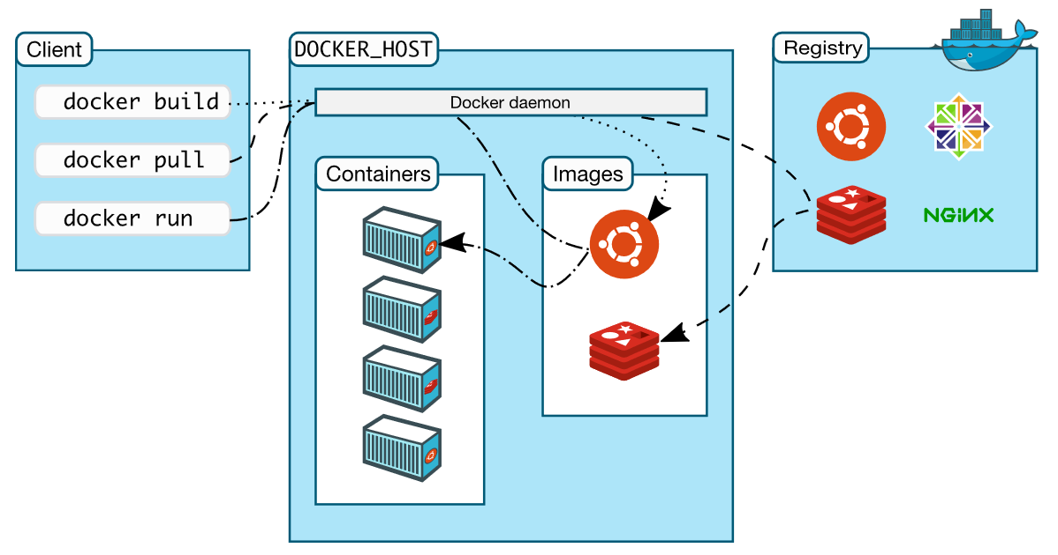
Docker Architecture
https://docs.docker.com/get-started/overview/

Slide 5
Docker Container Creation
the image is opened up and the filesystem of that image is copied into a temporary directory structure on the host
Docker filesystem is a stacked file system of individual layers stacked on “mount”
the ‘/’ root directory of the container is mounted and available on the host, e.g.:
/var/lib/docker/overlay2/51415bc9cd3ab2c47d218a897516ea2bf0545595fadf4a167ed5cfd3230a5f99/
changes to the directory are visible from both sides (host and container)
when the container is removed, any changes to its state disappear unless “committed” via dockerd

Slide 6
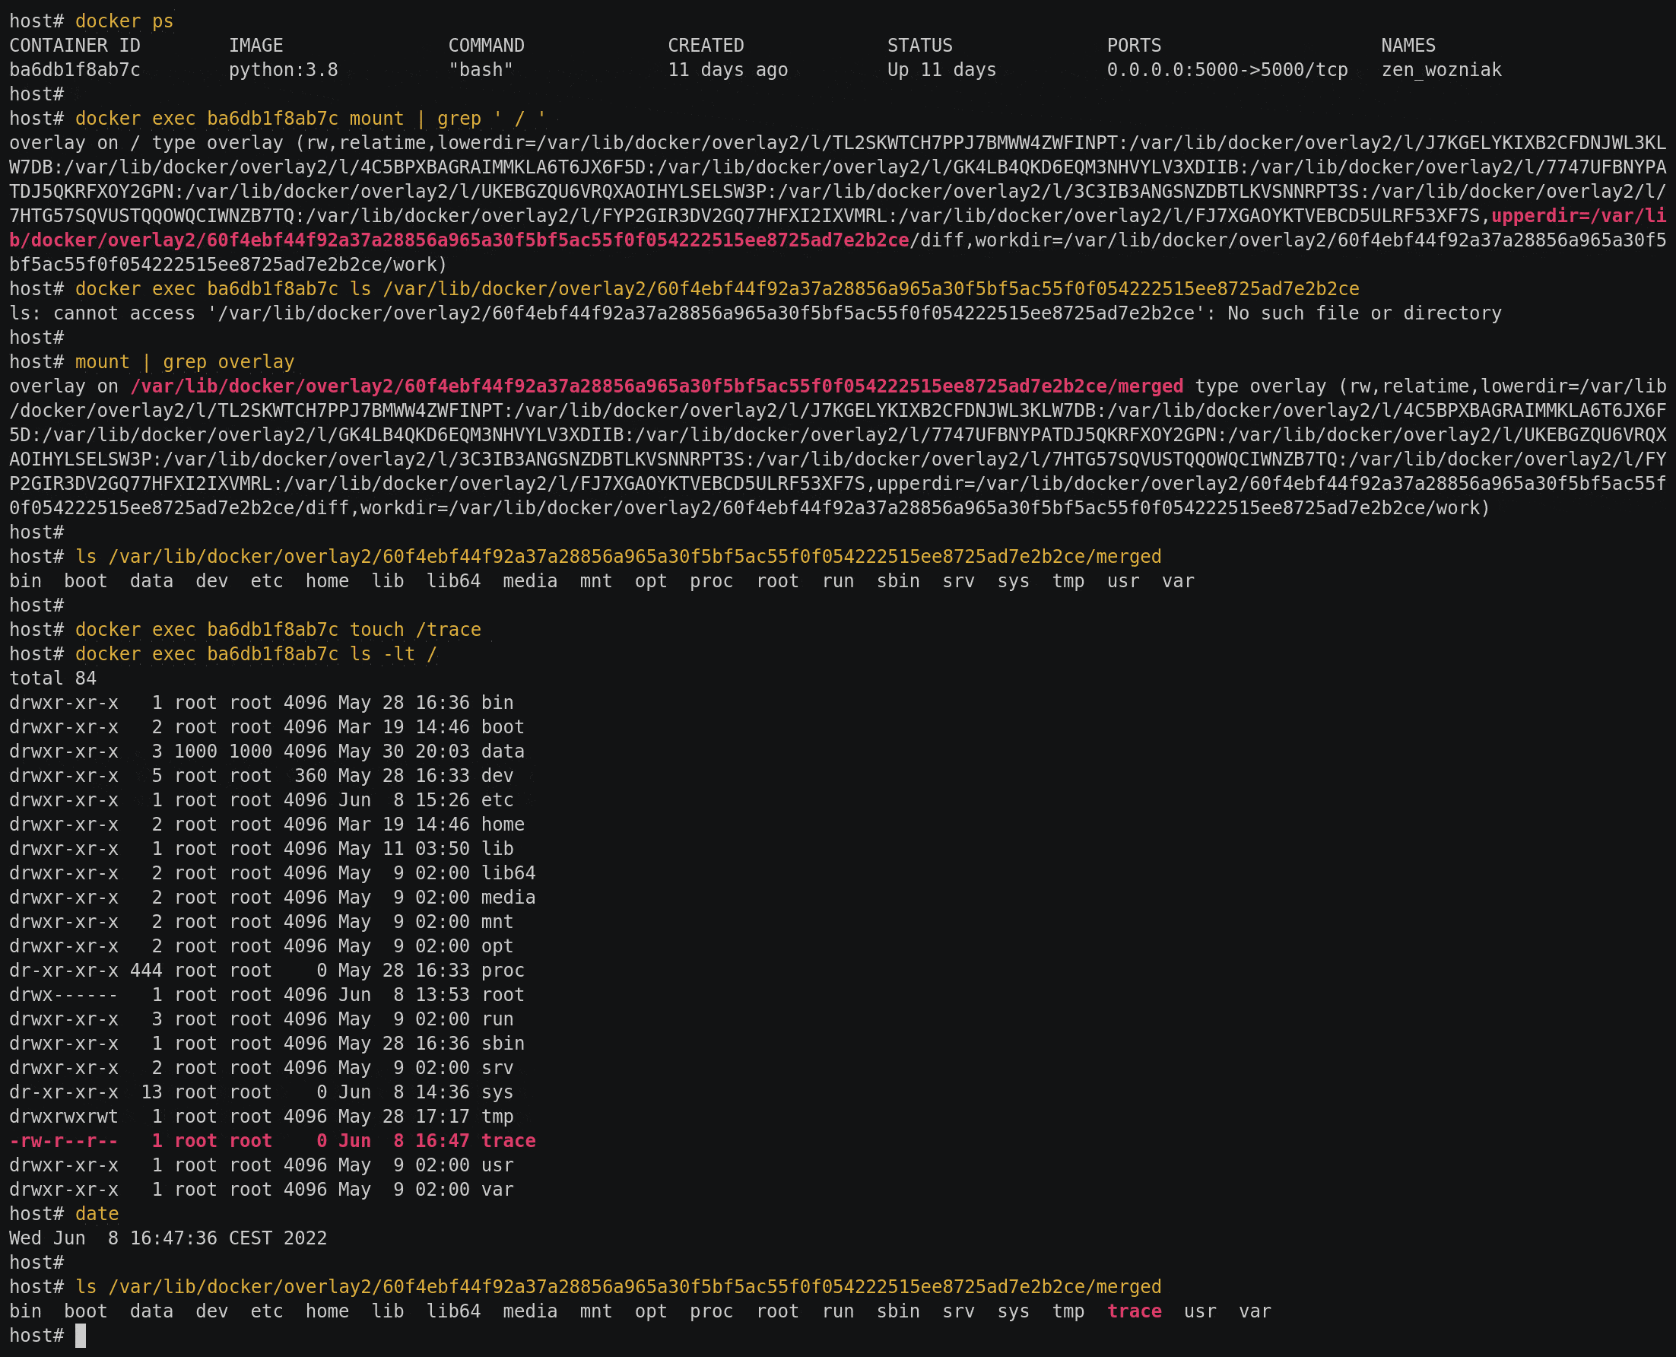

Slide 7
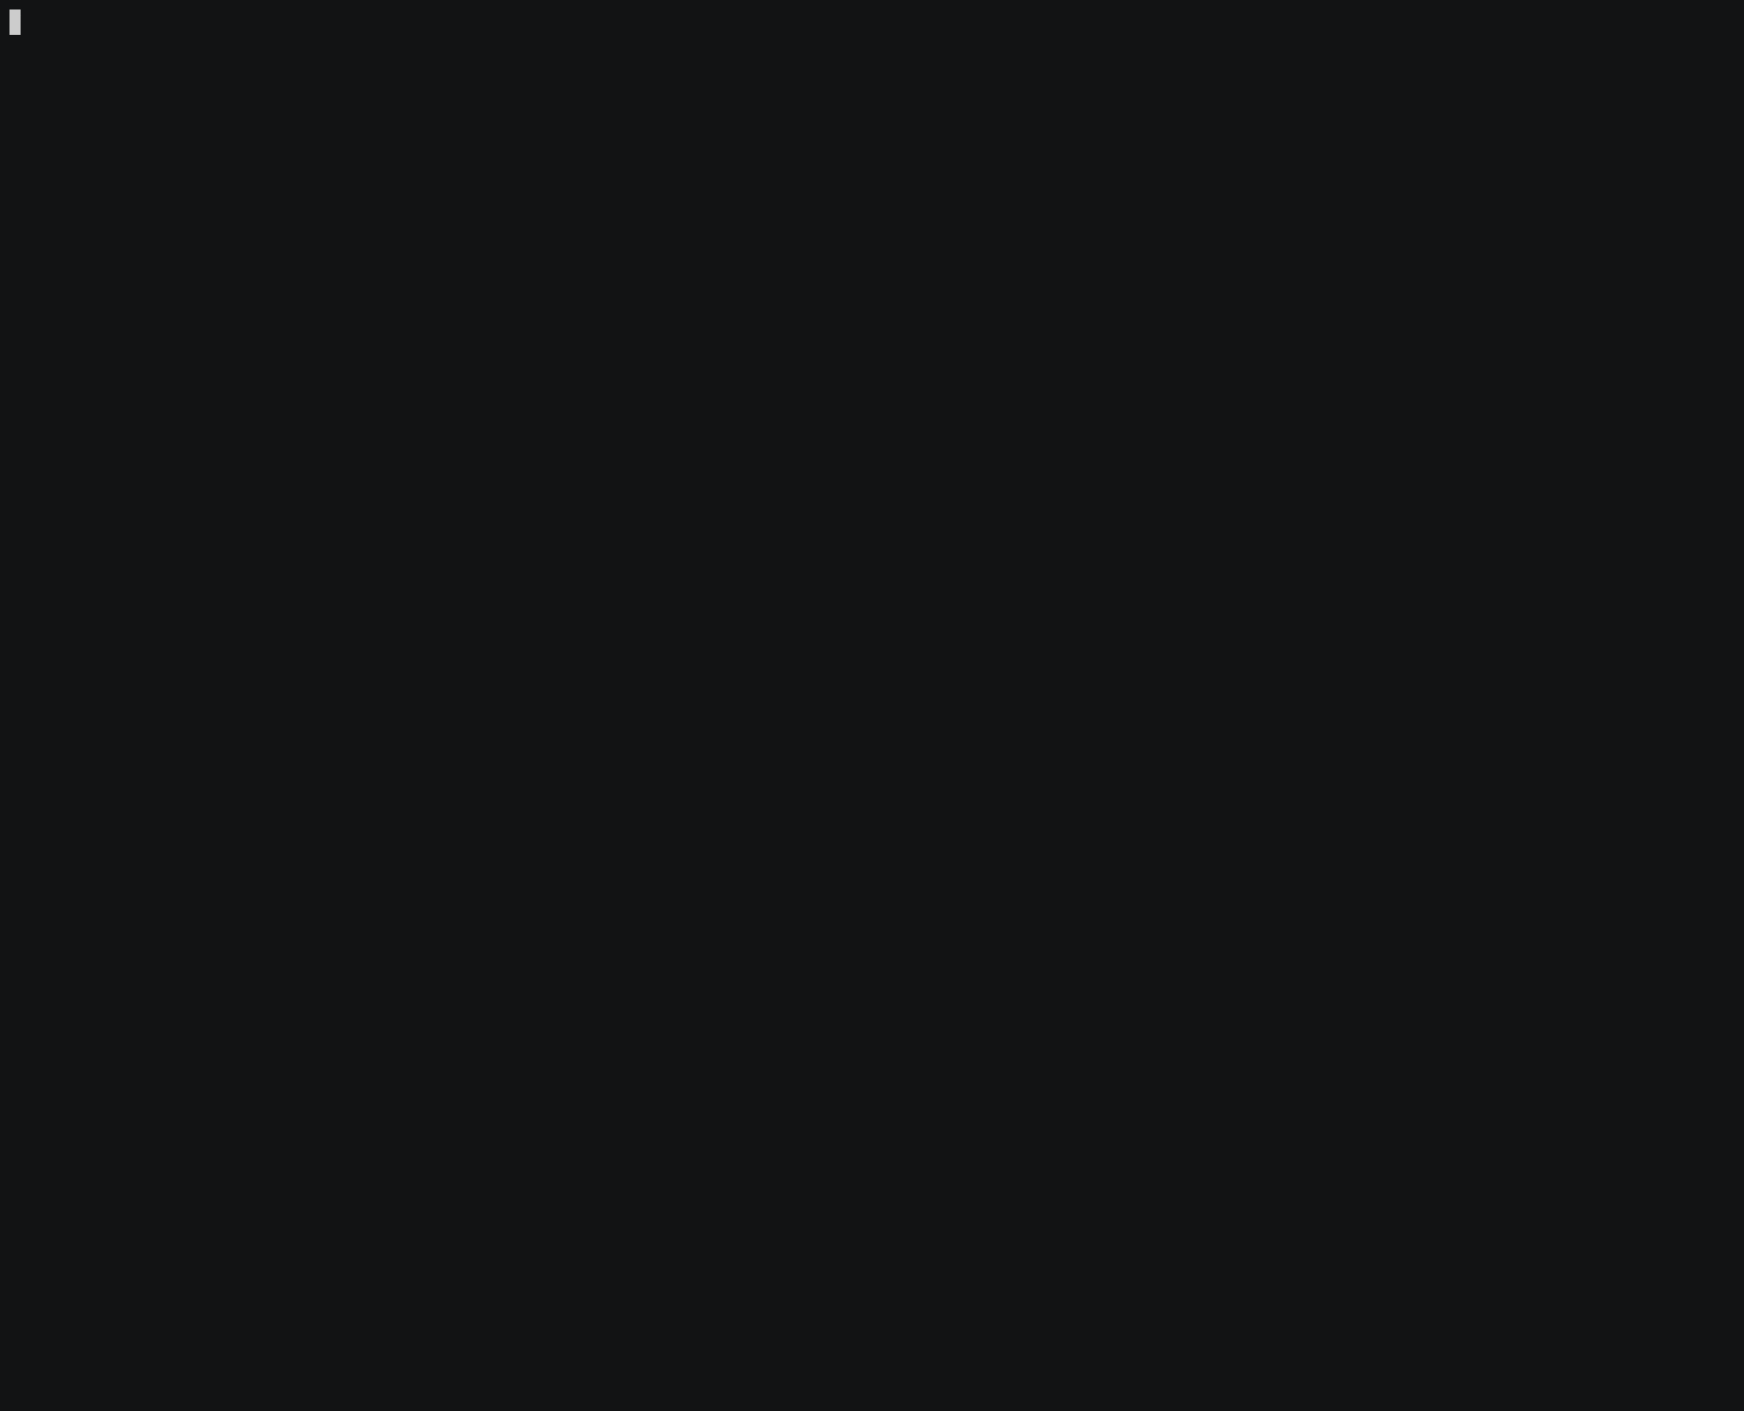

Slide 8
Starting Docker Container Processes
the container processes are maintained natively via the host kernel
to provide application sandboxing, Docker uses Linux namespaces and cgroups
when you start a container with docker run, Docker creates a set of namespaces and control groups, which contain the process(es) started inside the container

Slide 9
Namespaces
Docker Engine uses the following namespaces on Linux
  PID namespace for process isolation
  NET namespace for managing/separating network interfaces
  IPC namespace for separating inter-process communication
  MNT namespace for managing/separating filesystem mount points
  UTS namespace for isolating kernel and version identifiers
(mainly to set the hostname and domainname visible to the process)
  User ID (user) namespace for privilege isolation
user namespace must be enabled on purpose, it is not used by default

Slide 10
PID namespace
allows the container to establish separate process trees
the complete picture still visible from the host (running in the “system” namespace)
host# docker run -it debian bash
root@3146c2faec9b:/# dash
# ps af
PID TTY STAT TIME COMMAND
1 pts/0 Ss 0:00 bash
6 pts/0 S 0:00 dash
7 pts/0 R+ 0:00 \_ ps af
Host displays all processes
1029 ? Ssl 7:48 /usr/bin/containerd
28834 ? Sl 0:00 \_ containerd-shim -namespace moby ……...
28851 pts/0 Ss 0:00 \_ bash
28899 pts/0 S+ 0:00 \_ dash

Slide 11
User ID (user) Namespace
enables establishing separated uid/gid allocations, decoupled from real identifiers
  A user process in a the namespace is assigned a ‘local’ identifier that is recognized only inside the namespace
a mapping need to be maintained between uids/gids in the namespace and “global” (real) uids/gids
Host (real) id’s
0
1
….
100000
100001
id’s in a user namespace
0
1
by default, user namespace is not enabled by Docker, i.e. root in the container is root in the host
Notes:
pokud nemam uzivatelsky namepsace zapnuty, pak to mapovani neni
pokud to neni, pak root je plny root

Slide 12
Cgroups I.
short for control groups
they allow Docker Engine to maintain available system resources
they implement resource limiting for different resources (CPU, disk I/O, etc.)
they help to ensure that a single container can be assigned only limited resources
cgroups are organized in a (tree) hierarchy for a given cgroup type

Slide 13
Cgroups II.
a process (thread) may be assigned one or more cgroup(s)
  Management possible (e.g.) via the /sys pseudo-filesystem (/sys/fs/cgroup)
Example how to set up a cgroup:
# create a specific cgroup:
mkdir /sys/fs/cgroup/memory/memory_eaters
# limit the memory usage to 10MB
echo 10000000 > /sys/fs/cgroup/memory/memory_eaters/memory.limit_in_bytes
# enter the new cgroup with the current shell to apply to limit:
echo $$ > /sys/fs/cgroup/memory/memory_eaters/cgroup.procs

Slide 14
Linux Kernel Capabilities
capabilities turn the binary “root/non-root” dichotomy into a fine-grained access control system
by default, Docker starts containers with a limited set of capabilities
Docker supports the addition and removal of capabilities
additional capabilities extend the utility but have security implications, too
a container started with --privileged flag obtains all capabilities
running without --privileged doesn’t mean the container doesn’t have root privileges!

Slide 15
I am the root. Or not?
multiple levels of elevated privileges, from an unprivileged user to full root rights:
  if user namespace is enabled, the root inside a container has no root privileges outside in the host system
    not available in default Docker setup
  by default, the root in a container has some elevated privileges but restricted by a set of capabilities
  we can explicitly add extra capabilities to a container on start
  with the --privileged flag, we have full root rights granted

Slide 16
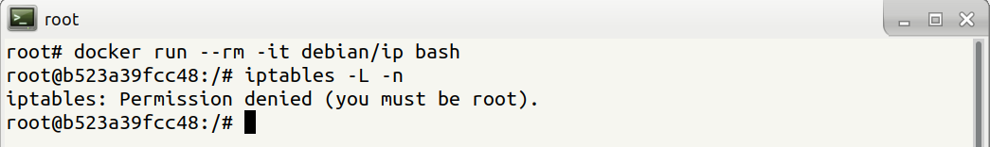
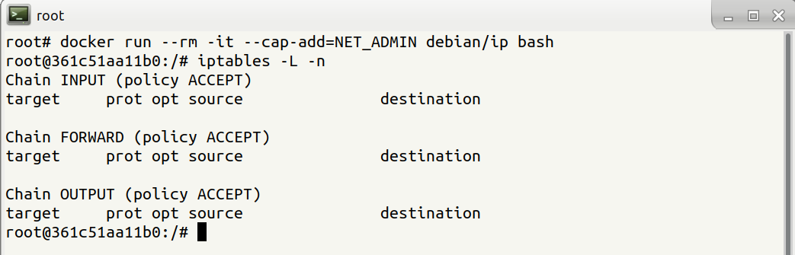
root may still be limited

Slide 17
Docker Daemon
containers and images are maintained by Docker Daemon
Docker daemon needs full access (administrative) to the system
  Containers can be given all features they need
    Internally (c.f. iptables before) or externally (port forwarding)
Docker daemon provides full access (administrative) to the system
  e.g., it allows you to share a directory between the Docker host and a guest container
    we can start a container where the /host directory is the / directory on your host
only trusted users should be allowed to control your Docker daemon
  Compare with root-less container technology

Slide 18
Docker interface
clients communicate with the daemon using an interface
by default, Docker Daemon listens for requests at a unix domain socket created at /var/run/docker.sock
it is possible to make the Docker Daemon listen on a network interface
CLI clients have options to specify the endpoint (e.g. over the network)

Slide 19
Docker vs. chroot command
a container isn’t instantiated by the user but the Docker daemon on behalf of the user
anyone who is allowed to communicate with the Docker Daemon can manage containers
that includes using any configuration parameters
  they can play with binding/mounting files/directories
  or decide which user id will be used in the container
  it’s not just better chroot
Notes:
komunika jde vzdy pres Docker servery, ten spousti ty kontejnery, ne my tim prikazem

Slide 20
Container Security
Notes:
Uvidíme tři praktické příklady, jak se kontejnery dají využít k eskalaci práv.

Slide 21
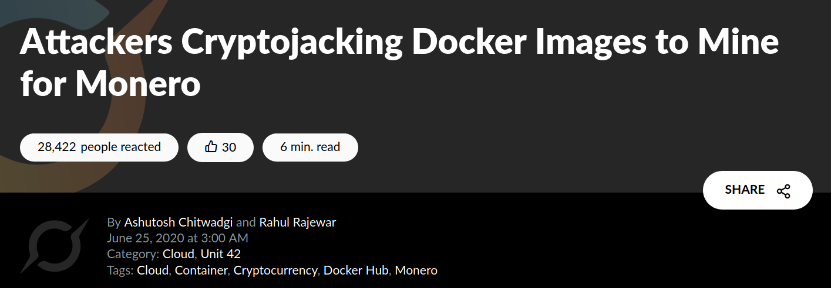
Threat Landscape
New technology with potential to harm the system (requires proper deployment and maintenance)
  Root-level access to the system, potential to escape from the container if the host/container is misconfigured
  New large surface for software vulnerabilities in the kernel
New approaches how applications are delivered/maintained
  image management (integrity and authenticity of the image)
  trust in the image maintainer and the repository operator
  malicious images may be found even in an official registry
https://unit42.paloaltonetworks.com/cryptojacking-docker-images-for-mining-monero/

Slide 22
Usual Best Practice
especially proper vulnerability/patch management
it is often kernel-related and therefore requiring reboot
proper patch management extremely important (couple of vulns over the past few years)
out of scope for today

Slide 23
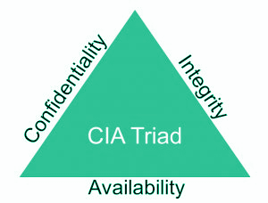
Escaping containers
a very general term
it does not necessarily mean controlling the host system
severity is determined by the risks
data access (according to the C.I.A triad):
  Reading (violation of C.)
  Modifying (violation of I.)
executing code outside the container (assigned cgroups and namely namespaces)

Slide 24
Escaping with containers
make use of technology to bypass existing barriers
  e.g., mounting a directory to a container
inject a “hook” that is invoked by a trusted component in the system
  a crontab rule or a kernel “notifier” running command on certain events
  must run outside the container - APIs (e.g. inotify) won’t help

Slide 25
Docker-related incidents
unprotected access to Docker Daemon over the Internet
  revealed by common Internet scans
  instantiation of malicious containers used for dDoS activities
stolen credentials providing access to the Docker Daemon
  used to deploy a container set up in a way allowing breaking the isolation
  the attackers escaped to the host system
  an deployed crypto-mining software and misused the resources

Slide 26
Other kernel security features
it is possible to enhance Docker security with systems like TOMOYO, AppArmor, SELinux, etc.
you can also run the kernel with GRSEC and PAX
all these extra security features require extra configuration

Slide 27
Cheat Sheets
Notes:
Uvidíme tři praktické příklady, jak se kontejnery dají využít k eskalaci práv.

Slide 28
Docker Cheat Sheet I.
start a new container
docker run IMAGE
docker run --rm IMAGE
start a new container in interactive mode (e.g. with a shell)
docker run -it IMAGE bash
start a new container from an image with a command
docker run IMAGE command
start a new container and map a local directory into the container
docker run -v HOSTDIR:TARGETDIR IMAGE
Notes:
if command isn't given, the image default one is used. May be shell (/bin/sh) or a particular command. Note that shell might not be present at all in a container image (making its investigation difficult)

Slide 29
Docker Cheat Sheet II.
show a list of running containers
docker ps
show a list of all containers
docker ps -a
delete a container
docker rm CONTAINER
start a shell inside a running container
docker exec -it CONTAINER bash
stop a running container
docker stop CONTAINER
resume a stopped container
docker start CONTAINER
download an image from a repository
docker pull IMAGE
List local images
docker image ls
Delete a local image
docker image rm IMAGE
Notes:
TODO: -it needs to be explained (for both run and exec).
TODO: the difference between run and exec

Slide 30
Practical Part
Notes:
Uvidíme tři praktické příklady, jak se kontejnery dají využít k eskalaci práv.

