Slide 1
Incident Response
Sirtfi and Beyond
Hannah Short
CERN Computer Security
AARC NA3
WISE
March 27th 2017

Slide 2
Agenda
Incident Response in Distributed Infrastructures
Impact of Identity Federations
Filing the gaps

Slide 3
Incident Response in Distributed Infrastructures

Slide 4
Security Incident Response in Distributed Infrastructures
Shared Policies
Trust
Operational Support

Slide 5
Shared Policies
Written rules, and obligations
Clear basis for exclusion from infrastructure if not followed
Reasonable likelihood that sites follow best practices in security

Slide 6
Operational Support
Incident preparation and prevention - cascade advisories, IOCs, patches etc
Coordinate incident response across multiple Sites
Power to block problematic Sites & users

Slide 7
Trust
Fundamentally, incident response is more successful when the individuals know and trust each other
Online trust
  Consistent, trustworthy behaviour
  Voluntary collaboration
Offline trust
  Key exchange
  Verification that you are a real person ☺

Slide 8
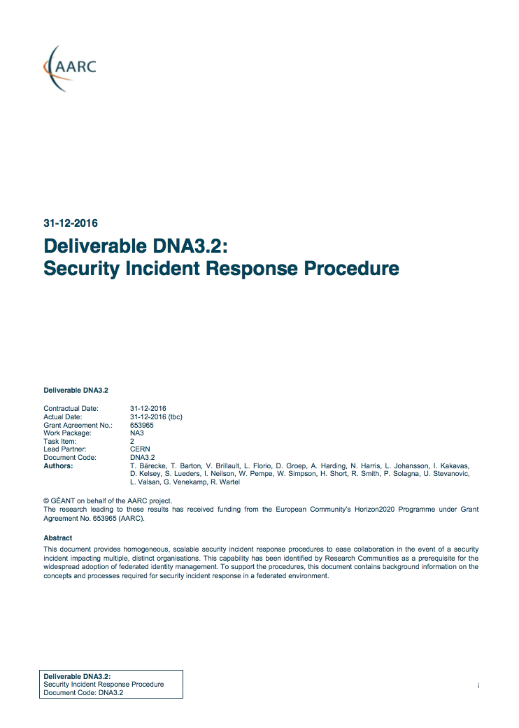
Security Incident Response Models
AARC Project Deliverable DNA3.2 provided opportunity to:
Analyse existing models
Consider Security Incident Response Procedures in the context of eduGAIN (stay tuned for the second part of this talk!)
https://aarc-project.eu/wp-content/uploads/2017/02/DNA3.2-Security-Incident-Response-Procedure-v1.0.pdf

Slide 9
Fully Distributed Model
1
2
3
4
5
1
2
3
4
5
During Incident Response
Post-Incident-Report Sharing
Information shared between all participants
Information shared between all participants

Slide 10
Hub and Spoke
Hub
1
5
4
3
2
Hub
1
5
4
3
2
During Incident Response
Post-Incident-Report Sharing
Information shared between affected participants
Information shared between all participants

Slide 11
Impact of Identity Federations

Slide 12
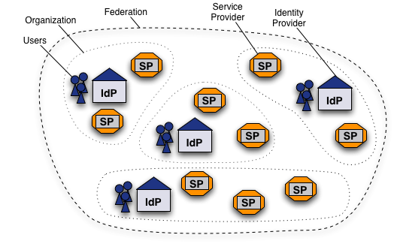
Federated Identity Management Worldwide
What is a Federation?
Federated Identity Mangement (FIM) is the concept of groups of Service Providers (SPs) and Identity Providers (IdPs) agreeing to interoperate under a set of policies.
Federations are typically established nationally and use the SAML2 protocol for information exchange
Each entity within the federation is described by metadata
https://www.switch.ch/aai/about/federation/
Credit to Alessandra Scicchitano – GEANT for this slide

Slide 13
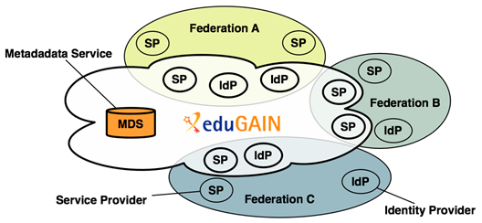
Federated Identity Management Worldwide eduGAIN
eduGAIN is a form of interfederation
Participating federations share information (metadata) about entities from their own federation with eduGAIN
eduGAIN bundles this metadata and publishes it in a central location.
Credit to Alessandra Scicchitano – GEANT for this slide
Notes:
eduGAIN aggregates metadata from participating federations (metadata service). This aggregate is consumed by all participating federations, such that Identity Providers and Service Providers can find each other.
Technically, this aggregate works as follows: 'export metadata aggregate’, eduGAIN aggregate,
Each participating federation produces a so called 'export metadata aggregate'; a file that contains the metadata of local Identity Providers and Service Providers that participate in eduGAIN. Note that this is often a subset of all Identity Providers and Service Providers from that federation.
eduGAIN combines all export metadata aggregates and generates an "eduGAIN aggregate"; a file that combines all metadata from all participating federations.
This eduGAIN aggregate is signed by eduGAIN and published on the internet, thereby making it available to all participating federations.
Each participating federation must consume this eduGAIN aggregate and supply it to their local Identity Providers and Service Providers.

Slide 14
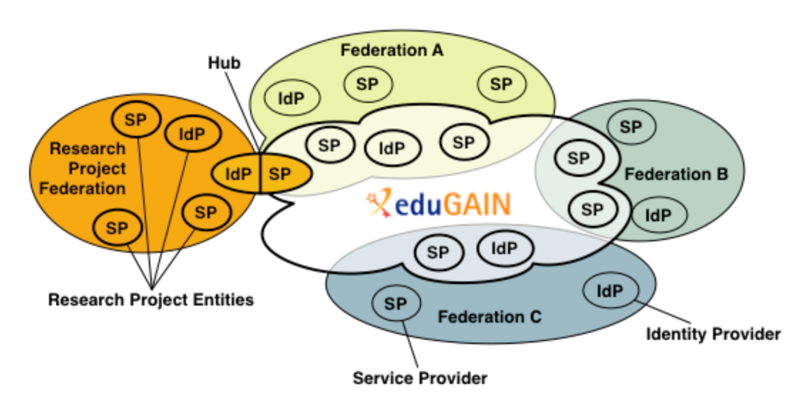
Our Interaction with Identity Federations
Research Communities typically join through an SP-IdP proxy
  From the outside (eduGAIN) it looks like an SP
  From the inside it looks like an IdP
We depend on the stability of eduGAIN as an authentication infrastructure!
The SP-IdP Proxy Model. Source: GEANT, GN3PLUS13-642-23

Slide 15
Security Incident Response in Distributed Infrastructures
Shared Policies
Trust
Operational Support

Slide 16
The challenge of Federated Identity Management
EduGAIN membership includes 4 policies… Security Incident Response is not one
We have no insight into security practices of each participant
Collaboration between IdPs and SPs is essential to build full incident timeline – they have no obligation to collaborate
Shared Policies
Trust
Operational Support

Slide 17
The challenge of Federated Identity Management
EduGAIN has no central help desk
Few national federations offer central security support
No way to block an identity, IdP, or federation everywhere and immediately
Shared Policies
Trust
Operational Support

Slide 18
The challenge of Federated Identity Management
Security is often not priority (or even in skillset) of engaged FIM participants
Simply too big…
Shared Policies
Trust
Operational Support

Slide 19
2360 IdPs
Potential sources of compromised identities
1493 SPs
Potential targets

Slide 20

What can we do?
Federation 2
SP
Federation 1
SP
IdP
IdP
SP
SP
SP
SP
SP
All I need is one identity…
IdP
Federation 3
SP
IdP
SP

SP
IdP
Clearly an inviting attack surface… luckily, this was noticed several years ago!

Slide 21
Beginnings
Issues of IdM raised by IT leaders from EIROforum labs (Jan 2011)
  CERN, EFDA-JET, EMBL, ESA, ESO, ESRF, European XFEL and ILL
  These laboratories, as well as national and regional research organizations, face similar challenges
Prepared a paper that documents common requirements https://cdsweb.cern.ch/record/1442597
“Security procedures and incident response would need to be reviewed. Today, each resource provider is for example responsible for terminating access by known compromised identities. With identity federation, this responsibility will be shifted to the IdP though resource providers will insist on the ability to revoke access.”
“Such an identity federation in the High Energy Physics (HEP) community would rely on:
• A well-defined framework to ensure sufficient trust and security among the different IdPs and relying parties.“
Credit to David Kelsey (STFC) for this content

Slide 22
Evolution
Several years later, 2016
Security
Incident
Response
Trust Framework for
Federated
Identity
Approved by the REFEDS (Research & Education FEDerations) Community
Registered Internet Assigned Numbers Authority (IANA) Assurance Profilehttps://www.iana.org/assignments/loa-profiles/loa-profiles.xhtml

Slide 23
Sirtfi
Operational Security
Require that a security incident response capability exists with sufficient authority to mitigate, contain the spread of, and remediate the effects of an incident.
Incident Response
Assure confidentiality of information exchanged
Identify trusted contacts
Guarantee a response during collaboration
Traceability
Improve the usefulness of logs
Ensure logs are kept in accordance with policy
Participant Responsibilities
Confirm that end users are aware of an appropriate AUP

Slide 24

Current adoption

Slide 25
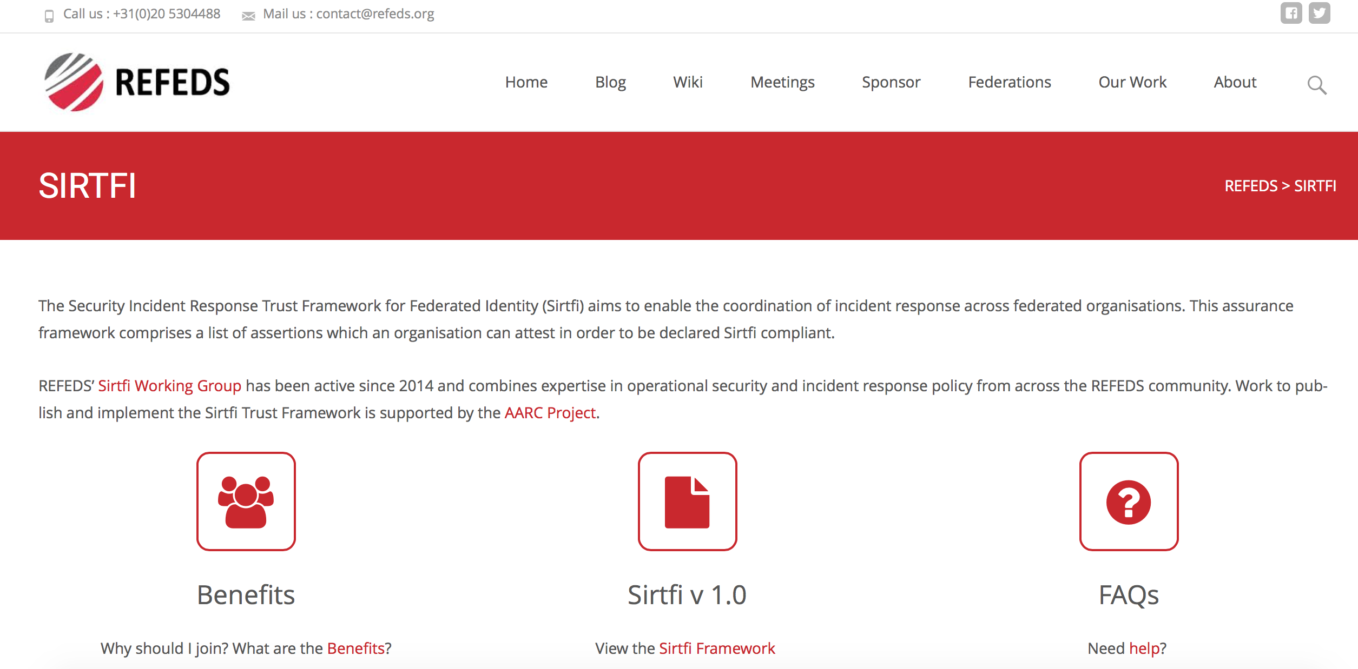
Find out more
https://refeds.org/sirtfi

Slide 26
How does Sirtfi help?

Slide 27
How does Sirtfi help?
Shared Policies
Trust
Operational Support
Shared framework fulfills purpose of basic policy
Obliged to collaborate
Basic operational security best practices
Allows us to identify security conscious bodies

Slide 28
How does Sirtfi not help?
Shared Policies
Trust
Operational Support
Some Federation Operators unwilling to act as gatekeepers
No shared procedures
No large-scale blocking mechanism
Trust tied to organisation/entity, not individual
Difficult to build offline trust

Slide 29
Filling the gaps

Slide 30
How can we build the necessary security capability for eduGAIN?
Operational Support
Trust
eduGAIN itself announced early this year that they will provide a support platform capable of coping with roughly 200 tickets per year
Security Incidents will be in scope of this team by Autumn
Identified need for Trust Portal
Crowd source trust and provide method for identifying confidence in an entity outside metadata

Slide 31
Incident Response Procedure for Interfederation
DNA3.2 provides template procedures based on EGI/WLCG and inspired by common practices
Leverages existing trusted relationships in Identity Federations
  Sort of “nested hub” →
We (RCs) need procedures for two purposes:
  eduGAIN to secure itself
  eduGAIN to cooperate with us during an incident
Hub
1
5
4
3
2
13
21
12
22
11
23

Slide 32
Role of Research Communities
Typical SPs do not have a mature security capability
RCs have expertise and motivation to lead incident response and should be allowed to do so
Procedures are flexible to allow the most appropriate entity to be the Incident Response Coordinator
CERT
Research Community
13
21
Hub
5
4
3
2
1
12
22
11
23

Slide 33
Next Steps
Document has already had input from many sources
  Identity Federations (Germany, US, UK, Sweden, Switzerland)
  SPs (ORCID)
  Research Community Reps (CERN, EGI, KIT)
  Review by Scott Koranda (LIGO) and Leif Nixon
Next steps
  Circulate more widely
  Encourage National Identity Federations to adopt similar policies
  Ensure that the eduGAIN support platform is able to effectively play the central role we need

Slide 34
hannah.short@cern.ch

