Slide 1
WISE
Nikhef, March 2017
Hannah Short
hannah.short@cern.ch
CERN, Computer Security

Slide 2
Agenda
When? | What?
Monday | Welcome
 | Working Group Intros
 | Community Updates
 | Dinner
Tuesday | Working Group Sessions
 | Dinner
Wednesday | Session Summaries
 | SC Meeting
https://wiki.geant.org/pages/viewpage.action?title=27-29+March+in+Amsterdam%2C+hosted+by++Nikhef&spaceKey=WISE

Slide 3
WG Sessions
STAA Working Group Session.
The aim is to make a first version of a guidance for security training and awareness. It must identify target groups, their training and awareness needs, and identify initial and recurring training and awareness activities. Where possible there can be references in this guidance to existing training and awareness programs.
SCIv2 Working Group Session.
The aim of the SCIv2-WG full day at the workshop will be to produce a close-to-final Version 2 of the SCI document together with a draft (perhaps not quite so final) version of the accompanying guidance document. We will also discuss/agree what Endorsement/Acceptance by the various Infrastructures means as we work towards a signing ceremony with at least some Infrastructures at TNC17 in Linz.
RAW Working Group Session.
The aim of the RAW-WG full day at the workshop will be to produce a first draft of the risk management template to be shared among sites and infrastructures.
H2.20
H3.20
H1.28

Slide 4
What is WISE?
Wise Information Security for Collaborating E-infrastructures
A trusted forum where security experts can share information on different topics like risk management, tools for operational security and threat intelligence, in the context of e-Infrastructures

Slide 5
WISE Meetups
September 2015 – Workshop in Barcelona
June 2016 – BoF (Birds of a Feather meetup) at TNC16, Prague
July 2016 – 1 day Workshop at XSEDE, Miami
September 2016 – 1 day Workshop at DI4R, Krakow
March 2017 – 2 day Workshop hosted by Nikhef, Amsterdam

Slide 6
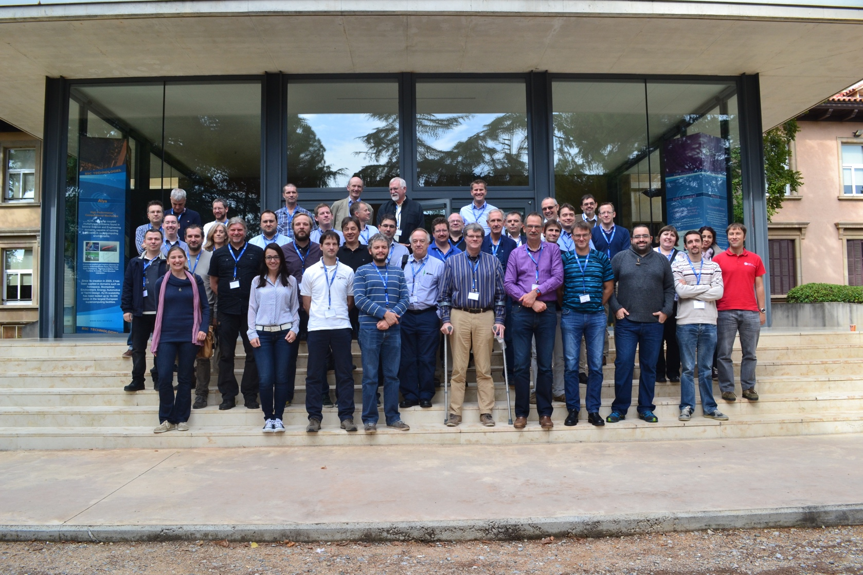
WISE – 2015
WISE Workshop – Barcelona Supercomputing Center – October 2015

Slide 7
WISE – 2017
WISE Workshop – Nikhef - March 2015

Slide 8
Activities
Community of volunteers
Led by a Steering Committee
Two face-to-face meetings a year, focus on producing practical output
Updating the SCI framework (SCIV2-WG)
Risk Assessment WISE (RAW-WG)
Security in Big and Open Data (SBOD-WG)
Working Groups
Security Training and Awareness (STAA-WG)

Slide 9
Feedback
If you have feedback or suggestions, speak up!
Want to host a WISE workshop?
Looking for input from the community?
  Start a discussion this week ☺
  Use the mailing lists ☺

Slide 10
Thank you!
Many thanks to
David Groep for hosting!
Sigita for organising dinners!

Slide 11
Who is here?

Slide 12
Thank you
Questions?
hannah.short@cern.ch

