Slide 1
WISE
Nikhef, March 2017
Hannah Short
hannah.short@cern.ch
CERN, Computer Security

Slide 2
Agenda
When? | What?
Monday | Welcome
 | Working Group Intros
 | Community Updates
 | Dinner
Tuesday | Working Group Sessions
 | Dinner
Wednesday | Community Updates
 | Session Summaries
 | SC Meeting
https://wiki.geant.org/pages/viewpage.action?title=27-29+March+in+Amsterdam%2C+hosted+by++Nikhef&spaceKey=WISE

Slide 3
WG Sessions
STAA Working Group Session.
Target groups & training topics identified
RAW Working Group Session.
WISE minimum set risk assessment checklist defined
Next step, mapping inventory to groups
SCIv2 Working Group Session.
SCIv2 draft complete
Test runs by WG participants
Next step, collect endorsement for TNC
https://wiki.geant.org/display/WISE/Working+Groups

Slide 4
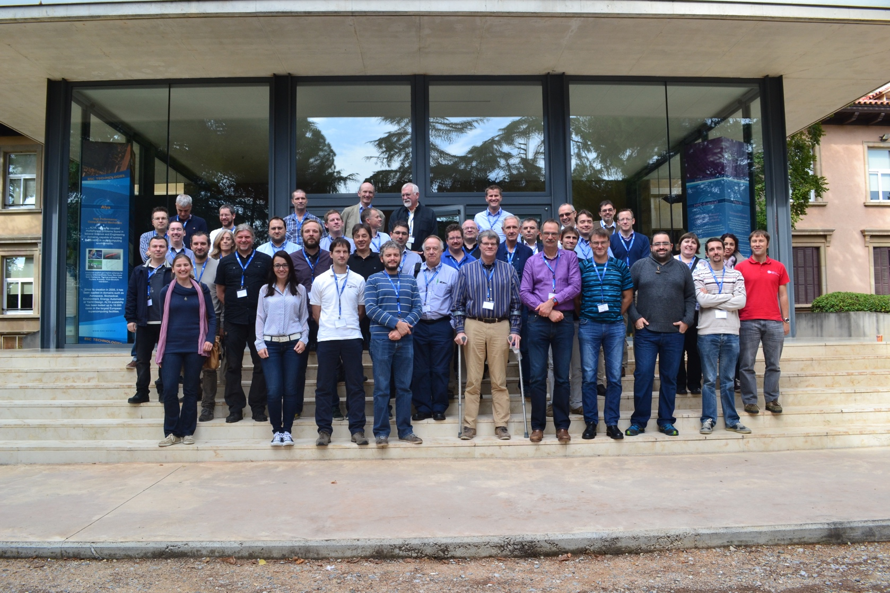
WISE – 2015
WISE Workshop – Barcelona Supercomputing Center – October 2015

Slide 5
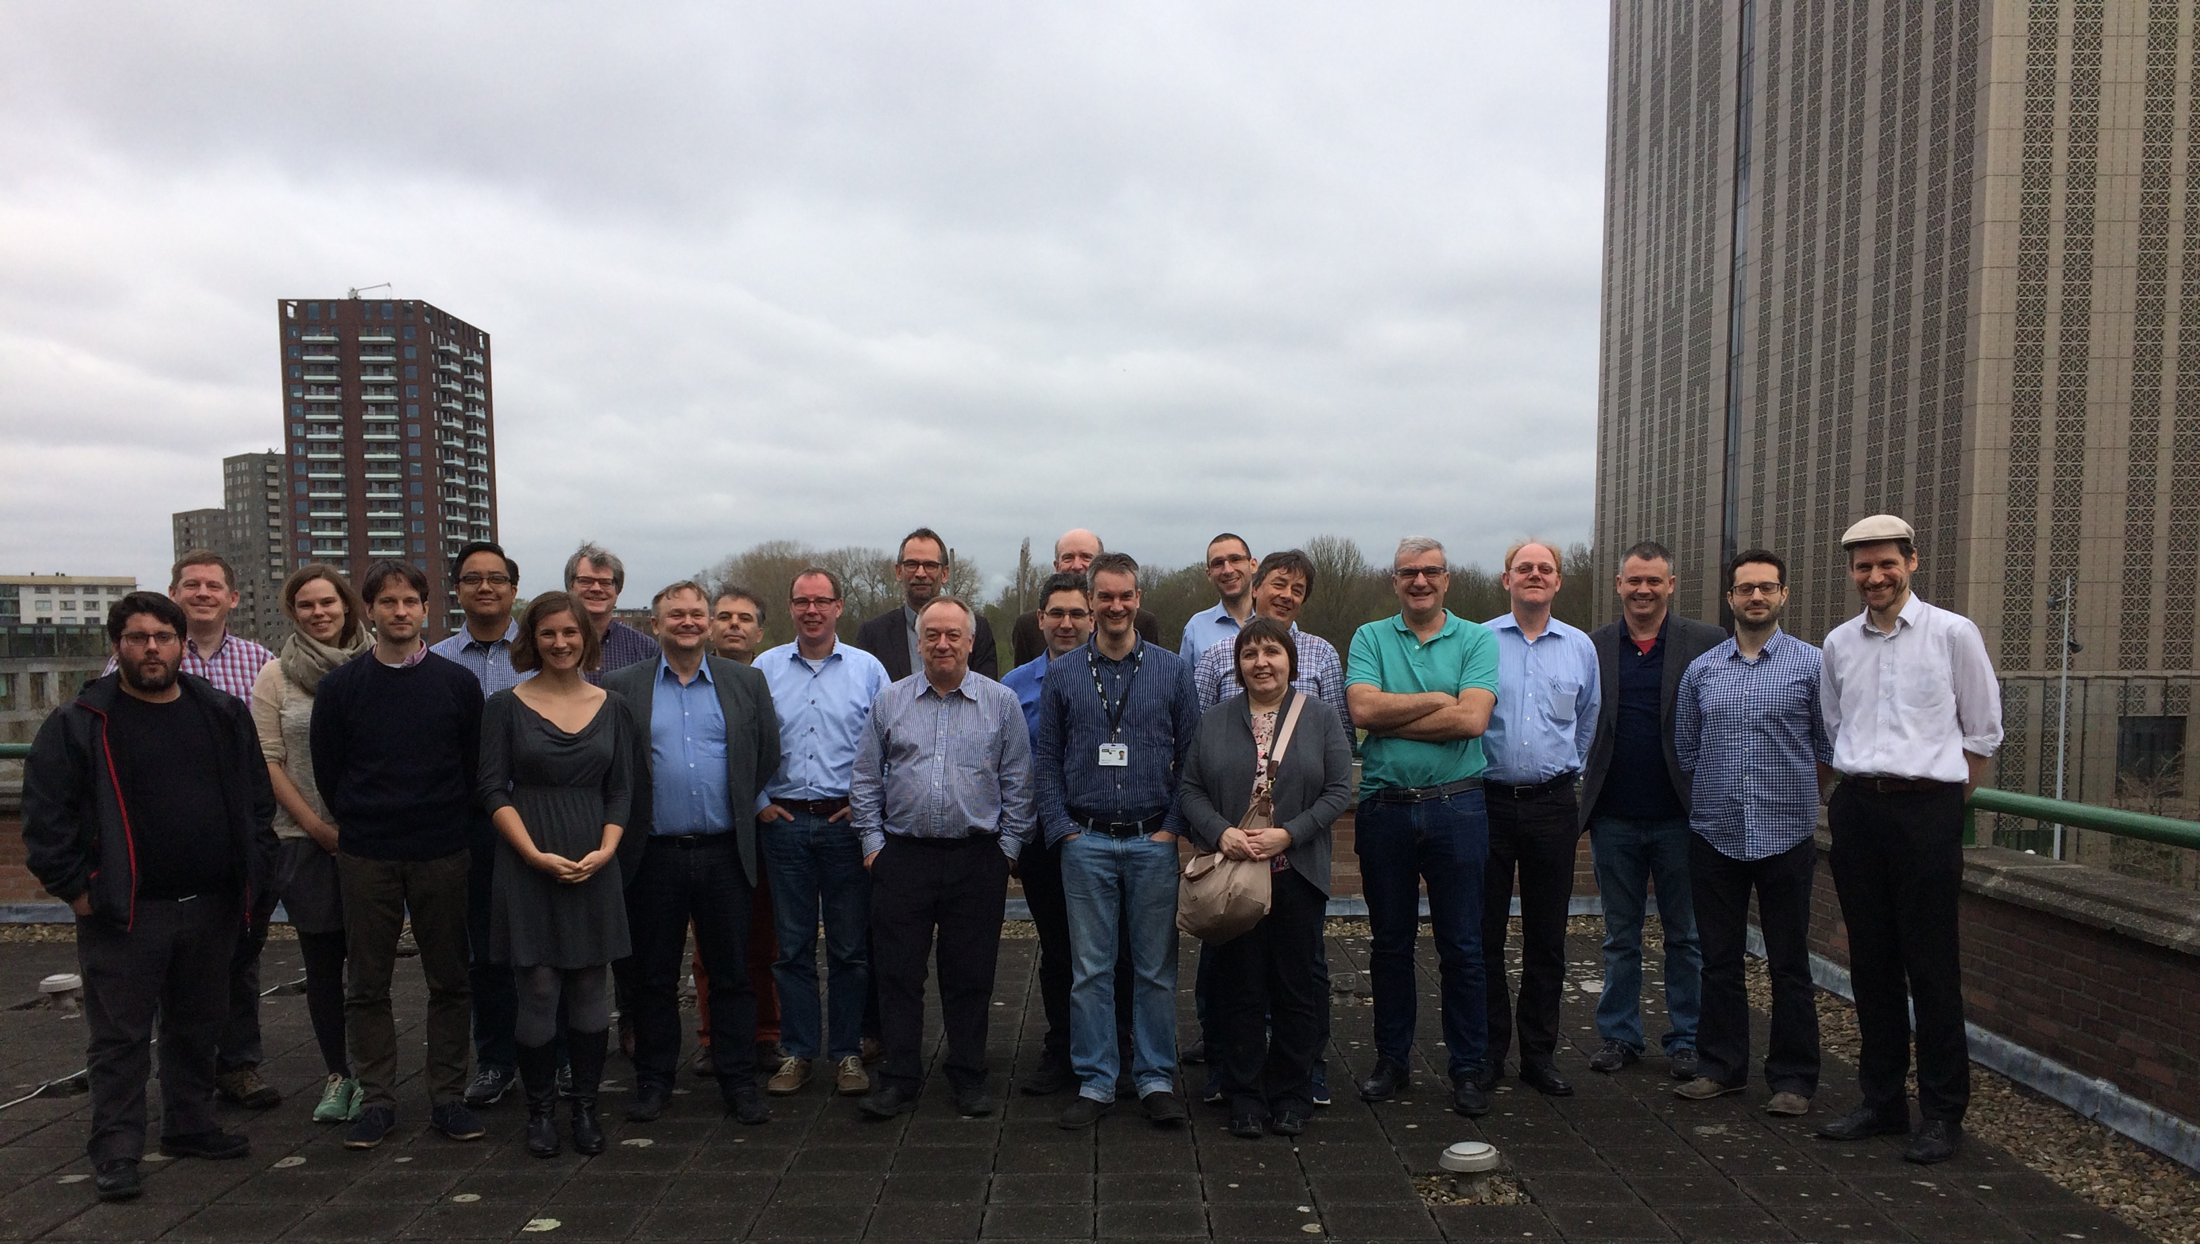
WISE – 2017
WISE Workshop – Nikhef - March 2017

Slide 6
SC points to discuss
Next meeting location and collocation
Document hosting and publication
…

Slide 7
“Thank you”s
Many thanks to
All the speakers!
David Groep for hosting!
Sigita for organising dinners!
Everyone who came to dinners, for paying the right amount!

Slide 8
Thank you
Questions?
hannah.short@cern.ch

