Slide 1

WISE SCIV2-WG
David Kelsey
STFC-RAL
4th WISE workshop, Nikhef
27 March 2017

Slide 2
Overview
SCI version 1 document
SCI maturity review
WISE SCIV2-WG
  Aims/mandate
  Plans for tomorrow’s working group meeting
    And next couple of months

Slide 3
Security for Collaborating Infrastructures (SCI)
A collaborative activity of information security officers from large-scale infrastructures
  EGI, OSG, PRACE, EUDAT, CHAIN, WLCG, XSEDE, HBP…
Developed a Trust framework
  Enable interoperation (security teams)
  Manage cross-infrastructure security risks
  Develop policy standards
    Especially where not using identical security policies

Slide 4
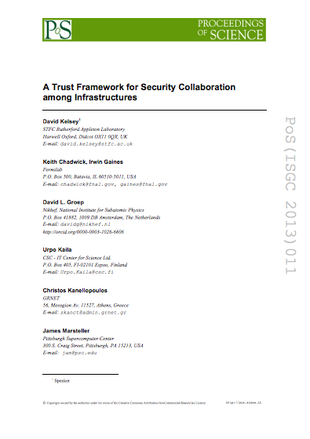
SCI Document – V1
Proceedings of the ISGC 2013 conference
http://pos.sissa.it/archive/conferences/179/011/ISGC%202013_011.pdf
The document defines a
series of numbered
requirements in 6 areas

Slide 5
SCI V1: areas addressed
Operational Security
Incident Response
Traceability
Participant Responsibilities
  Individual users
  Collections of users
  Resource providers, service operators
Legal issues and Management procedures
Protection and processing of Personal Data/Personally Identifiable Information

Slide 6
SCI Maturity
To evaluate extent to which requirements are met, we recommend Infrastructures to assess the maturity of their implementations
According to following levels
  Level 0: Function/feature not implemented
  Level 1: Function/feature exists, is operationally implemented but not documented
  Level 2: … and comprehensively documented
  Level 3: … and reviewed by independent external body
We have a spreadsheet to help assess

Slide 7
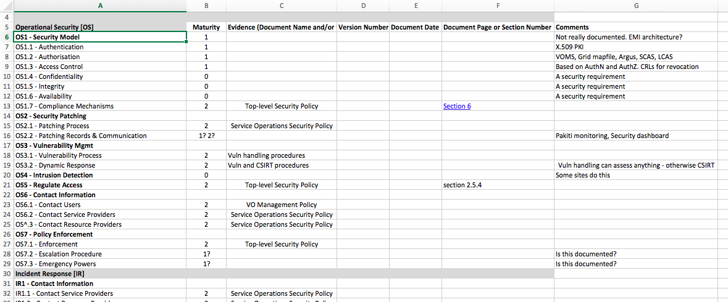
Review
An example of the info that can be recorded
(part of the spreadsheet)

Slide 8
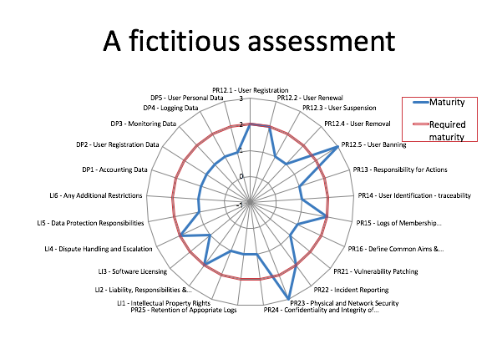
Review (2)

Slide 9
Now to the WISE SCIV2-WG

Slide 10
SCIV2-WG Aims/Mandate
Work towards a Version 2 document
Involve wider range of stakeholders
  GEANT, NRENS, Identity federations, …
Address conflicts in version 1 for new stakeholders
Add new topics/areas if needed
  security audit/peer review, security risk assessments and software security review
Give guidance on the assessment of infrastructures against the SCI requirements
We are not an operational security/trust group
  Not compete with other op sec trust activities
  But will seek feedback from such groups on our work

Slide 11
Other work
FIM4R and REFEDS work
The Security Incident Response Trust Framework for Federated Identity (Sirtfi)
https://refeds.org/sirtfi
AARC policy work:
Scalable Negotiator for a Community Trust Framework in Federated Infrastructures (Snctfi)
Close to final draft – not yet public
Both of the above are Creative Commons derivatives of SCI v1
In SCI version 3 we should see if we can re-merge
  But could also include some of the words in SCI V2 perhaps?

Slide 12
SCIV2-WG Workplan
Work done already
Self-assessments against Sections 4 (Operational Security) and 5 (Incident Response) of SCI version 1
  To decide what guidance is needed and what words need to be changed (completed)
Producing draft guidelines for same sections
  all topics considered and questions discussed (see wiki)
https://wiki.geant.org/display/WISE/Guidance+for+SCI+version+1

Slide 13
Next steps - Tomorrow!
Tomorrow’s workshop
  Start with other sections (not OS nor IR)
    What to exclude?
    What is missing?
    Look at other input
  Back to Draft wording for OS and IR in version 2
By end of April (we can do it!)
  Agreed version 2 (final draft) – out to Stakeholders
  Draft of the V2 guidance document (by end May?)
    Or perhaps after TNC17
Sign-off at TNC17 (Linz 29 May – 1 June)

Slide 14
Questions?

