Slide 1
RAW Working Group
WISE @ Nikhef, www.wise-community.org
March 27- 29, 2017
Urpo Kaila, urpo.kaila@csc.fi

Slide 2
Milestones
Mission of RAW
Current status of risk management at WISE stakeholders
Best Practices/ Standards/Guidelines
Issues with with Risk Management
Required next steps
RAW workshop

Slide 3
Mission of RAW
This working group has the objective to provide e-infrastructures and their member organisations with guidelines on how risk assessments can be effectively implemented.
As input, experience from organisations will be used. At the first WISE meeting some experiences were already presented, e.g. from XSEDE, UNINETT and EGI (https://www.terena.org/activities/ism/wise-ws/agenda.html).
Some organisations may consider that information about specific risk assessments cannot be publicly provided and should be kept confidential.
The working group should implement policies and procedures which enable, if needed, the exchange of confidential information among selected parties.

Slide 4
Current status of risk management at WISE stakeholders
You tell me:)!
Raise you hand if you do:
  Regular risk assessments
  Your risk assessments are comprehensive
  Define risk ownership
  Connect IT Risks and business risks
  Your management is involved with risk management
  You connect risk and security controls
  You do follow ups to the risk assessment

Slide 5
Issues with with Risk Management
Issues
  Risk Management not done at all
  No connection to strategic or operational risks
  Fragmented RA’s
  Missing management approval
  Risk management a formality with no connections to operations or services
  Risk ownership not defined
  Missing connections between risks and controls
  No follow ups
  No methods
  No audits

Slide 6
Activities
Presentation at TNC17 as part of joint WISE presentation
SC Meetings
GÉANT SIG-ISM
  Parallel work
  Redefining ITSM basics/ Minimum requirements (an alternative to SCI)
Audit tour of national universities (.fi)
Preparing paper for SC conference

Slide 7
Best Practices/ Standards/Guidelines
  GÉANT SIG-ISM Whitepaper on Information Security Risk management (2016)
    https://wiki.geant.org/download/attachments/51741496/Whitepaper%20Information%20Security%20Management%201.0.pdf
  ISO 3100
  NIST Technical series publications
    800-37, 800-53 ( R 4),
  ENISA on Risk Management
    https://www.enisa.europa.eu/topics/threat-risk-management/risk-management
  National Guidelines and Best Practices

Slide 8
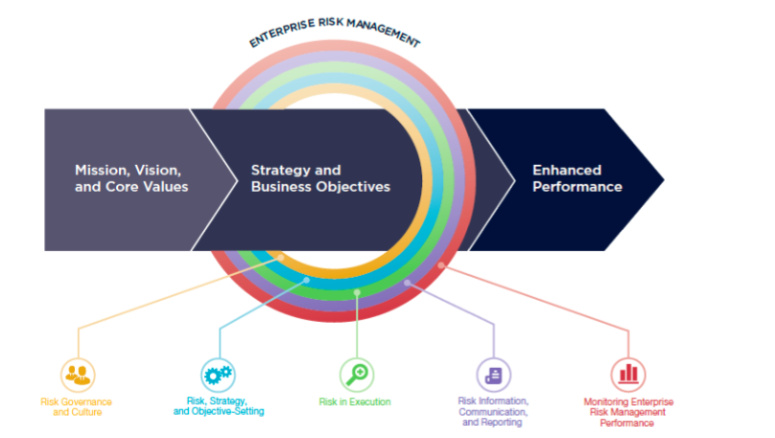
Risk Management frameworks for various scopes
COSO-ERM (-->)
BIA
PESTE
Information Risks
OWASP

Slide 9
Objectives for RAW Workshop
Create a practical and comprehensive risk management template with instructions to be shared among sites and infrastructures
Subtasks, to to define best practices and practical examples for
  Template
    Scope of Risk Management
    Risk Management methods
    ISMS
    Risk ownership
    Procedures for follow up and continuous improvement of risk management
    Framework to share information about risk management
  A model implementation
    Risk register

