Slide 1
WISE 2017
Collaborating Communities
WISE: a global trust community where security experts share information and work together, creating collaboration among different e-infrastructures
Update on workgroup Security Training and Awareness
Alf Moens
WISE conference March 2017, Amsterdam

Slide 2

national communities
International communities
Géant SIG-ISM
WISE
TF-CSIRT
CEO Forum Security Group
NREN CERT
????
Notes:
Describe how these communities reinforce each other
PRACE security group
Human Brain Project

Slide 3
Competing or collaborating?
Organisation, governance, roles and responsibilities, policy
SIG-ISM / WISE / CEO Forum
Incident detection, prevention and respons
Monitoring of infrastructure and suppliers
Risk management, security measures
Awareness and training
TF-CSIRT
NREN-CERT
national communities
Assessments, Audit
Notes:
Describe how these communities reinforce each other

Slide 4
TF-CSIRT
Computer Security Incident Response teams:
  Building mutual trust between security teams
“owns” trusted Introducer program and TRANSIT training program
  Helps to get in contact with other NERNs for operational matters, security incidents
  Enables trusted communication between CSIRTs
Target audience are CSIRT teams
  From NREN & e-infradstrcutures, public sector and industry/banking/ISP
Trusted Introducers program, “trust levels”
  Listed member (155)
  Accredited member (150)
  Certified member (20)
TF-CSIRT is one of the regional ”members” of FIRST
3 yearly meetings, january meeting co-organised with FIRST regional meeting

Slide 5
Géant SIG-ISM
SIG-ISM offers CISOs (Chief Information Security Officers) of national research and education network (NREN) organisations the opportunity to share best practices and learn from each others' experience, to safeguard their NREN against security incidents and threats.
Strategic collaboration
Whitepapers
  Security management, risk management
Working on:
  Inventory: Who-is-who fro NRENs, reference to public information, possible extended with (mildly) confidential information
  Miinimal set: What are the basic security needs for an NREN?
  Risk inventory
Encouraging small-scale regional collaboration:
  Nordic, UK-Ireland, Benelux
  Go into confidential details of local security organidation and details in small groups of trusted people

Slide 6
Global NREN CEO forum – security working group
CISO’s of AARnet, SANren, Internet2, Esnet, Canary, Nordunet, JISC, SURFnet, DFN
  Executive sponsors: AARnet, Internet2, Géant
TOP 4 priorities (from list of 11 initiatives)
  Establishing a security baseline for NREN’s
  Development of advanced tools for Filtering and DDOS scrubbing
  Work to develop an automated threat information system
  Develop and rehearse global cyber crisis exercises. Process to respond to a global major security incident – Incident Response Plan [IRP], Emergency Contact Lists etc
Each priority has a sponsoring CISO
Meet-and-greet (BoF) session at TNC17, may 30th

Slide 7
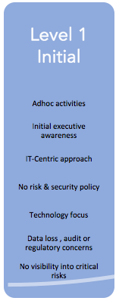
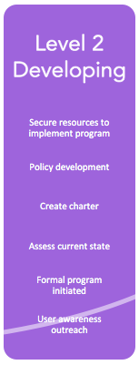
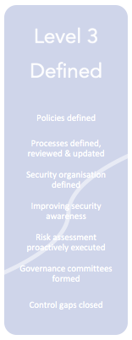
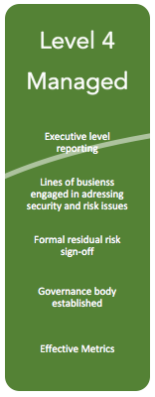
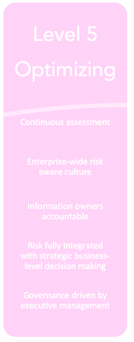
CURRENT SECURITY POSITION
Gartner Maturity model
Global NREN CEO Forum

