Slide 1
”Countries that lack natural population growth due to low birthrates and at the same time are major senders of immigrants to other countries face the severe risk of contraction of higher education institutions, stagnation within the education market as well as the labor market, and thus a decline in economic growth.”
Demographic Trends and Risks for European Higher Education
Fatma Mizikaci and Bernd Baumgartl

Slide 2

Up to University (Up2U)
Bridging the gap between schools and universities through informal education

Slide 3
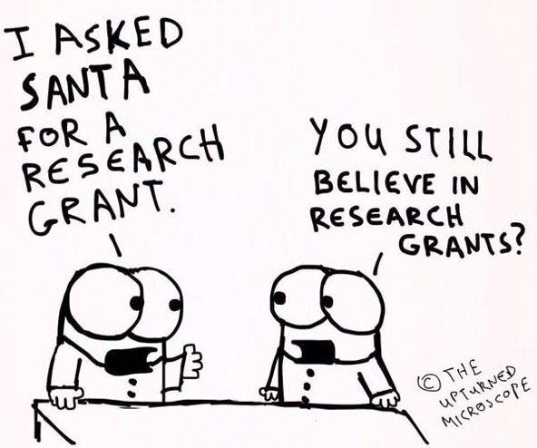

Slide 4
Motivations
The “Opening Up Education” policy of the European Commission was announced in 2013 to boost innovation and digital skills in schools and universities.
  The major statement of the policy was that about 63% of nine year olds in the EU are in schools that are still not digitally equipped although 90% of jobs will require digital skills by 2020.
The Net Children Go Mobile project study, funded by the Commission, concluded that, in all the European countries asked, daily Internet access is strongly differentiated by age, with older children having more access everywhere.
  Age differences, however, are more pronounced for private or mobile Internet use with teenagers aged 15-16 years old far more likely, about 84%, to access the Internet in their own bedroom.

Slide 5
EC Funded Project*
The key objective of our project is to bridge the gap between secondary schools and higher education and research by better integrating formal and informal learning scenarios and adapting both the technology and the methodology that students will most likely be facing in universities.
Innovation Action getting 5ME funding from the EC for 3 years
18 partners:
  Universities: OU, NTUA, UROMA, UVIGO, TAU, KTU, ISEP
  NRENs: GARR, GRNET, FCT, NIIF, IUCC, PSNC
  Research Infras: CERN, GWDG, GÉANT
  SMEs: ownCloud, TELTEK
Starting in January 2017...
*if Grant Agreement gets signed with the Comission

Slide 6
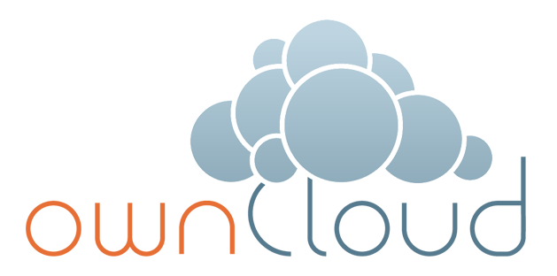



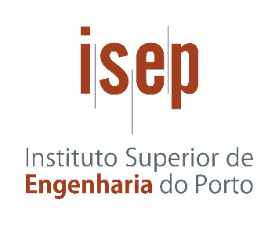









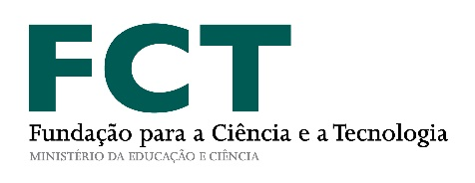
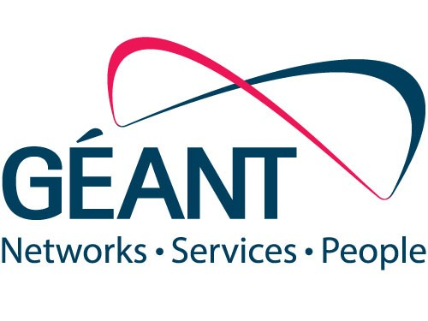
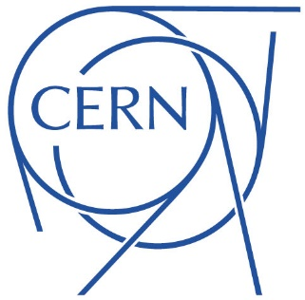


Slide 7
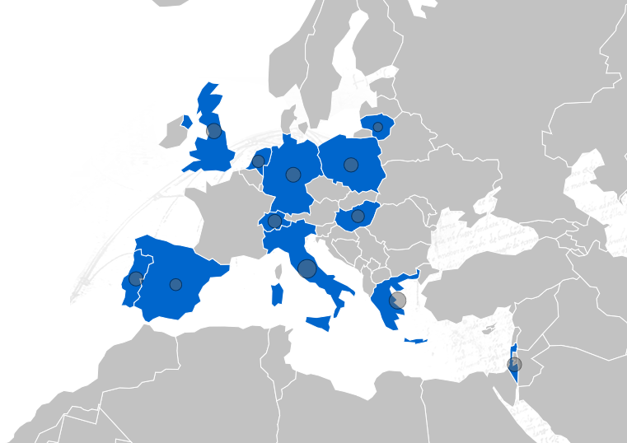

Slide 8
Target
Secondary schools, often referred to as high schools, which provide secondary education between the ages of 11 and 19 depending on the country
Intersection of formal and informal spaces, a dynamic hybrid learning environment where synchronous activities meet in both virtual and real dimensions
Develop an innovative Up to University (Up2U) ecosystem – based on proven experiences in higher education and big research
  open, more effective and efficient co-design, co-creation, and use of digital content, tools and services adapted for personalised learning and teaching
  address project based learning and peer-to-peer learning scenarios.

Slide 9









Up2U ECOSYSTEM
FORMAL LEARNING SPACE
INFORMAL LEARNING SPACE
LOR
Attend
INTERACTIVE LEARNING PATH
Search
LMS
Create
SIS
Assessment
Share
INFRASTRUCTURE
at school
in library
in museum
at home
on the go

Slide 10





Up2U ECOSYSTEM
FORMAL LEARNING SPACE
INFORMAL LEARNING SPACE
LOR
Attend
INTERACTIVE LEARNING PATH
Search
LMS
Create
SIS
Assessment
Share
’Always-on’ education
at school
in library
in museum
at home
on the go

Slide 11

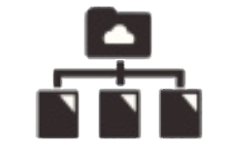


Up2U ECOSYSTEM
FORMAL LEARNING SPACE
INFORMAL LEARNING SPACE
LOR
Attend
INTERACTIVE LEARNING PATH
Search
LMS
Create
SIS
Assessment
Share
INFRASTRUCTURE
eduOER aggregation
WiFi eduroam
TO UNIVERSITY
Sync&Share ownCloud
’Always-on’ education
at school
in library
in museum
at home
on the go

Slide 12
Objectives
To assess the use of public and private cloud-based infrastructure services with proven track records in higher education and research, integrating and adapting them to the specific learning context of schools.
To design and develop a scalable and flexible integrated “application toolbox”, which supports student-driven, personalised, dynamic learning path creation with social sharing and interactions (i.e. project-based and peer-to-peer learning and assessment) on top of the abovementioned cloud-based service infrastructure.
To build and train the learning community for the specific learning context
To propose an executable roadmap for ensuring security and privacy.
To roll out and test the infrastructure service components and the application toolbox through very large-scale pilots
To develop, establish and operate a continuous risk assessment function
To define an effective sustainability and exploitation framework

Slide 13
Objectives
We are not going to reinvent the world.
Take what exists already and make it available in a larger scale.
  NREN infrastructure (”real” not ”e”)
  ownCloud based sync&share
  eduOER based search&find
  Integrated services on top...
Notes:
GTS

Slide 14
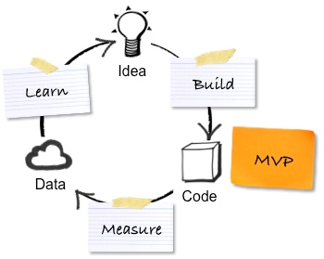
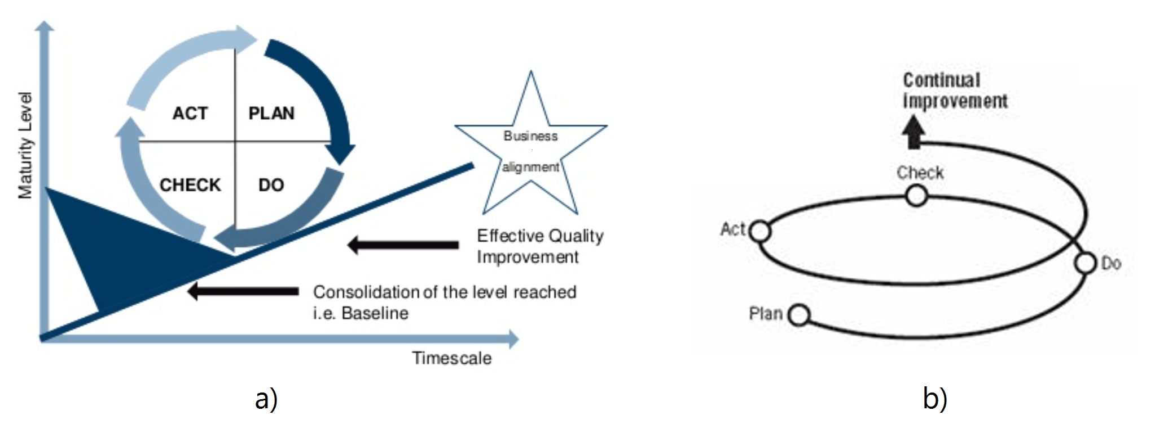
Methodology

Slide 15
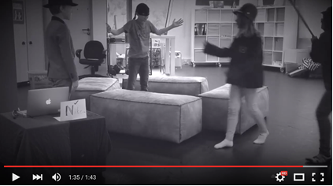
Local Use Case – Make it as a global experience...
Students were asked to form small groups, come up with ideas and agree on a short play to make into a silent movie.
Students recorded the movie using a mobile device (iPad), edited the video with online tools (iMovie), uploaded the final product to a video sharing platform (YouTube) and finally reflected on the results as part of their digital portfolio (stored in Google Sites).
Such a project based exercise develops skills related to communication, language, literature, science/technology, maths, PE, social skills, and giving presentations. The basic technology, cloud based applications and services are already there to support this principle.
Students perform a silent movie that they authored, directed, recorded and shared as a collaborative project

Slide 16
In conclusion
There has been no extensive study that investigates the intersection of digitally equipped but not digitally educated high school students in Europe.
  Technology aspects
  Pedagogical aspects
Formal and informal learning environment intersection is that our project proposal primarily addresses in order to create equal opportunities for students going to university.
Stay tuned until January 2017...

Slide 17
Statement
”We strongly believe that all the tools and services the project is going to use and/or make available (i.e. incorporate, design, develop and test) must be sustainable after the lifetime of the project.”
  business plans and investigate appropriate business models using the expertise of the Small Medium Enterprise and National Research and Education Network partners and their contacts with third-party business actors
  make it easy for new schools to join the Up2U infrastructure and ecosystem that will form a federated market-place for the learning community

Slide 18
Thank you!
Q&A
Peter.Szegedi@GEANT.org

Slide 19
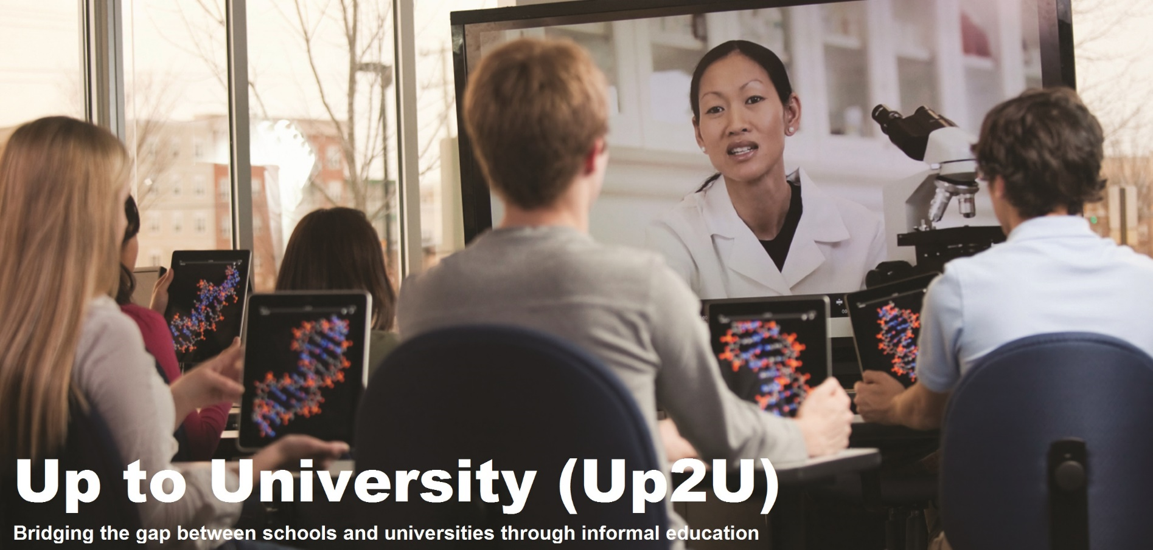

Slide 20

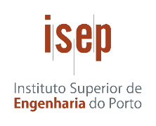



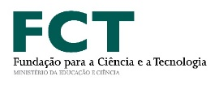




Pipeline model
    Students (Parents)
    Classes
    Teachers
    SCHOOLs
Reach out via NRENs, universities,
national government programmes,
or public/private foundation’s initiatives
UK
Spain
Lithuania
Italy
Portugal
Israel
Hungary
Greece
Europe
Germany
Poland

Slide 21






Existing tools & services
”Toolbox” for personalized learning paths to students o
Joint/Shared challenges can be created to groups of students
Rewards, ”digital badges” using blockchain, can be earned by students/groups
GOVERNMENTS
Platform for national competitions of Physics, Maths, Drama, etc.
UNIVERSITIES
SCHOOLS
LEARNING PATH
Modul 1
Modul 2
Modul 3
Modul 4
Universities can also setup and publish challenges to schools/classes/students.
Rewards can be given upon completion of a module or path and taken into account in case of enrolment to university.
School teachers must be trained on how to use the platform and its modules for better education.
School teachers sign up their class and create a shared ”learning path” or challenge for students
Modules can be dynamically picked from a ”widget library”
blockchain
Application services to be assessed and rolled-out
Plugged-in to the ”Toolbox” framework (i.e. made available in the ”widget library”)
Language
Added-value pedagogical aspects (project based learning, p2p learning)
Learning analytics on the specific learning paths or students’ progress
eBooks
Learning Analytics
SeLCont
Videotorium
xyz
WebTUT
DigiLab
xyz
Proven technology
xyz
eduOER
xyz
Jupiter
PuMuKIT
MOOCs
GTS
CloudShare
CERNbox
ownCloud
eduGAIN
eduroam
Okeanos
CONTENT
COMPUTE
OPEN DATA
Existing infastructue services hosted by project partners: GÉANT, GWDG, CERN, PSNC, GRNET
Integration, API development (where needed)

