Slide 1
Kick-Off GN5-1 WP5 T7
Distributed Identities
Christoph Graf, Switch
Tasklead GN5-1 WP5 T7
04&05 December 2023
Project Participants Sensitive (SEN)

Slide 2


Paul can we have an agenda slide?
Agenda
Expectations/Intros (see our wiki with your inputs)
Scoping our task
Proposed work plan
Collaboration (tooling, scheduling, etc.)
Administrivia (FTEs, etc.)
Next steps

Slide 3
Round-table introductions
See also: https://wiki.geant.org/display/GWP5/Who%27s+who+-+quick+intro
amineh.akhavan-saraf@lrz.de | Amineh Akhavan Saraf
christoph.graf@switch.ch | Christoph Graf
hardt@kit.edu | Marcus Hardt
maarten.kremers@surf.nl | Maarten Kremers
marina@sunet.se | Marina Adomeit
mohacsi.janos@kifu.gov.hu | János Mohácsi
niels.vandijk@surf.nl | Niels van Dijk
nliam@grnet.gr | Nicolas Liampotis
pempe@dfn.de | Wolfgang Pempe
ruiz_ben@dfn.de | Esther Ruiz Ben
slavek@ics.muni.cz | Slávek Licehammer
A couple of sentences on:
  Who you are
  Your affiliation
  Your interest in the topic
  What you might want to contribute

Slide 4
Scoping our task
A number of ”dimension” to look into
  A look at our Task in the Tech Annex of GN5-1
  Embedding SSI in our IDM big picture: why bother?
  Ripeness considerations: where to engage?
  SSI functional blocks: areas of interest?
  ToIP thematic fields: technical and/or governance?
  The USPs of GÉANT: where are we needed?
  What will our contribution be?

Slide 5
Our Task in the Tech Annex of GN5-1
See: https://geantprojects.sharepoint.com/:b:/s/gn5-1wp1/ERCbd1W7ia5KnYD-Lr37ztgBJ6uwwrS7GlGhEOZvSDl5LA?e=bSh0WK
Task 7: Distributed Identities (Task Leader: Christoph Graf – SWITCH)
There has recently been a strong movement to make the whole identity space more user-centric to allow users greater control of their identities (and other related information) and a more active role in the process of sharing their information with other parties.
This task will explore the use cases that would be better supported via distributed technologies and the implications on the current services and infrastructure used in the R&E community. Starting at M6 of the project, Task 7 will:
Review existing services to identify opportunities and challenges to adopt the distributed technologies paradigm.
Gather previous work done by the NRENs/universities on using SSI technologies, as well as other sectors.
Investigate implementation of distributed identities use cases and pilot them with the broader community and assess impacts and technological readiness.
Establish a communication channel with relevant existing initiatives in the NRENs and beyond (i.e., EBSI).

Slide 6
Scoping: IDM trends, how we look at SSI
Service
centric
Org-
centric
Inter-
federated
federated
User-centric
SSI
t
nationalAAI
eduGAIN
National edu-IDs
??
«Next big thing» in IDM-world ->

Slide 7
Scoping: Ripeness considerations and proposed positioning
Approach
Demos
(Click dummies/
Real tools,
personas)
Pilots
(Real tools, real
users, time limited)
MVP
(Real tools, real users, start small but extensible)
Production/DevOps
Ambition
t
Stakeholders get the idea
Learning, users feel the future
Engage users, add value & grow
Service
Potential positioning
Many players active, decide where to participate
Decide on our role and what to trial and what to bring into production

Slide 8










Scoping: SSI functional blocks
Conditions of participation
Rules of conduct
Proposed positioning: concentrate on areas we have a strong footprint already:
Exchange of data between organisations
Standardise protocols, formats & semantics
Set up governance for our sector
Probably not much on the wallet, as this is likely organised cross-sectorial
VC Verifiable Credentials
Proof of Credentials
VC
Holder
Proof
verification
DID Decentralized Identifiers
Detection quality
DID
DID
Data Protection & Privacy
verification
verification
Issuer
decentralized trust network
Verifier
Governance
technical scheme
Framework
registration
registration
Remuneration models
authorithy
Roles & Responsibilities

Slide 9
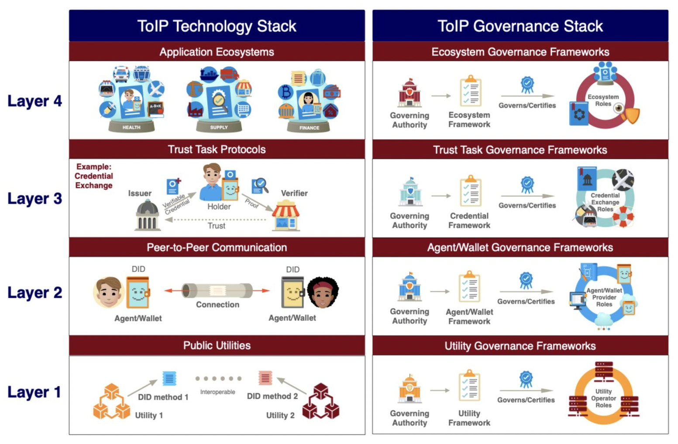
Scoping: technical and or governance (Trust over IP)
Proposed positioning:
Top candidates are the fields we are already active in, e.g. eduGAIN, Refeds and co.:
Layer 3 and 4 for the international NREN ecosystem
Re-use the established governance structures in the emerging SSI-ecosystem

Slide 10
Scoping: The USPs of GÉANT
Track record of setting technical and governance standards for the federated identity and access management framework in the academic and research community worldwide
  Test: pick two universities worldwide and we can show how they are connected with fat pipes and we can also establish a trusted path for resource sharing across our interfederation framework
GEANT has also a track record of maintaining this infrastructure and evolve it over time, including adding/replacing protocols used (SAML->OIDC)
GEANT has governance structure so that it can speak in the name of the NREN community and somehow combine the existing national structures into a international structure
GEANT has a track record in doing that on a technical level with the interfederation metadata collection and re-distribution mechanisms in place for long time
GEANT has also a track record in setting up and maintaining the governance for those services (committees for profiles and semantics, security profiles, etc.)

Slide 11
Scoping:
Scoping: What will our contribution be?
Proposed positioning:
Rather paper than services initially
Propose and validate our positioning towards SSI as a community
Propose engagements on appropriate levels (NRENs, GÉANT, others)
Spin-off activities, most likely elsewhere (e.g. T&I incubator)

Slide 12
Proposed initial work plan
Still in 2023:
  Workshop to discuss (preferably also validate) the scoping of the task (candidate dates based on doodle)
  Kick-off initial research topics as per the description of work:
    “Review existing services to identify opportunities and challenges to adopt the distributed technologies paradigm.”
    “Gather previous work done by the NRENs/universities on using SSI technologies, as well as other sectors.”
  Propose on first outline (TOC) of report in line with other WP5 deliverables (check with Marina)
In 2024:
  Continue to work on report
  Fill backlog for activities to pick up later

Slide 13
Our tooling for collaboration
Mailing list for info sharing and collaboration in Task: gn5-1-wp5-t7@lists.geant.org
Intranet: https://geantprojects.sharepoint.com/sites/gn5-1
  Project templates: https://geantprojects.sharepoint.com/sites/gn5-1/SitePages/Templates.aspx
  Onboarding guidance: https://wiki.geant.org/display/GW/GN5-1+and+GN5-IC1+Onboarding+Presentations+and+Guidance
  WP5: https://wiki.geant.org/display/GWP5/GN5+Trust+Identity
  WP5 T7: https://wiki.geant.org/display/GWP5/T7+-+Distributed+Identities
These Slides: https://wiki.geant.org/display/GWP5/Task+meetings

Slide 14
Administrivia
GN5-1 particularities:
  Familiar with your organisational accounting processes for time spent in this task? Aware of what your organisation agreed in terms of FTEs for 2023 and 2024?
  If not, we will take this up shortly (either as group or individually, after checking your needs)
  (editor note: sorry, most of this does not apply for me the same way…)
Known vacation plans?

Slide 15
Next steps and tasks
Set up bi-weeklies (Monday afternoon like this time? Doodle needed?)
Set up scoping workshop (looked promising in the poll: 20 Dec?)
Report TOC and check with other dependencies with Marina
Call for volunteers for the research topics as per the DoW:
  Review existing services to identify opportunities and challenges to adopt the distributed technologies paradigm.
  Gather previous work done by the NRENs/universities on using SSI technologies, as well as other sectors.

Slide 16
Thank You

