Slide 1
Data Center Interconnection (DCI) over Spectrum Sharing
CNAF-CERN
Paolo Bolletta
09/04/2024
14th SIG-NGN – Catania

Slide 2
Outline
Spectrum Sharing
DCI interconnection and L3 Overlay
Data Challenge

Slide 3







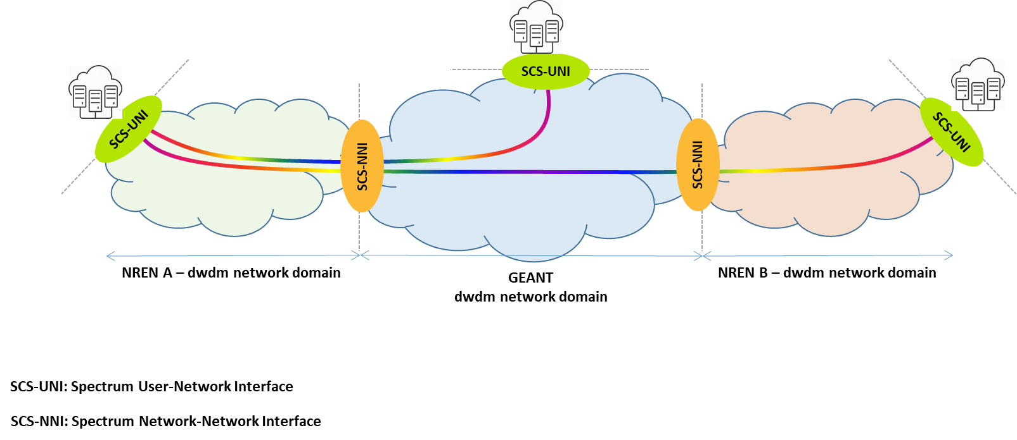



GEANT project and the Spectrum Connection Service (SCS) team
GÉANT network has been upgraded during last years.
A new Spectrum Connection Service (SCS) has been proposed in the GÉANT Network Evolution Plan
Activity started in GN4-3 WP7-T2 (SCS) and taken over in GN5-1 (NDS)
The SCS team
  has defined a service description
  is running field trials
  engages Users to run service pilots
Real Use Case CNAF-CERN:

Slide 4
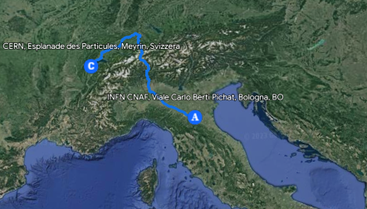




CERN – CNAF Data Centre Interconnection
Geneva
CERN DC
Bologna
CNAF DC
~ 1000 km
TRX
TRX
Add/Drop
Add/Drop
1.6 Tbps
        4 carriers
        DP-16QAM
        27% SD-FEC
        69 Gbaud
        75 GHz
GEANT
Open Line System
ROADM
ROADM
GARR
Open Line System
8x AMP
3x AMP
Milan PoP

Slide 5
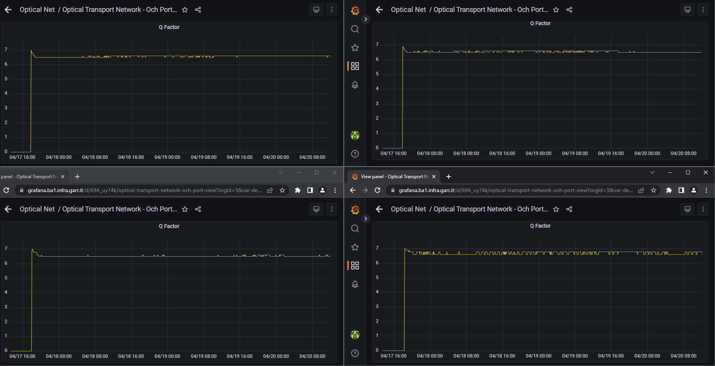
Quality of Transmission (Q-factor)

Slide 6
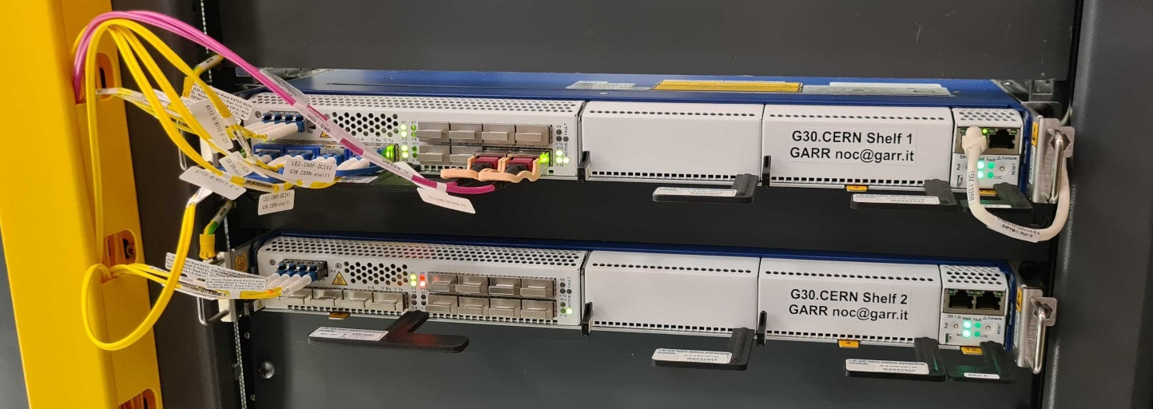
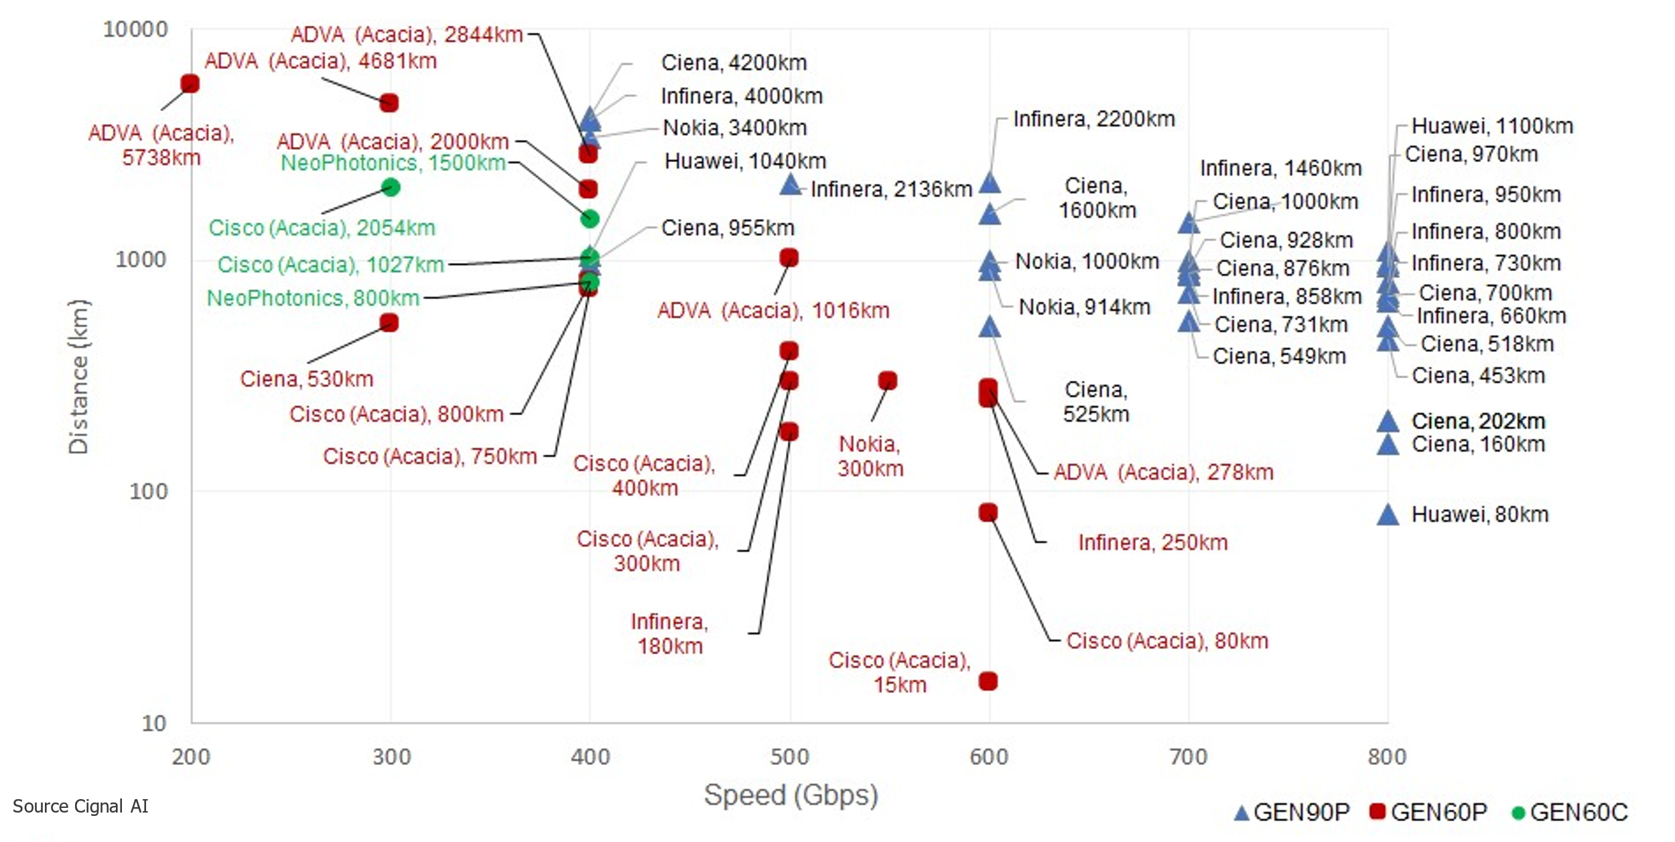
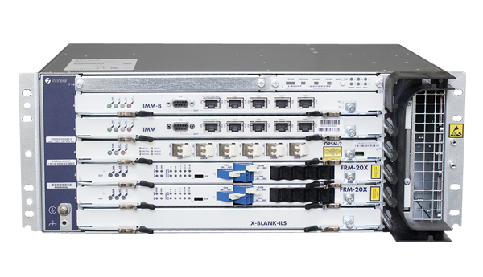
Enabling Technology
Disaggregated optical network:
Open Optical Line System (~10y life span)
Coherent optical interfaces (~3y life span)
  Transponders boxes
  Pluggable transceivers

Slide 7
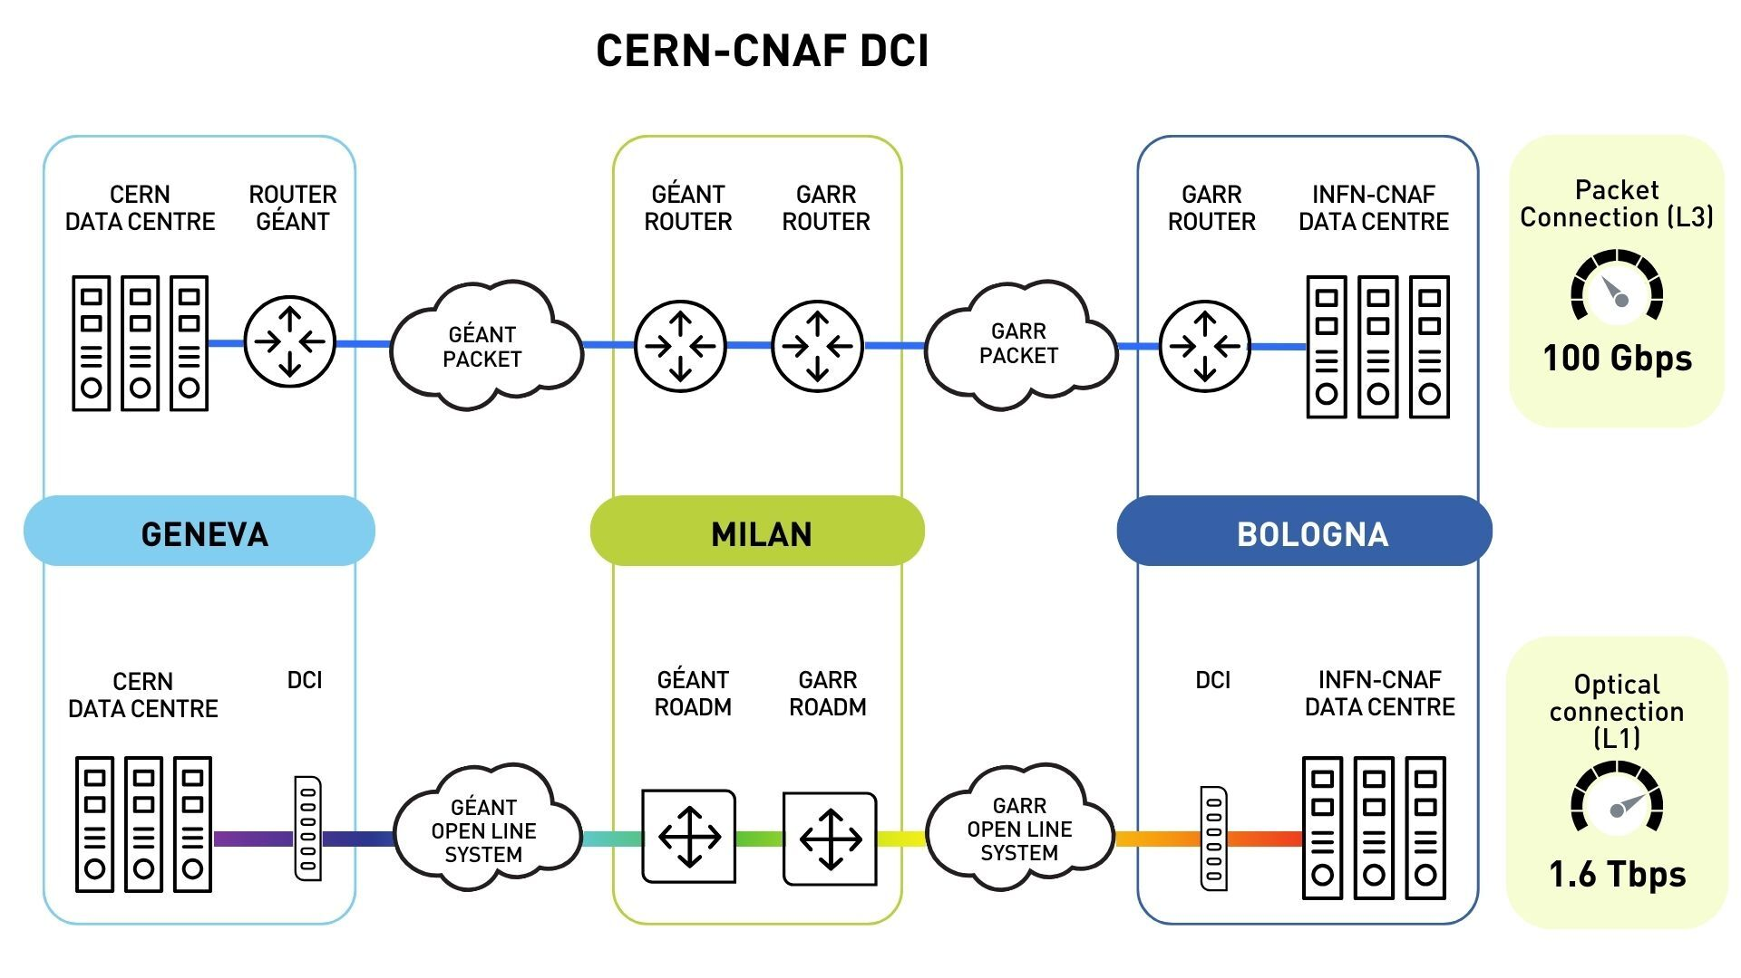
DCI LHCOPN [CNAF-CERN] L3 vs. L1
Before - L3
RTT: 15ms
After – L1
RTT: 9.5ms

Slide 8
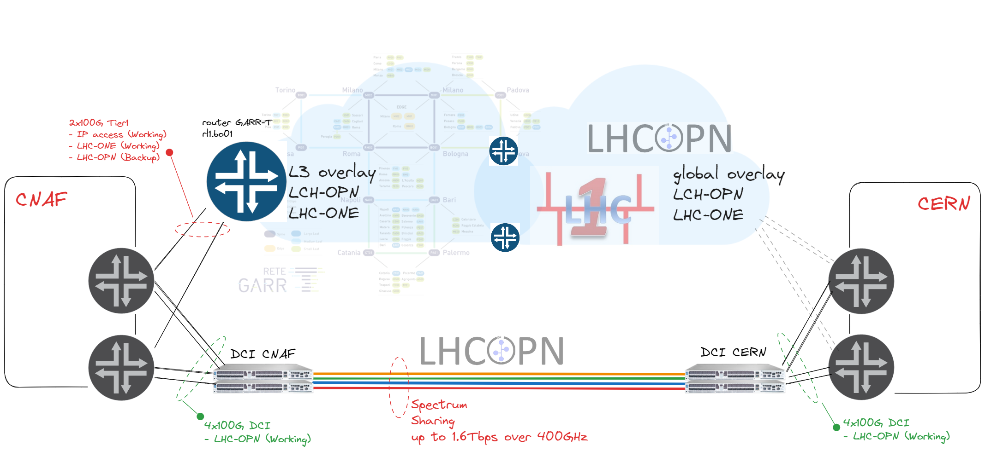
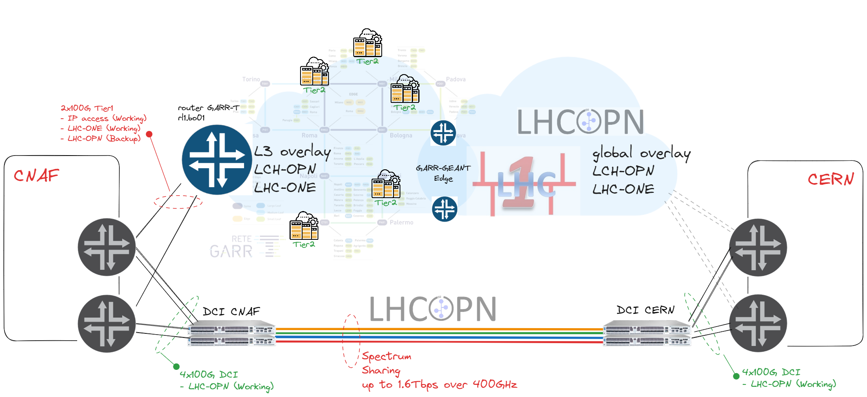


Overlay: full picture

Slide 9

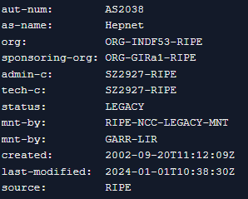
Overlay: full picture
Public ASN required for BGP direct peering between CERN and CNAF
as-path
2038 - 137 - 513
as-path
2038 - 513

Slide 10
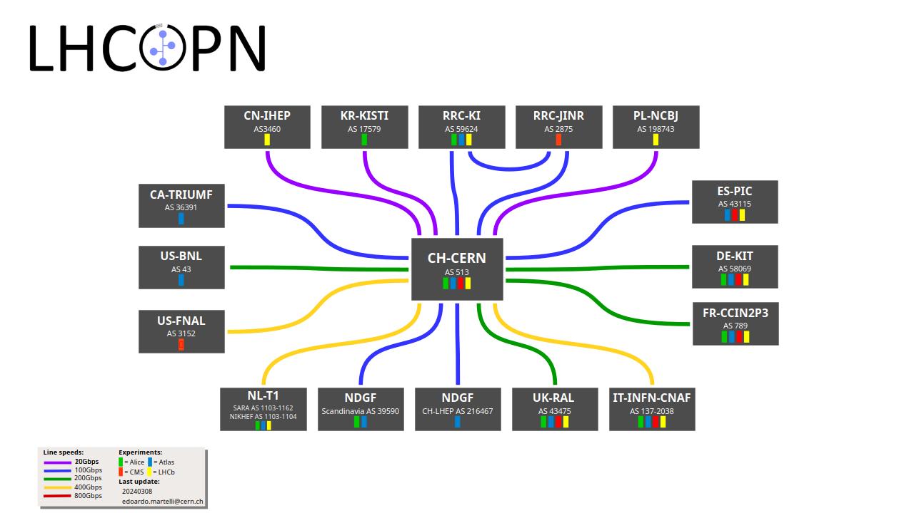
LHCOPN – complete picture
Credits: CERN-WLCG wiki

Slide 11

Data Challenge WLCG – [12-24/02/24]
From 12/02/24 to 24/02/24
Opportunity to verify if the network is ready and able to match WLCG needs and expectations
GREAT Opportunity to understand if a pure multidomain optical connection ( based on SCS) may be fully considered a stable and valid element in the WLCG networking
CNAF and GARR sprint aimed to include the new SCS connection as primary link for LHCOPN between CNAF and CERN
(T0 -->T1)
Decision to use SCS connection for DC24 early December 2023
By mid-January setup implemented, tested and fully operational
Image credits: AI MS-Copilot

Slide 12
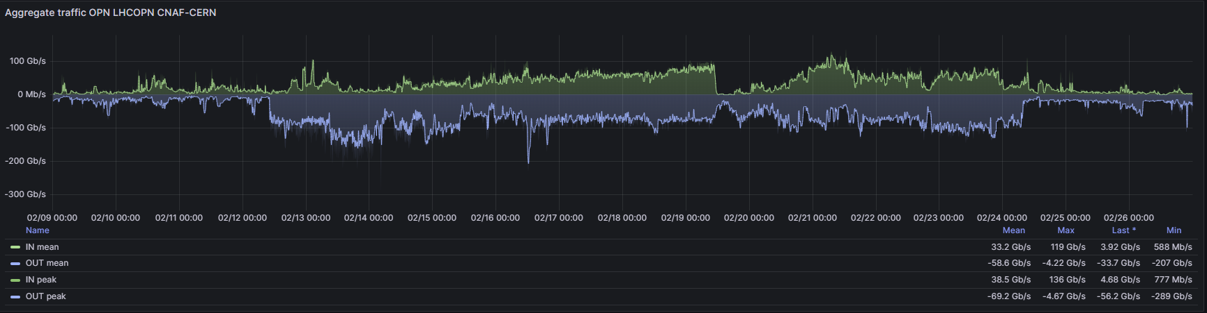
OPN DCI Spectrum Sharing – CNAF CERN Data Challenge
OPN DCI Max IN: 136Gbps Max OUT: 289Gbps

Slide 13
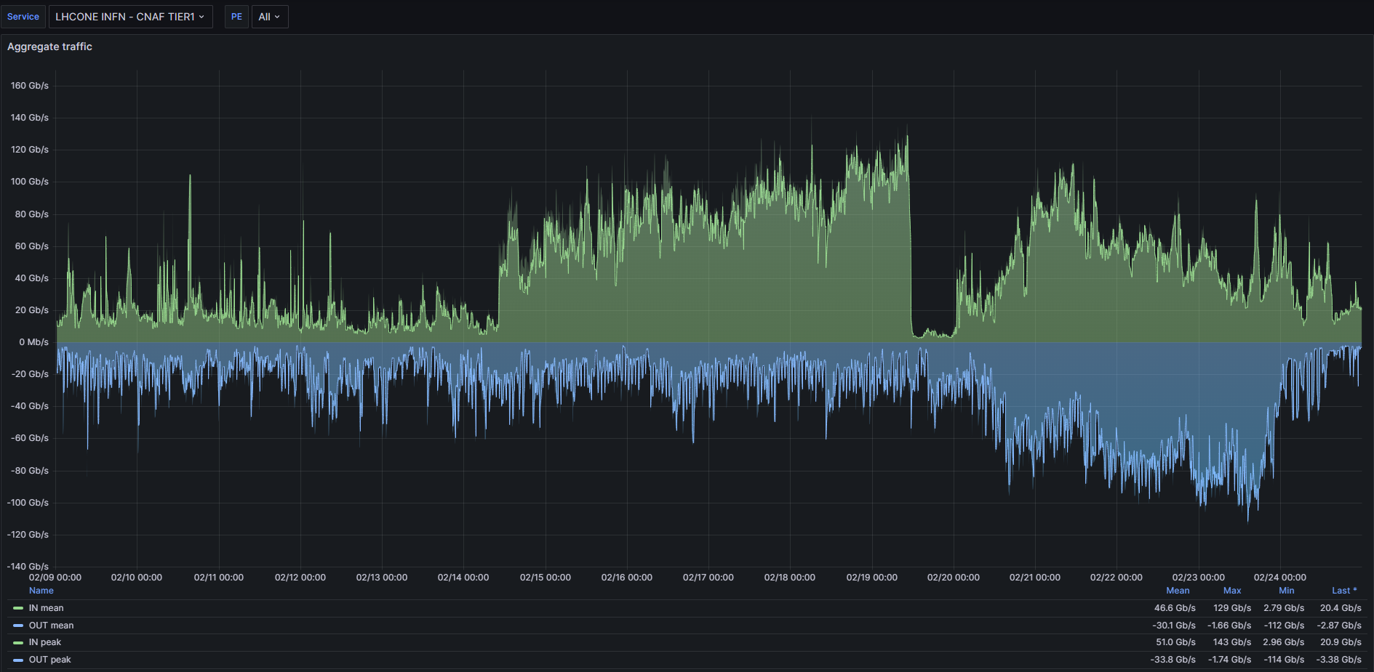
CNAF LHCONE VPN (L3)
LHCONE Max IN: 143Gbps Max OUT: 114Gbps

Slide 14
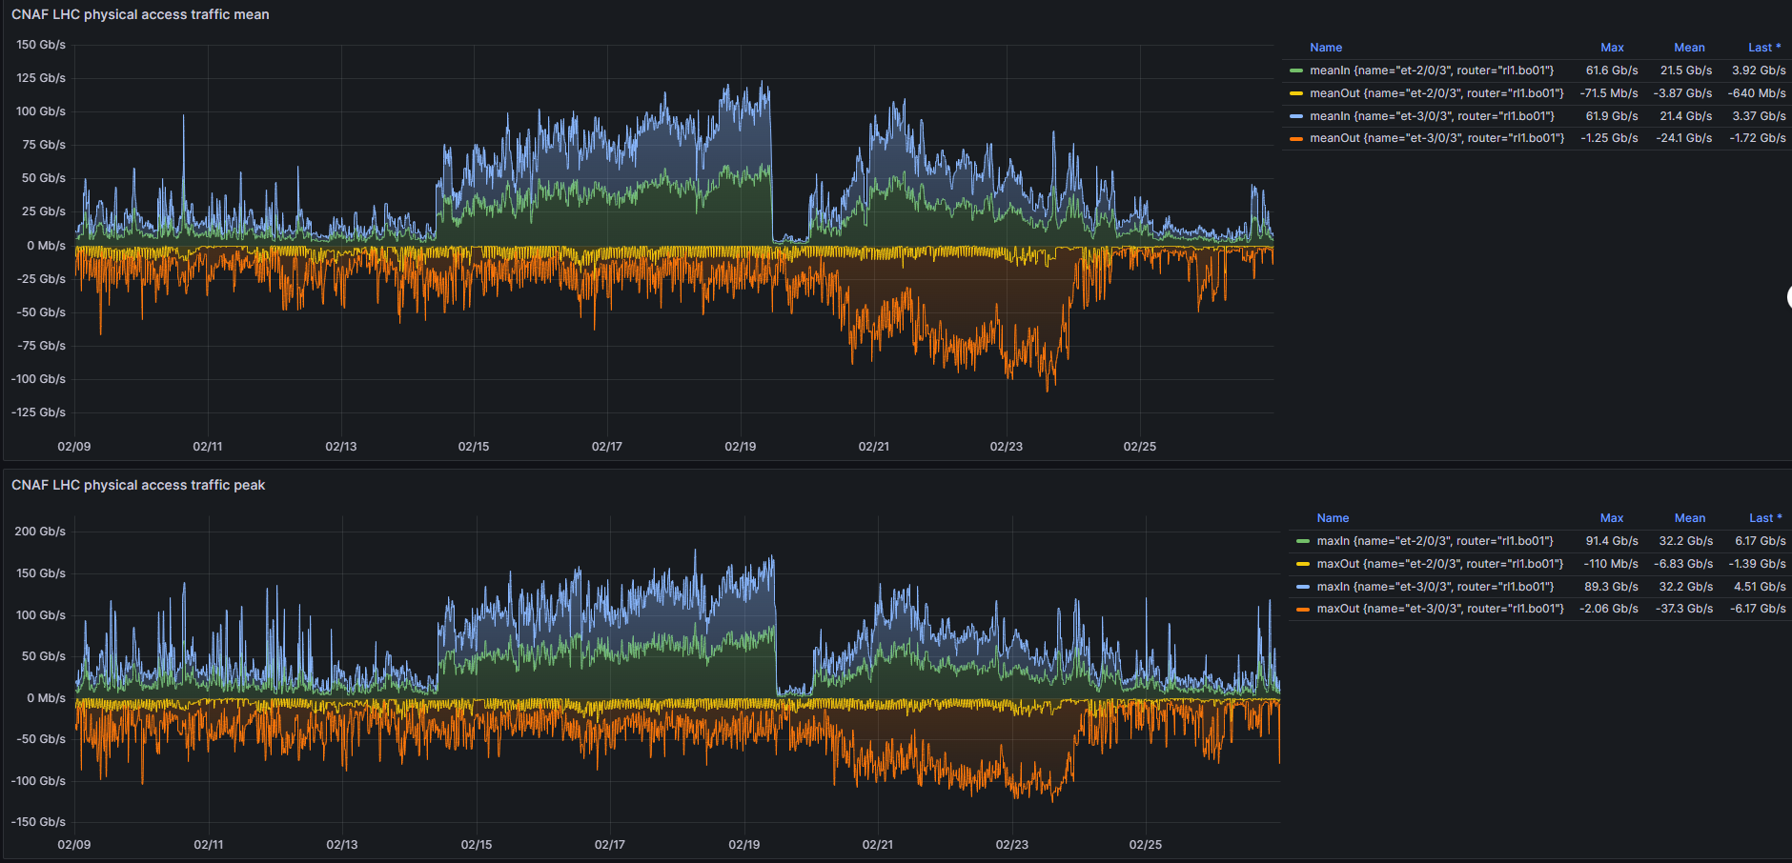
CNAF LHC physical interface

Slide 15
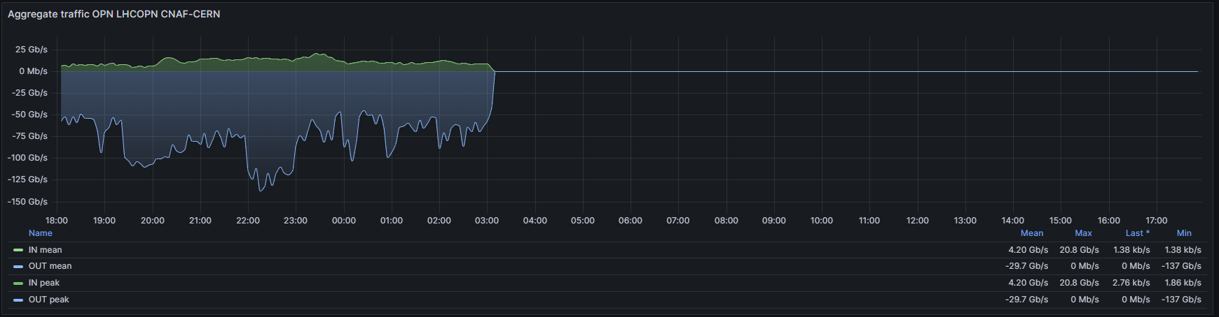
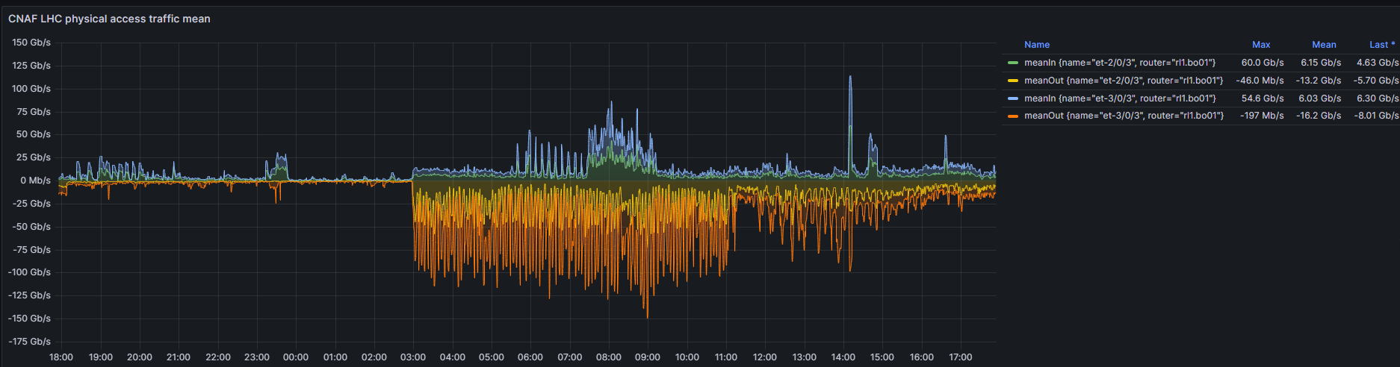
Failover
Fiber Cut

Slide 16
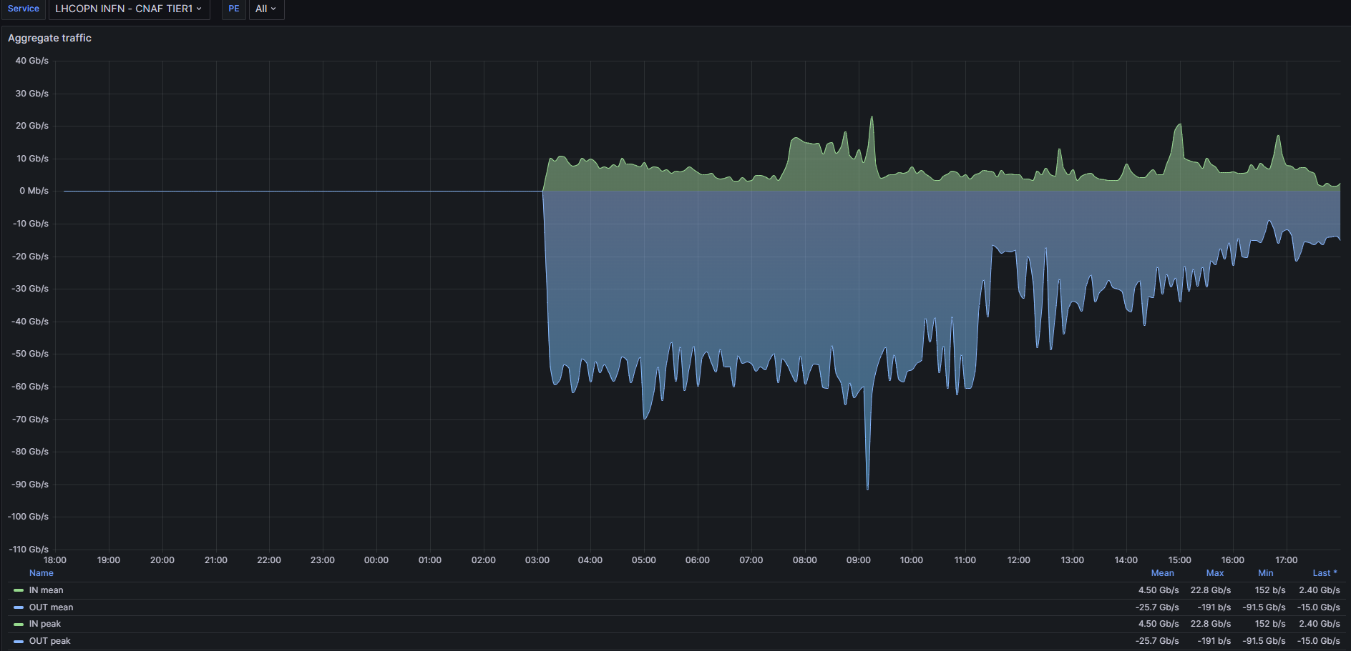
Failover
Fiber Cut

Slide 17
Next Steps
Pilot
400GEth interface evaluation
Satellite Sites integration
--> new site BO06@Tecnopolo
Network to Network interconnection (@MI01) standardization process with GEANT
3rd party Planning Tool (GNpy)
Production
Channel diversification in order to improve interconnection resiliency
GEANT Geneva ROADM setup reshuffling
Transition from Pilot to Production Service (ongoing)
  4 x 100GHz channels:

Slide 18


Conclusions
Solution ready to production and to scale-up and evolve
Network service model could be exported and adopted in other communities.
Pilot and development activities will continue
Alternative Cross Board Path should be investigated ?
Acknowledgments:
GARR Optical : Colantonio, Vuagnin
GARR Packet : Inzerilli, Marletta, Valiante
GARR DC & DevOps : Cesaroni, Chiarelli, Marzulli
CNAF Team: Zani, De Girolamo
CERN Team: Martelli
GEANT Team: SCS Team, Roberts
GARR Management/Amm/CTS
Contact:
paolo.bolletta@garr.it
infra.optical@garr.it
'image: Flaticon.com

