Slide 1

GÉANT Operations automation on perfSONAR
Ivan Garnizov ・ GÉANT / NOC pS systems engineer & perfSONAR Development Team ivan.garnizov@fau.de

Slide 2
GÉANT Operations OC team
GN OC team, led by Tony Barber
  Network management and incidents
    Support perfSONAR
  Security incidents
  First line support team
Single point of contact: (support@oc.geant.net)

Slide 3
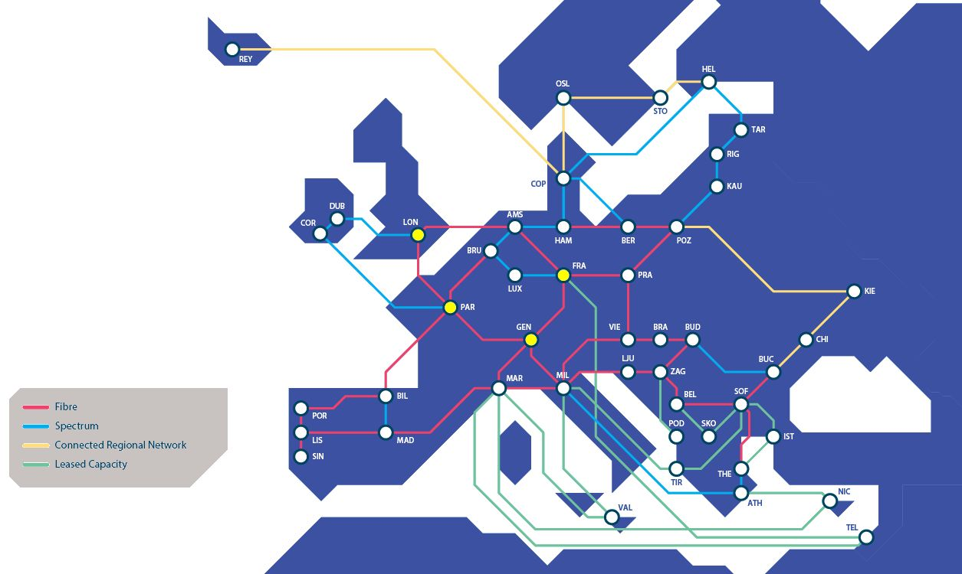
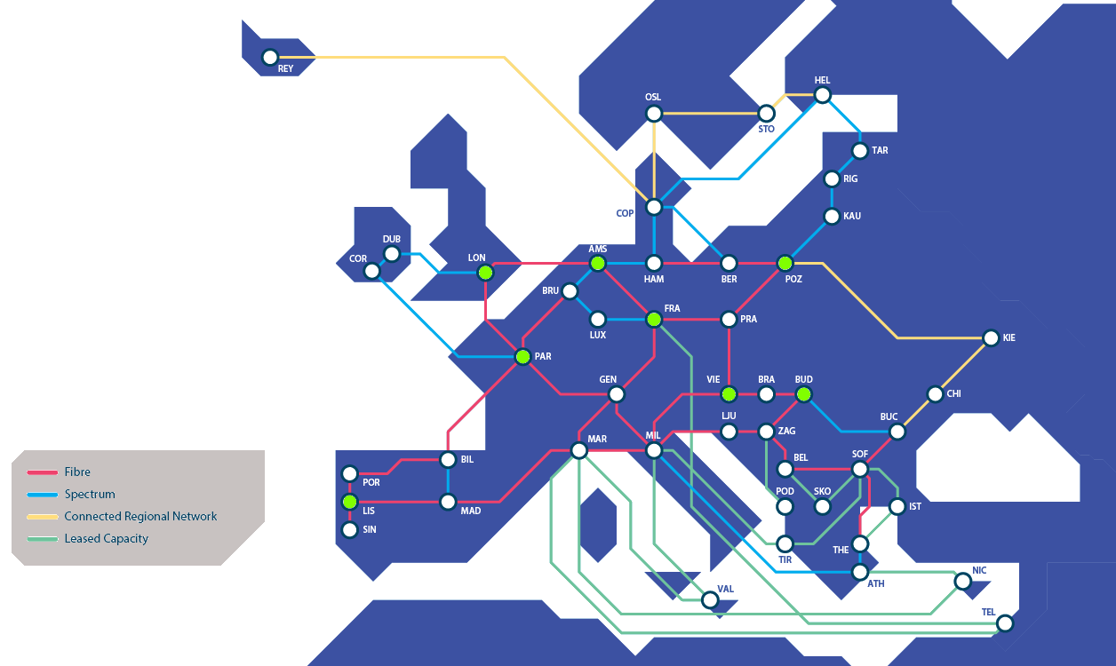


GN Backbone and pS deployment PoPs
GÉANT backbone
R&E available servers
LHC VRF available servers

Slide 4
pS server hardware deployment
Servers are 10Gb/s capable
Interfaces
  Physical
  VLAN
Assignments
  Management: psmp-gn-mgmt-par-fr.geant.org
  Latency: psmp-gn-owd-par-fr.geant.org
  Throughput: psmp-gn-bw-par-fr.geant.org

Slide 5
perfSONAR configuration management
Puppet based automation
  cooperation between OC, DevOps, IT, Network Implementations
  modules based collaboration with Git backend
  applies T/U/P model for code
  management separation and sharing with DevOps
  Overlappings
  Template management in 2 stage
  Inheritance and overruling

Slide 6
Main areas
Software versioning
OS specific customizations
Firewall
pScheduler
pSconfig
Lookup service

Slide 7
Software versioning
Repository snapshots
Deployment version control for rebuilds and new servers
perf_role::perfsonar::psrepo: '5.0.8'
'perfsonar_focal': os_release => '20.04', repo_name => 'perfsonar', snapshot_purge => ['04.09.2023'], snapshot_names => ['5.0.6', '5.0.8'], deb_line => 'deb http://downloads.perfsonar.net/debian perfsonar-release main';

Slide 8
OS specific customization
VLAN, IP, Hostname
Source routing
Disk partitioning LVM
System optimizations
  Network card
  TCP stack

Slide 9
FW configuration
Based on service descriptions
Interface assignments to service descriptions
Strict FW Ingress and Egress management
  Egress (source port & destination port)
Issue
  pScheduler schedule

Slide 10
pScheduler Limits
Limits configuration
  Identifier (which other)
  Limits
    automatic rules for generic interface assignments
  Applications
  Priorities

Slide 11
pSconfig management
Management of multiple pS mesh sources
  Inheritance
  (De)activation of measurement archive
Default measurement archive
  pScheduler task param
  Inheritance
  (De)activation of measurement archive

Slide 12
Lookup service configuration
All fields managed
Specific interface registrations:
  http://35.223.142.206:8090/lookup/host/4211b758-2671-4dae-a7f9-5b4e61bfd265

Slide 13
Questions? ivan.garnizov@fau.de

