Slide 1
Quality Assurance for perfSONAR
Adriatik Allamani (RASH)

Slide 2
Github repository for QA
Automated/virtualized quality assurance tools; system integration testing, service sanity checks
This includes these components:
Integration test tools - Automated testing of bundle installs, upgrades, etc. - virtualized (docker/vagrant)
Sanity Checking - sanity checking for QA testing. Checks that services are running/available, webservices are correctly loading/responding, expected ports are open, etc.
  Run on demand or automated
  Includes a dockerised ELK environment for archiving/visualizing results

Slide 3
https://github.com/perfsonar/quality-assurance
Three main components:
  integration-testing
  pscheduler-crawler
  sanity-checking

Slide 4
sanity-checking
Building:
  docker build –t sanity .
Running:
docker run --privileged --name sanity --network host --rm sanity
SINGLE
docker build -t single-sanity -f Dockerfile-single .
docker run --privileged --name single-sanity --network host --rm single-sanity

Slide 5
integration-testing
This project provides ways of performing installation/integration testing on various parts of perfSONAR using virtual environments.
These modules create fresh OS environments (container or VM), install the relevant components from scratch, making sure that no errors are encountered in the process. Next, optionally, additional sanity checks are run before tearing down the temporary containers.

Slide 6
bundle-deb-install-tests
Testing perfSONAR installation on Debian and Ubuntu
OS Support
  Debian 10 Buster
  Debian 11 Bullseye
  Ubuntu 18 Bionic Beaver
  Ubuntu 20 Focal Fossa
  Ubuntu 22 Jammy Jellyfish
Running the script
  The script attempts to install a perfSONAR bundle and then perform sanity checks using the sanity-checking scripts.
  Can run the tests by executing
    test_install_instructions.sh -r $REPO -o $OS -b $BUNDLE

Slide 7
bundle-deb-install-tests
$REPO is one of these:
perfsonar-release (production)
perfsonar-patch-snapshot
perfsonar-minor-snapshot
perfsonar-patch-staging
$OS is one of these (default to test all):
debian:buster
debian:bullseye
ubuntu:bionic
ubuntu:focal
ubuntu:jammy
$BUNDLE is one of these (default is tools an testpoint as only those are supported on Debian and Ubuntu at the moment)
perfsonar-tools
perfsonar-testpoint
perfsonar-core
perfsonar-centralmanagement
perfsonar-toolkit

Slide 8
Main files
Dockerfile, docker-compose.yml, docker-bake.hcl
  for building and running the images
  copy ps_install_bundle.sh to the containers
test_install_instructions.sh
  for running the tests
ps_install_bundle.sh
  Run within the container and test pScheduler

Slide 9
test_install_instructions.sh
REPO="perfsonar-release"
declare -a OSimages=("debian:buster" "debian:bullseye" "ubuntu:bionic" "ubuntu:focal" "ubuntu:jammy")
declare -a BUNDLES=("perfsonar-tools" "perfsonar-testpoint" "perfsonar-archive" "perfsonar-core" "perfsonar-toolkit" "maddash")
We build the images from $OSimages
Then test $BUNDLES within $OSimages with ps_install_bundle.sh
enable debug mode (-D) if you want to drop into a shell after the failed install.
Stop the containers and log the results for each test

Slide 10
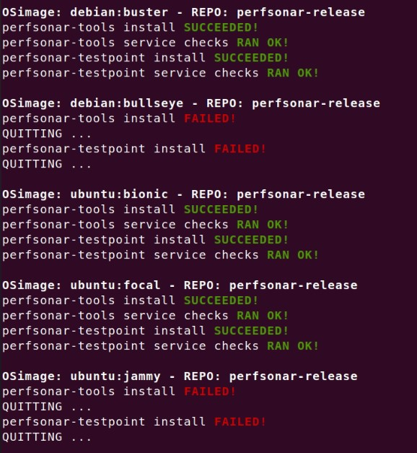

Slide 11
bundle-rpm-install-tests
Dockerfile, docker-compose.yml, docker-bake.hcl
  for building and running the images
  copy ps_install_bundle.sh to the containers
test_install_instructions.sh
  for running the tests
ps_install_bundle.sh
  Run within the container and test pScheduler

Slide 12
feature-MNGScriptDevelopment branch
Developed by Mark Golder
  Improved docker bake and docker compose setup for 5.0.0 testing.
  Adding a pscheduler-api debug script to use in testing image when install or test failed.
  Improved text output and logging to files instead of stdout. Test specific OS and specific bundle through CLI arg.
  Using getopts to make testing script cleaner.
  The output and logs of the tests are more organized and fancier.

Slide 13
Merging files to create 1 folder
docker-compose.yml, docker-bake.hcl
  Can be merged and added content for deb and rpm
  copy ps_install_bundle.sh to the containers
Dockerfile, ps_install_bundle.sh
  Different set of commands dedicated for deb or rpm packages
test_install_instructions.sh
  Same content and instructions, must direct deb to deb instructions and rpm to rpm instruction files

Slide 14
Challenges
docker-compose.yml, docker-bake.hcl
  Merged the content of rpm and deb in one file. Still not working, centOS containers not starting
  Did some test using different files and declaring them in instructions (Dockerfile-rpm and docker-compose.rpm.yml).
test_install_instructions.sh
  Tested some options to run deb and rpm with the same file, some issues to be fixed.

Slide 15
Results
Merge folders bundle-deb-install-tests and bundle-rpm-install-tests and have one folder to run with one command for all the tests
To have 1 test_install_instructions.sh file and execute all the tests for all given OS and Bundles.
Add testing for Alma Linux and other OS in the future
  Customize the files to be compatible for required OS

