Slide 1
SIG-Transnational education
Inaugural meeting
Esther Wilkinson
Transnational Education lead, NA3 Task 1, GÉANT
Head of International, Jisc
TNC17
31 May 2017

Slide 2
Transnational education and mobility
Transnational education (TNE) is the provision of education for students based in a country other than the one in which the awarding institution is located, e.g. students based in country X studying for a degree from a university in country Y
  Type of TNE Activity
  Overseas branch of UK awarding institution (‘branch campus’)
  Overseas partnership
    - students registered at UK institution
    - students registered at overseas institution
  Distance/online learning (may involve in-country support centre)

Slide 3
Context and session objectives
GÉANT funded area of work – importance of supporting transnational education and mobility with technology requiring global infrastructure and services
Past sessions at APAN 2016, TNC16, Internet2 Global Summit 2016, China America Network Symposium 2015 and 2016, and ASREN e-Age 2015 to share experiences, best practice and case studies
Established GÉANT SIG for TNE led by Steering Committee:
  CERNET (Wan Li)
  Internet2 (Urszula Chomicka)
  GARR (Claudio Allocchio)
  Jisc (Esther Wilkinson)
  SURFnet (Alexander van den Hil)
Workshop held at Internet2 Global Summit (April 2017) to identify key challenges and opportunities for working together
Notes:
Although we are talking about international education here, there are also members here who have been discussing ICT in education, so its important we can identify areas of overlap and synergy

Slide 4
The ‘Big Issues’
TNE data – regional, national and global – what exists now and how do we obtain it? What more do we need?
Global TNE policies (the strategic challenge) – how do we develop consistent policies to support TNE, e.g. connectivity and services, charging models?
Technology barriers and TNE service development (the operational challenge) – interoperability, measurement, what will a service bundle look like, for both NRENs and the institutions we support?
Tools, toolkits and resources - what is in development/do we need to develop to help us share information and support TNE, for both NRENs and the institutions we support?
Notes:
These are the four big issues that we identified as a SC from the I2GS meeting
Today what we want is your endorsement of these as the four issues to initially address, and your help in scoping these out and contributing to the workstreams
Important to consider the different audiences – this was the basis for our work last time.
Different perspectives and different audiences
Sending NREN
Receiving NREN
NREN developing TNE support
Education institution delivering TNE
Possibly also policy stakeholders and government in country – those we may need to influence

Slide 5
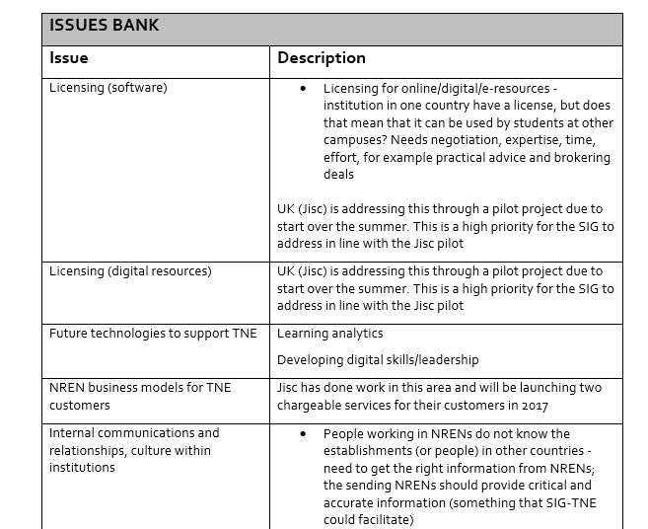
Issues Bank
Notes:
Other issues that we are capturing but are not part of the four priorities we’re ‘parking’ in an issues bank - we’ll develop this as part of the SIG to inform our future work
So for example one other ‘big issue’ is that of licensing overseas – both software and digital resources. But not timely to address this work now as Jisc are already working on a pilot project on this which will inform the SIG-TNE work at a later date

Slide 6
Outputs: SIG-TNE Workplan
Item No | Activity title | Activity detail | Deliverables | Responsible | Stakeholders (Global, National, other SIGS, NRENs, etc) | Timescales/ milestones
1.
2.
3.
4.
5.
Notes:
Three to five activities in each workstream (led by a Steering Committee member)
Scope of each activity
What will the activity deliver
Overlaps and synergies with other areas
Stakeholders – e.g. Global, National, other SIGS, NRENs, etc
Timescales

Slide 7
Contact: esther.wilkinson@jisc.ac.uk

