Slide 1
Workstream 4: Tools, toolkits and resources
Esther Wilkinson
Transnational Education lead, NA3 Task 1, GÉANT
Head of International, Jisc
TNC17
31 May 2017

Slide 2
Scope: Tools, toolkits and resources
To identify tools and resources already in existence to enable NRENs to support TNE, individually and globally and enable accessibility
To develop a suite of tools and resources to enable NRENs to support TNE, individually and globally and enable accessibility
To understand requirements of tools and resources to more directly support education institutions or policy stakeholders in the NREN country
Notes:
Whats out there that we can share
What do we need to develop – for you; - for your education sector and stakeholders
So have some examples on whats already out there to provoke discussion on what we need to do next
This is also where audiences become important – what are we developing for who

Slide 3
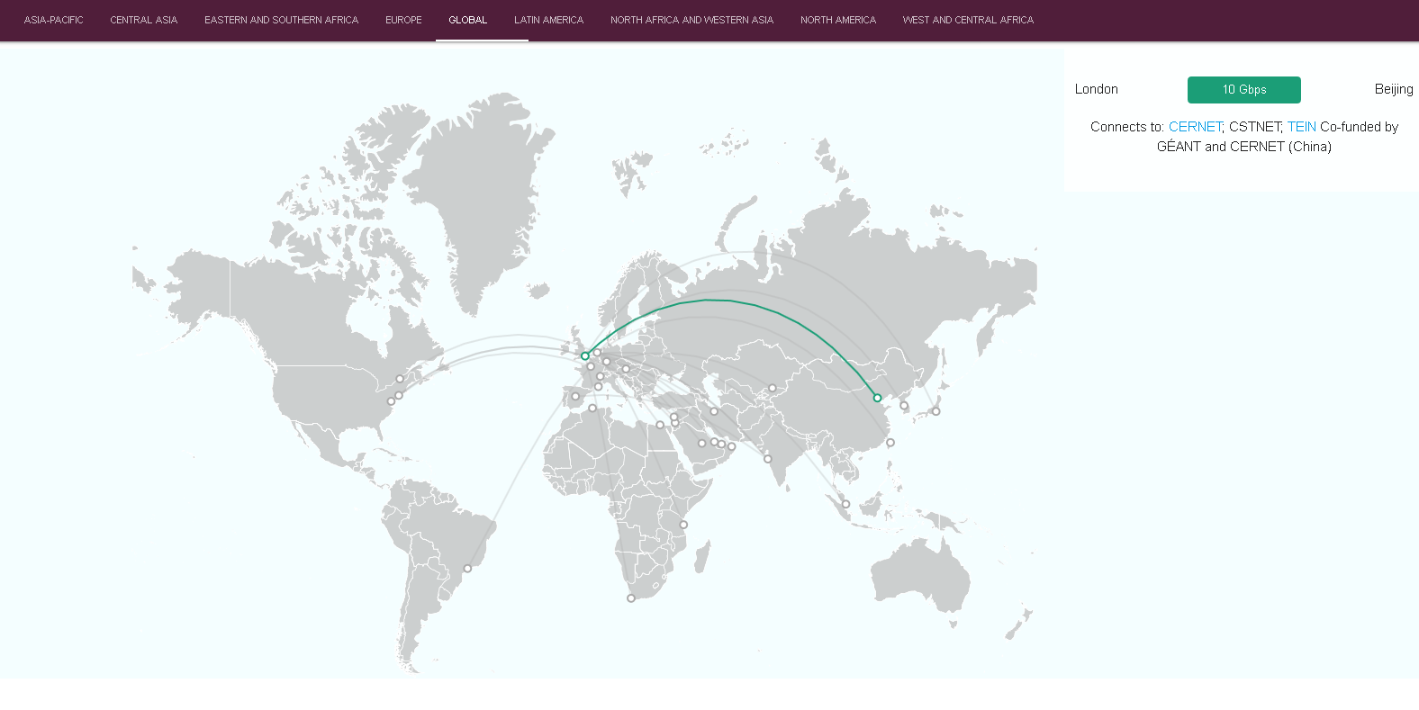
Example: GÉANT Interactive Connectivity Map
Audience: global NRENs, policy stakeholders, education institutions
Go-live shortly at map.geant.org
Further development work planned on TNE by Jisc and Global REN CEO Forum
Overlays to include:
  NREN contact details and connection policies
  Local ISP connectivity and contact details
  TNE activities (both sending and receiving)
  Regulatory and policy information including British Council ‘Global Gauge’
  Quality assurance information
Notes:
The Global Gauge is an interactive higher education policy monitor to be used alongside ‘The shape of global higher education’ research reports.
This study identifies three areas where national governments can provide an enabling environment to their higher education institutions to internationalise and forge collaborations:
a) Openness: government-level commitment to internationalisation; environment enabling international mobility of students, researchers, academic programmes and university research;
b) Quality assurance and recognition: A regulatory environment to facilitate the international mobility of students, education providers and academic programmes.
c) Access and sustainability: Promoting student/academic mobility and international research collaboration; consideration of possible unintended consequences of internationalisation.

Slide 4
Example: UK (Jisc) TNE Tech Special Interest Group
Audience: UK education institutions (both higher and further education)
Established in March 2016, made up of representatives from UK HEIs (including IT, library leads, academic leads, coordination roles and international departments ) as well as TNE policy leads across the sector (Quality Assurance Agency, Universities UK international, British Council, Association of Colleges)
Current membership: 34 representatives from 23 HEIs (and expanding)
Building a network to share best practice, provide peer to peer advice
Discussion topics have included: the future of TNE/TNE 2.0; support packages for TNE; overseas licensing
Initially tasked with developing a toolkit to support delivery of TNE due to be published summer 2017
Notes:
Sector group being established in UK

Slide 5

Example: Jisc TNE Toolkit
Audience: UK higher education institutions
Developed in response to community demand
Developed by the Jisc TNE Tech SIG
Launched in summer 2017
Toolkit will:
  Share advice and best practice
  Highlight common challenges
  Provide country-specific information
Will be developed into online tool and become part of Jisc ‘TNE offer’
Notes:
Simple checklists for an NREN to consider (and for an education institution to consider) when embarking on establishing and supporting TNE
Country specific info – this is where we can all work together to help develop this.

Slide 6
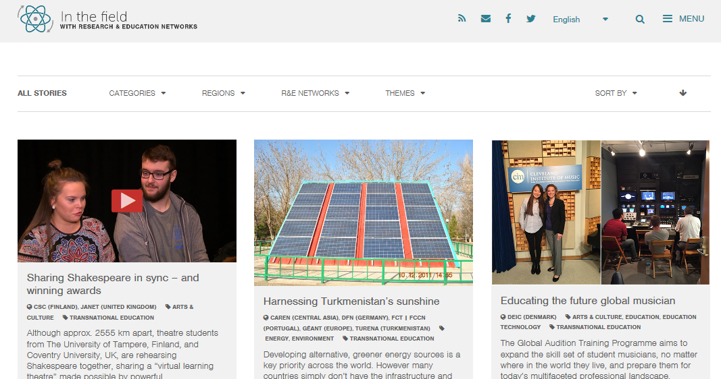
Example: ‘In the Field’
Audience: global NRENs, policy stakeholders, education institutions
Handful of case studies on TNE – more needed!
Notes:
Case studies

Slide 7
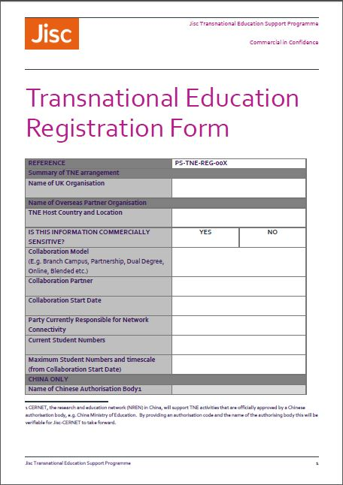
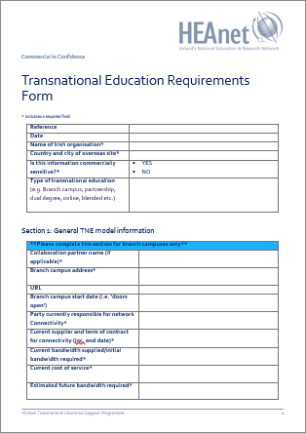
Example: TNE Registration Form
Audience: global and regional RENs
Operational tool for (N)RENs to capture appropriate information and contacts to support and TNE
Adapted and adopted for HEAnet
Jisc working on online form to make ‘application’ to (N)RENs
Notes:
An example of efficiencies

Slide 8
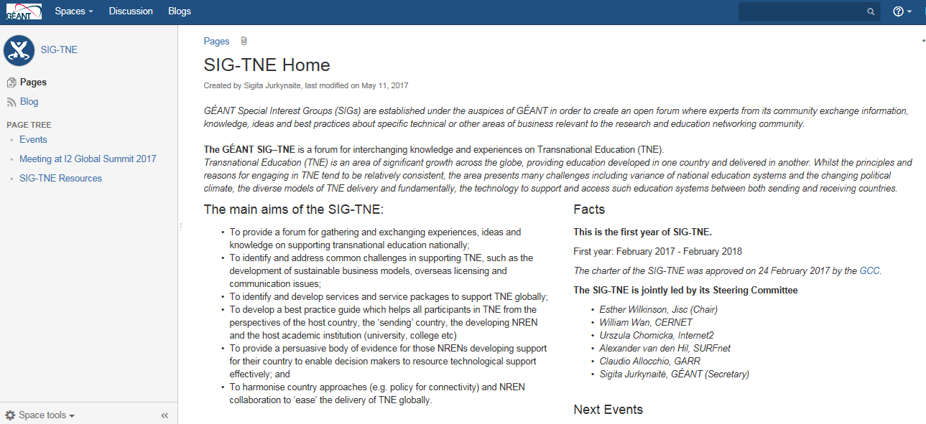
GÉANT SIG-TNE Wiki
Audience: global and regional RENs, education institutions
Access to past TNE sessions, reports and presentations
Resources: articles and blogs, reports and case studies, links and websites, other groups
Events past and future
Notes:
Made a start on this already
UK focussed but broaden out more globally
Needs input from you

Slide 9
Scope: Tools, toolkits and resources
To identify tools and resources already in existence to enable NRENs to support TNE, individually and globally and enable accessibility
To develop a suite of tools and resources to enable NRENs to support TNE, individually and globally and enable accessibility
To understand requirements of tools and resources to more directly support education institutions or policy stakeholders in the NREN country
Notes:
Whats out there that we can share
What do we need to develop – for you; - for your education sector and stakeholders

Slide 10


Next steps for SIG-TNE
Steering Committee to develop SIG-TNE Workplan based on todays discussions and share on SIG Wiki
Survey SIG-TNE members on Workplan contents and call for contributors
Plan and communicate next meetings of SIG-TNE every six months (on or around November 2017, then TNC18
Continue to develop SIG-TNE Wiki site resources
Continue to communicate!
Notes:
Any further comments or questions?

Slide 11
Contact: esther.wilkinson@jisc.ac.uk

