Slide 1
TNE Special Interest Group Meeting - May 31
TNE data: regional, national and global
What exists now… and how do we obtain it?

Slide 2

TNE data is … complicated
We speak of:
transnational education
crossborder education
borderless education
offshore education
Source: British Council and DAAD report “Transnational education data collection systems: awareness, analysis, action”
https://www.britishcouncil.org/sites/default/files/1.1_report_tne_data_collection_system.pdf
Notes:
To refer to one concept: Program/provider mobility

Slide 3
Or…
joint
double
dual
multiple
tri-national
cross-national
integrated
collaborative
international
consecutive
concurrent
co-tutelle
overlapping
conjoint
parallel
simultaneous
common
degree programmes
Source: British Council and DAAD report “Transnational education data collection systems: awareness, analysis, action”
https://www.britishcouncil.org/sites/default/files/1.1_report_tne_data_collection_system.pdf
Notes:
To describe the phenomenon of local/foreign collaboration in the joint design and delivery of an academic programme in a host country, we use these terms:

Slide 4
Wait….
Programme… or program??

Slide 5
TNE data – why is it so complicated?
-Linguistic differences
-Cultural differences
-Regulatory differences
-Methodology differences
-Classification differences
… and many others
There is no one central body that collects this data, so there is no one universal TNE data system!
Notes:
Linguistic; As demonstrated earlier
Cultural: Trust – what are you going to do with the data? Competitiveness.
Regulatory: Not every country is required to collect information (and not every institution – it may depend on the status of the host campus)
Methodology of data gathering: Some use numbers provided by HEIs themselves, others do surveys, still others collect the information on their own
Classification: Not everyone uses the same criteria to distinguish different kinds of programs/initiatives/collaborations.

Slide 6

http://epicpew.com/how-saints-disappointment/

Slide 7
NREN TNE data collection
Just two examples today:
-Jisc (UK)
-Internet2 (US)
Notes:
And anyway, even if the data existed, is that the kind of data that NRENs specifically need?
Enrollment numbers, graduation rate,
What NRENs need: what kind of users, what kind of programs will use what kind of services, is it R&E or just education?
not just current programs, but planned ones (easier to plan for connectivity needs before a campus is built!)
Today I will name just two examples I’m the most familiar with.

Slide 8
UK TNE data sources
Table: Agency responsible for higher education data collection
• General higher education data | Higher Education Statistics Agency (HESA).
• TNE data | HESA Aggregate Offshore Record – annual Quality Assurance Agency for Higher Education (QAA). UK Government – Department for Business, Innovation and Skills (BIS) - 2014 HEGlobal Survey: Scale and Scope of UK TNE - 2016
But does this data answer NREN TNE questions??
Source: British Council and DAAD report “Transnational education data collection systems: awareness, analysis, action”
https://www.britishcouncil.org/sites/default/files/1.1_report_tne_data_collection_system.pdf
Notes:
HESA Aggregate Offshore record: Updated annually via an online data collection system, where templates are completed and returned by HEIs. Enrollment data.
QAA: annual review of TNE activity, which covers a different country every year
UK Department for Business, Innovation and Skills produced a report in 2014 that assessed the value of TNE to the UK economy. The report was informed by a census of all publicly funded HEIs
HEGlobal Survey: Scale and Scope of TNE : students, countries, delivery methods

Slide 9

Jisc’s TNE support programme
Activities (April 2014-June 2016)
Commissioned Observatory for Borderless Higher Education (OBHE) to survey UK Higher Education Institutions to establish current and future TNE activities technology demands and requirements

Slide 10


Market intelligence
Survey
For 2 streams: International Relations and Technical Staff of institutions
Current TNE activity (models):
a) International Branch campus
b) International Partnership operated jointly with an overseas HEI partner
c) International Partnership entirely dependent on infrastructure provided by an overseas HEI partner
d) Online provision, blended and/or distance learning, including MOOCs
e) Other____________
Locations
Network use
Network issues
Notes:
Key issue: communication and coordination between International and IT Offices in TNE planning and delivery
Key issue: Network arrangement and management: ‘don’t know’

Slide 11
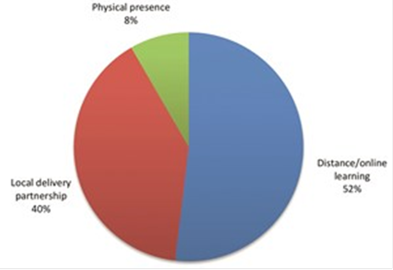

Slide 12
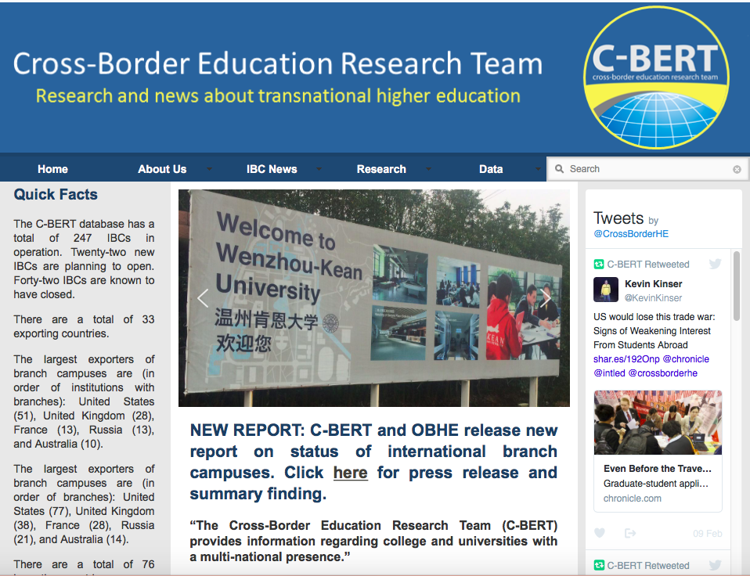
US TNE data sources?
Data on branch campuses:
International Branch Campuses - Trends and Developments 2016: The OBHE with SUNY, Albany & Pennsylvania State University
Notes:
Where are our members? What are they doing internationally, and how can we help them?
US Department of Education is no help!
Some papers/articles published by:
American Council on Education
World Education New and reviews
Institute of International Education (on international partnerships).

Slide 13
Global Presence Project (completed 2016)
An ongoing internal market analysis project within Internet2
  Goal: help us identify the extent and location of our members’ research and educational program investments around the world
Different data sources are used:
  Internet2 Foundational Database
  Internet – Universities’ websites
  Global Higher Education (Cross-Border Education Research Team at SUNY Albany)
Categories:
  Physical presence: branch campus abroad, regional office, center of research/education
  Academic collaborations: joint/dual degree programs, other collaborations
  Scientific research collaborations
  Other engagement (MoUs signed, US government-funded development program, etc).
May 31, 2017 © 2013 Internet2

Slide 14
Internet2 members global programs by location updated April 18, 2016
DATABASE:
All 108 Level 1 and 80 Level 2 schools in database
2558 program initiatives in 130 countries
VISUALS:
All 108 Level 1 and 80 Level 2 schools
SCHOOL PROFILES:
20 of highest global activity
Sources:
Internet2’s Foundational Database and research by staff
Global Higher Education, Cross-Border Education Research Team (C-BERT) at SUNY Albany.
May 31, 2017 © 2013 Internet2
Notes:
Did this for our Level 1 and Level 2 schools. Level 3 still in progress.

Slide 15
Global Programs by location
Sources:
Internet2’s Foundational Database and research by staff
Global Higher Education, Cross-Border Education Research Team (C-BERT) at SUNY Albany.
May 31, 2017 © 2013 Internet2
Notes:
Did this for our Level 1 and Level 2 schools. Level 3 still in progress.

Slide 16
Global Programs by type
Sources:
Internet2’s Foundational Database and research by staff
Global Higher Education, Cross-Border Education Research Team (C-BERT) at SUNY Albany.
May 31, 2017 © 2013 Internet2
Notes:
Did this for our Level 1 and Level 2 schools. Level 3 still in progress.

Slide 17
Program locations in China (by city)
Sources:
Internet2’s Foundational Database and research by staff
Global Higher Education, Cross-Border Education Research Team (C-BERT) at SUNY Albany.
May 31, 2017 © 2013 Internet2
Notes:
Did this for our Level 1 and Level 2 schools. Level 3 still in progress.

Slide 18
Program locations in China by city (map)

Slide 19
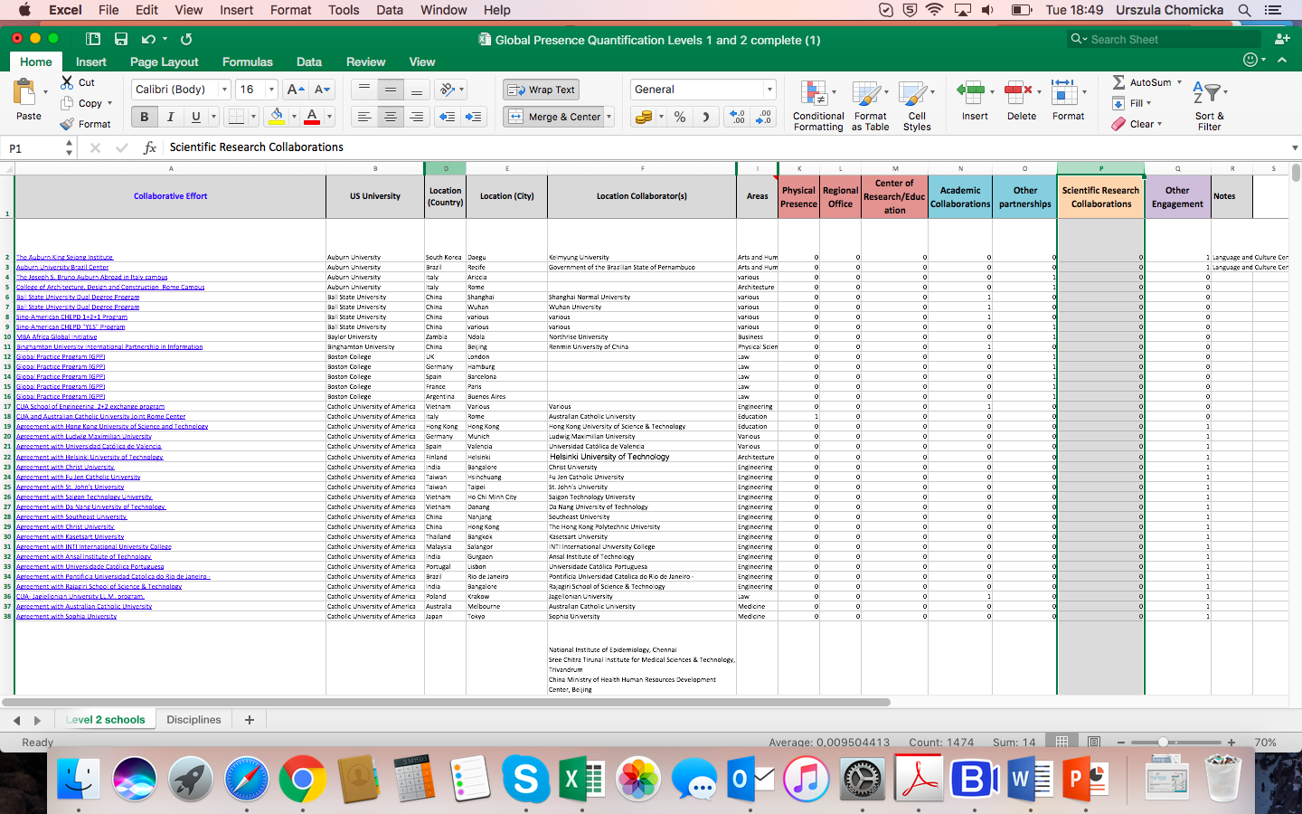

Slide 20
Programs in China by type

Slide 21
School Profile (Example)
Categories include:
Executive Contact Information
Global Activity Overview
Global Presence Visuals
Centers Abroad
Joint/Dual Degree Programs
Study Abroad
Alumni Abroad
Other Global Involvement

Slide 22
Challenges for NRENs
-different data sets
-different needs for TNE data usage (host vs. sending campus)
-different stages of TNE support program(me) development
-different resources available to tackle this

Slide 23
Some ideas for moving forward
-We have different ways of approaching TNE data. Can we - as NRENs -consolidate our information into one useful ‘thing’?
-Can we work with other national/international organizations on this data?
-Best practice-sharing among ourselves (wiki?)
-Your ideas?

Slide 24

Some TNE data sources
Notes:
http://www.universitiesuk.ac.uk/policy-and-analysis/reports/Pages/international-facts-figures-2017.aspx
The publication looks at a wide variety of themes, including: international students and academics; transnational education; student and staff mobility; global research collaborations, and innovatio.
Sources: European Commission, Erasmus+ UK National Agency – For faculty mobility
Source: HESA student record (2015–16) – for student mobility
Source: HESA Aggregate Offshore Record (2015–16) - for TNE student numbers
Source: Sources: Elsevier and BIS (2013), International Comparative Performance of the UK Research Base – 2013 – for research collaborations
Source: Top: HESA Finance Record (2009–10 to 2015–16). Bottom: OECD (2016) – for research income from international sources
Source: Elsevier Scopus 2000–2013 - for international research collaboration
Source: Source: CORDIS, as of December 2016 - UK RESEARCH COLLABORATION THROUGH HORIZON 2020

