Slide 1
Risk Management Workshop
Introduction to
the WISE-RAW risk analysis approach for e-infrastructures
easy-to-use, direct results
Alf Moens, SURFnet

Slide 2
WISE RAW-WG
WISE Risk Assessment Working Group shares information and best practices on how risk assessments can be effectively implemented
RAW will now release an easy-to-use risk assessment template and related instructions for e-infrastructures for research and higher education
Check our web page and our wiki:
  https://wise-community.org/risk-assessment/
  https://wiki.geant.org/display/WISE/RAW-WG
  https://wiki.geant.org/display/SIGISM/SIG+ISM+white+paper+risk+management
Join by contacting the chairs and by subscribing to our email list
https://lists.wise-community.org/sympa/subscribe/raw-wg
More information from the WG chairs
  Urpo Kaila <urpo.kaila@csc.fi>
  Bart Bosma <bart.bosma@surfnet.nl>
Notes:
Bart Bosma has been appointed vice chair of RAW WG
Intro page with purpose of this mini workshop:
Het acquaintanced with this method
Give feedback for improvement
Overview risk analysis methods with plusses and minuses
Background how we came to this method
Explain the method
Explain the exercise
Do exercise
Feedback from groups
Feedback on method

Slide 3
Why Risk Analysis/Assessment/Management?
You only have limited resources
You need to know where the value of your operation is
You need to know against which threats you need to protect
Not a one-time process, it is recurring:
  Periodically
  After a major change
  After serious incidents (own organization, peers, sector, globally)

Slide 4
Risk Assessment Methods and Tools
Austrian IT Security Handbook
Cramm
Dutch A&K Analysis
Ebios
ISAMM
ISF Methods
ISO/IEC 13335-2
ISO/IEC 17799
ISO/IEC 27001
IT-Grundschutz
Magerit
Marion
Mehari
MIGRA
Octave
RiskSafe Assessment
NIST SP800-30
Callio
Casis
CCS Risk Manager
CloudeAssurance
Cobra
Countermeasures
Cramm
EAR / PILAR
Ebios
GSTool
KRiO
ISAMM
Mehari 2010 basic tool
MIGRA Tool
Modulo Risk Manager
Octave
Proteus
Ra2
Methods
Tools
https://www.enisa.europa.eu/topics/threat-risk-management/risk-management/current-risk/risk-management-inventory/rm-ra-methods
Notes:
https://www.enisa.europa.eu/topics/threat-risk-management

Slide 5
2 Ways to start:
By Threat of by Asset
Notes:
Normally you start risk assessment and other security measures by identifying assets to be protected. In some environments, for example in NRENs the assets are well known, an you can instead start with identifying threats.

Slide 6
Sharing Best Practices: Survey on Risks Related to Vulnerabilities
A survey* sent to IT security specialist and system and network administrators in research
infrastructures , 55 persons from 19 countries replied:
9. The best way to mitigate risks caused by software vulnerabilities are (choose three)
* https://cug.org/proceedings/cug2017_proceedings/includes/files/pap168s2-file1.pdf
Notes:
Interesting answers, more information in linked the article.

Slide 7

Risk analysis by Threat
Initial Threat based approach
Ad hoc analysis vulnerabilities
‘Heartbleed’
’Broadpwn’ (Broadcom wifi chip)
Wannacry
Threats are:
Vulnerabilities,
Misconfiguration
Rogue admin
Abuse of stolen credentials
Human error
…..
Notes:
Plaatje van poodle of recente wifi attack of digicert of heartbleed!

Slide 8
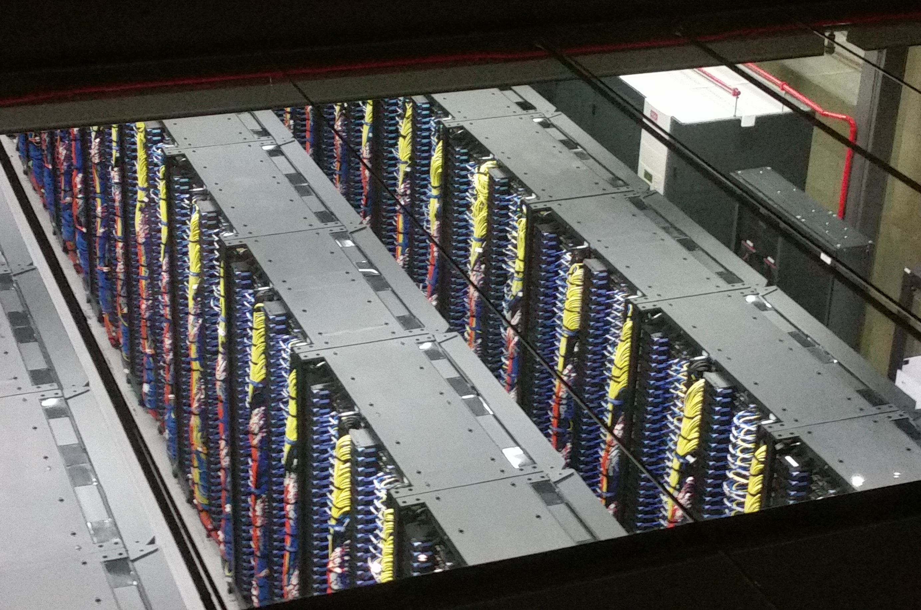
Risk Analysis for assets
Initial Asset based approach
Risk analysis for new equipment, major changes in infrastructure, network etc.
Assestes are: infrastucture, scientific data, pesonal data, reputation
Notes:
Plaatje va infrastructuur: BCS? Of Huygens?

Slide 9
Release of RAW Risk Assessment template 1.0
- now available from RAW wiki
An easy to use spreadsheet template with example implementations and with instructions on how to implement a risk assessment.
Wise Security Risk AssessmentInstructions
Some samples risks
Authors:
  Linda Cornwall, STFC;
  Stéphan Coutin,CINES;
  Sedat Çapkın, SURFsara;
  Urpo Kaila, CSC/EUDAT;
  Dankmar Lauter, DFN-CERT;
  Christian S. Fötinger, hs-augsburg.de;
  Bart Bosma, Surfnet;
  Mischa Sallé, NIKHEF,
  Ingimar Örn Jónsson, RHNET
Asset or service
Business value
Risk targets
Threat
Existing controls
Still existing vulnerabilities
Description of Impact
Impact
Probability
Risk
Risk owner
Approved residual risk
Actions items
Reviewed
Notes:
The WISE RAW Risk Assessment template is hereby released. Many thanks to all who contributed by sharing best practices.

Slide 10
Likelyhood, Impact and other “standards”
 | Likelyhood | Impact
1 | Unlikely to happen | Minimal impact
2 | Happens less than once a year | Minor, local service disruption of less than 1 week
3 | Happens every few months/ more than once a year | Serious disruption for multiple users or sites
4 | Happens every 2 – 3 months or even more frequent | Service cannot be delivered for a length of time

Slide 11
Let’s get to work
Asset bases or Threat based?
Granularity? Complete data center or the wifi chip in your smartphone?
  Initial risk analysis (your “baseline”) should probable be high level, with more detailed follow-up analysis based on specific threats (Heartbleed) or vulnerable equipment (wifi chips)

