Slide 1




Combining network surveillance of different optical domains with one dashboard and Grafana
Jonas Hagström @ SUNET

Slide 2
Increased transparency in the Nordics
(How is the weather)
Jonas Hagström @ SUNET

Slide 3
Topics
Background
System Design
Polling
Database
Data replication
Visualization
Notes:
Colaboration between the nordic NRENS SUNET,FUNET,SIKT,DEIC,NORDUnet, (RHNET)

Slide 4
Background
WP1 Monitoring
WP2 Statistics
Increase collaboration
Improved transparency between NOCs
Seek common ground for statistics and monitoring
Notes:
Collaboration between the nordic NRENS SUNET,FUNET,SIKT,DEIC,NORDUnet, (RHNET)

Slide 5
Design
Poller
Poller
Poller
Poller
Poller
DB
FUNET
DB
SUNET
DB
DEIC
DB
SIKT
DB
NORDUnet
DB – NORDUnet (shared instance)
Vizualisation
Notes:
To be able to swap out different pieces if necessary.
Change polling methods over time perhaps go from SNMP to API-calls
Change DB in the future to something else?
Change graphical layer without having to change the complete system.

Slide 6



Polling
Poller
NREN DB
Notes:
LibreNMS - SNMP
Telegraf – SNMP/GNMI
Script – SSH
Vendor agnostic/vendor independent/customized
RFC 2863 - The Interfaces Group MIB
IfAdminStatus and IfOperStatus
https://datatracker.ietf.org/doc/html/rfc2863#section-3.1.13

Slide 7
Database
Notes:
LibreNMS - SNMP
Telegraf – SNMP/GNMI
Script – SSH
Cendor agnostic/vendor independent/customized

Slide 8
Data replication
SIKT
SUNET
FUNET
DEIC
NORDUnet
InfluxDB version 2 with bucket replication
Notes:
Each NREN collects data and stores it in influxDB
Eash responsible for the own filtering and selection of data to be pushed
The Pushing data from each NREN to shared platform at NORDUnet
Each nren has write (and read) to their own bucket and read to others data
InfluxDB is setup with remote and then replication on bucket level (duplicates all writes to a certain bucket to a remote)

Slide 9
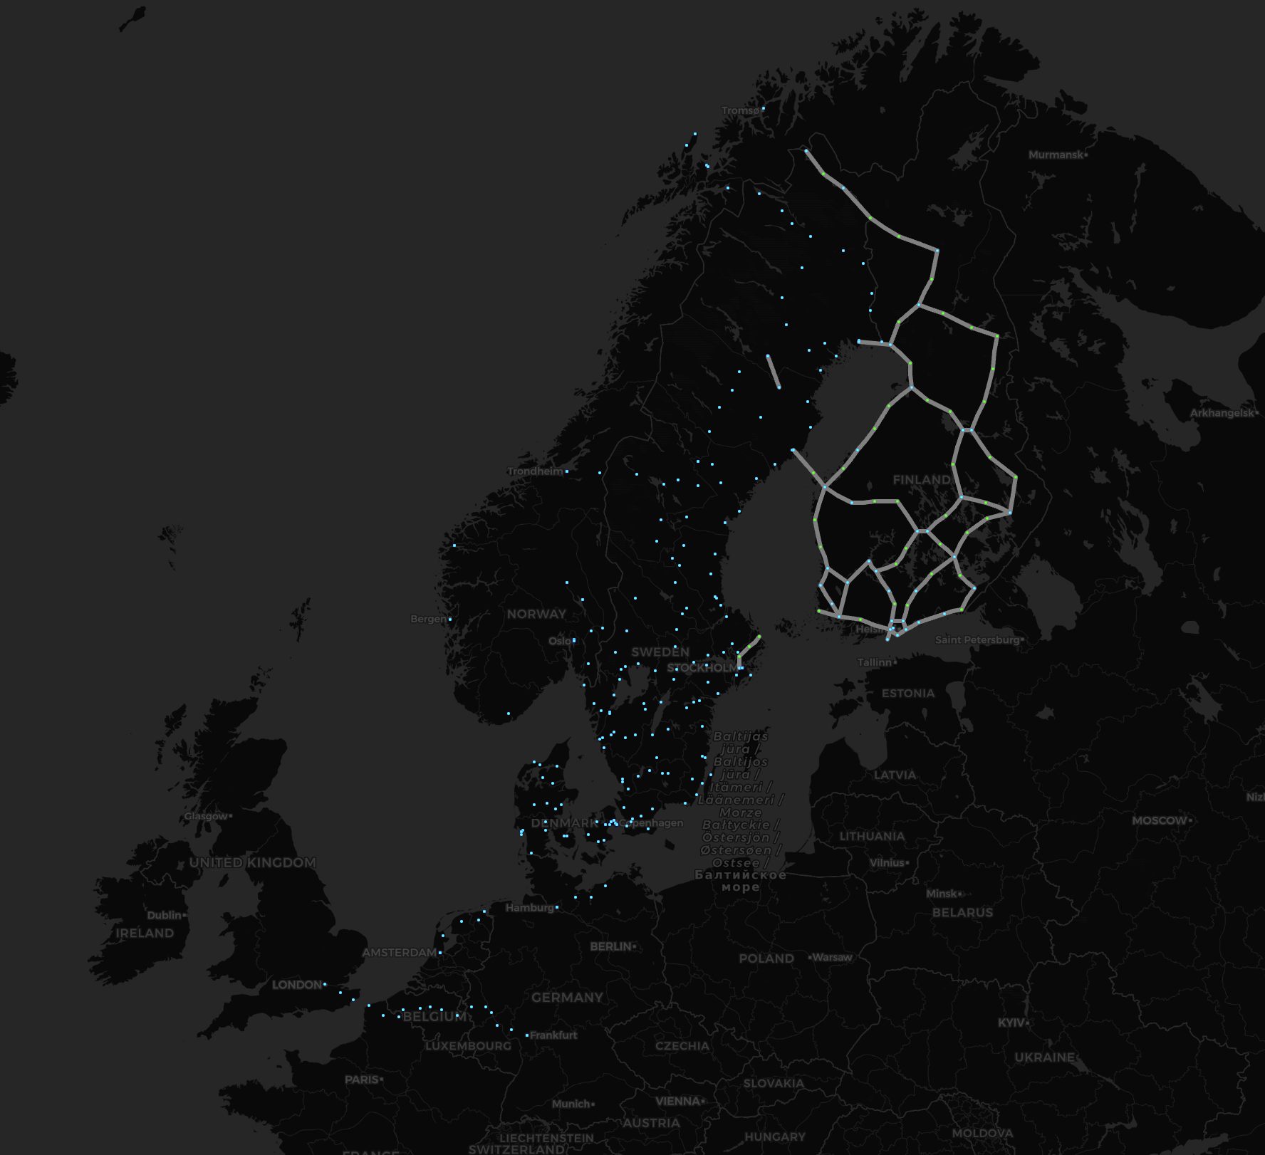
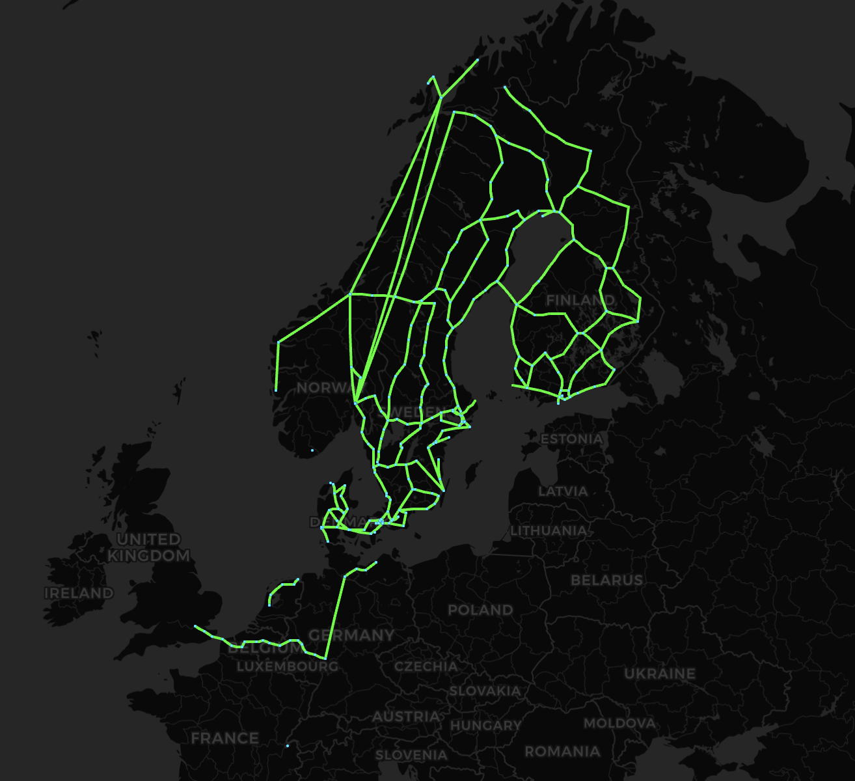
Notes:
Continued development of the map from FUNET
Originally developed for network traffic https://netmap.funet.fi/
Data for configuring the map has been provided from each NREN Sites and Links
Links changes status depending on operational status. (To be developed - If incoming light level is passing -30dBm)

Slide 10
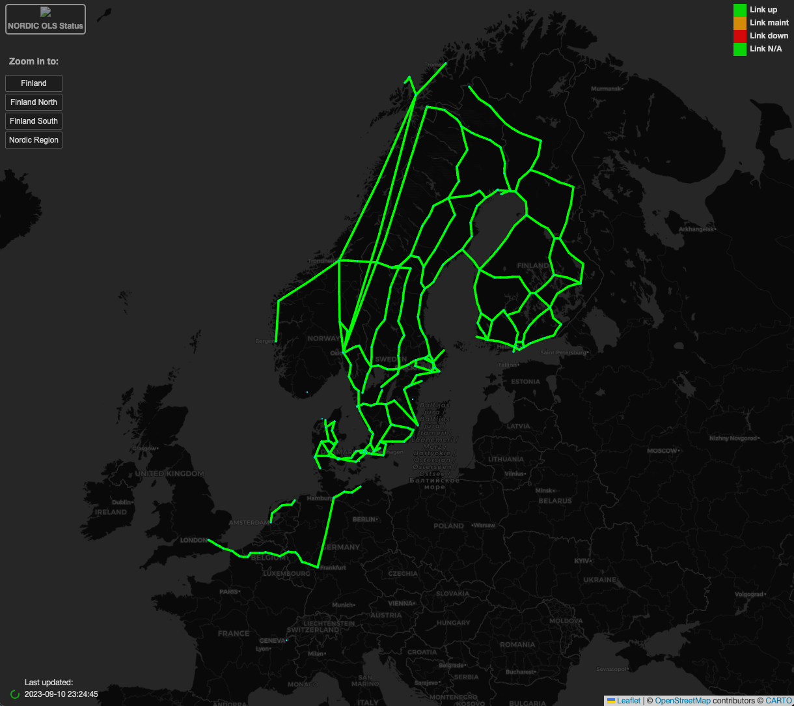
Links from:
SIKT
SUNET
FUNET
DEIC
NORDUnet
Notes:
LeaftletJS
PearlCGI
Continued development of the map from FUNET
Originally developed for network traffic https://netmap.funet.fi/
Nordic optical weathermap
Data for configuring the map has been provided from each NREN Sites and Links
IfAdminStatus and IfOperStatus
Links changes status depending on operational status. Previous was if total input power was lover than -30dbm (rough indication)

Slide 11
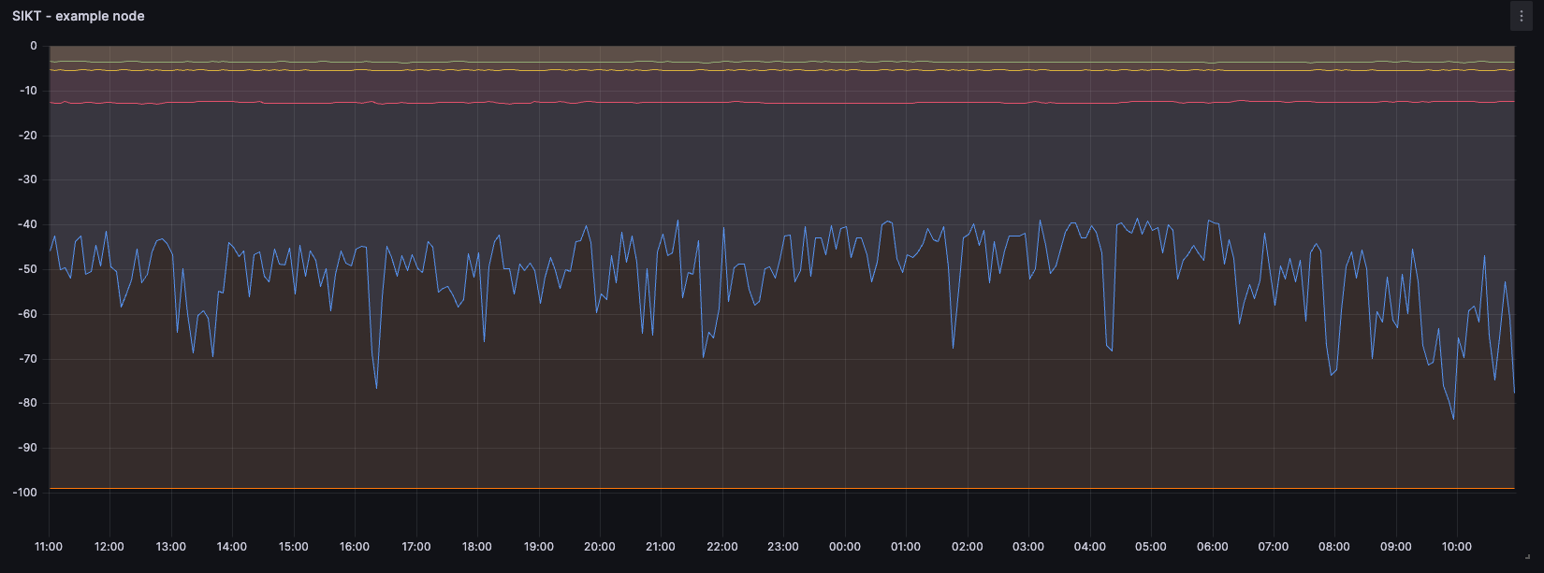

Slide 12
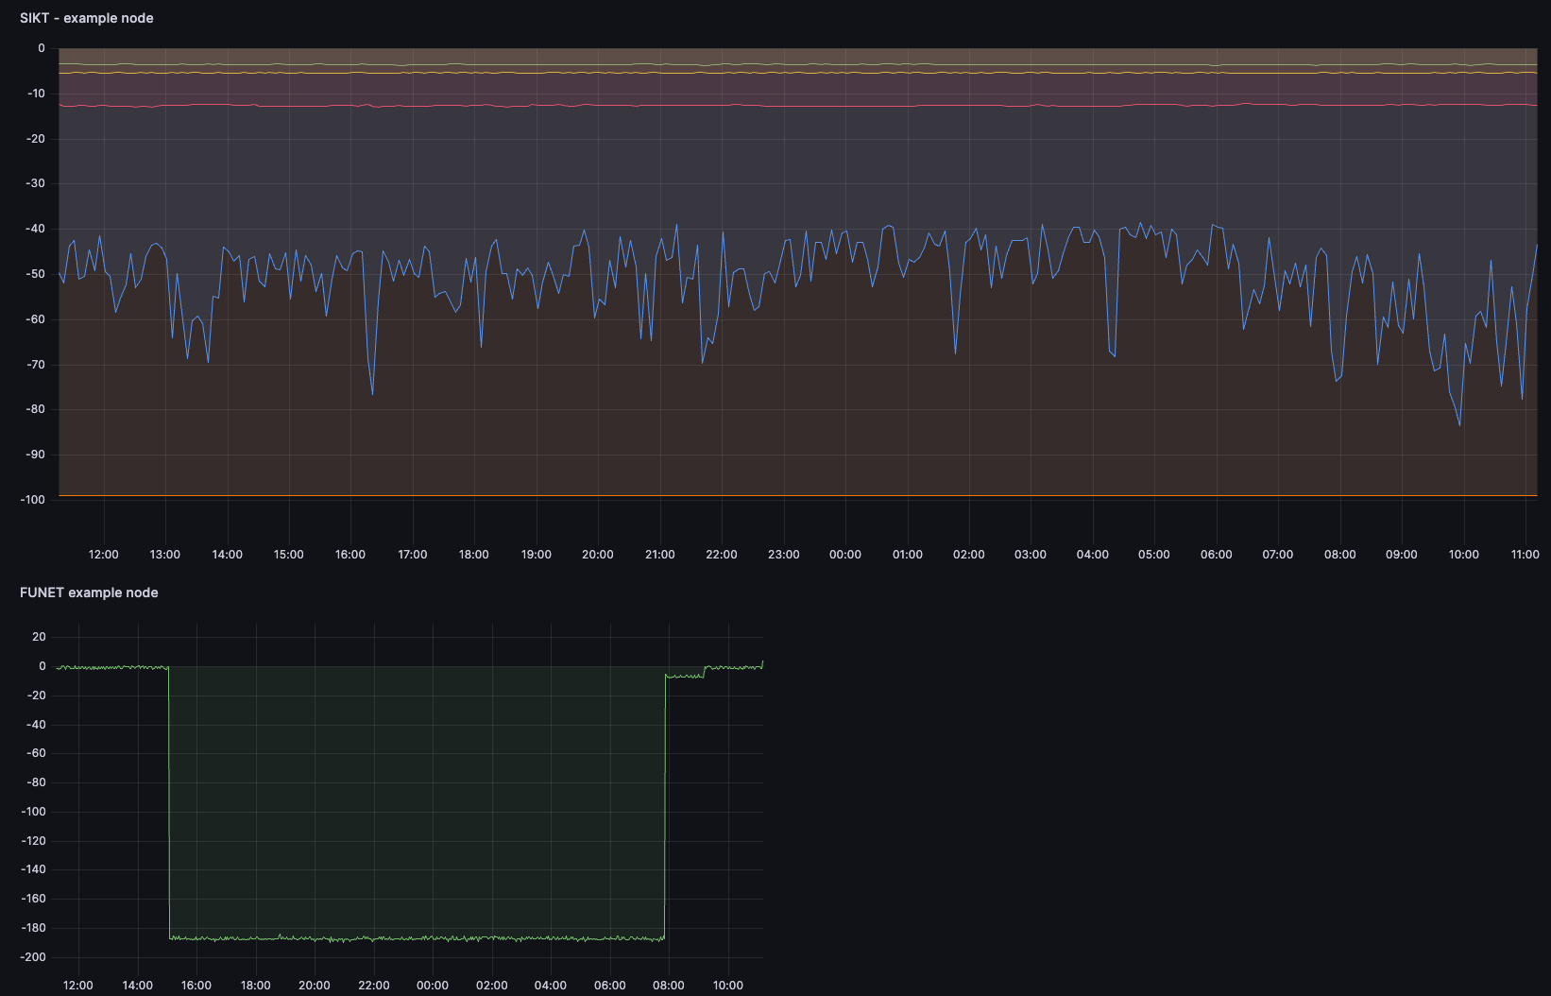

Slide 13
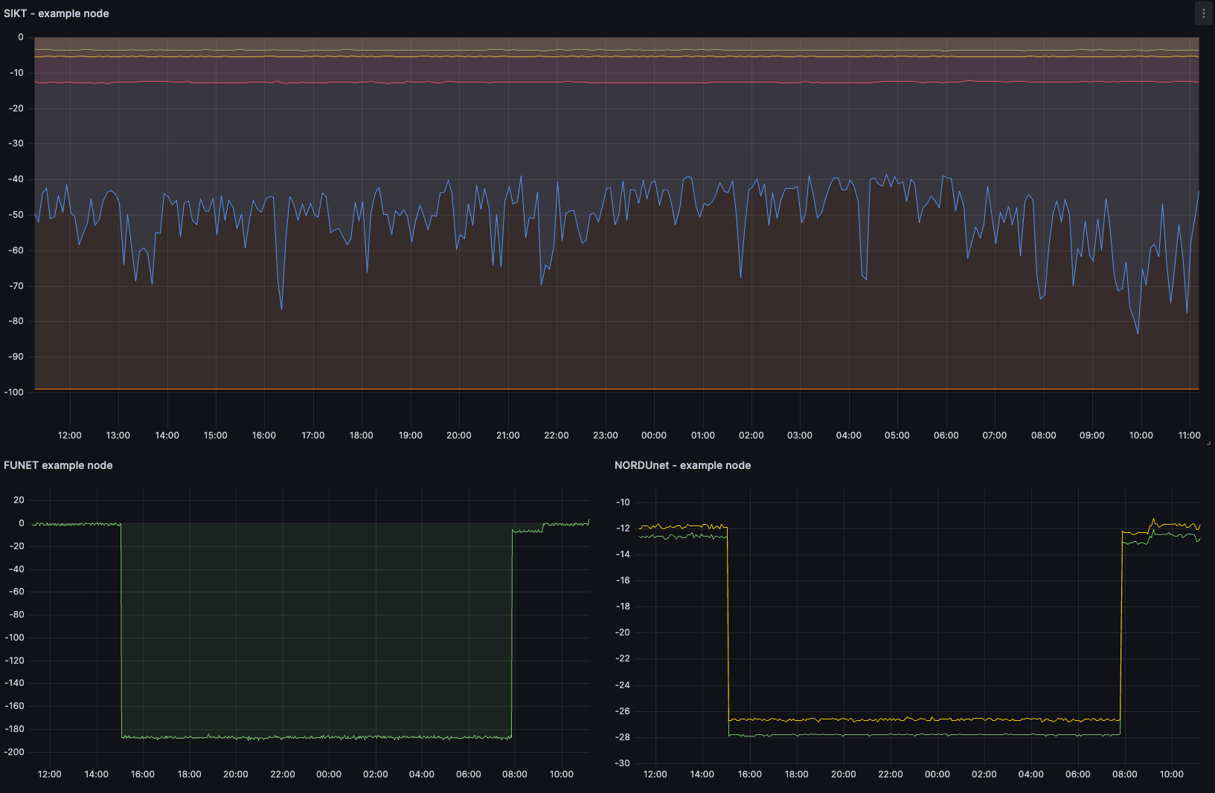

Slide 14
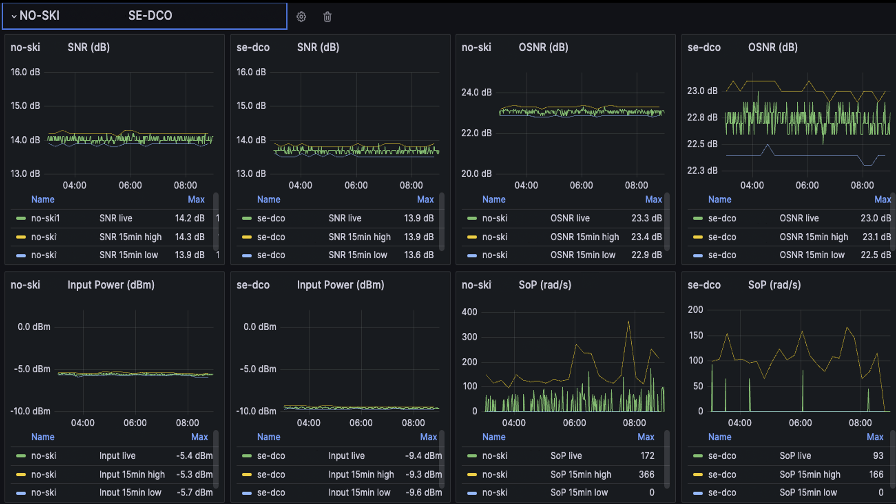

Slide 15
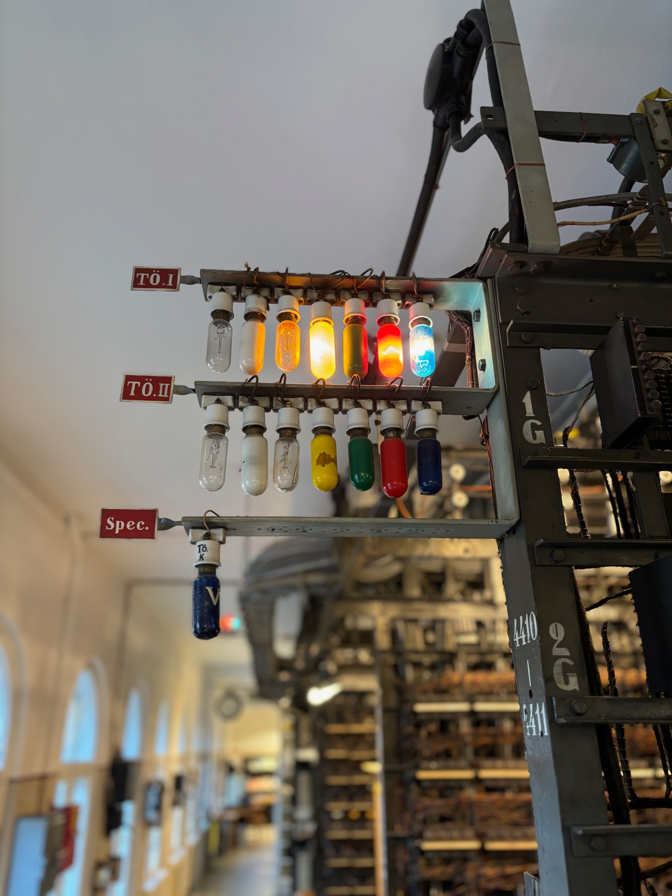
Notes:
You could say we built another lightbulb system

Slide 16
Questions

