Slide 1


Impact of NIS-2 for Network teams
SIG-NOC – Helsinki
Alf Moens
8 May 2024
Public

Slide 2
What is NIS-2?
Security Management
CSIRT cooperation
For whom?
Duty of Care
Where are we now?
What does it mean?
Duty to Report
National implemen-tations
Rulings
For GEANT
For you
Incidents
Vulnera-bilities
What is next?

Slide 3

Quick Summary
NIS-2 is to improve the resilience of services that are critical for day-to-day life in the European Union
NIS-2 directive has been published on 15th of December 2022 , and will be in action within 21 months from the ”entry in force”:
4th of October 2024: (January 4th 2023+ 21 months) latest, but with the Council Recommendation to do it ASAP.
Standards are still ‘negotiated’ via comitology (delegated Act)
  Expect „Rulings” or „guidance” from ENISA and NIS Cooperation Group
Obligations are „logical”, no real surprises

Slide 4
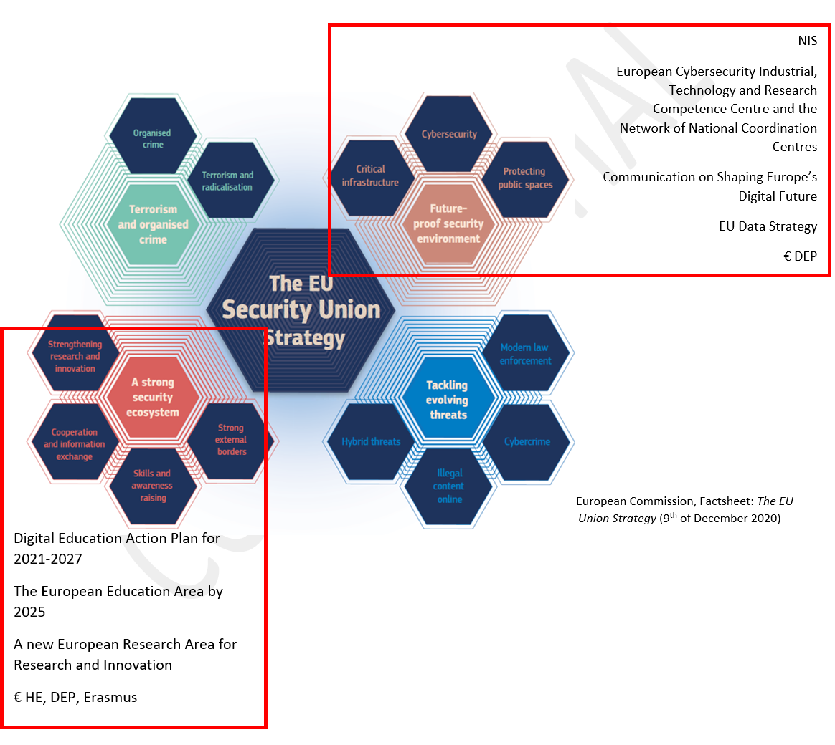
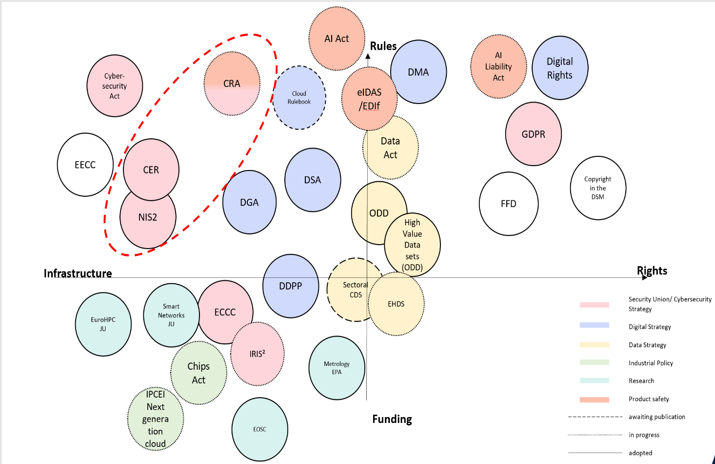
The EU Security Union is complex and overlaps with the EU Digital priorities

Slide 5
What is the NIS-2 directive about?
73 pages
144 preambles
64 Articles
2 Annexes
Obligations for Member States
Cybersecurity information sharing
International Collaboration
Implementation guidance, governance and control for MS
Vulnerability disclosure & European Vuln. database
Obligations for Essential and Important entities
Obligations to report security incidents
Use of European cybersecurity certification schemes
Union level coordinated security risk assessments of critical supply chains

Slide 6
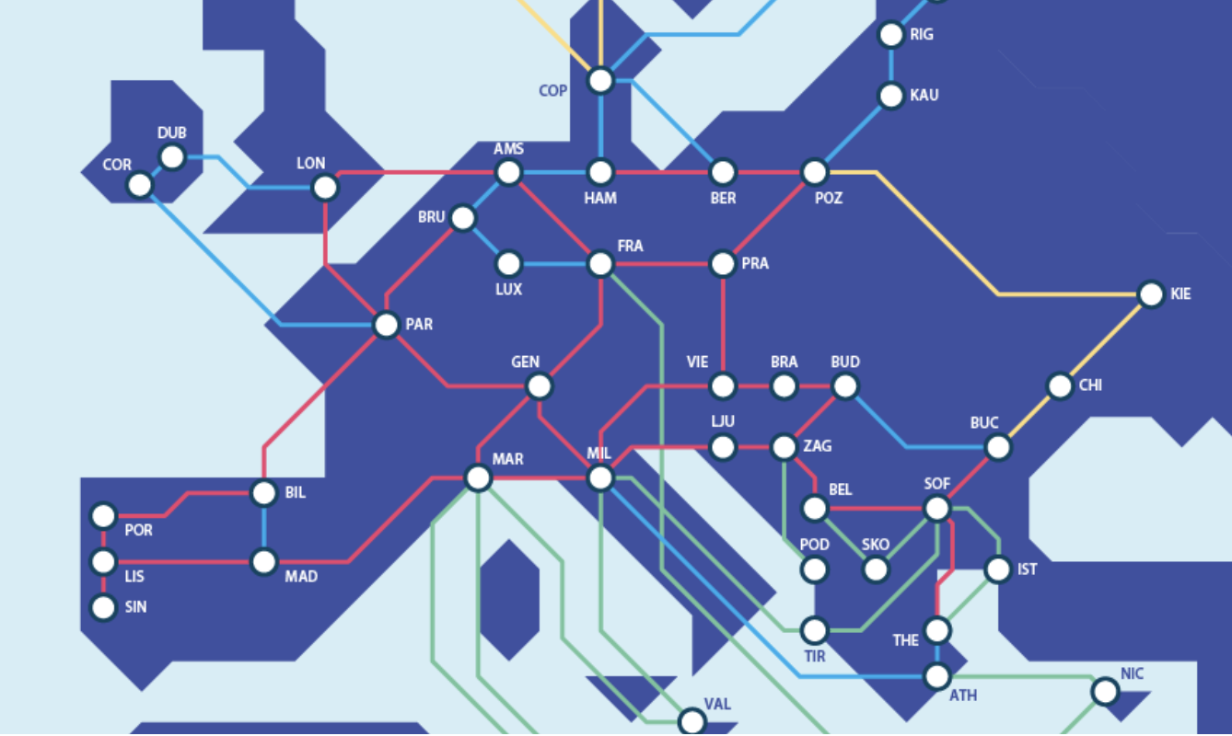
In or out of scope?
Critical Infrastructure?
In scope of NIS1?
Governement Agency?
Public Digital Infrastructure?
.tld? Internet exchange?
DNS resolver?
Supply chain dependencies?

Slide 7
What is the impact of NIS-2 for your organisation?
It will depend!
.tld, Internet exchange and DNS resolver are in scope
Closed network services are not!
Position Paper on Impact NIS-2 for NRENs in different positions
But how about Supply Chain dependencies?

Slide 8
SECTORS OF HIGH CRITICALITY (Annex I)
Other Critical SECTORS (Annex II)
IMPORTANT
Energy
Transport
Banking
Financial Market Infrastructure
Health
Drinking water
Waste Water
Digital infrastructure
ICT Service management
Public Administration
Space
Postal and courier services
Waste management
Chemical industry and supply chain
Food supply chain
Manufacturing (limited)
Digital providers
  Online marketplace
  Search engines
  Social networkingn services platforms
Research organisations
ESSENTIAL

Slide 9
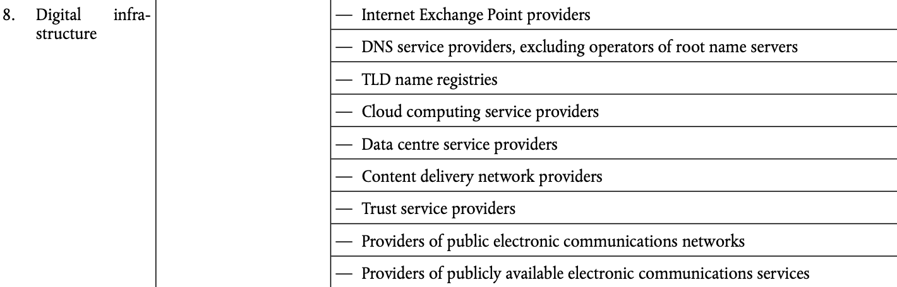
SECTORS OF HIGH CRITICALITY (Annex I)
Other Critical SECTORS (Annex II)
Energy
Transport
Banking
Financial Market Infrastructure
Health
Drinking water
Waste Water
Digital infrastructure
ICT Service management
Public Administration
Space
Postal and courier services
Waste management
Chemical industry and supply chain
Food supply chain
Manufacturing (limited)
Digital providers
  Online marketplace
  Search engines
  Social networkingn services platforms
Research organisations

Slide 10
What is NIS-2?
Security Management
CSIRT cooperation
For whom?
Duty of Care
Where are we now?
What does it mean?
Duty to Report
National implemen-tations
Rulings
For GEANT
For you
Incidents
Vulnera-bilities
What is next?

Slide 11

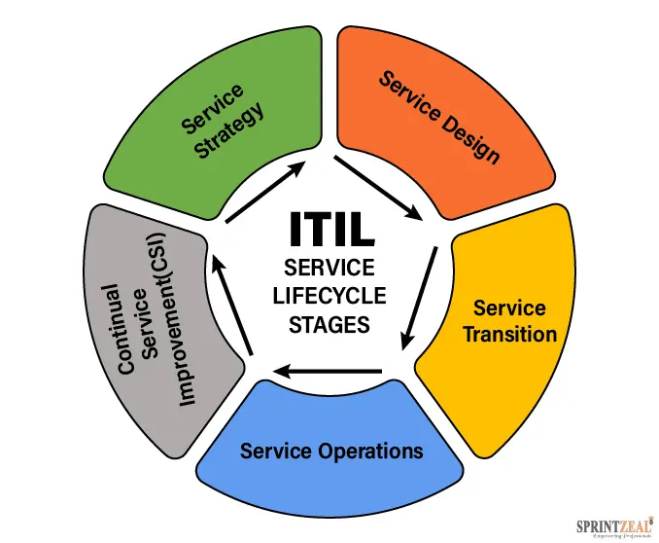
Duty of Care
Risk management
IT / Service management
Incident management process
Change management process
Supplier management!!!!

Slide 12
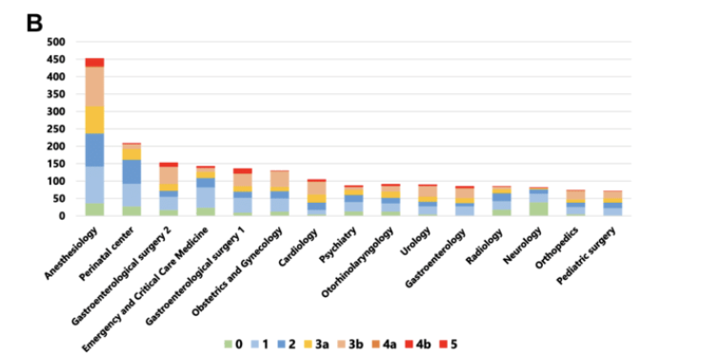
Duty to Report
What incidents?
What vulnerabilities?
National choices, international guidance
Exceptions, not the long tail
When is a port scanner a security incident?
Incidents
Vulnera-bilities

Slide 13
What is NIS-2?
Security Management
CSIRT cooperation
For whom?
Duty of Care
Where are we now?
What does it mean?
Duty to Report
National implemen-tations
Rulings
For GEANT
For you
Incidents
Vulnera-bilities
What is next?

Slide 14
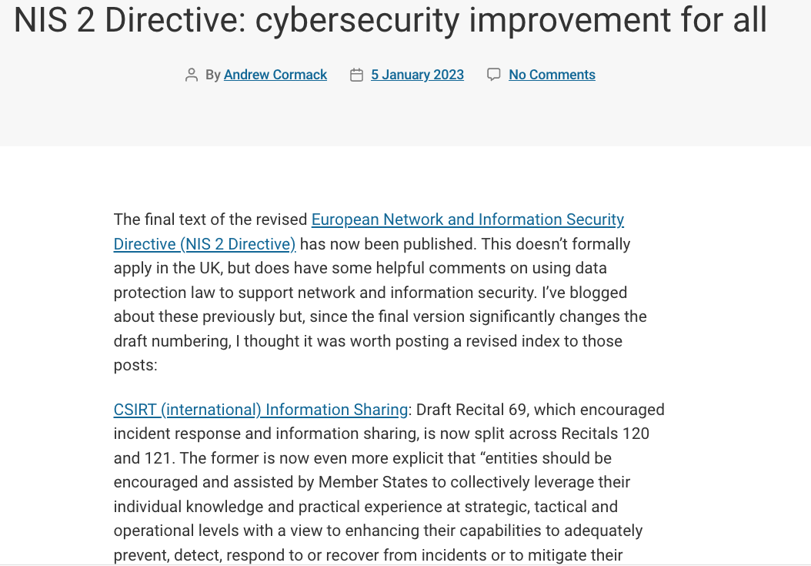
What CSIRTs can do
https://regulatorydevelopments.jiscinvolve.org/wp/2023/01/05/nis-2-directive-cybersecurity-improvement-for-all/

Slide 15



CSIRT cooperation
Information Sharing and Analysis
(European) R&E Security Intelligence Hub
Actual and actionable information
Trend analyses and reporting
National CSIRT coordination
International CSIRT coordination

Slide 16
Where are we now?
Transposition of the directive
Assignment or Self-assessment
Standards
National implemen-tations
Rulings

Slide 17

Bottom Line
duty to report
duty of care
Information sharing

Slide 18
How can we help?
GN5-1 WP8 T1: Best practices, guidelines and baselines
SIG-ISM wiki pages: https://wiki.geant.org/display/SIGISM/NIS-2+Directive

Slide 19
Questions?
Remarks?

Slide 20

Thank You
www.geant.org
© GÉANT Association
As part of the GÉANT 2020 Framework Partnership Agreement (FPA), the project receives funding from the European Union's Horizon 2020 research and innovation programme under Grant Agreement No. 856726 (GN4-3).

